Slide 1
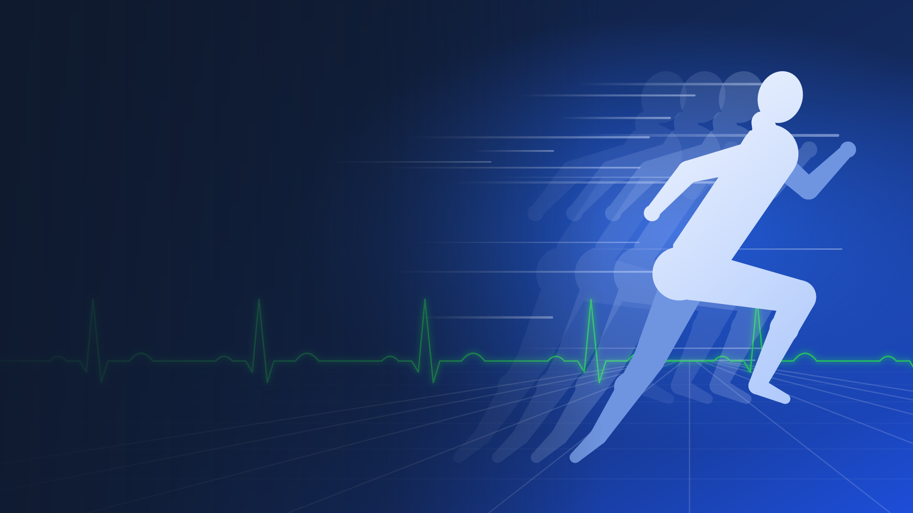
DHRUV
DIAGNOSTICS
Health check-ups for people who train
A proposal for gyms, coaches and fitness communities in Nagpur
NABL accredited since 2011 | Laxmi Nagar and Ramdaspeth
Notes:
Open with the gym's own members in mind: people who lift, run and cut weight, and who get generic health check-ups that were not designed for them.

Slide 2
Questions your members already ask
“Is my heart ready for high-intensity training?”
“My creatinine came back high. Is it my kidneys or my protein and creatine?”
Treadmill stress test, ECG and NT-proBNP
Kidney function by cystatin C, which muscle mass does not distort
“My shoulder hurts on bench press. Is it a tear?”
“I am cutting hard. Are my hormones and iron holding up?”
Ultrasound by a musculoskeletal (MSK) radiologist
Hormone panel, ferritin, vitamin D and B12
Notes:
Each of these questions has a specific test that answers it. A standard full-body package answers none of them well.

Slide 3
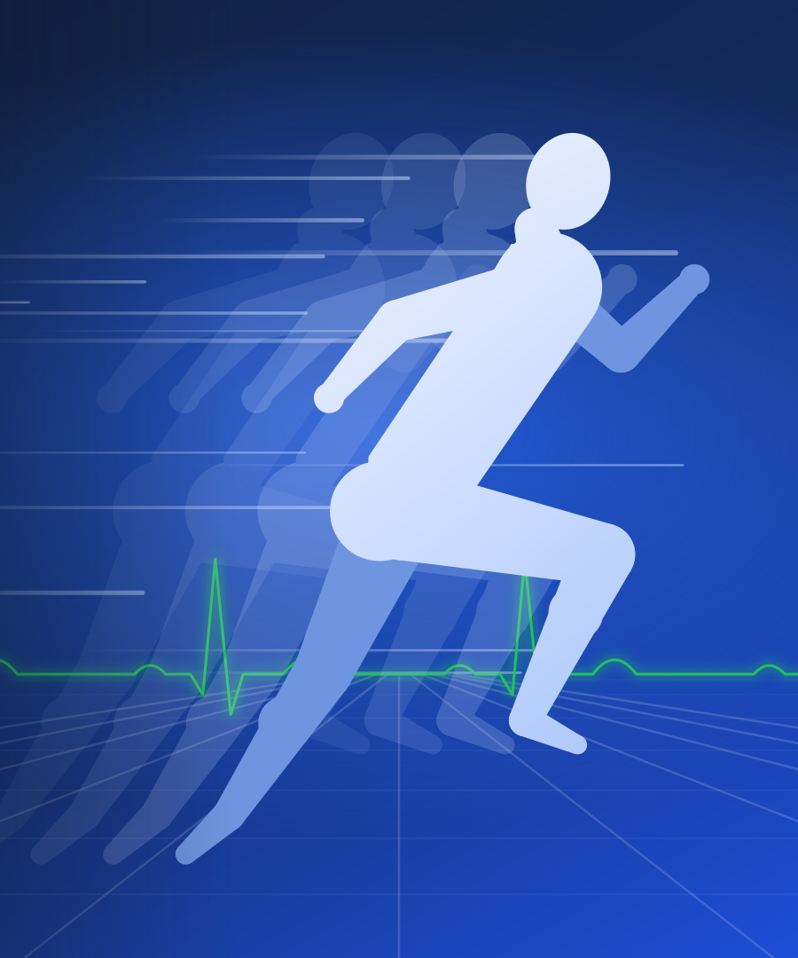
Dhruv Diagnostics, Nagpur
30+
2011
years of diagnostics in Nagpur
NABL accredited since
2
7
branches: Laxmi Nagar and Ramdaspeth
days a week, from 7 AM
Pathology, molecular diagnostics, immunology and radiology under one roof.
Notes:
Figures from dhruvlabs.com: NABL accredited since 2011; Mon-Sat 7 AM-9 PM, Sun 7 AM-5 PM. Confirm the years-in-service figure before external use.

Slide 4
What the check-up covers
Heart
Cholesterol risk
Muscle and recovery
Treadmill stress test, resting ECG, NT-proBNP, hs-troponin
Apo B, Lp(a), full lipid profile
CK, CK-MB, myoglobin, LDH, liver enzymes
Hormones
Long-term health
Tendon scans
Testosterone, LH, FSH, oestradiol, cortisol, IGF-1, thyroid
hs-CRP, HbA1c, fasting insulin, homocysteine, cystatin C
Ultrasound of tendons and ligaments by an MSK radiologist
Notes:
Every result is read against athletic norms. For example, the CK upper limit in athletes is about twice that of non-athletes (Mougios, Br J Sports Med 2007).

Slide 5
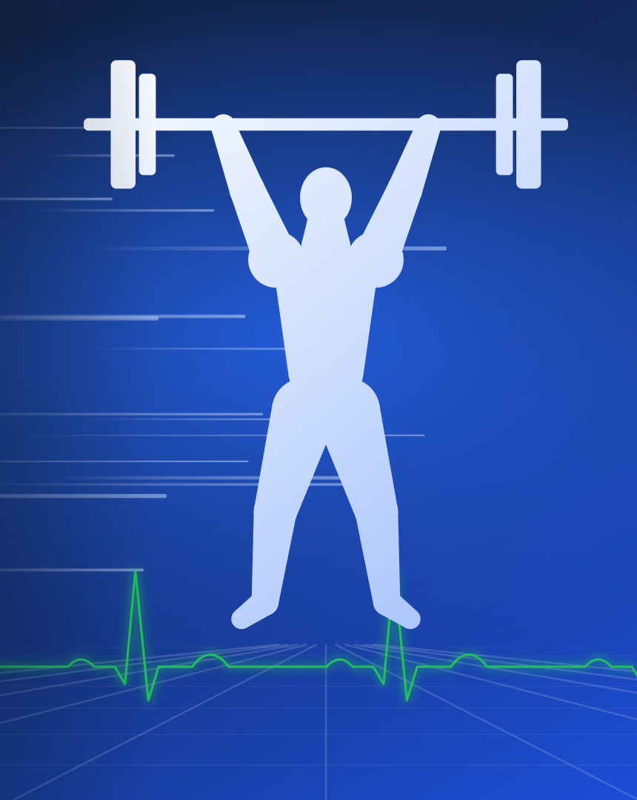
Injury scans by an MSK radiologist
Common gym injuries we scan
Rotator cuff and biceps tendon (pressing, pull-ups)
Tennis and golfer's elbow
Patellar tendon (squats, jumping)
Achilles tendon and plantar fascia (running)
Why ultrasound
Done and reported by a radiologist trained in musculoskeletal ultrasound
The joint is scanned while it moves; no radiation
Compared with the healthy side, and kept as a baseline for return to training
Notes:
A specialist MSK radiologist is the selling point here: general ultrasound often misses partial tendon tears and early tendinopathy.

Slide 6
Three plans
Base
Performance
Elite
Members starting out or under 35
Regular lifters, runners, members on a cut or bulk
Competitors, bodybuilders, members over 35 starting high-intensity work
Full blood panel and ECG
CK muscle marker
Physician review
Everything in Base
Apo B, Lp(a), NT-proBNP
Hormone and full muscle panel
One ultrasound region
Everything in Performance
Treadmill stress test
hs-troponin, IGF-1, cortisol
Up to three ultrasound regions
Partner price on request
Partner price on request
Partner price on request
Notes:
Fill in partner prices before the meeting. A urine drugs-of-abuse screen can be added to any plan.

Slide 7
How a gym partnership works
What we offer
What your gym gets
1
Member pricing
on all three plans for your members
A medical service no other gym nearby offers
Members over 35 screened before high-intensity classes
Trainers who plan with real numbers: fitness in METs, recovery markers, scan results
Injury questions answered by imaging, not guesswork
2
Check-up days at your gym
sample collection on site, by appointment
3
Talks by our doctors
heart screening, supplements, doping risk
4
A front-desk QR standee
members book in under a minute
Notes:
All partnership terms are proposals to be agreed with each gym. Do not offer referral payments; the value to the gym is the service to its members.

Slide 8
For members who feel fine
Know your baseline
Your own normal, so future changes stand out
Find silent problems early
High Apo B, low iron or a heart-rhythm issue rarely causes symptoms at first
Train with numbers
Fitness in METs and recovery markers guide how hard to push
Stay safe on supplements
Liver, kidney, blood count and hormones checked in confidence
Notes:
Results stay between the member and our physician. This is health monitoring, not a doping test.

Slide 9
Recovery Club for women
Sauna, spa and health club, open to women members only at present.
Sauna
Spa
Health club
Dry heat after training, opened to each member after her blood pressure and heart check are reviewed.
Massage and hydrotherapy to ease soreness between sessions.
Supervised strength, conditioning and mobility work.
Men's access has not opened yet.

Slide 10
How booking works
1
2
3
4
Scan or call
Confirm
Visit
Review
Scan the QR code or call the branch nearest you
We confirm the plan, the branch and your slot
Come fasting, between 8 and 10 am, with your supplement list
A physician goes through the report with you
No hard training for 48 to 72 hours before the visit, so muscle and heart markers reflect you, not your last session.

Slide 11
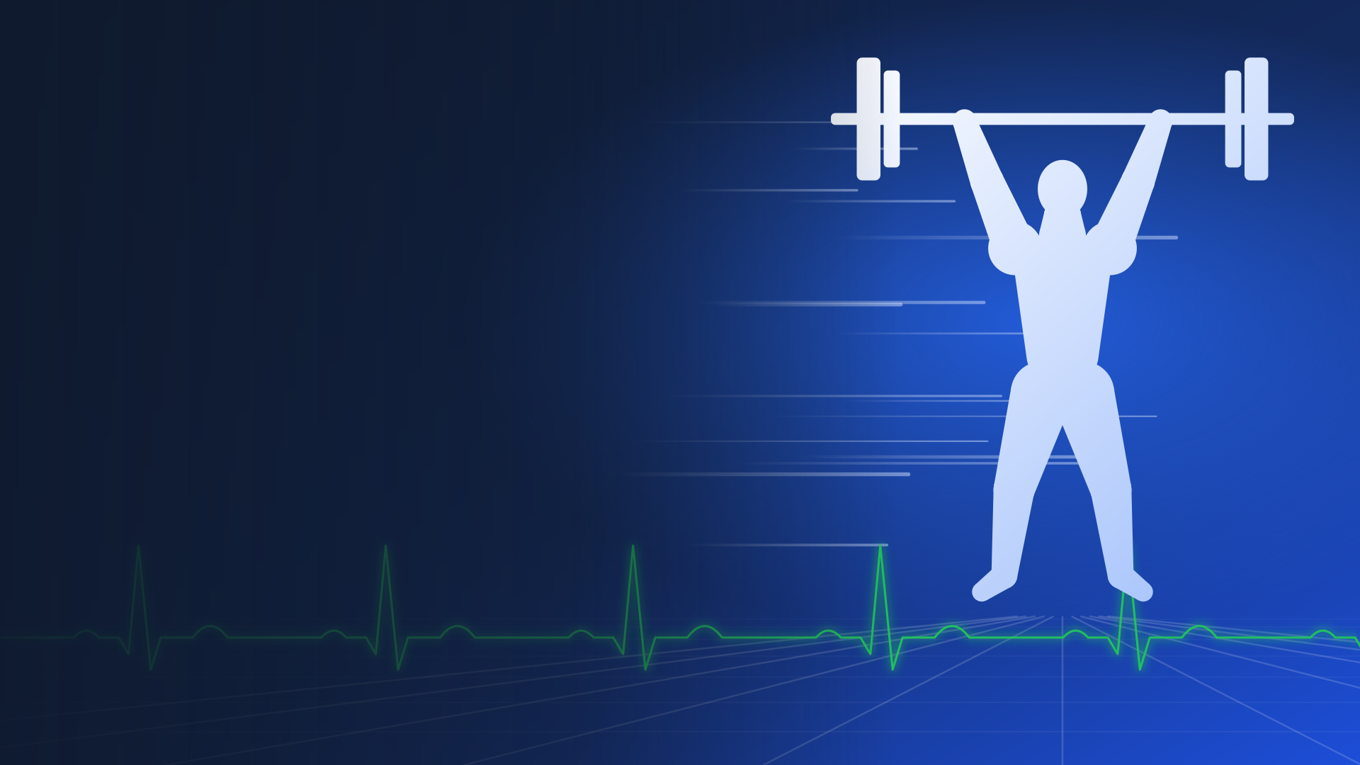
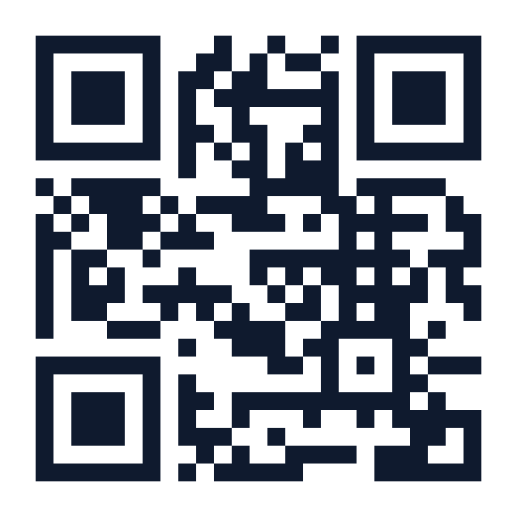
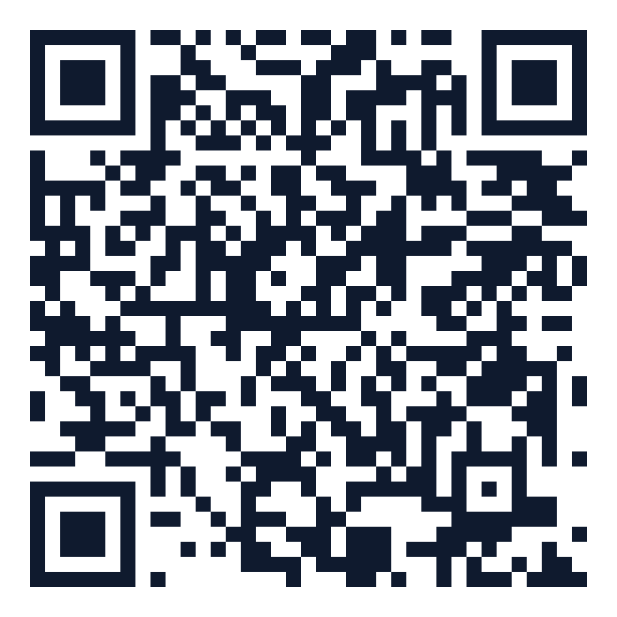
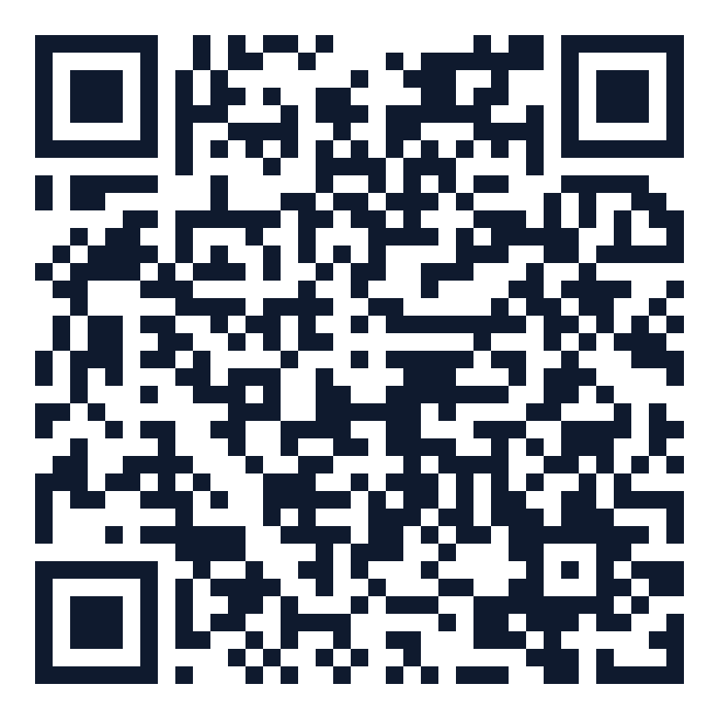
DHRUV
DIAGNOSTICS
Call to confirm your appointment
Laxmi Nagar +91 89282 95328
J-11, West High Court Road, Laxmi Nagar, Nagpur 440022
Ramdaspeth +91 99224 16303
3rd Floor, Aditya Enclave, Central Bazar Road, Ramdaspeth, Nagpur 440010
Mon-Sat 7 AM-9 PM | Sun 7 AM-5 PM | dhruvlabs@gmail.com
Website
Laxmi Nagar map
Ramdaspeth map
Notes:
Laboratory tests are performed in a NABL-accredited laboratory. The check-up is a screening programme and does not replace a consultation with your own doctor.

