Slide 1


DHRUV
DIAGNOSTICS
Health benefits built for tech teams
A proposal for IT companies in Nagpur, from MIHAN SEZ to IT Park Parsodi
Dhruv Diagnostics
Face n Figure
Jeevan Jyoti Blood Bank
Notes:
Open with the tech workforce: long hours at a desk, screens, shift work and a young average age that hides early metabolic risk. Three services from one Laxmi Nagar campus cover check-ups, women's fitness and blood donation.

Slide 2
Tech jobs carry their own health risks
2 in 3
40.6%
Indian IT professionals report work-related neck, back or other musculoskeletal pain
of IT professionals in Delhi NCR had metabolic syndrome at a preventive check-up
Meta-analysis of 20 studies, 15,709 people, 2025
J Family Med Prim Care, 2025
63.5%
84%
of 1,350 young Pune IT employees (average age 33) had two or more cardiometabolic risk factors
of 345 Hyderabad IT employees had fatty liver on FibroScan
Indian J Occup Environ Med, 2016
Scientific Reports, 2025
Notes:
Studies are from different cities and use different criteria, so they are shown side by side, not combined. The common thread is sedentary, screen-heavy work and a young workforce whose risks are found late.

Slide 3
Regular check-ups go with fewer hospital stays
What the data shows
Employees who completed three annual check-ups were hospitalised about a third as often as those who skipped them
Skippers were a quarter of employees but made up 46% of inpatient claims
Fewer than 30% of employees take part in company wellbeing programmes; on-site camps and same-campus visits close that gap
Sources: CII-MediBuddy Workplace Health Report (3rd edition), an association, not proof of cause; Plum, Health Report of Corporate India 2023.

Slide 4
What the new rules mean for employers
Labour codes
Data protection
CSR
In force since 21 November 2025. In May 2026 the government launched free annual check-ups for workers aged 40+. The binding central rule now covers dock and construction work; Maharashtra's rules are in draft.
The DPDP Rules were notified on 13 November 2025; most duties apply from 13 May 2027. Health results need consent and may be used only for the stated purpose.
Programmes that benefit only your own employees are not CSR. Blood donation and health camps open to the community can count as preventive health care.
We can run 40+ check-ups for you now, ahead of any wider rule.
Each employee gets their own report. HR gets anonymised group results only.
Run staff check-ups as a benefit, and blood camps as community CSR.
Not legal advice. Sources: Gazette notifications of 21 Nov 2025; OSH (Central) Rules 2026, G.S.R. 345(E); DPDP Rules 2025; Companies (CSR Policy) Rules 2014, rule 2(1)(d).

Slide 5



Three services, one Laxmi Nagar campus
Dhruv Diagnostics
Face n Figure
LADIES GYM · BEAUTY PARLOUR
Jeevan Jyoti
BLOOD BANK & COMPONENTS
NABL-accredited pathology and ultrasound. Health check-ups, on-site camps, reports and physician review.
Women-only gym and beauty parlour: gym, Zumba, Pilates, yoga, steam, sauna and grooming.
NABH-accredited blood bank and components centre. Voluntary donation camps at your premises.
J-11 and Ramdaspeth
J-11, same building
J-12, next door
All three are on West High Court Road, Laxmi Nagar, Nagpur 440022. One meeting, one coordinator, one invoice.

Slide 6

Dhruv Diagnostics, Nagpur
30+
2011
years of diagnostics in Nagpur
NABL accredited since
2
7
branches: Laxmi Nagar and Ramdaspeth
days a week, from 7 AM
Pathology, biochemistry, hormones, molecular tests
Ultrasound, including musculoskeletal scans by a trained MSK radiologist
ECG and treadmill stress test

Slide 7
Health check-up packages, per employee
Essential
Comprehensive
Executive
All employees
Staff over 30
Staff over 40 and leadership
CBC, blood sugar and HbA1c
Lipid, liver, kidney and thyroid
Vitamin D and B12 (desk workers run low)
Urine routine
BP, BMI and a doctor's summary
Everything in Essential
Ferritin and hs-CRP
Resting ECG
Physician consultation
Everything in Comprehensive
Treadmill stress test
Ultrasound of abdomen and pelvis
Apo B, Lp(a), and PSA or Pap smear
Tasty breakfast included
₹1,499
₹2,499
₹5,499
Tests at walk-in prices ₹5,489
Tests at walk-in prices ₹7,819
Tests at walk-in prices ₹13,128
Add-ons: Women's health add-on ₹1,499 | Neck, shoulder or wrist ultrasound ₹999. Per-employee prices for groups of 50 or more; family members at the same rate.
Notes:
Prices are proposed per-employee rates for on-site camps or branch visits, set from 2026 Nagpur walk-in prices for the same tests and Nagpur hospital package benchmarks (Wockhardt Rs 3,999-7,199; KIMS-Kingsway Rs 3,000-8,500). Confirm with Dhruv management.

Slide 8

Executive check-up, breakfast included
1
Fasting blood and urine samples
2
Ultrasound of abdomen and pelvis
3
Breakfast
4
ECG and treadmill stress test
5
Physician goes through the results
A tasty, healthy breakfast after the fasting tests: poha, upma or idli, fresh fruit, eggs, and chai or coffee. Low-oil and diabetes-friendly.
Notes:
Breakfast is part of the Executive package. Sequence: fasting tests and ultrasound first, then breakfast, then ECG and TMT. Dhruv to confirm the breakfast menu, caterer and seating at the Laxmi Nagar branch.

Slide 9
Built around how tech teams work
On your campus
Around your shifts
No admin for HR
Camps at MIHAN SEZ or IT Park Parsodi; we bring phlebotomists, ECG and the forms.
Early-morning and weekend slots; night-shift teams can book a branch visit at 7 AM.
QR booking with employee code; we upload results and send each employee a digital report.
Family and parents
Co-pay friendly
Desk-pain clinic
Spouses and parents at the same per-person price, booked through the same QR.
The company funds Essential; employees can top up to Comprehensive or Executive.
Neck, shoulder and wrist ultrasound by our MSK radiologist, as an add-on.
Notes:
Infosys runs an annual health week with co-paid master health checks (HALE), and Persistent offers paid annual check-ups; this model slots into both. Only 25% of Indian employers extend health cover to parents (Plum 2023), so parents' check-ups are a valued add-on.

Slide 10
On-site camps with confidential reporting
Camp day
Who sees what
Registration by QR the week before
Fasting samples from 7:30 AM at your office
Height, weight, BP and SpO2 on the spot
Ultrasound, TMT and Executive tests at our Laxmi Nagar branch
Reports in 24 to 48 hours on WhatsApp and email
Employee
Their full report and a doctor's summary
HR
Participation and anonymised group results, such as the share of staff with high blood sugar
Nobody else
Consent is taken at registration, in line with the DPDP Act

Slide 11
Women in tech
A women-only gym and beauty parlour in Laxmi Nagar for over four decades.
Fitness
Beauty parlour
Gym and strength
Zumba, aerobics, Pilates
Yoga and meditation
Steam and sauna
Skin and hair care
Grooming for client-facing staff
Bridal and event make-up
For your company Corporate membership rates, Women's Day and wellness-week sessions on your premises, and a women's health add-on from Dhruv: ₹1,499 for an anaemia, thyroid and hormone check with a Pap smear.
Face n Figure
LADIES GYM · BEAUTY PARLOUR
Notes:
Face n Figure corporate rates to be set by Face n Figure management. Founding year from directory listings (1978-79), so the slide says 'over four decades'.

Slide 12
Blood donation day
NABH-accredited since 2011, open 24 hours, and the region's first blood bank to prepare all components (1997).
We bring
You provide
Doctor, nurse, technicians and counsellor
Donor screening and refreshments
Certificates for every donor
A room about 20 x 30 ft
Power point, water, 3-4 tables, 20-25 chairs
Donor sign-ups through HR
Who can donate Age 18-65 (first-time donors up to 60), weight 45 kg or more, haemoglobin 12.5 g/dL or more. Men every 3 months, women every 4 months.
Jeevan Jyoti
BLOOD BANK & COMPONENTS
Notes:
Camps are free to the host company. Eligibility per Drugs and Cosmetics (Second Amendment) Rules 2020 and NBTC guidelines. A camp open to the wider community can be booked as CSR (preventive health care); confirm with the CSR committee. Firsts and dates are the blood bank's own claims; NABH certificate BB-2011-0033 is valid to 4 April 2027.

Slide 13
A year of wellness, planned with you
Mar 8
Apr 7
Jun 14
Jun 21
Sep 29
Oct 1
Nov 14
Women's Day
World Health Day
World Blood Donor Day
International Yoga Day
World Heart Day
National Voluntary Blood Donation Day
World Diabetes Day
Face n Figure session and women's health add-on
Annual check-up camp opens
Blood donation camp
Yoga session on your premises
Executive heart checks for staff over 40
Second blood donation camp
HbA1c follow-up for staff at risk
Dates are the official international and national observance days. The order and content can be changed to suit your year.

Slide 14
How companies work with us
Service | Model | Price
Health check-ups (Dhruv) | Per employee, on-site camp or branch visit; family at the same rate | Essential ₹1,499, Comprehensive ₹2,499, Executive ₹5,499
Volume | Free on-site camp for 50+ employees at one location | Extra 5% off at 300+, 10% at 1,000+ employees
Women's wellness (Face n Figure) | Corporate memberships, on-site sessions, grooming | Corporate rates on request
Blood donation (Jeevan Jyoti) | Camp at your premises, 1-2 a year | Free to the company
Reporting | Anonymised group report after each camp | Included
Notes:
Volume discounts and camp minimums are proposals for Dhruv management to confirm.

Slide 15
Getting started takes four steps
1
2
3
4
Meet
Plan
Run
Review
We agree headcount, packages and who pays what
Camp dates, site visit and the QR booking link
Camp day, branch visits and reports within 48 hours
Group report to HR and follow-up for staff at risk
First camp can run within three weeks of sign-off.

Slide 16


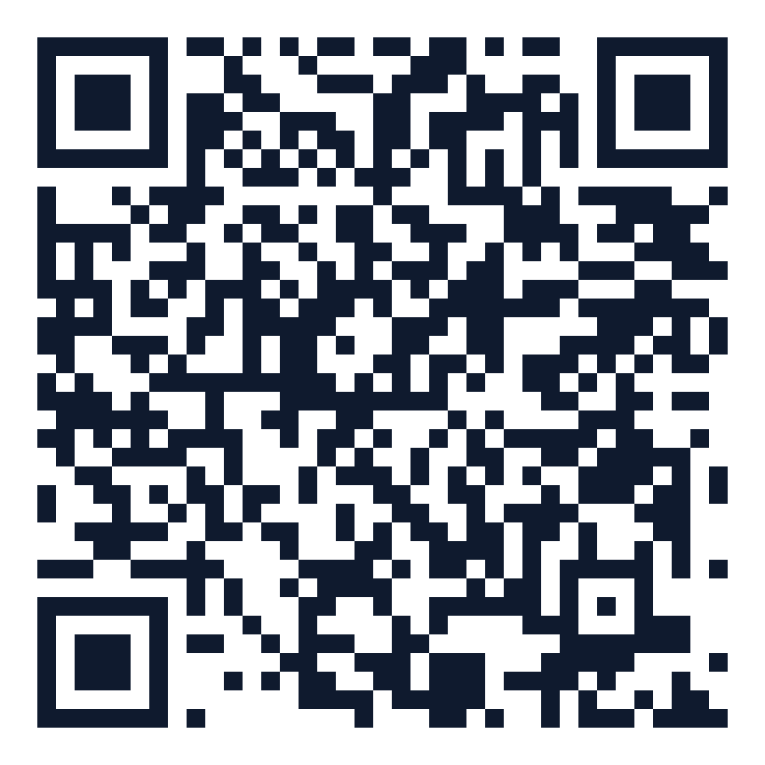
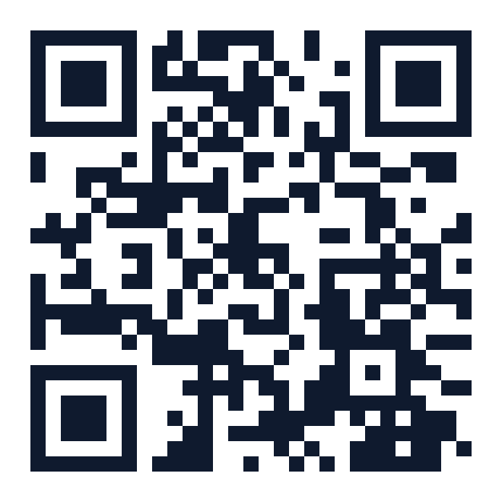
DHRUV
DIAGNOSTICS
Call to set up a meeting
Dhruv Diagnostics, Laxmi Nagar +91 89282 95328
J-11, West High Court Road, Laxmi Nagar, Nagpur 440022
Dhruv Diagnostics, Ramdaspeth +91 99224 16303
3rd Floor, Aditya Enclave, Central Bazar Road, Ramdaspeth, Nagpur 440010
Jeevan Jyoti Blood Bank (24 hours) 0712 223 0876
J-12, West High Court Road, Laxmi Nagar, Nagpur 440022
Face n Figure (women only) book through Dhruv Diagnostics
J-11, West High Court Road, Laxmi Nagar, Nagpur 440022
Dhruv website
Laxmi Nagar campus map
Jeevan Jyoti Trust website
Notes:
Mon-Sat 7 AM-9 PM | Sun 7 AM-5 PM. dhruvlabs@gmail.com. Laboratory tests in a NABL-accredited laboratory; check-ups are screening and do not replace a consultation with the employee's own doctor.

Slide 17
Sources
Musculoskeletal pain among Indian IT professionals: systematic review and meta-analysis of 20 studies (15,709 participants), 2025.
Metabolic syndrome among IT professionals undergoing preventive health check-up in Delhi and NCR. J Family Med Prim Care, 2025.
Limaye T et al. High prevalence of cardiometabolic risk factors in young employees of the IT industry (Pune, n=1,350). Indian J Occup Environ Med 2016;20(1):64-67.
Prevalence of metabolic dysfunction-associated fatty liver disease among IT employees in India (Hyderabad, n=345). Scientific Reports 2025;15:10124.
CII and MediBuddy. Workplace Health Report, 3rd edition, 2026.
Plum. Health Report of Corporate India 2023 (reported by Business Standard, November 2023).
Ministry of Labour and Employment. Notifications bringing the four labour codes into force, 21 November 2025; Occupational Safety, Health and Working Conditions (Central) Rules 2026, G.S.R. 345(E), 8 May 2026.
Ministry of Electronics and IT. Digital Personal Data Protection Rules 2025, notified 13 November 2025.
Companies (Corporate Social Responsibility Policy) Rules 2014 as amended in 2021, rule 2(1)(d); Companies Act 2013, Schedule VII.
Drugs and Cosmetics (Second Amendment) Rules 2020, G.S.R. 166(E); National Blood Transfusion Council donor selection guidelines.
NABH accredited blood banks list: Jeevan Jyoti Blood Bank & Components, BB-2011-0033, valid 5 April 2024 to 4 April 2027.
Package benchmarks: Wockhardt Hospitals Nagpur and KIMS-Kingsway Nagpur health check-up price lists; national lab package listings, October 2026.

