Slide 1
DJANGO PROJECT
ATHREYA KM ANIKETH HEGDE SHAMITA K
PES1201700951 PES1201700104 PES1201700973
To: Mrs. Vidhu Rojit

Slide 2
Title of the Project:
MOVIE RANKING WEBSITE REDESIGNED USING DJANGO

Slide 3
Webpage description:
Our web page is a simple movie ranking page which ranks movies of different categories. The website contains some of the best movies of different genres like horrors,crimes,thrillers,mysteries and scientific fiction.All the webpages are rendered using django. Comments can be added in the webpage for any of the above mentioned genre. These comments are stored in the database and all the comments can be viewed in a separate webpage i.e, comment section webpage. Almost all concepts taught in the class are covered except login page since there is no scope for login page in our website.

Slide 4
Link to our webpage: athreyakm.pythonanywhere.com

Slide 5
Individual Contribution:
Since it is difficult to work django in different systems, most part of the project was done staying together. Initial setup, creating apps ,setting up database and the admin page was done by shamita and the remaining part such as creating models, views, templates, connecting front end to backend, displaying database contents and deploying it in pythonanywhere was together done by us.

Slide 6
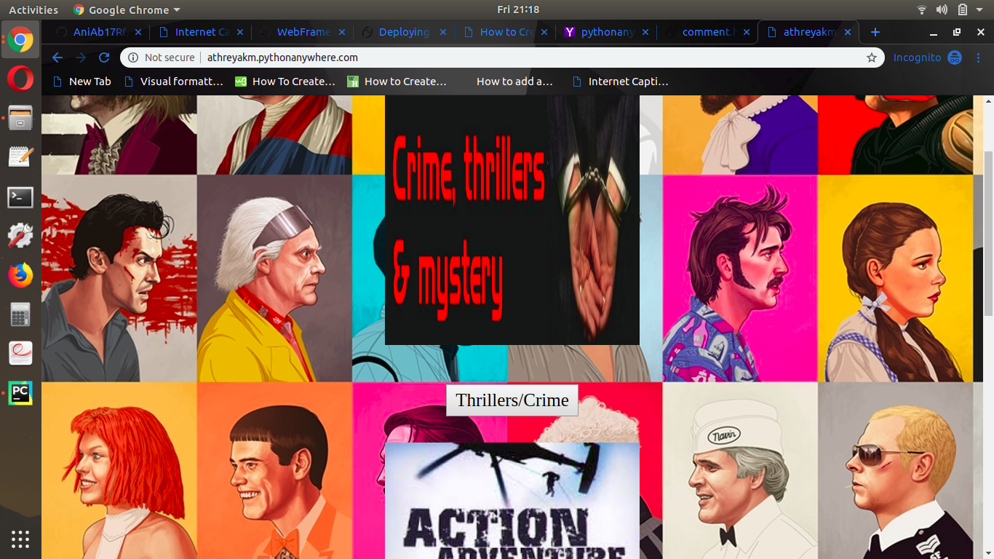
Screenshots:

Slide 7
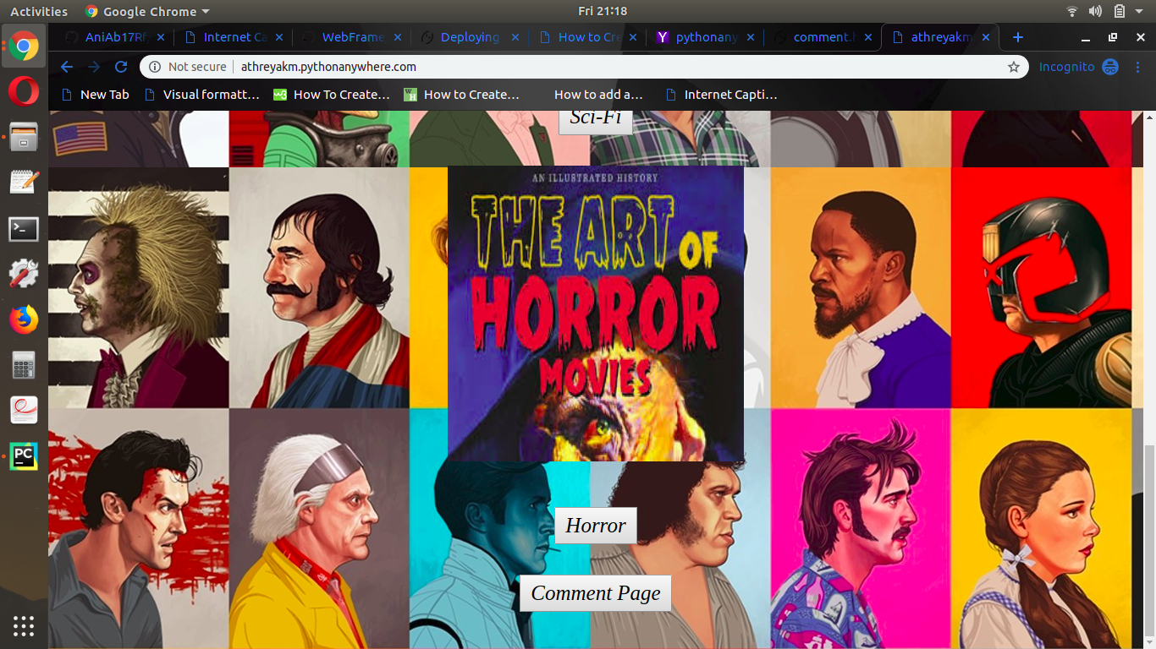
Screenshots:

Slide 8
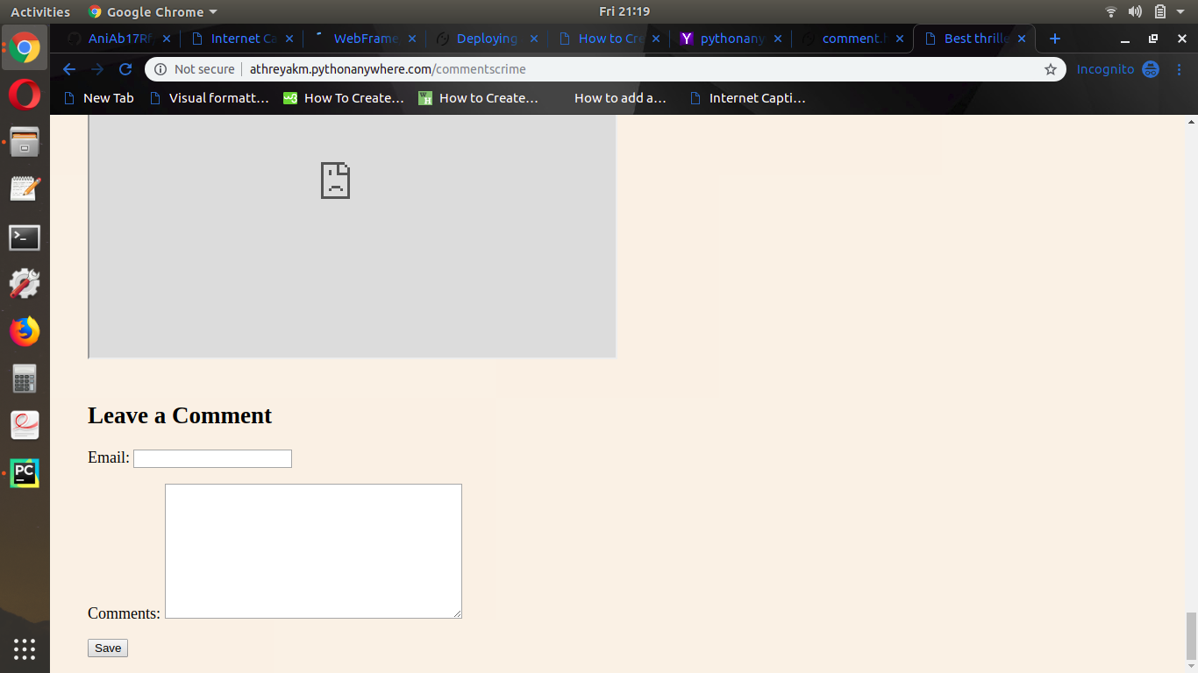
Screenshots:

Slide 9
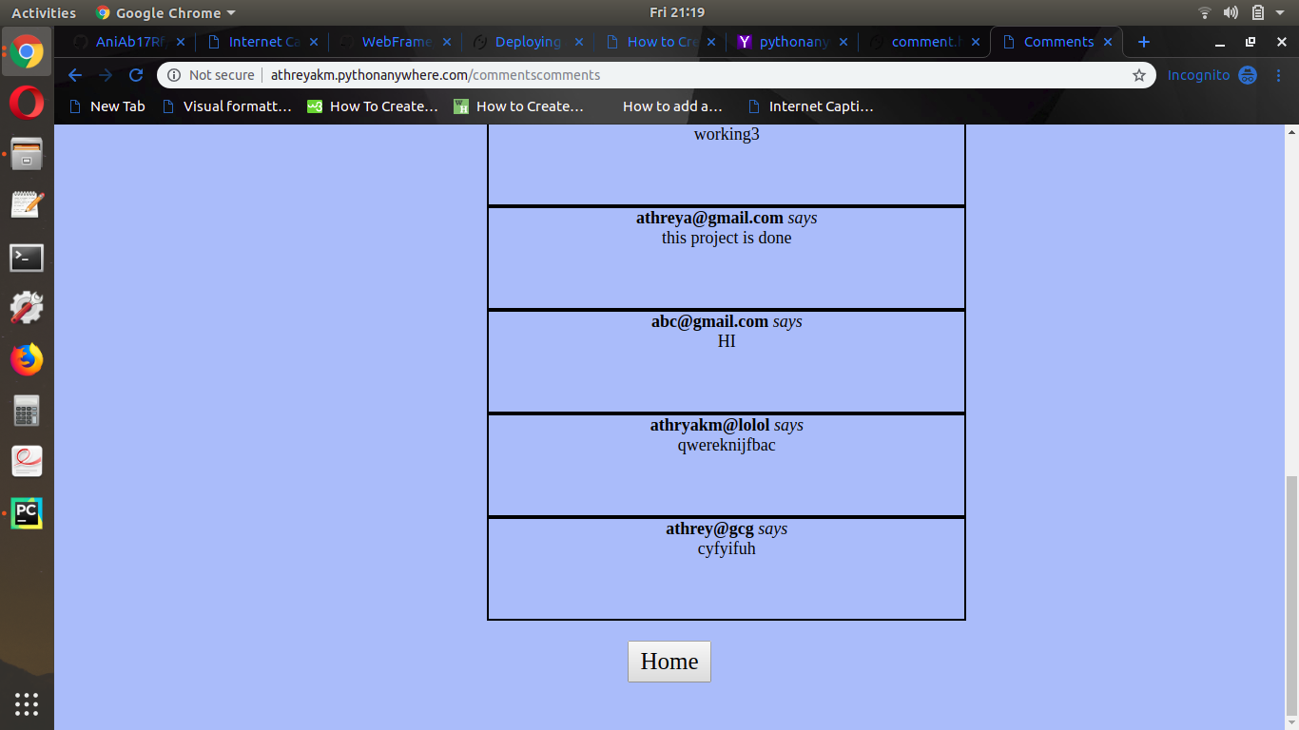
Screenshots:

Slide 10
Takeaways:
When php is used to connect frontend and backend lot of code has to be written to make sure the connection is proper whereas in django it is much easier to do that. Python language also makes it much simpler to write the code.
When code is written in php, it is difficult to debug since it is lengthy and all the files have the same extension. Since django is modular, it is much easier to find where the error is and hence simpler to correct the mistake.

Slide 11
Contact Info:
Name: Athreya KM ; USN: PES1201700951 ; Email: athreyakm@gmail.com
Name:Aniketh S ; SRN: PES1201700104 ; Email:anikethhegde15@gmail.com
Name: Shamita ; SRN: PES1201700973 ; Email: shamita2511@gmail.com

