Slide 1
Lending Club Case Study
Team Members:
Anindya Dasgupta (anindyavik@gmail.com)
Angiras Modak (modak.angiras@gmail.com)

Slide 2
Abstract
Lending club is the largest online loan marketplace facilitating personal loans, business loans, and financing of medical procedures. Borrowers can easily access lower interest rate loans through a fast online interface.
Like most other lending companies, lending loans to ‘risky’ applicants is the largest source of financial loss (called credit loss). The credit loss is the amount of money lost by the lender when the borrower refuses to pay or runs away with the money owed. In other words, borrowers who default cause the largest amount of loss to the lenders. In this case, the customers labelled as 'charged-off' are the 'defaulters'.
Mainly there are three types of loans:-
Fully Paid, Current and Charged Off, of which Fully paid and Current are not considered as Defaulters.
The objective is to identify loan defaulters through Exploratory Data Analysis (EDA)

Slide 3
Analysis breakdown
Whole analysis is broken down into below subdivisions:-
1. Understanding data and variables
In this section we try to understand the data, the columns it has and see the statistical variables on the entire data.
2. Cleaning the dataset
In this segment we try to see what all columns are required and what can be dropped, also convert columns to suitable formats to work with.
3. Univariate and Segmented Analysis
To analyze the distribution of various numerical/categorical variables and create any derived metrics wherever required. In segmented analysis, a segment of a variable is taken to analyze against another variable.
4. Bivariate Analysis
This analysis mainly deals with the correlation analysis between two variables to find the defaulted loans. To see how the distribution changes variable to variable.
5. Recommendations based on plots and analysis
Based on the plots created we could draw several suggestions

Slide 4
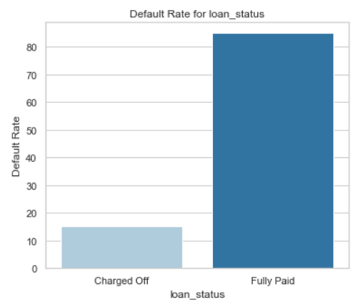
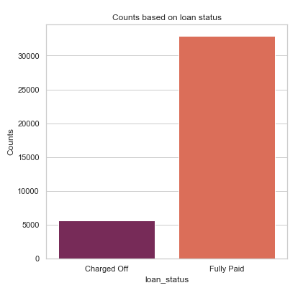
Analysis : Loan_status Default rate
Loan_status becomes the driving variable and the whole analysis boils down to this column in particular, i.e., whether a loan is Charged Off or not.
Based on the calculations it was found that nearly 14% of the total loans defaulted
Out of total around 5000 loans are there in the dataset which defaulted

Slide 5
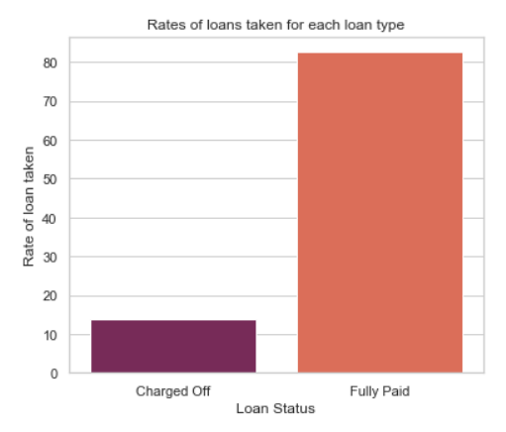
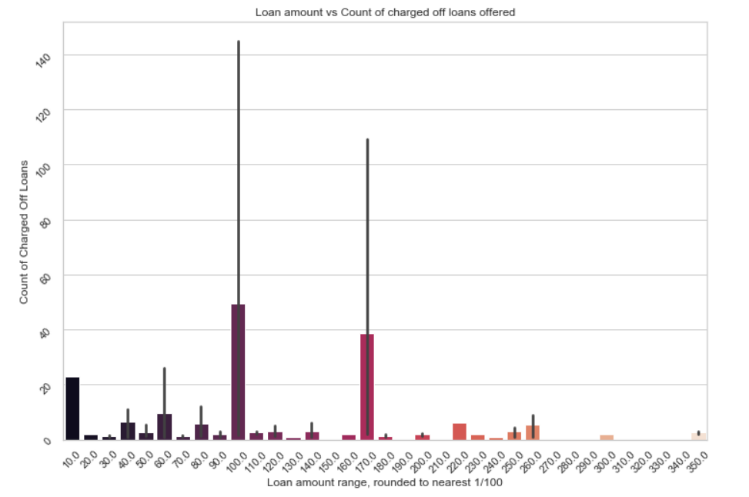
Analysis : Loan_amount and default loans relationship
Based on the total loan amount, around 13% of the total loan approved by lending club, came out to be defaulted ones
There is a major spike at 10000 and 17000 dollars mark. Which clearly suggests, borrowers prefer taking loans of these two amount the most and likely to default.

Slide 6
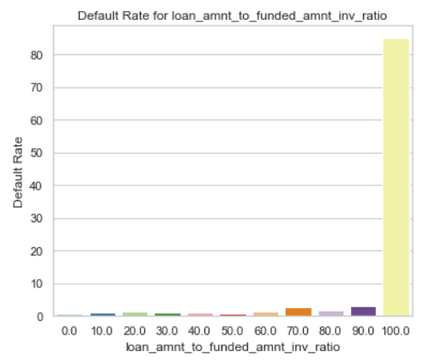
Analysis : Relationship between loan_amnt and funded_amnt_inv
From the loan_amnt to funded_amnt_inv insight we find that more than 85% of the defaulted loans were granted where the exact loan_amnt requested by the borrower was approved by the investors. Investors should strictly stop approving loans of the same amount which the borrowers asks for.

Slide 7
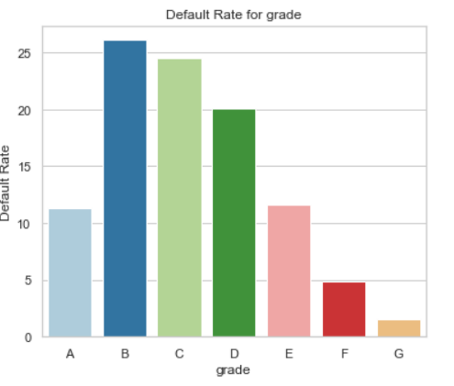
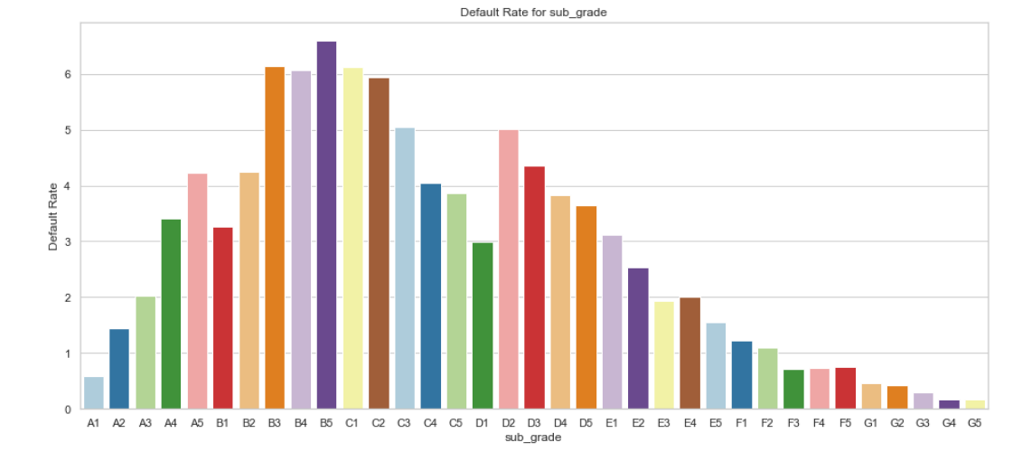
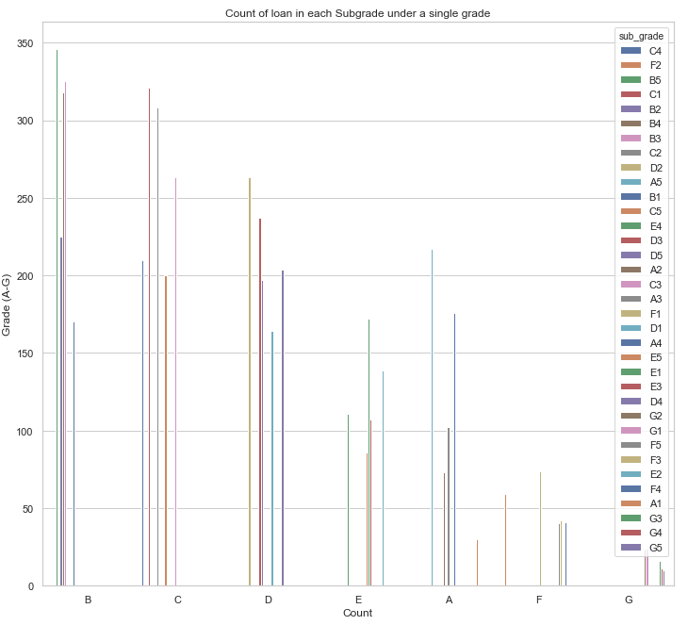
Analysis : Default rate based on grade and sub_grade
B5 has the maximum default rate of around 70%. Along with B3, B4, C1 and C2 which has default rate of close to 6o%
Each sub_grades under each grade and their counts in terms of default loans. Here as well, we find B5 to be at the top
Most of the loans defaulted falls under grade B and C. B has the highest rate of defaulters. More than 25% of the other grade types

Slide 8
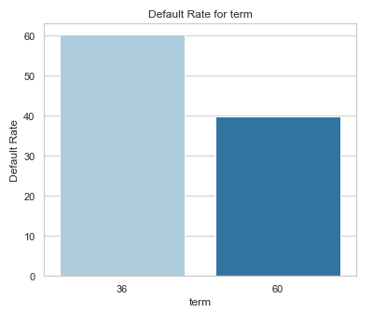
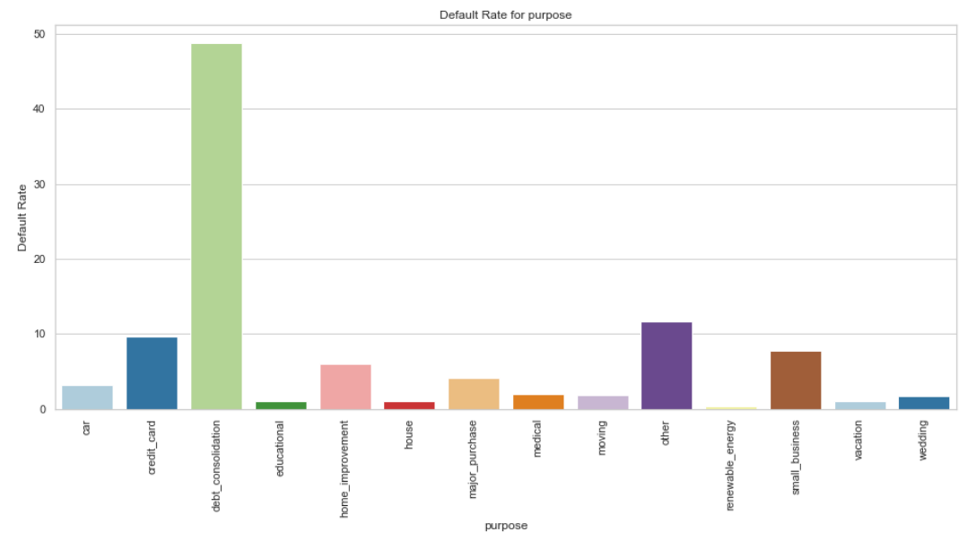
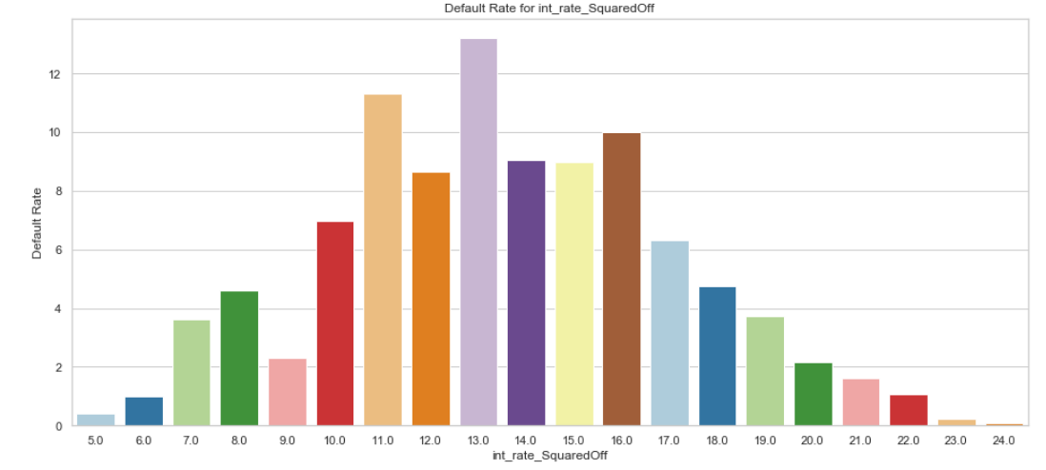
Analysis : Default rate by term, int_rate, purpose
Debt_consolidation is the major purpose for which most of the default loans were taken. With default rate of around 50%
Around 60% of the defaulted loans were taken for a term of 36 months.
More than 10% of the loans defaulted between rate of interest range of 11-13%

Slide 9
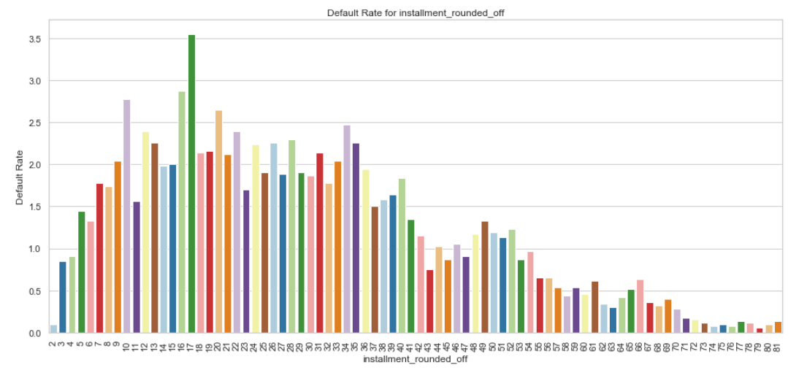
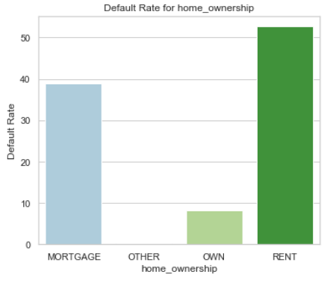
Analysis : Default rate by installment and home_ownership
More than 50% of the defaulted loans are taken for by borrowers who stays on Rent
Nearly 40% of the defaulted loans are taken by the borrowers who has kept mortgages
Self house owners has least percentage to default a loan. Default rate is close to 10%
Installment amount is rounded to 1/10 th of actual installment values to installment bins. For e.g., 1 unit = 10 dollars in X axis
With installment of 170 dollars loans are likely to default the most i.e., by 35%

Slide 10
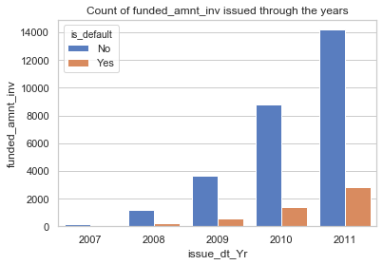
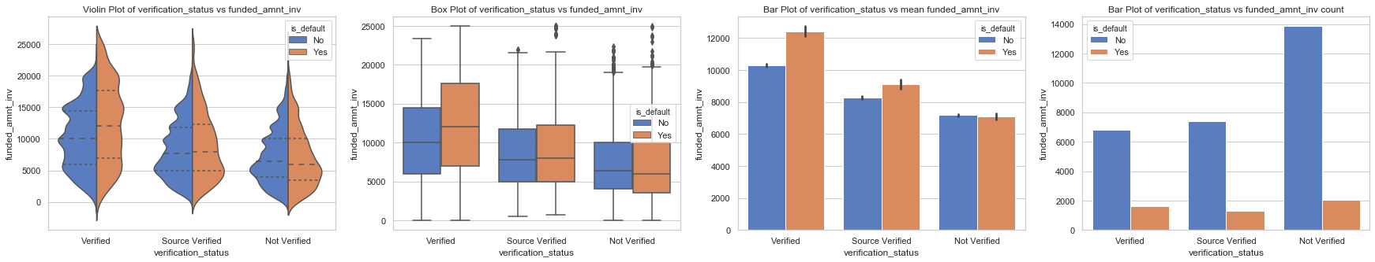
Analysis: Verification Status vs funded_amnt_inv
Analysis: Verification Status vs funded_amnt_inv
Observation: The count of loan issued by investors through the years are increasing. The default loan count is also increasing through the years as well.

Slide 11
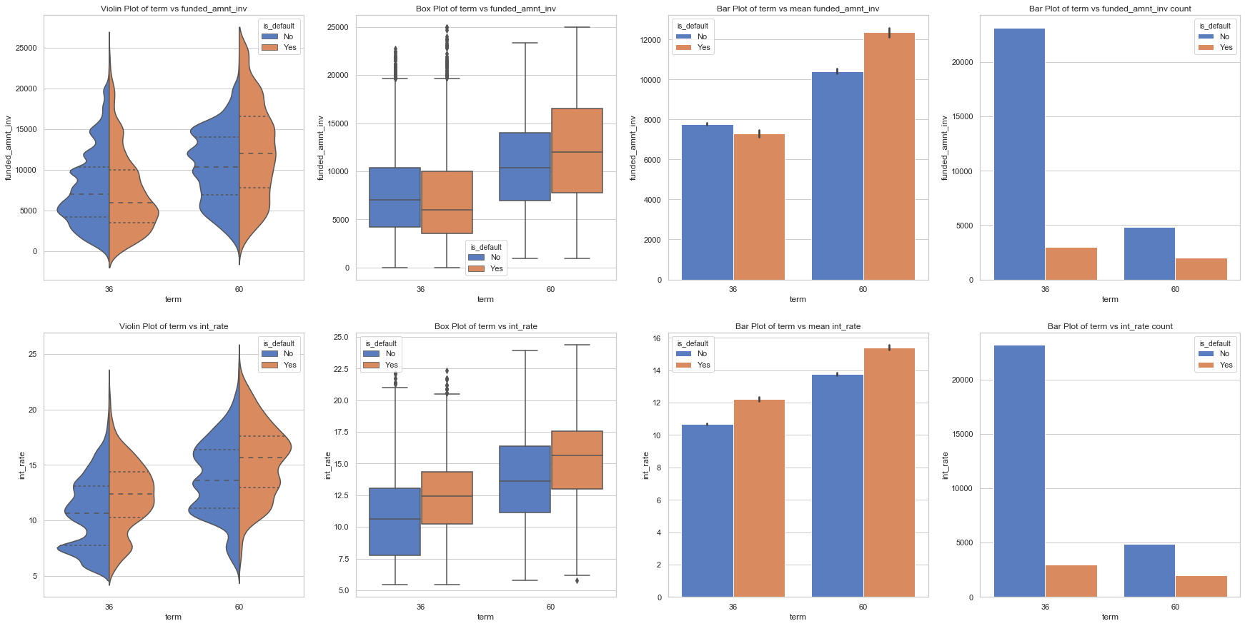
Analysis: Term vs funded_amnt_inv vs Interest Rate

Slide 12
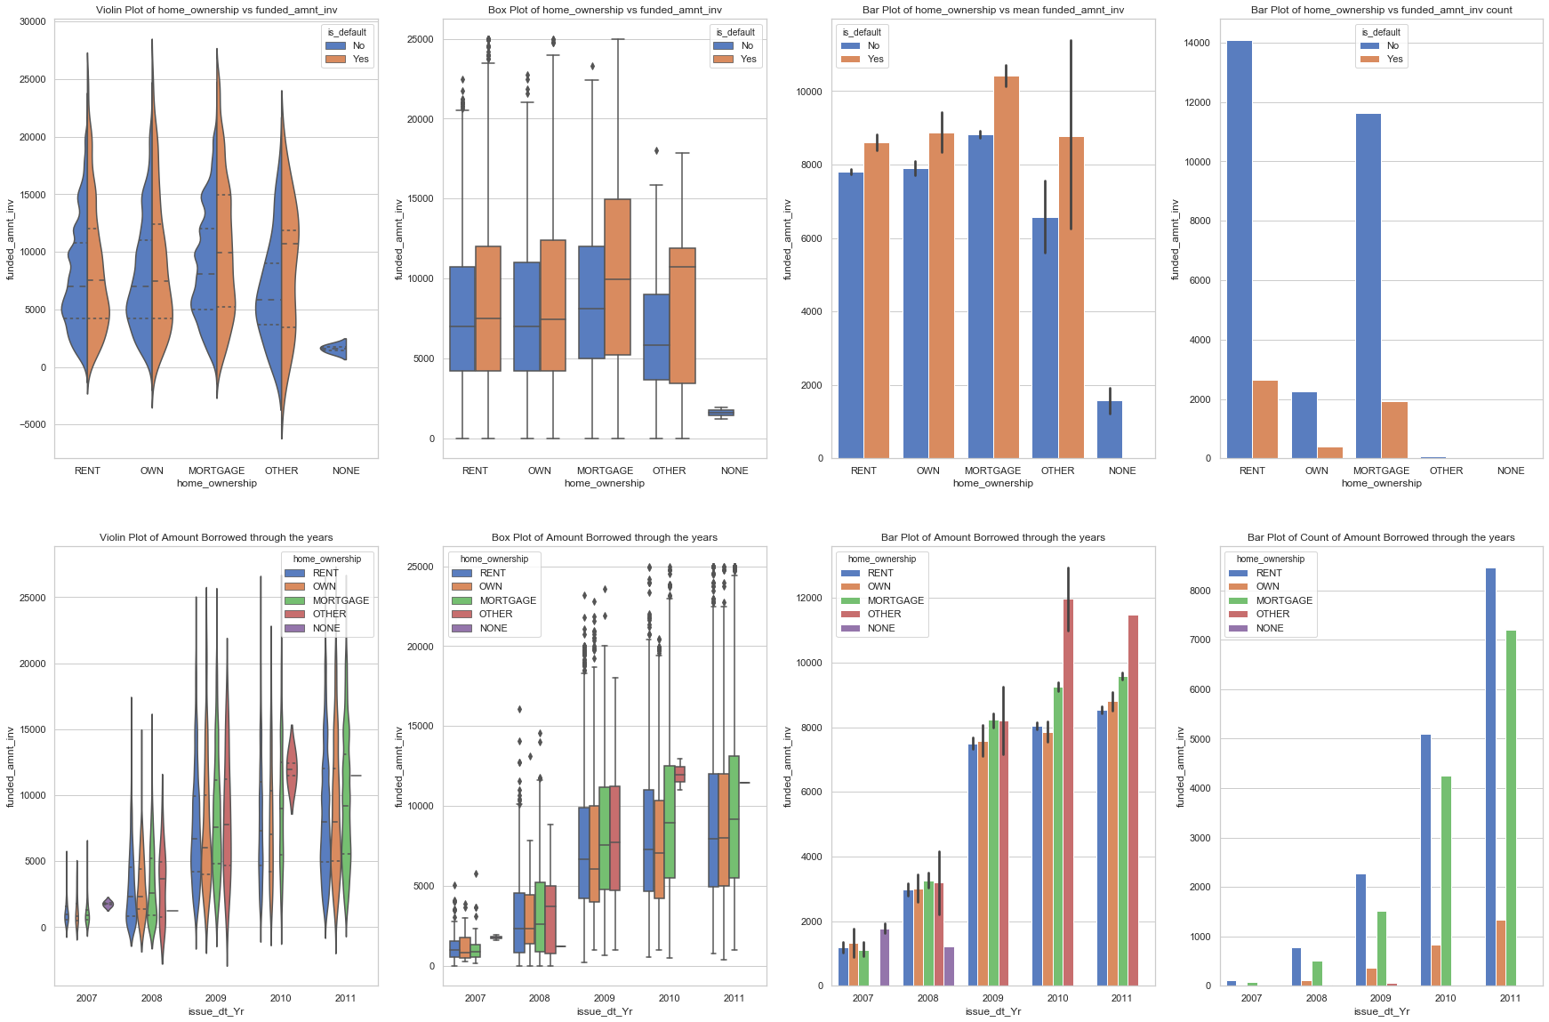
Analysis : Home Ownership vs funded_amnt_inv vs Issue Date Year
Observation:
Default of loan mostly done on RENT and MORTGAGE home ownership category.
The spread of mortgage is higher than other categories.
There is no default for NONE category.
Amount of loan borrowed are increasing from 2007 to 2011 gradually.
The existence of NONE category has only existence for 2 years (2007 and 2008).
There was no existence of OTHER home ownership category in the year 2007. The OTHER category came into existence from 2008 and it gradually increased through the years. From year 2009 onwards, OTHER category is leading based on loan issued.
The count of loan borrowed are very high through the years for RENT and MORTGAGE.

Slide 13
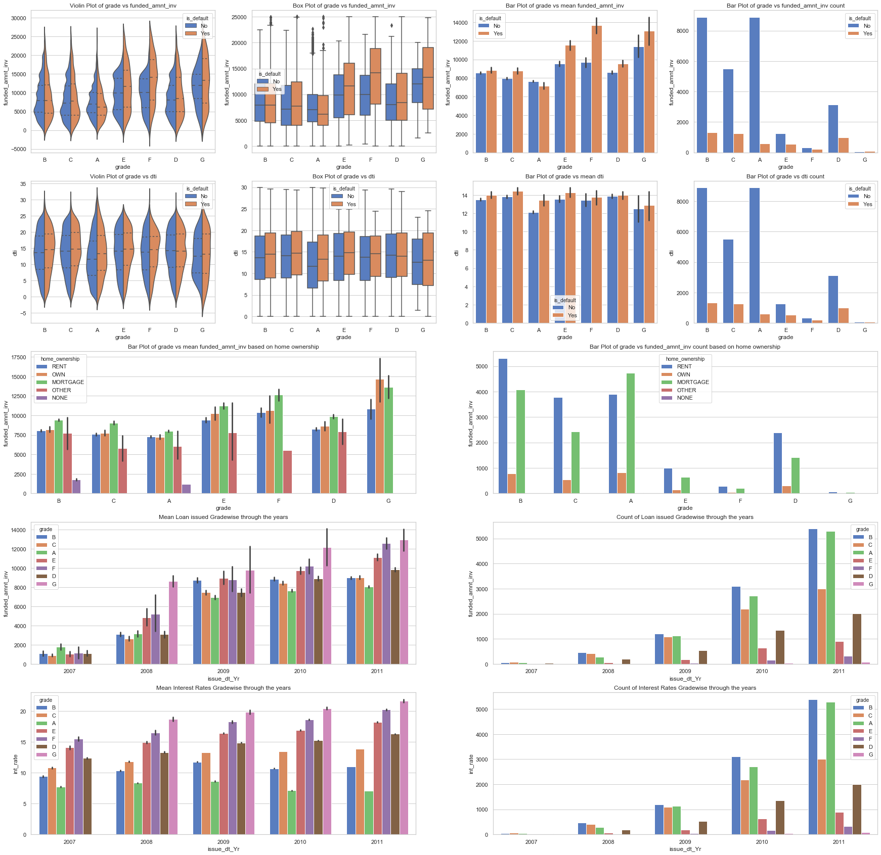
Analysis : Grade vs dti vs funded_amnt_inv vs Interest Rate Year vs Issue Date
Observations:
The spread in the lower grades are lesser than higher grades and therefore more likely to give loan to the lower grades.
The median loan issued by investor for higher grades are also high which likely to get default.
Grades like E, F and G have very low dti.
For high grades F and G, having OWN and MORTGAGE category of home ownership receives high loan amount from investors, though its count is very less.
Count of Loan issued along with its interest rates gradewise through the years are increasing for lower grades.
It is interesting to see that grades B followed by C and D are more likely to default loan.

Slide 14
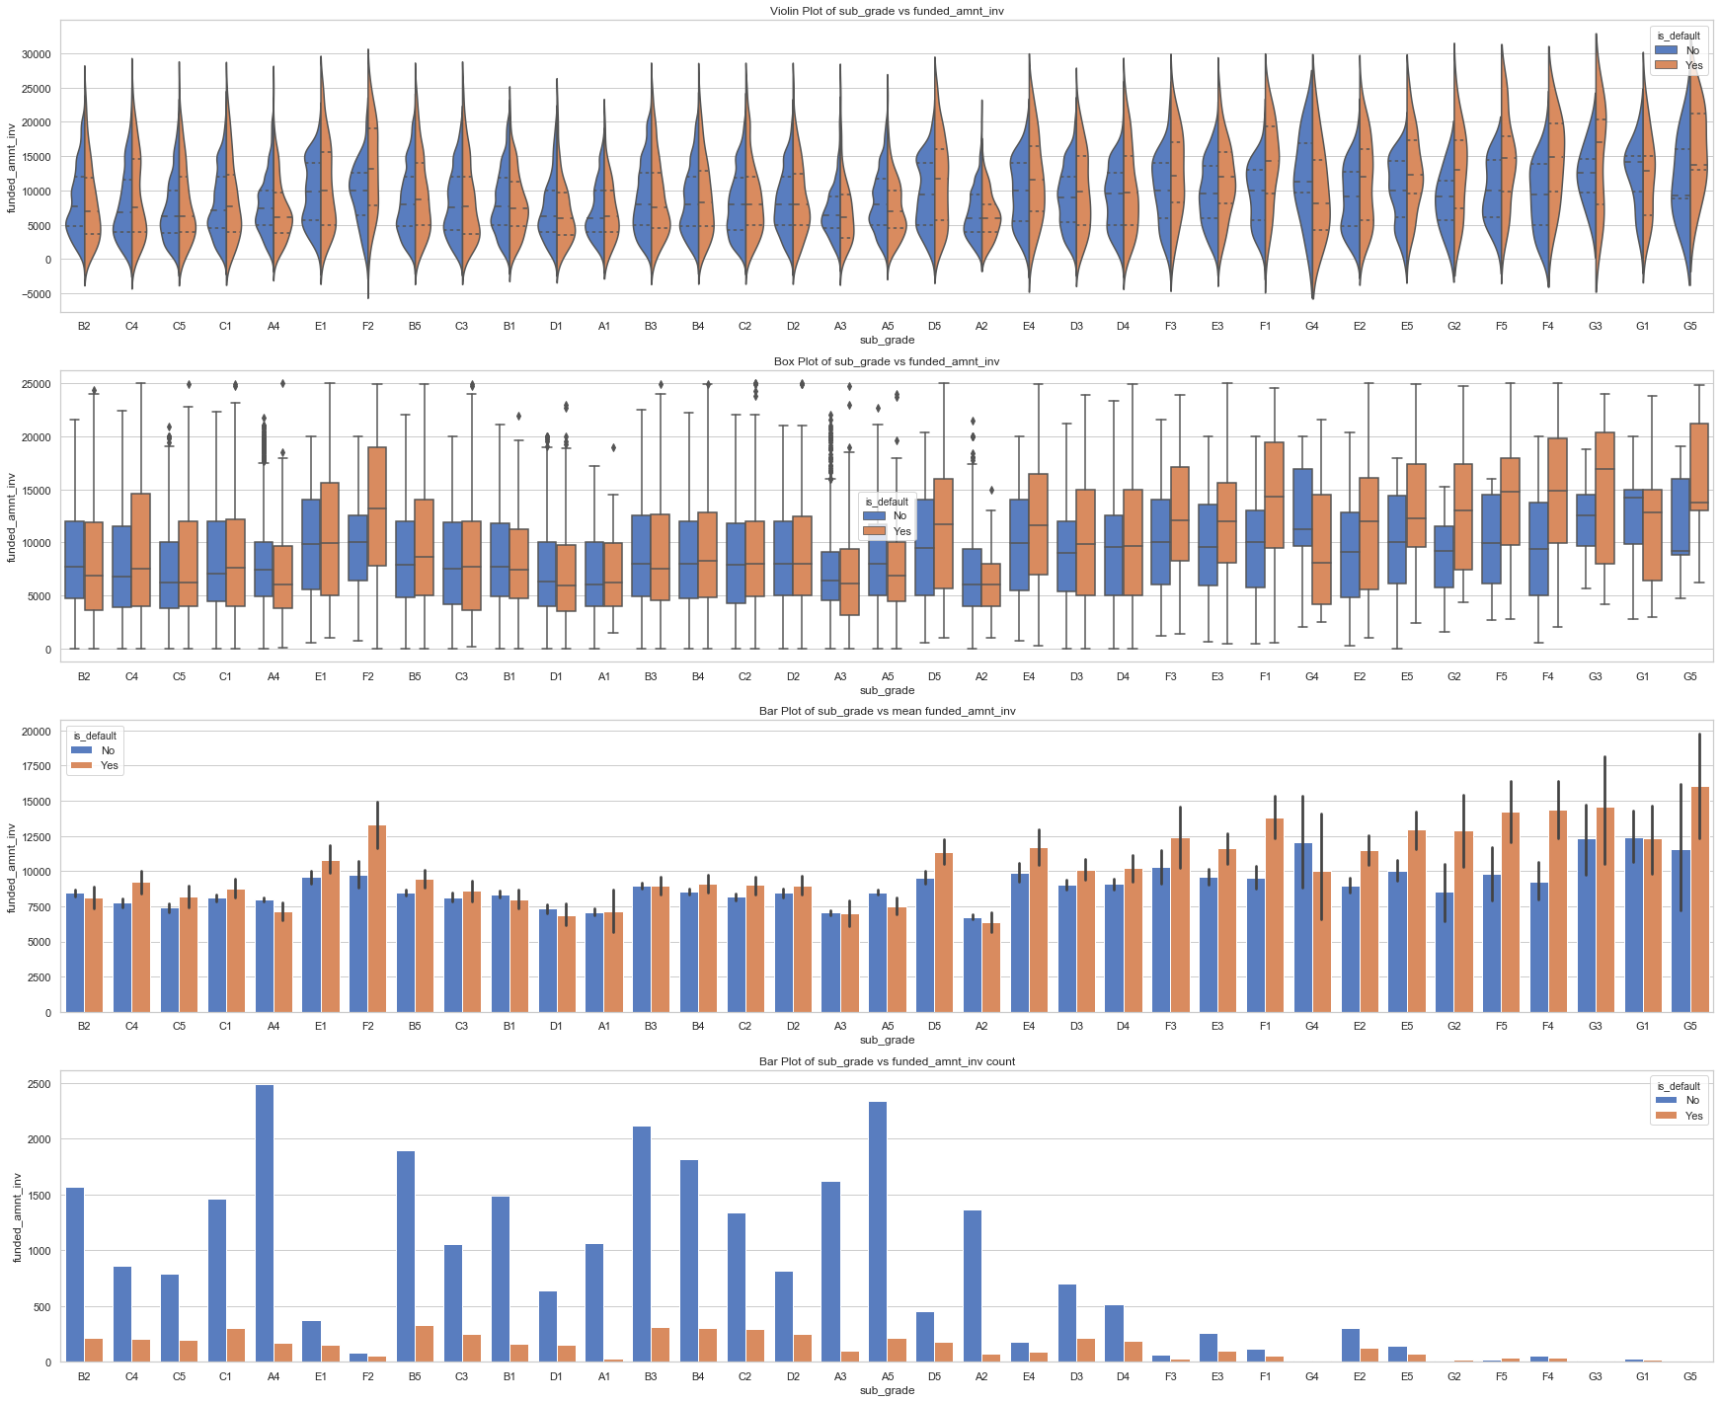
Analysis: Sub-Grade vs funded_amnt_inv
Observations:
It is more clear by seeing sub-grades that the sub-grades of grade B and C are more likely to default loan.
Grade B has highest number of defaulters.
Most of the default loans were granted under grade B sub_grade B5.

Slide 15
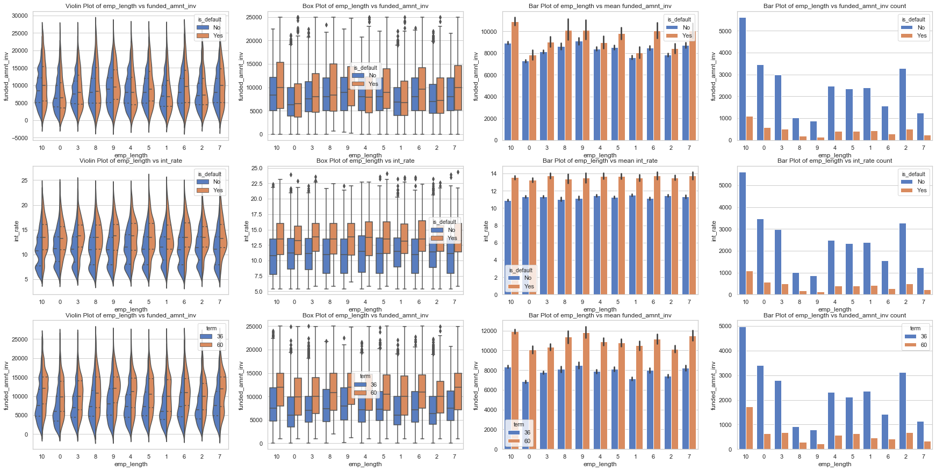
Analysis: Employee Length vs funded_amnt_inv
Observations:
10+ experience holder employees has issued maximum loan for 36 months and 60 months term.
10+ experience holder employees are more likely to default loan along with highest interest rate.

Slide 16
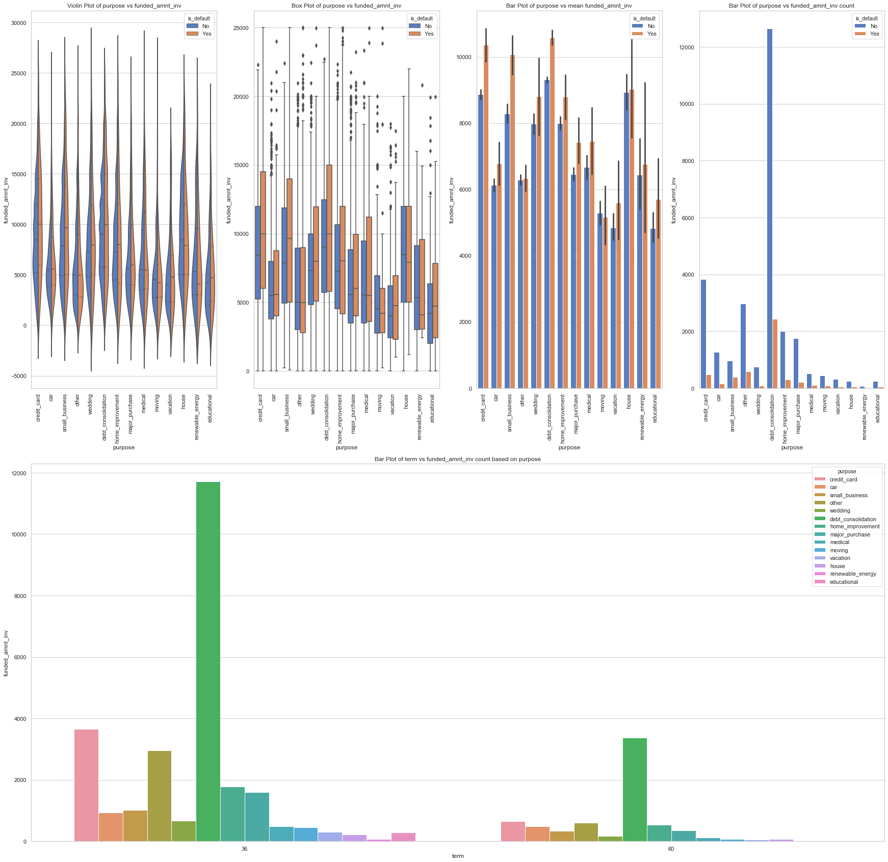
Analysis: Purpose vs funded_amnt_inv
Observations:
Highest number of loans issued for purpose debt_consolidation for 36 months and 60 months term.
Highest number of loans are defaulted for purpose debt_consolidation.

Slide 17
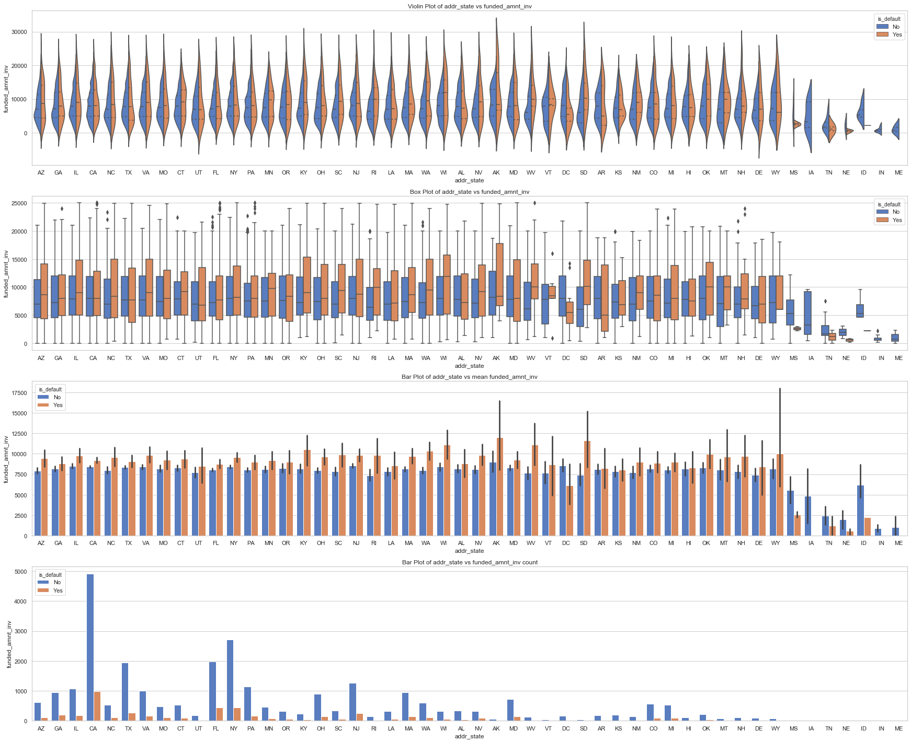
Analysis : addr_state vs funded_amnt_inv
Observations:
Highest number of loans are applied in CA state where the number of loans to get defaulted are likely to be the highest.

Slide 18
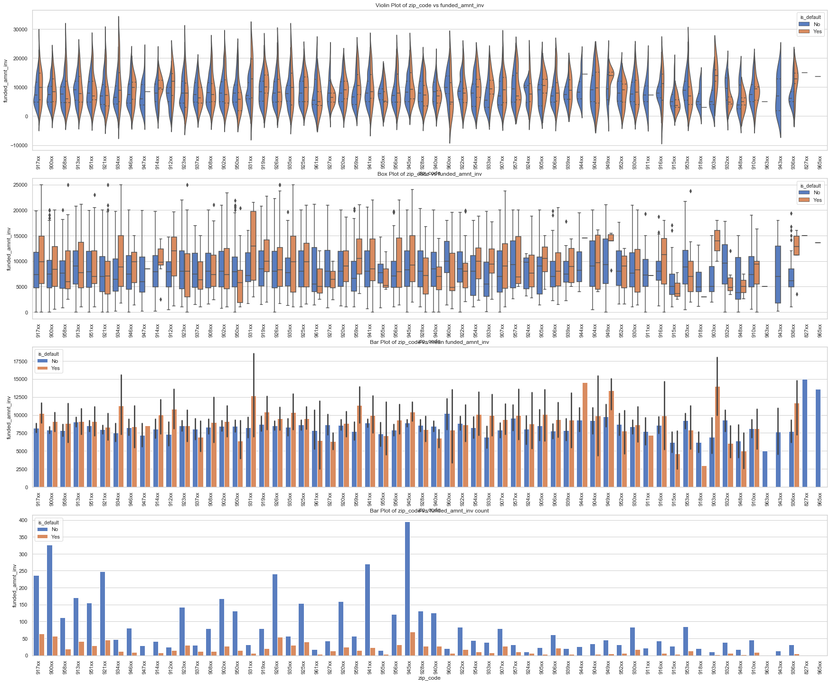
Analysis: zip code vs funded_amnt_inv (For the state having highest loan defaulter)
Observations:
As State CA has highest default loan, therefore the analysis for zip code is conducted for state CA.
It is found that top three default zip codes are 945xx, 917xx and 900xx respectively.

Slide 19
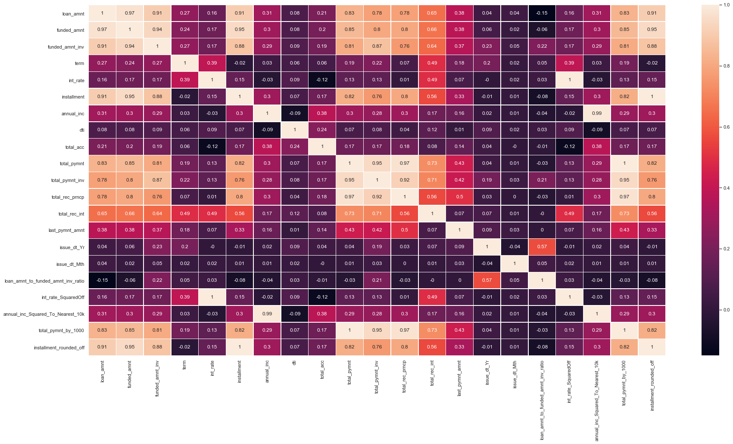
Correlation Matrix

Slide 20
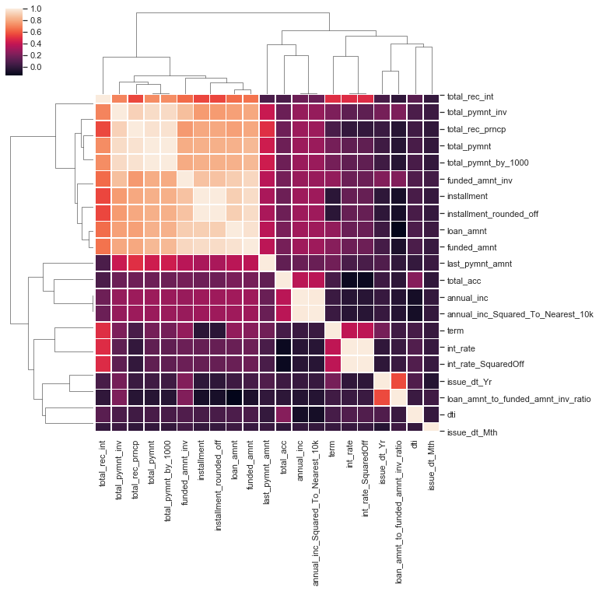
Cluster Map

Slide 21
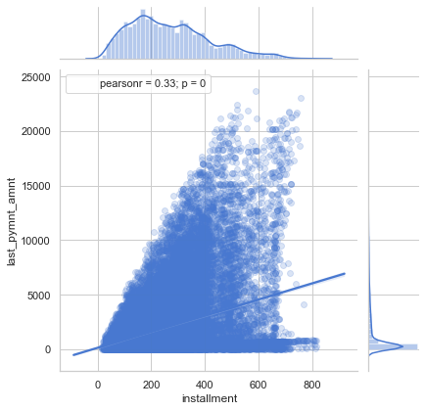
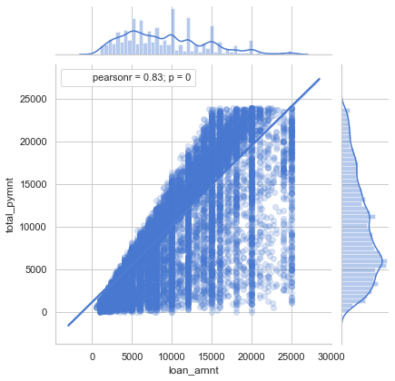
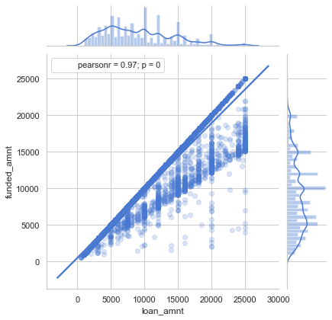
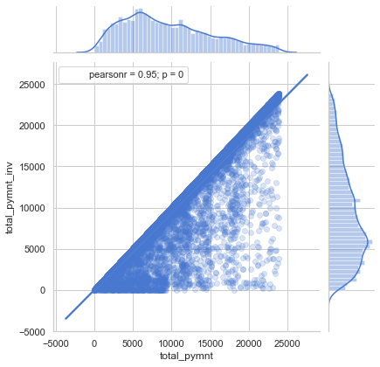
Jointplot between various important variables

Slide 22
Recommendations from the analysis
Below pointers should be kept in mind before approving any future loans :-
Approval of loan amount of 10000 and 17000 should be done carefully, as because majority of the defaulter are prone to take loans of this particular amounts
Borrowers taking loan for the purpose of “debt_consolidation”, their case has to be properly scrutinized
Majority of the defaulted loans granted falls under subgroup B5, from next time onwards the loans falling under B grade and B5 subgrade need to be checked properly before approval
Most of Rented house owners are likely to default by a huge margin around 50%, followed by mortgage holders around 40%. Lending club must scrutinize the loan applications submitted for these two types of house owners
Borrowers having employee length more than 10 years are likely default the most by around 30%. They should approve loans with utmost importance for emp_length > 10
Investors are found approving the exact loan_amnt. Which resulted in 85% default loans out of the total charged off loans
Most default loans are taken for a term of 36 months
Most of the default are done for the verification status as "Not Verified". From future, to reduce the default of loan, it is advisable to thoroughly verify before giving loan.
Highest number of loans are applied in CA state where the number of loans to get defaulted are likely to be the highest.
It is found that for state CA, top three default zip codes are 945xx, 917xx and 900xx respectively.

Slide 23
Thank You!

