Slide 1
KINECT
BY DJANGO MILKSHAKE

Slide 2
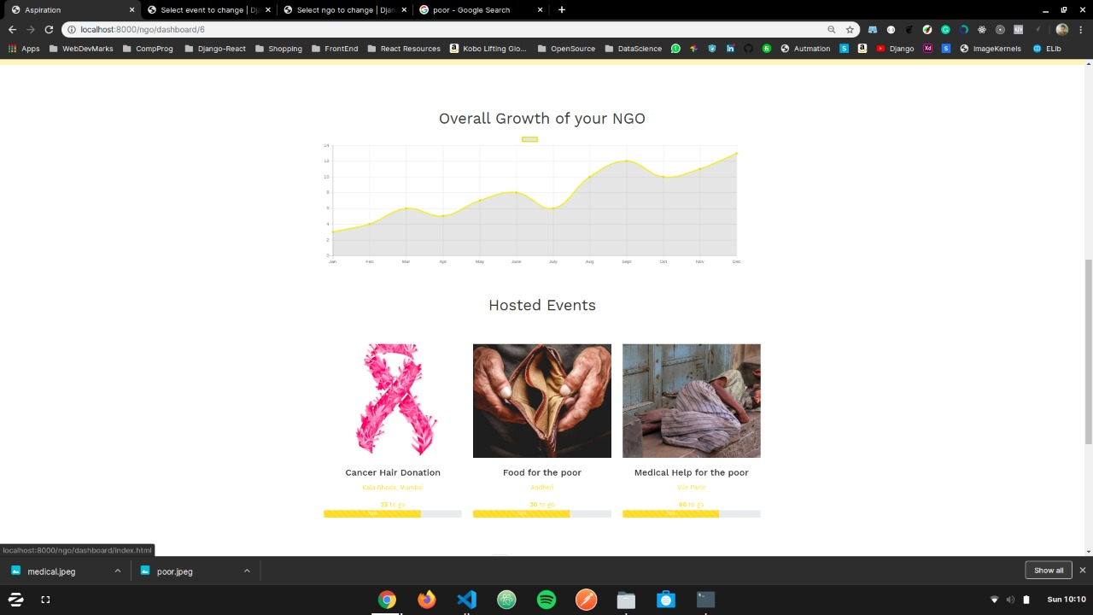
NGO DASHBOARD
Displaying data of past events and growth of the organization

Slide 3
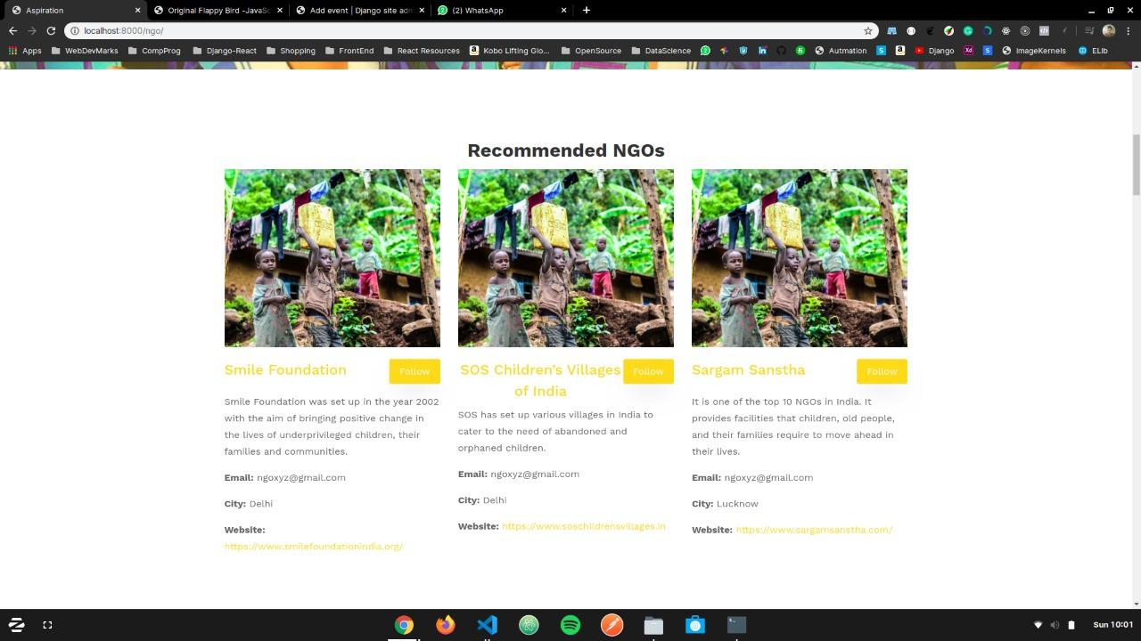
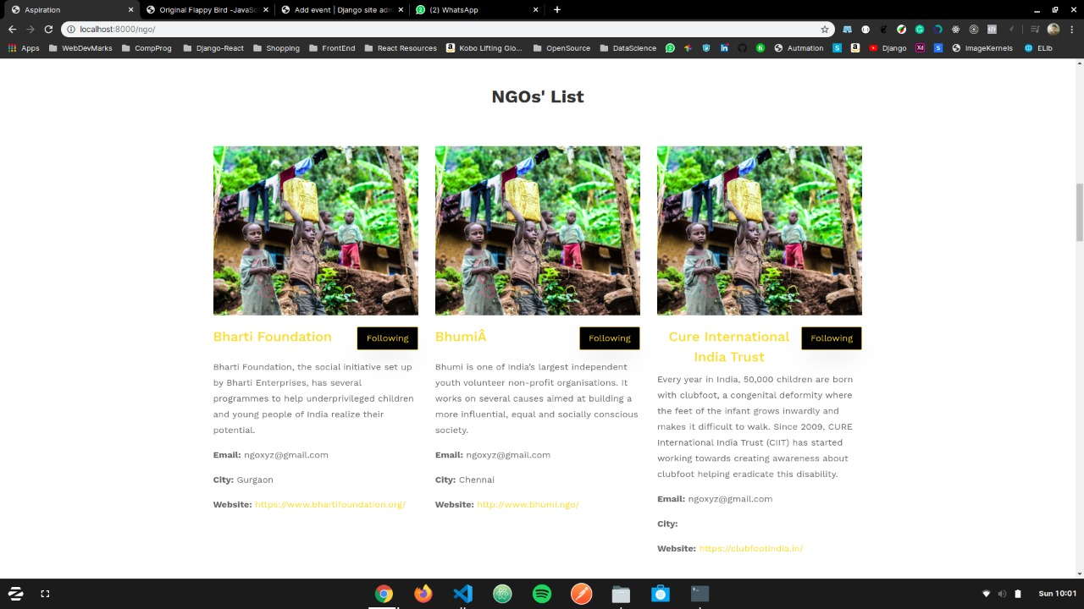
USER HOME PAGE
Users get a view of all NGOs
They can choose to follow any number and based on these, we give them recommendations for other similar NGOs they may like

Slide 4
EVENTS PAGES
Shows list of events coming up by NGOs based on previously attended events, the number of people registered to attend and the timeline of the event
Users can join an event as an attendee or as a volunteer
Email notifications sent to users a day prior to an event they rsvp for
Also updates recommended events based on events a user attends/ volunteers for
We also perform sentiment analysis on tweets to analyse how people are responding to live events taking place
This data is provided as feedback to NGOs

Slide 5
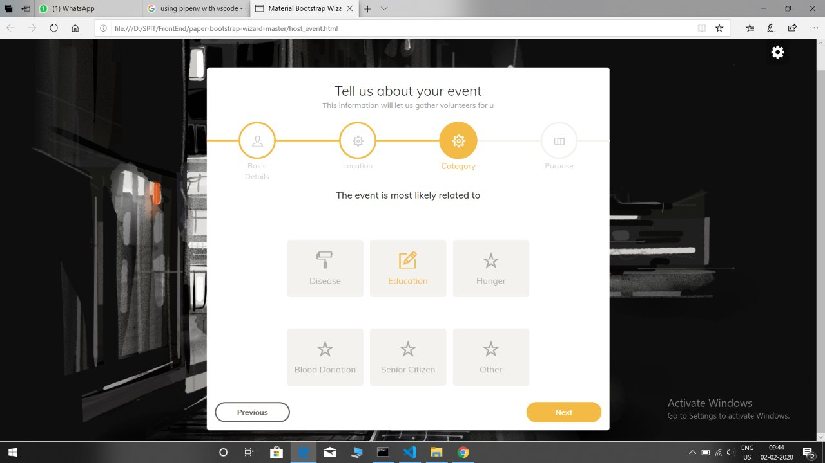
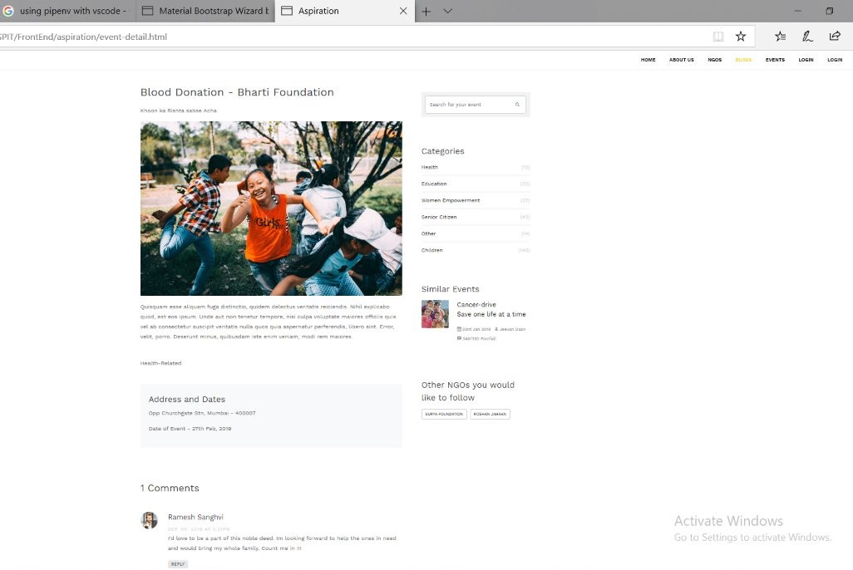

Slide 6
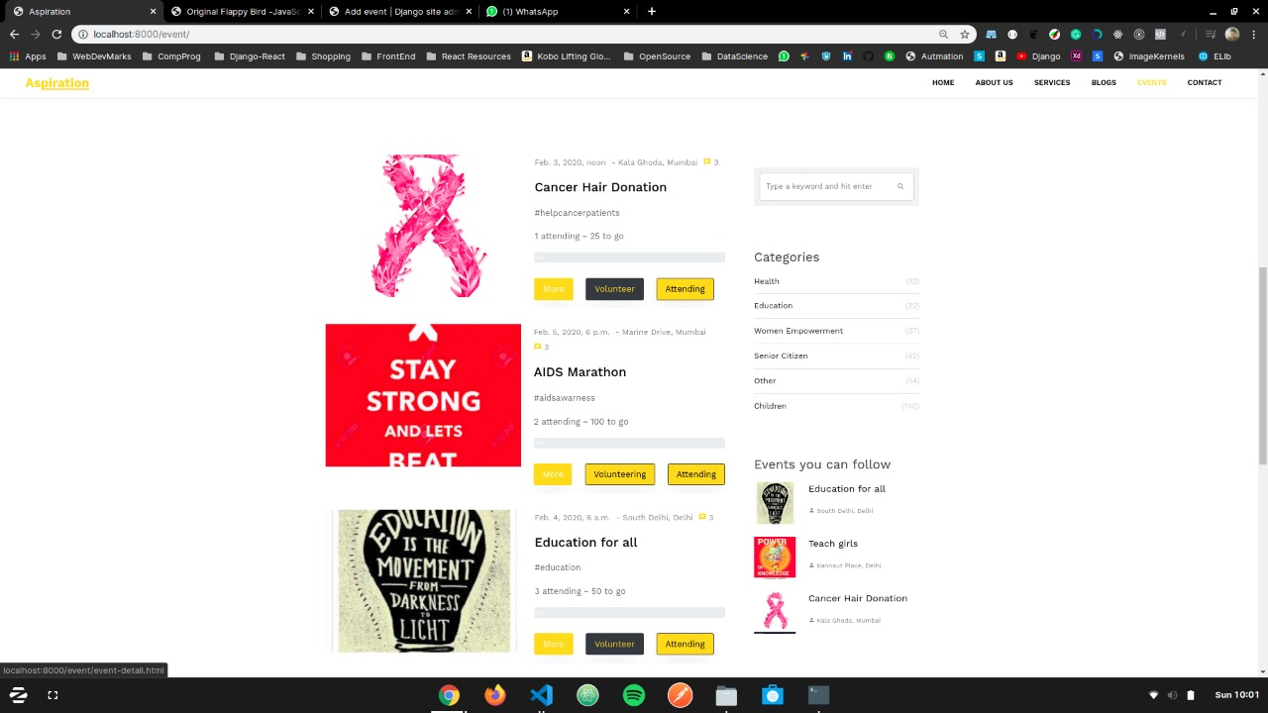

Slide 7
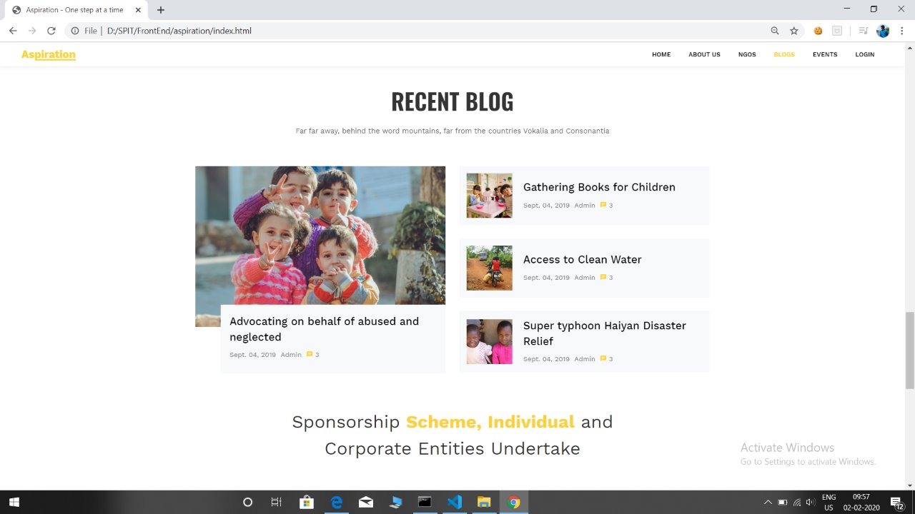
BLOGS

Slide 8
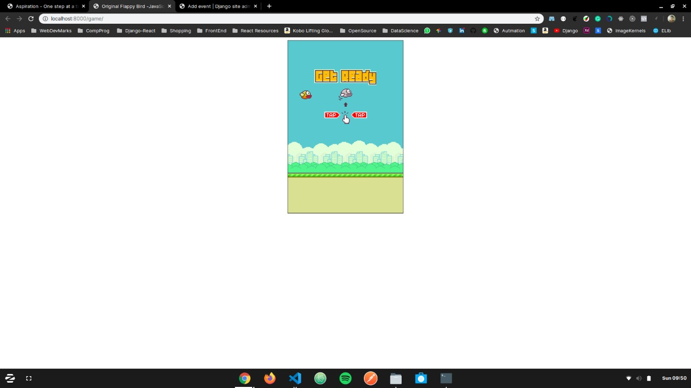
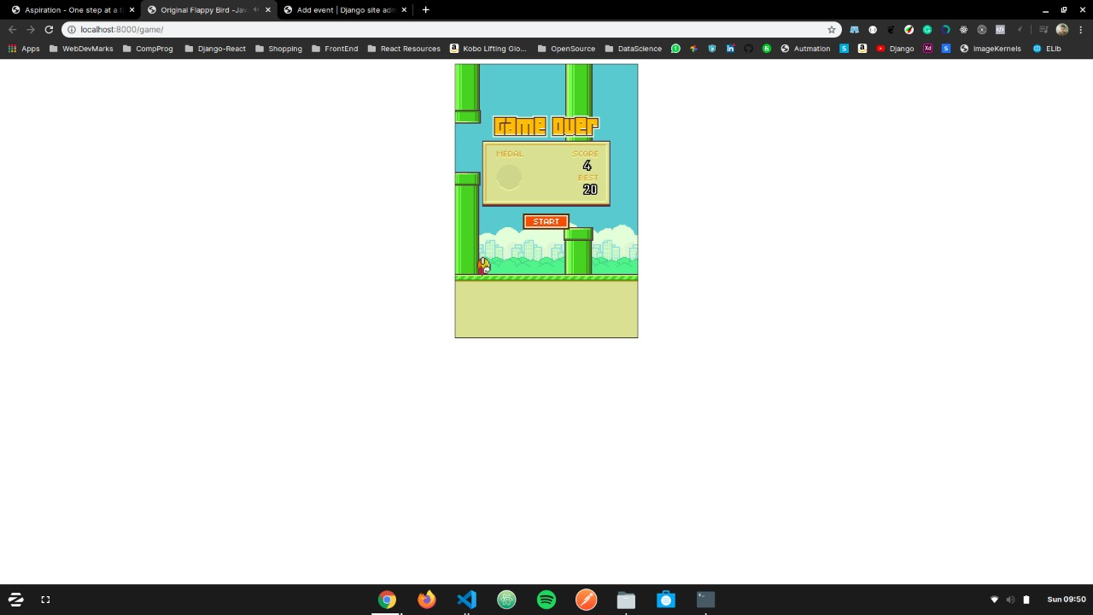
INBUILT GAME
We use an inbuilt game to increase user interaction
The score got from the game are added to the users total points which can be redeemed to attend paid events as well
Revenue generated from ads on the game go as proceeds to the NGOs

Slide 9
TECH STACK
Python
HTML/ CSS
Django
Scikit Learn
Nltk
Javascript
PostgreSQL

Slide 10
FUTURE SCOPE
Allowing users to add comments for events and detect their sentiments so as to provide better wholesome data to the NGOs
Fraud detection for detecting people that try to sign up as a fraudulent NGO
Implement payment gateway for users at directly donate to organizations of their choice

Slide 11
THANK YOU

