Slide 1
Machine Learning Model for Classification of Various Cat Breeds
Cameron V. Adkins
Gabriel A. Abeyie
Purnachandra Anirudh Gajjala
• December 9th, 2022

Slide 2
Overview
Contents
Background
Pipeline
Results
Conclusions, Limitations & Future Work

Slide 3
Background
Image classification is used in computer vision tasks such as object recognition, object detection and image segmentation
The goal of image classification is to categorize images into one of several predefined classes
Our goal was to create a classifier for determining the breed of a cat based on their images

Slide 4
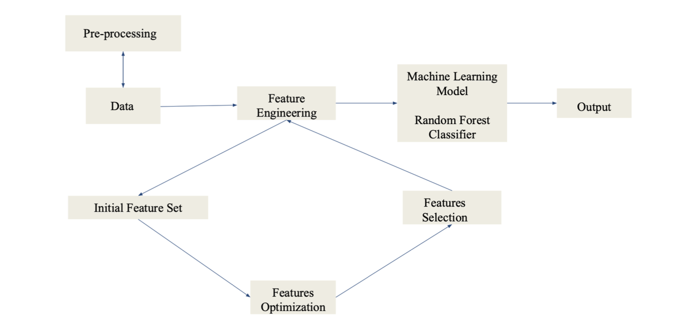
Pipeline

Slide 5
Pipeline
Data/Preprocessing:
Used Oxford-IIIT dataset. It has images of both cats and dogs. For our purposes, we use only the cats, where we have 12 breeds in the dataset, which leaves us with 1187 images among 12 classes of breeds.
Image matte on all the images as a trimap, head bounding box for approx. half of the images
Feature Engineering:
Segmentation - Threshold segmentation, Color-based segmentation, edge detection
Color Histograms
Features: size, coat, color

Slide 6
Results
Model:
Used SMOTE and robust scaler
Random Forest Classifier
Obtained an average cross validation score of 0.35467.
Achieved an accuracy of 31.94% on our model.

Slide 7
Conclusions, Limitations & Future Work
Conclusions:
The accuracy obtained from the model was less than ideal
Takes a significant period of time (roughly 30 min) to complete the pipeline
However, we were able to successfully implement the pipeline
Limitations and Future Work:
For better results, more work required to be done on feature engineering
Two of our three segmentation models ended up unused on our model
Other options such as instance contour generations, position of eyes and nose as well
Implementing the above mentioned points in the model might improve the performance of the model

