Slide 1
Measurement of flow rate, velocity profile and friction factor in Pipe Flow
S. Ghosh, M. Muste, M. Marquardt, F. Stern

Slide 2
Overview
Purpose
Experimental design
Experimental Process
  Test Set-up
  Data acquisition
  Data reduction
  Uncertainty analysis
  Data analysis

Slide 3
Purpose
Provide hands-on experience with pipe stand facility and modern measurement systems including pressure transducers, pitot probes and computer data acquisition and data reduction.
Comparison between automated and manual data acquisition systems.
Measure flow rate, velocity profiles and friction factor in smooth and rough pipes.
Determine experimental uncertainties.
Compare results with benchmark data

Slide 4
Experimental Design
The facility consists of:
Closed pipe network
Fan
Reservoir
Instrumentation:
3 Venturi meters
Simple water Manometer
Differential Water manometer
Pitot Probe
Digital Micrometer (Accurate radial positioning)
Pressure transducer
Computer based Automated Data Acquisition System (DA)
Contraction Diameters (mm): | 12.7 | 25.4 | 52.93
Flow Coefficient, K | 0.915 | 0.937 | 0.935

Slide 5
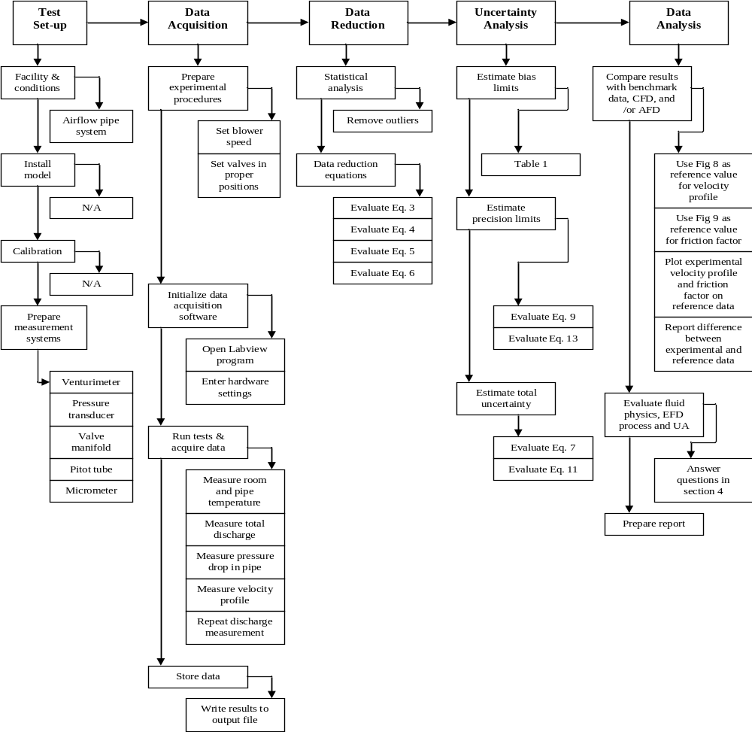
Experimental process

Slide 6
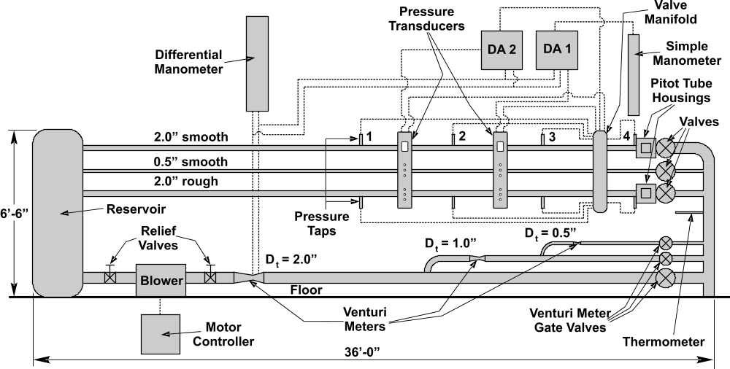
Test set-up

Slide 7
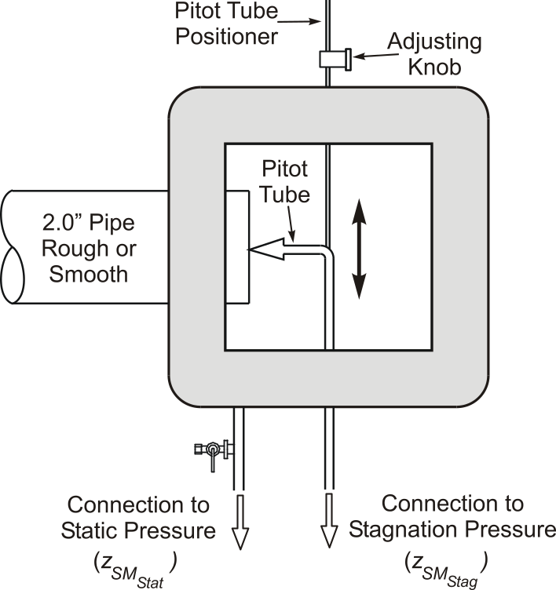
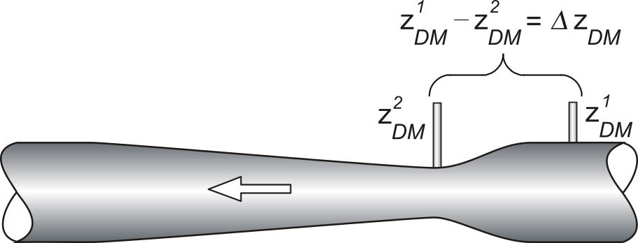
Test Set-up: Venturi meter and Pitot-tube housing
Venturimeter
Pitot-tube housing

Slide 8
Test set-up: Instrumentation
The equipment used in the experiment includes:
Digital thermometer with a range of – 40 to 450 °F and a smallest reading of 0.1 °F for measurement of the environment temperature.
Digital micrometer with least significant digit 0.01 mm for positioning the Pitot-tube inside the pipe.
Simple water manometer with a range of 2.5 ft and a least scale division of 0.001 ft for measurement of the head at each pressure tap along the pipes and for measurement of velocities using the Pitot-tube arrangement .
Differential water manometer with a range 3 ft and a least scale division of 0.001ft for measurement of the head drop across the Venturi meters.
Pressure transducer calibrated with ft of water

Slide 9
Test set-up: Instrumentation
Reservoir: To build up pressure and force the air to flow downstream through any of the three straight experiment pipes. | Digital Micrometer: Allows the measurement of the position of the Pitot probe at different locations along the cross section of the pipe tested
Pitot Probe: Located in the glass-wall box Used to measure the Stagnation pressure and calculate the velocity profile in pipe | Venturi meters: Located on each pipe type Used to measure flow rate Q along the differential water manometer
Pressure Taps: Located along each pipe, they are connected to the simple water manometer to evaluate the head measurement They are used to calculate the friction factor | Manometers: To measure the head at each pressure Tap along the pipe and to make the Pitot-tube measurements (simple Manometer) To measure head drops across the venturi meters (differential Manometer)

Slide 10
Data acquisition
The procedures for data acquisition and reduction are described as follow:
  Use the appropriate Venturi meter, (2” contraction diameter) to measure the total discharge. Increase blower setting from 15% to 35% with 5% increments and measure flow rate using both manometer and pressure transducer.
  Take reading for ambient air (manometer water) and pipe air temperatures.
  To obtain velocity data, use the Pitot-tube box to measure the ambient head and stagnation heads across the pipe. Measure the stagnation heads at radial intervals. The recommended radial spacing for one half of the diameter is 0, 5, 10, 15, 20, 23, and 24 mm.
  Maintaining the discharge at 35%, measure the head along the pipe by means of the ADAS the pressure heads at pressure taps 1, 2, 3, and 4
  Repeat step 2

Slide 11
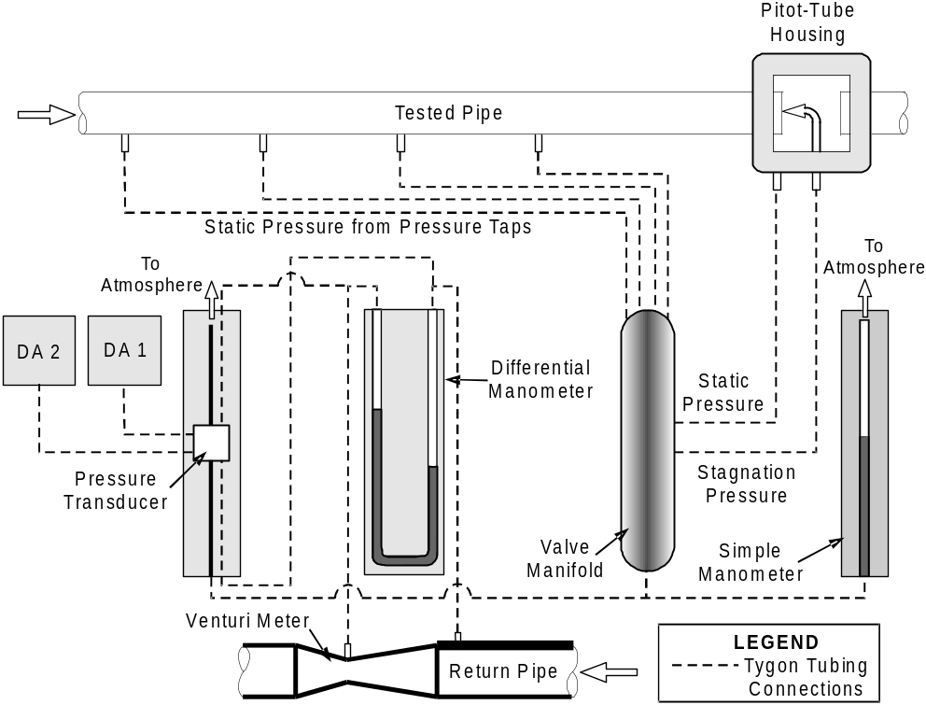
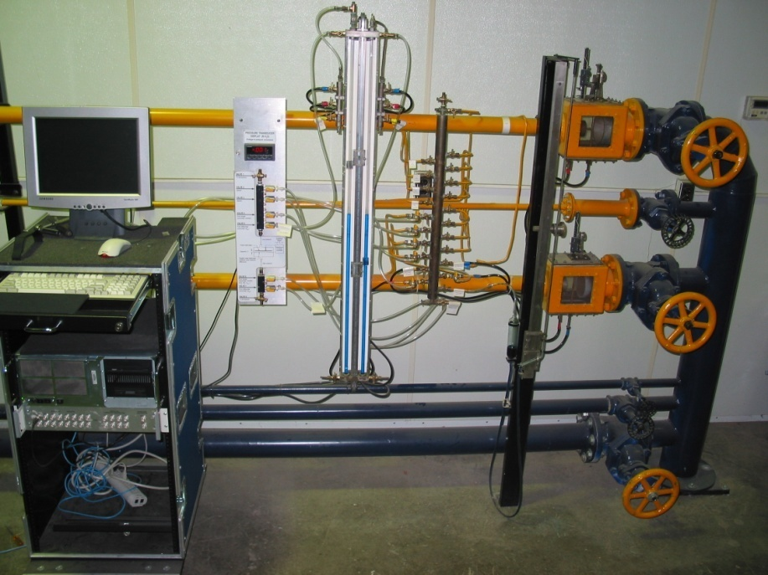
Automated Data Acquisition System
(a)
(b)
Layout of the data acquisition systems: a) photo; b) schematic

Slide 12
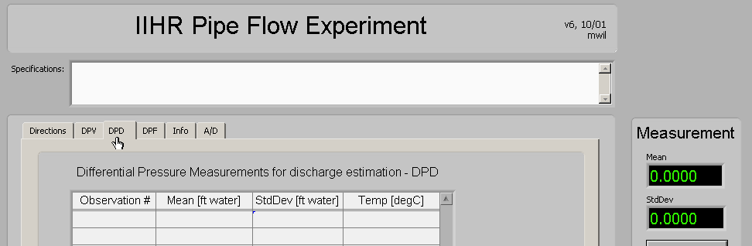
Introduction to ADAS Software - Labview
Front panel on Data Acquisition program

Slide 13
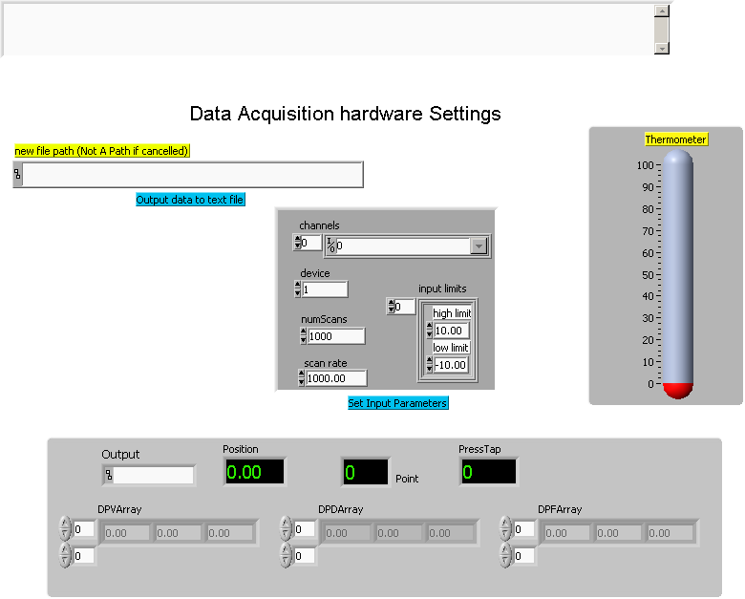
Initial settings

Slide 14
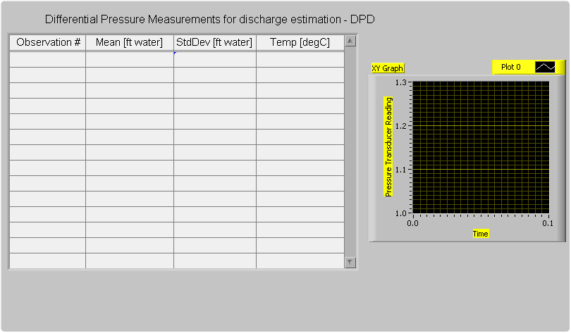
Flow rate measurement

Slide 15
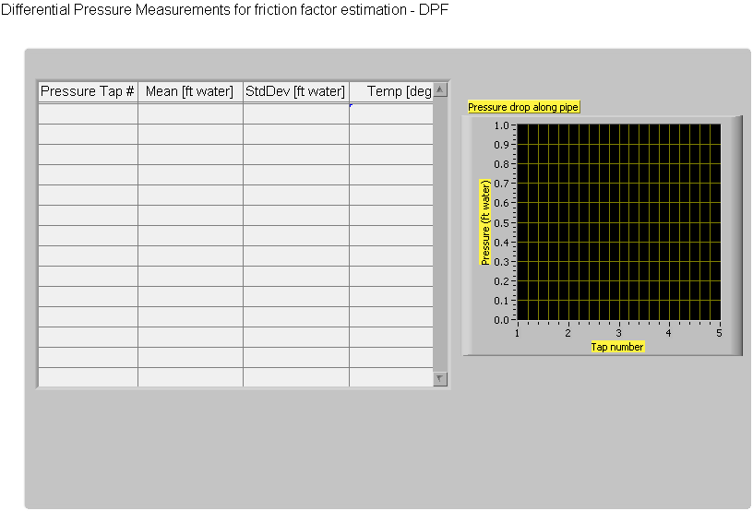
Friction factor measurement

Slide 16
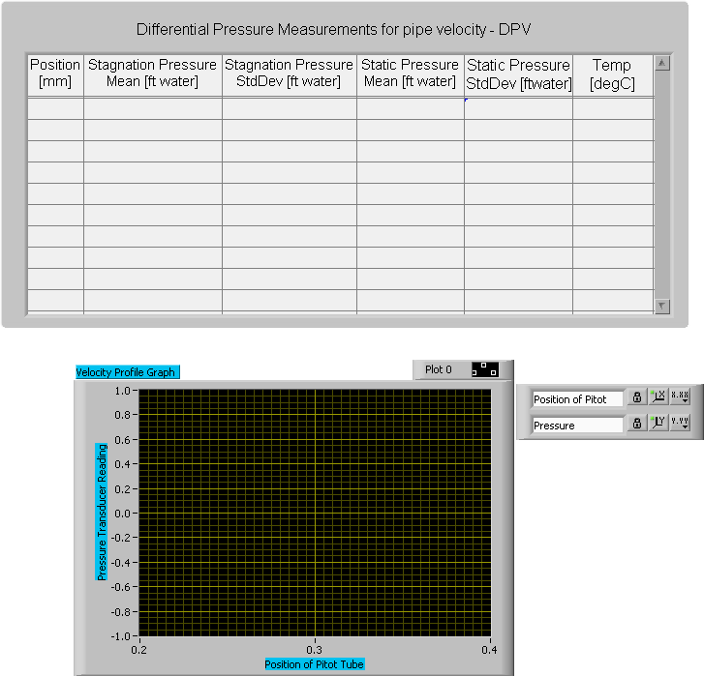
Velocity profile measurement

Slide 17
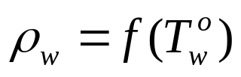


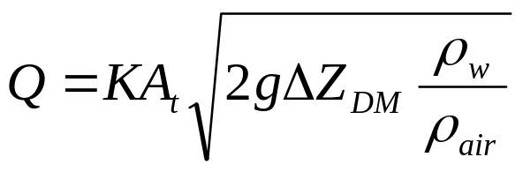
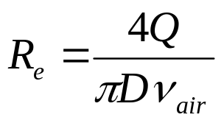
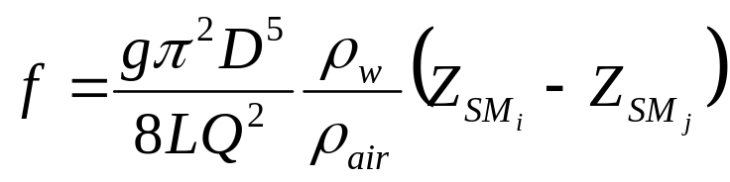
Data reduction
For the flow rate and friction factor, the individual measurements are performed for:
  Ambient air temperature
  Pipe air temperature
  Pipe pressure head
  Venturi meter pressure head drop
The experimental Results are:
  Manometer water density
  Air density
  Kinematic viscosity
  Flow rate
  Reynolds number
  Friction factor
Data reduction equations are:

Slide 18
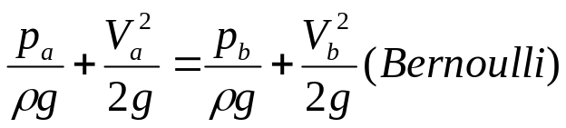
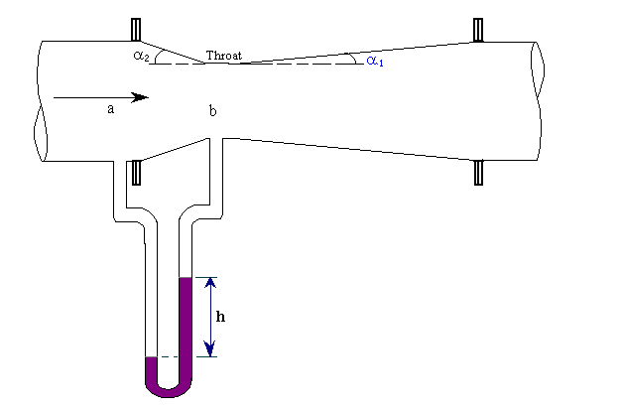

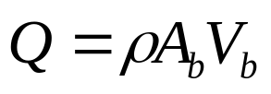
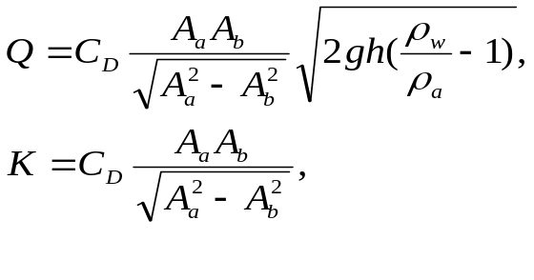
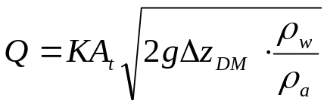
Data reduction equations: Flow rate
Volumetric flow rate
Equation (1), lab handout

Slide 19
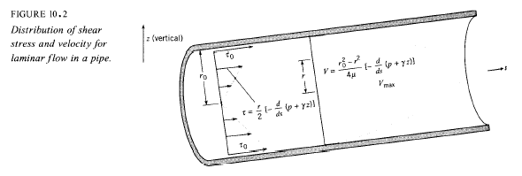
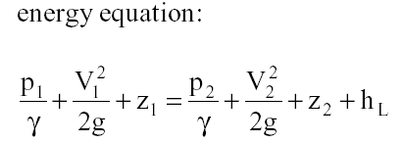
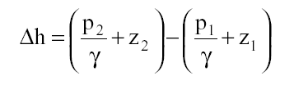


Friction factor

Slide 20
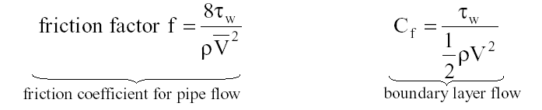

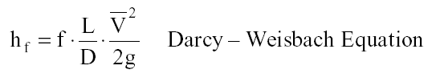
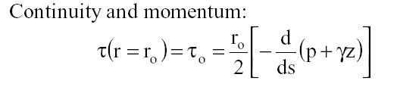
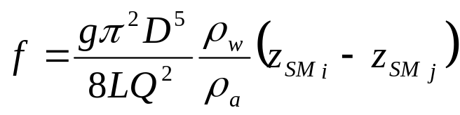

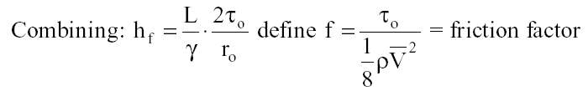
Friction factor (contd.)
Equation 2 is a form of Darcy Weisbach equation
in terms of flow rate Q and pressure drop where,
and A is the pipe cross sectional area.

Slide 21
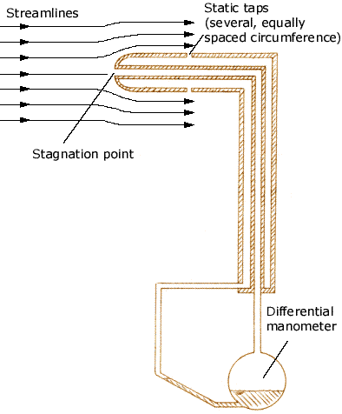
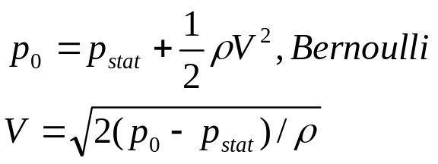
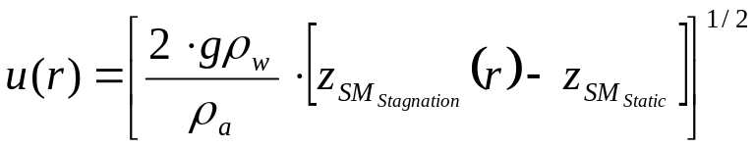
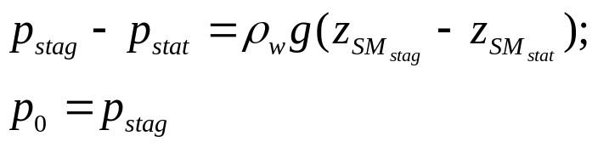
Velocity profile
Equation 3, Exercise notes

Slide 22
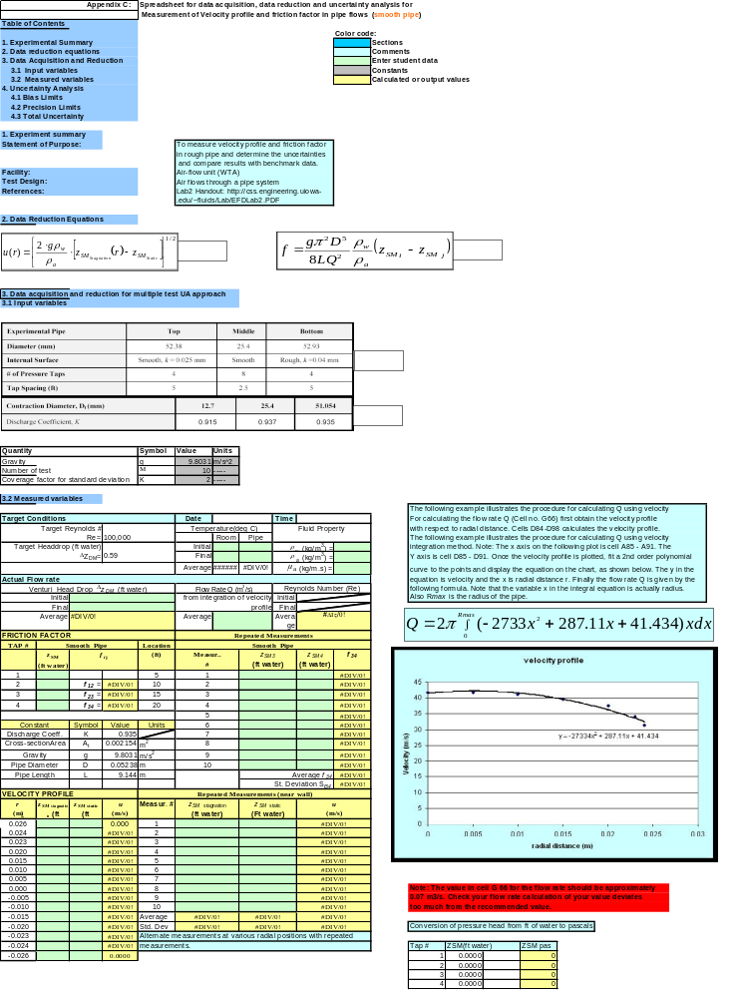
Data reduction: Spreadsheet

Slide 23
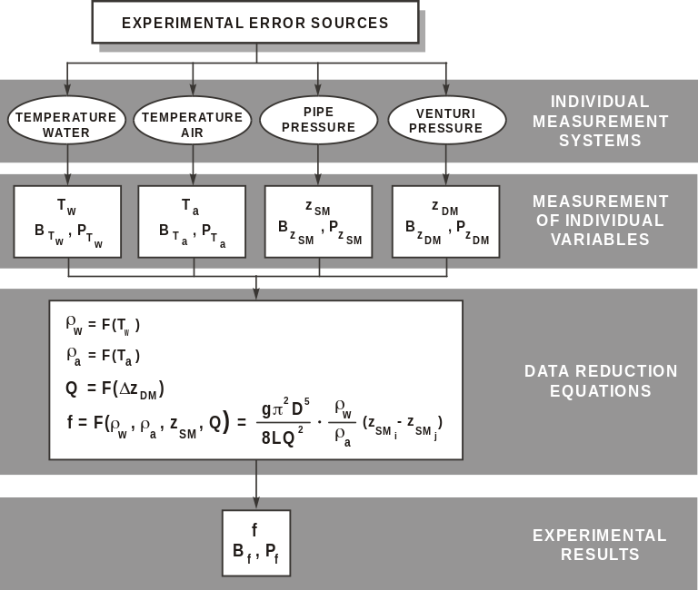
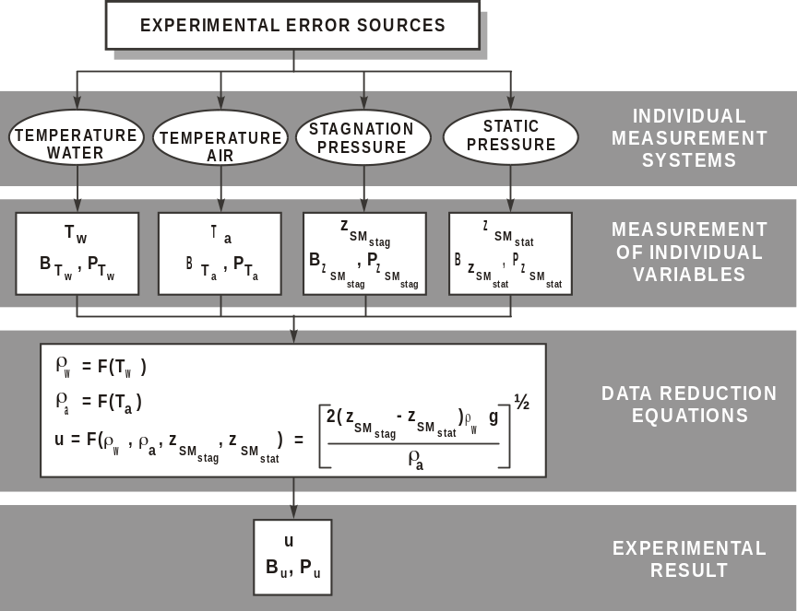
Uncertainty analysis
Block diagram of the experimental determination of the Friction factor
Block diagram of the Velocity measurement

Slide 24
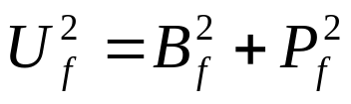
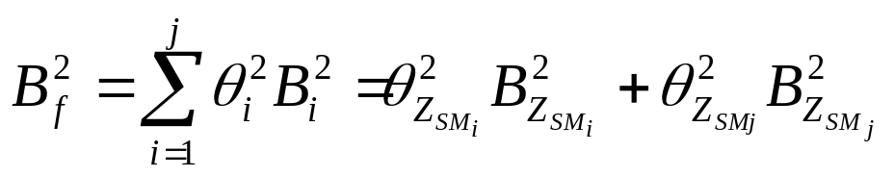
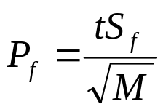
Uncertainty Analysis
The data reduction equation for the friction factor is:
However here we will only consider bias limits for Z_{SM i} and Z_{SM j .} The total uncertainty for the friction is:
The Bias Limit, B_{f} and the precision limit, P_{f}, for the result are given by:

Slide 25
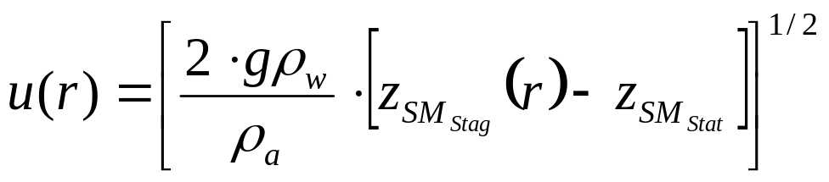
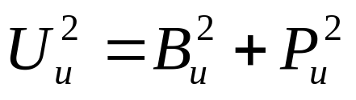
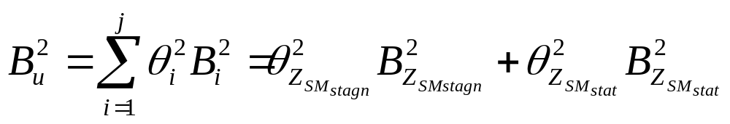
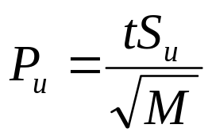
Uncertainty Analysis (continue)
Data Reduction equation for the velocity profile is as follow:

Slide 26
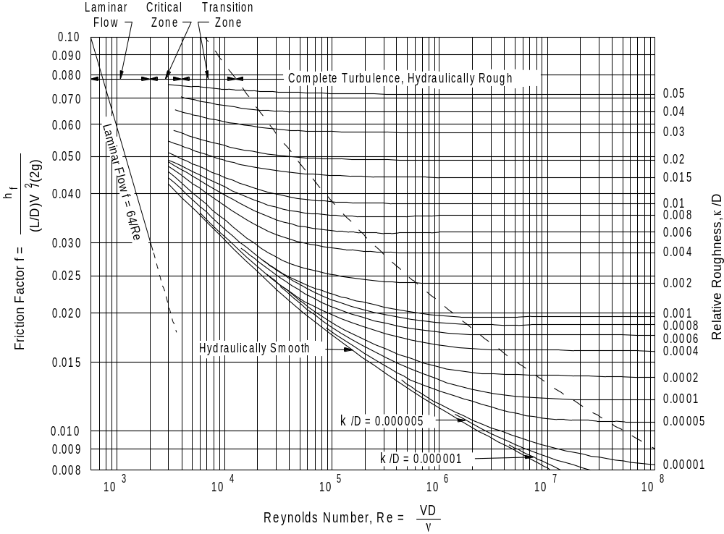
Data Analysis: Results and discussions
Moody Chart for pipe friction with smooth and rough walls
Low speed = 44 m/s
Smooth Pipe (2”) low speed
Rough Pipe (2”) low speed
07/10/03
Benchmark data for Friction Factor

Slide 27
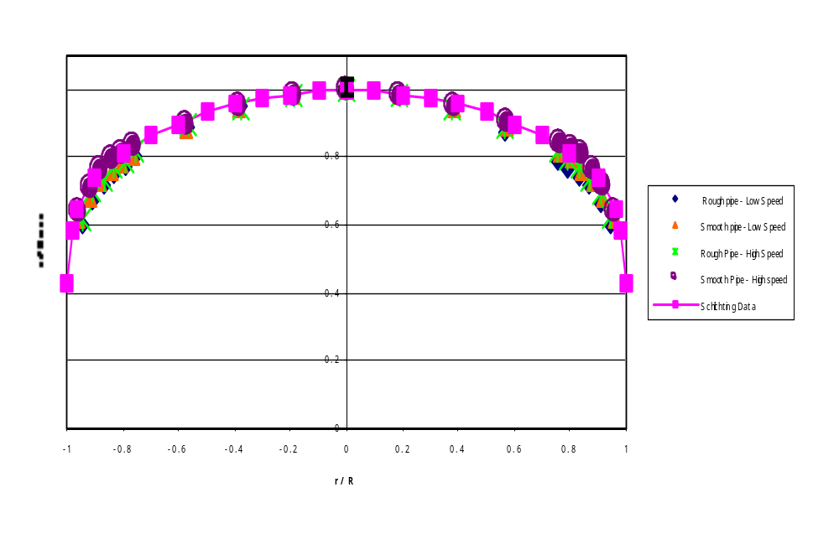
Data Analysis: Results and discussions (contd.)
r/R
u/u_{max}
0.0000
1.0000
0.1000
0.9950
0.2000
0.9850
0.3000
0.9750
0.4000
0.9600
0.5000
0.9350
0.6000
0.9000
0.7000
0.8650
0.8000
0.8150
Low speed = 44 m/s
High speed = 62 m/s
0.9000
0.7400
0.9625
0.6500
0.9820
0.5850
1.0000
0.4300
Benchmark data for velocity profile (Schlichting, 1968)

Slide 28
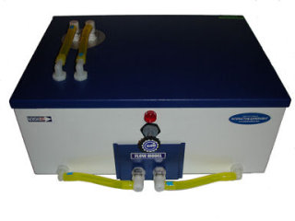
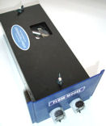

PIV-Particle Image Velocimetry
PIV Process
  Inject flow with Particles
  Illuminate particles with Light
  Take snapshots of the particles with a Camera
  Process Images with Software
PIV Equipment
  Particles : Very small, neutrally buoyant, and “reflective”.
  Light: Generated using lasers, LEDS,… and formed into a thin sheet of light
  Camera: Digital camera capable of taking images at a fast rate
  Images: Show movement of particles with stark contrast
  Software: Analyzes patterns of particles, now pixels, and tracks there displacement

Slide 29
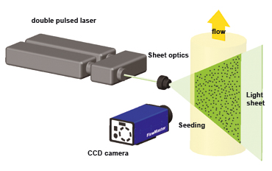
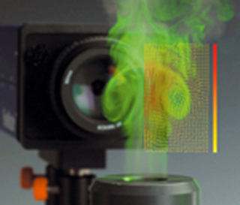
PIV-continued
PIV Fundamentals-abridged
  -PIV measures whole velocity fields by taking two images shortly after each other and calculating the distance individual particles travelled within this time. From the known time difference and the measured displacement, the velocity can be calculated
Benefits of PIV
-Pitot tube, thermal anemometers, laser Doppler velocimetry,…only measure velocity at points of the flow→PIV measures entire cross section or volume of flow

Slide 30
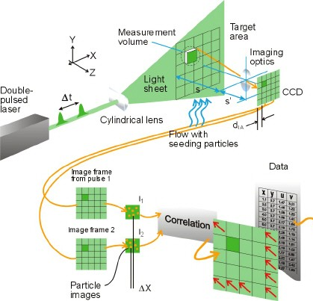
PIV-Continued
PIV Fundamentals-fine details
  Two camera images are divided in to similar small tiles, called interrogation windows.
  A pattern of particles is detected in the interrogation window
  The predominant movement of the pattern from the first image to the second is measured
  The displacement of the pattern from the first to the second image is measured in pixel dimensions
  The spatial dimensions of the image are correlated to the pixel dimensions
  The spatial displacement divided by the time interval of images →velocity

Slide 31
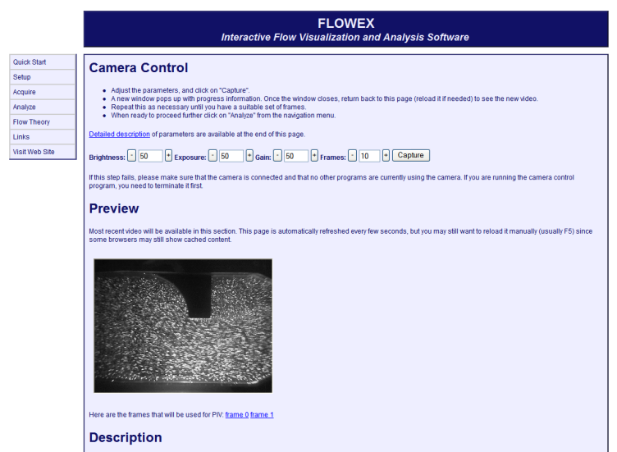


PIV-Continued
PIV uses for Lab 2
  Apply the continuity equation to flow field measurements
  Calculate flow rate across a varying cross section orifice
PIV steps for Lab 2
  Take at least two images of the flow
  Analyze the images
  Extract the raw velocity field measurements
  Sample velocity data from two transverse cross sections of the flow
  Extract the mean stream wise velocity components from each cross section
  Multiply the mean velocity by cross sectional area to find flow rate

Slide 32



PIV-Continued
PIV equations
Stream wise velocity component
Average flow rate

Slide 33
The End

