Slide 1

INFM 600: Information Environments
Week 13: Audience Analysis
Dr. Andrea Wiggins | November 30 & December 1, 2016
<number>

Slide 2
Today’s Episode
Overview
Assignment feedback (pick up at break)
Final project deliverables
Personas & scenarios
Activity: Persona Components
Using personas to make decisions
Break
Activity: Persona-based decision making
Activity: Project audience personas
Reminder: get your discussion posts done!
<number>

Slide 3
PBJ & R Script feedback
PBJ: Pretty good overall!
Only lost points if your instructions would have made a mess; smaller deduction if you had a figure that helped clarify
Awards:
Longest & most detailed: Name Removed
Best figures: Name Removed
Most unusual variation: Name Removed
Safety first: Name Removed
Clean & neat: Name Removed
R Scripts: GREAT JOB!
If you used “data” or “mydata”, consider a different label
Avoid special characters in labels
read.csv(file.choose( ))
<number>
Notes:
PB doesn’t need to be kept in fridge!
<number>

Slide 4
Final deliverables
Presentation
15 minutes per team, make sure you cover key items in syllabus!
Submit repo URL for any files used as presentation materials
Be convincing
Git Repo
All items listed in syllabus + as-is output from today’s activity
Note items 1 & 2 can be combined
Note item #2 where it says “any outputs that it generates”
If you’re not using R for data cleaning, analysis, and/or plotting, make sure your documentation & code are very thorough
Your summary must be very brief & targeted!
Snacks?
<number>

Slide 5

Personas
“A ‘fictitious, specific, concrete representation of target users’ (Pruitt & Adlin, 2006, p. 1) … [that] represents an aggregate of target users who share common behavioral characteristics.” (Maskiewicz & Kozar, 2011)
Origin: Introduced by Cooper in 1999
Quickly adopted by MSFT & Silicon Valley
Expected to produce better product design
Evidence supporting use? Mostly anecdotal
Related concept: scenarios
Description of persona using product
<number>
Notes:
Show of hands: who has covered this topic in another class?
<number>

Slide 6
Example
<number>
Notes:
Always includes a name, a picture, and a narrative
<number>

Slide 7
Activity: Persona Components
Work with a partner you haven’t yet worked with in class
Seriously, get up and find a new partner!
Task: List important details we should include in a persona; not just “field headers” but also content in narrative
2 minutes silent thinking
8 minutes pair discussion
10 minutes round-robin sharing
Result: handy dandy persona template!
<number>

Slide 8
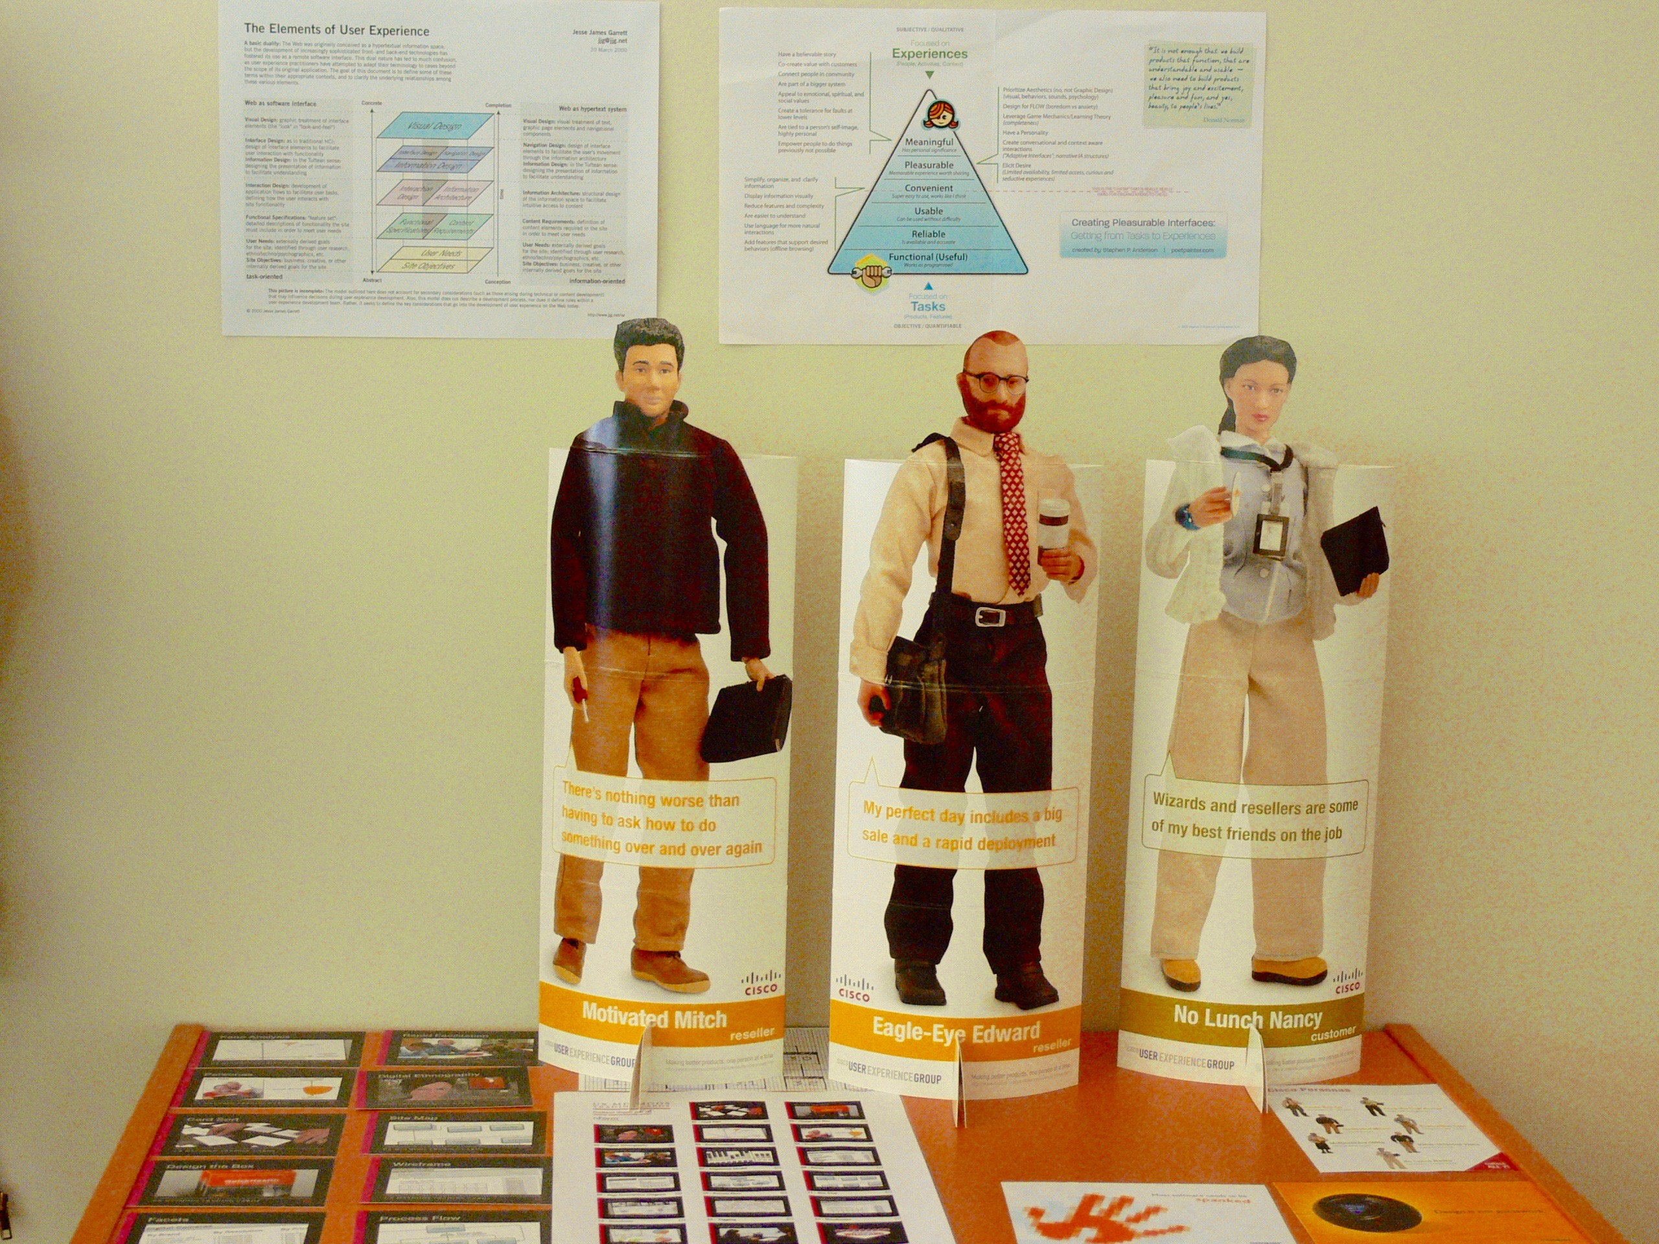
Putting personas to work
<number>

Slide 9
Miaskewicz & Kozar, 2011
Research question: what are personas actually good for?
Delphi study with known experts, iterative brainstorms & ranking
Results: What were some of the benefits of personas?
See Table 3
Audience focus, requirements prioritization, audience prioritization, challenge assumptions, etc.
Broader themes these benefits reflect
Acknowledge & respect stakeholder differences & priorities
Facilitate creative & business processes
Address team decision-making challenges
<number>

Slide 10
Break
10 minutes
<number>

Slide 11
Activity: Persona-based decision making
Two products (circa 2005)
Flickr Organizr: tool within Flickr photo sharing platform
Shazam! FitPlayer: fitness-focused music player software
Step 1: 15 minutes
Review your product details and persona
Create a ranked list of system features for the product
Step 2: 10 minutes
Rotate personas: same product, different user
Repeat ranking task & keep track of changes to feature ranks
Step 3: Report out
<number>
Notes:
7 groups, 1 through 3: Flickr, 4 through 7: FitPlayer
<number>

Slide 12
Activity: Project Audience Personas
Work in your project groups
30 minutes to create a persona for your project presentation
Use the template we created earlier to create a persona
Upload to GitHub & include persona in the final repo as-is
Copy the persona into the shared GDoc
Suggestions:
Don’t spend too much time debating things like name & photo
Focus more on critical details for your presentation
You can add more details if you think they will help
Will give you a heads-up when ~5 minutes left
<number>

Slide 13
Debrief
What components of the persona template were hardest to decide on? Why?
What components will have the biggest impact on your presentation design decisions?
Did this help you identify any specific issues or needs for an effective presentation to this audience?
<number>

