Slide 1

INFM 600: Information Environments
Week 14: People’s Choice – Data Mining
Dr. Andrea Wiggins | December 7 & 8, 2016

Slide 2
Today’s Episode
Overview
R Plot drafts – pick up at break
Data mining definitions & background
Activity: create data mining resource list
Break – sign up for presentation slots for next week
Modern data mining
Discussion: policy implications
Activity: matching data mining techniques to data
Wrap-up & evaluation for Jonathan
End early! (a little)

Slide 3
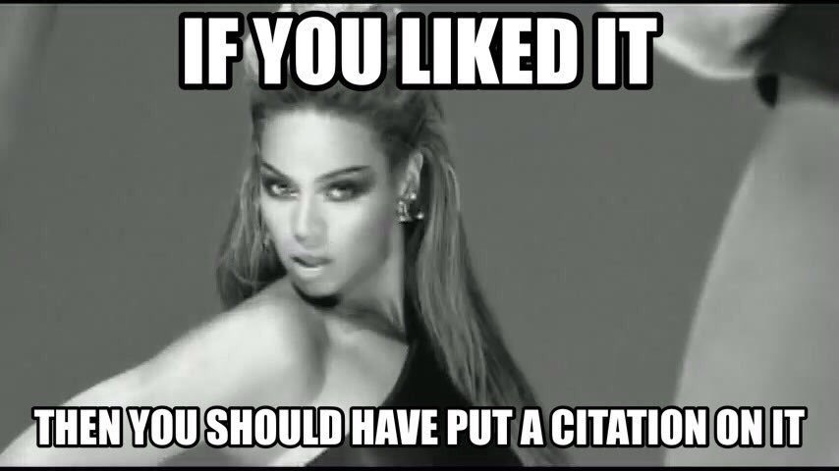
Don’t forget!

Slide 4
Knowledge Discovery in Databases
KDD aka Data mining
“Nontrivial process of identifying valid, novel, potentially useful, and ultimately understandable patterns in data” – Fayyad et al.
Nontrivial: search or inference involved, not straightforward
Process: many iterative steps
Pattern: description of a subset or applicable model (knowledge?)
Data: facts
Primary goals are prediction and description
3 components to any data mining algorithm:
Model representation: language to describe discoverable patterns
Model evaluation: criteria for fitness functions
Search: method for optimizing parameters & models to fit evaluation criteria

Slide 5
Data mining techniques/tools
Fayyad et al. (1996)
Classification
Regression
Clustering
Summarization
Dependency modeling
Change and deviation detection
Decision trees & rules
Chen et al. (2015)
Classification
Clustering
Association analysis
Time series analysis
Outlier analysis

Slide 6
Data mining techniques/tools
Fayyad et al. (1996)
Classification
Regression
Clustering
Summarization
Dependency modeling
Change and deviation detection
Decision trees & rules
Chen et al. (2015)
Classification
Clustering
Association analysis
Time series analysis
Outlier analysis

Slide 7
KDD process
Fayyad et al.
Understand domain
Create target data set
Clean & preprocess data
Data reduction & projection
Match #1 to data mining method
Exploratory analysis, model & hypothesis selection
Data mining: actually searching for patterns of interest
Interpret mined patterns
Act on what you learned
Notes:
How different from project process in this class?

Slide 8
Data mining process
Chen et al.: preparation, data mining, presentation
Integrate data sources
Extract target data
Preprocess data
Mine data
Visualize patterns
Derive knowledge
Biggest differences in processes?
Fayyad et al. point out importance of context & acting on findings
Chen et al. expect visualization as part of process
How well do these processes map to your project process?

Slide 9
Application areas, then & now
In the 1990’s
Marketing
Investment markets
Fraud detection
Manufacturing
Telecom
Data cleaning
Today
e-Commerce
Industry: retail, banking, telecom
Health care
City governance
Examples from Canvas?

Slide 10
Activity: DIY resources
Each group of 3-4 will be assigned a data mining technique
Find a basic definition of the technique: what does it do? When is it used? (don’t forget to credit sources, but full refs not required)
Identify what kind of data this technique/method requires
Create a starter list of resources for learning to use it
R packages & functions
Tutorials & MOOCs
Reference materials of any sort!
Fill in the details and paste in the resources in the GDoc linked from Week 14 module
Notes:
15-20 minutes for activity, 5 minutes to report out on type of data it requires
Classification
Clustering
Association analysis
Time series analysis
Outlier analysis

Slide 11
Break
Sign up for presentation slot

Slide 12
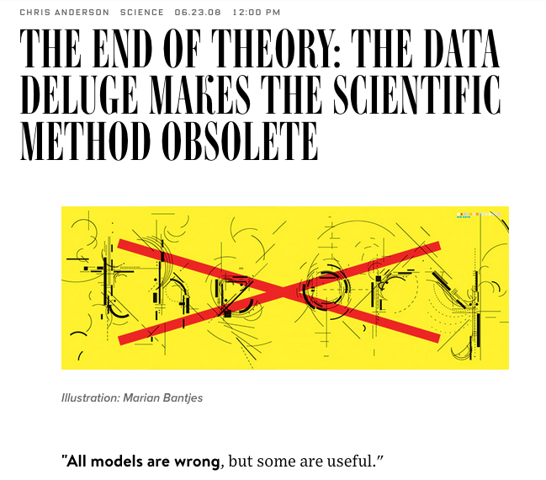
Death of Theory?

Slide 13
Modern Data Mining
More methods and tools available within each category
Highly algorithm-focused
Requires increasing sophistication to apply data mining well
Application areas are much broader (health, gov’t)
Now applied in public sector areas as well as profit-driven
Wider range of potential uses identified
Not mentioned, but important!
AI is involved more and more, with pros and cons
Algorithmic transparency/accountability becoming priority
Still need to understand domain/context for data → knowledge
If anything, data management skills are more important

Slide 14
Challenges in data mining
Fayyad et al.
Bigger and bigger databases
High dimensionality: more attributes/record
Overfitting: signal vs noise
Assessing statistical significance: chance vs meaningful
Changing/dynamic data
Missing & noisy data
Complex relationships between fields
Understanding patterns is hard
Bringing domain knowledge to bear
Systems integration
Notes:
testing many models means some will be significant purely by chance, so is it meaningful?

Slide 15
Modern challenges
Chen et al.
Bigger and bigger databases
Heterogeneous, noisy data
Complex knowledge to extract
Extracting & integrating data from multiple sources
Mining uncertain & incomplete data
Optimization for both data prep & analysis
Frameworks supporting security, privacy, sharing, size, etc.
Systems interoperability
Notes:
Table 1: is there any reason they couldn’t be using all of those functionalities in all of those application areas? Let’s fill in blanks.

Slide 16
Discussion: Data mining & AI
Stats
Fayyad et al. mention potential for AI…
Using NLP methods
Planning to streamline mining
Intelligent agents for data collection
Uncertainty management & interpretation
Knowledge representation (ontologies)
What have we actually seen?
Data mining is now part of AI stack
Techcrunch: all apps are “intelligent”, growth of services for middleware & data prep; trust & transparency issues; need humans involved for best outcomes
TechRepublic: dramatic improvements in deep learning; AI replacing workers (including white collar); IoT; detecting emotion; more advanced recommenders; automated customer service; ethics issues; too white and too male
What else?
Data mining
Machine learning
AI
Notes:
Data mining usually involves humans, has different purposes

Slide 17
Discussion: Policy implications
Most reputable summaries of trends include mentions of…
Unintended consequences (Target story)
Improved performance when humans are involved
Trust, transparency, & ethical oversight
What are some negative consequences of uncritical adoption of data mining & related tech? (any examples from Canvas?)
What are some of the policies that can help address them?
Within organizations
For certain kinds of data
At national levels

Slide 18
Activity: Mining project data?
In your project groups…
Review the info in the GDoc from earlier to get a sense of what each technique offers & what data it requires
Identify which techniques could be used with your project data, what it would accomplish (what would you learn), and why or why not to use it on this data.
Make notes for reporting out at the end!
Note that you could consider trying these out for various student competitions...

Slide 19
Wrap-up
Final assignment rubrics & feedback will be electronic
CourseEvalUM is now open, available via Canvas
Please do provide feedback! It’s a quick form.
Teaching evaluation for Jonathan (anonymous)
Constructive suggestions & opportunities for improvement
Thanks for being a great class!

