Slide 1

INFM 600: Information Environments
Week 3: Turning Data into Information
Dr. Andrea Wiggins | September 14, 2016
Notes:
Welcome back – you’ve survived 20% of the class already! And a rough week with long readings, detailed discussion posts, and an assignment.

Slide 2
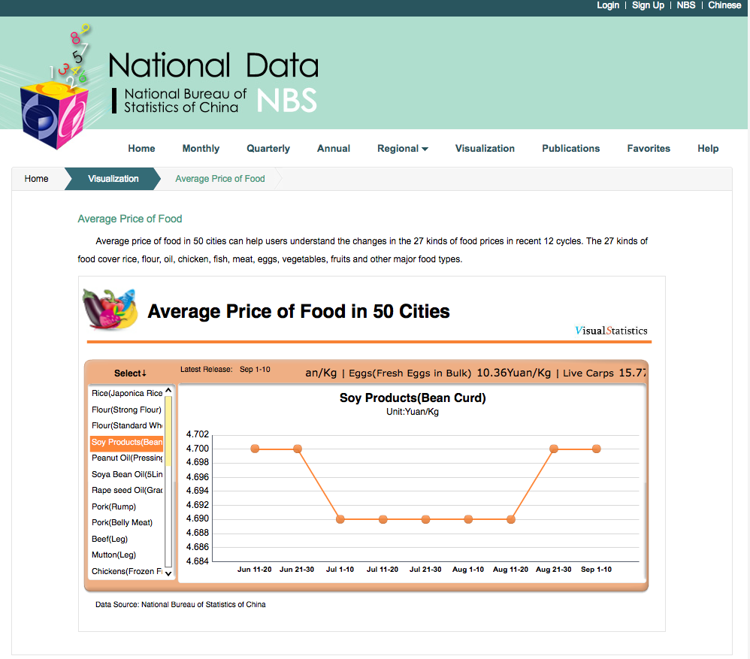
Icebreaker: 1 Data Set You Found

Slide 3
Today’s Episode
Icebreaker ✔️
Overview ✔️
FYI: working out kinks on Canvas
No spoilers for Thursday class!
Info Seeking post-mortem
Context of data production & validity issues
From interesting propositions to interesting questions
Activity: Restructuring questions
BREAK
Activity: Developing research questions that fit the data
With a bunch of sub-parts!
Wrap-up notes

Slide 4
Info Seeking Assignment
What did you find challenging or surprising about this task?
What strategies did you use to find data?
What criteria did you use for selecting data sets?
How did you evaluate licensing?
What was the main take-away for you?

Slide 5
Context of data production
Evans & Schmalensee (paraphrased):
“US Census data have problems. We’re upset because it made extra work for us. Census Bureau needs to do a better job on data documentation, speed of production, and public accountability.”
Yes, and… (check the Canvas discussion!)
Census Bureau staff have more duties than public knows about
Funds & people limited: any data managers on payroll?
Data cleaning & processing are complex
Rising expectations in age of big data
Bureaucracy!
What would you prioritize investing in to make Census data more usable & useful?

Slide 6
Context & validity
What is (digital) trace data? (from Howison et al., 2011)
“Records of activity (trace data) undertaken through an online information system (thus, digital). A trace is...evidence that something occurred in the past.”
“Found data” were created for some purpose other than yours: what does this mean for your analysis?
What types of validity were discussed?
Construct, statistical conclusion, internal, external, face, congruent & discriminant
Chain of reasoning: coherency!
theory/question → concept/construct → operationalization/measure → analysis → result → interpretation
Notes:
Ask for show of hands – did anyone find trace data for their assignments?

Slide 7
10 validity issues: which ones to watch out for?
System & practice issues
Reliability of system-generated data
Conceptualizing relationships (single/multiplex links)
Operationalizing relationships (link intensity/dichotomization)
Interpreting absence (defining non-links)
Temporal aggregation
Temporal mismatch
Black box software (tool effects)
Data completeness & inference
Uncritical interpretation (importation of measure)

Slide 8
10 validity issues: which ones to watch out for?
System & practice issues
Reliability of system-generated data
Conceptualizing relationships (single/multiplex links)
Operationalizing relationships (link intensity/dichotomization)
Interpreting absence (defining non-links)
Temporal aggregation
Temporal mismatch
Black box software (tool effects)
Data completeness & inference
Uncritical interpretation (importation of measure)

Slide 9
Are your questions interesting?
Theories → Propositions ← Questions
Davis’s criteria for interestingness:

Slide 10
Activity: Restructure questions
Count off & pair up
Review questions from your Info Seeking assignments
Not one that was posted on Canvas!
Pick one & reformat like Davis:
“Is what seems to be…<assumption>...in reality...<not-assumption>?”
Example: Is what seems to be a single information behavior, editing Wikipedia, in reality composed of multiple behaviors?
Organization (structure)
Composition (one-many)
Abstraction (universality)
Generalization (localness)
Stabilization (change)
Function (effectiveness)
Evaluation (goodness)
Co-relation (interdependence)
Co-existence (compatibility)
Co-variation (relationship)
Opposition (similarity)
Causation (influence, complexity)

Slide 11
Discussion: Interestingness
Which questions did you find most interesting & why?
What did the questions you formed require you to assume about your audience’s knowledge?

Slide 12
Break
10 minutes

Slide 13
Mega-Activity: Developing Qs
Data set description:
Rows: US states, grouped (& averaged) by region
Columns: state, # customers, avg monthly consumption (kWh), avg price (¢/kWh), avg monthly bill ($ & ¢)
What “types” of data are each of the columns? (NOIR)
What questions can we answer with these data?
What patterns would we expect to see?
Notes:
Write some Qs on board, switch to Excel for live data

Slide 14
Activity: Causal factors
Think-pair-share
2 minutes of SILENT thinking & jotting down your own ideas
8 minutes to share ideas w/ partner
10 minutes for round-robin report-out (share 1 idea @ a time)
What are some other variables that might influence energy consumption besides costs?
What data would you need to test that hypothesis?

Slide 15
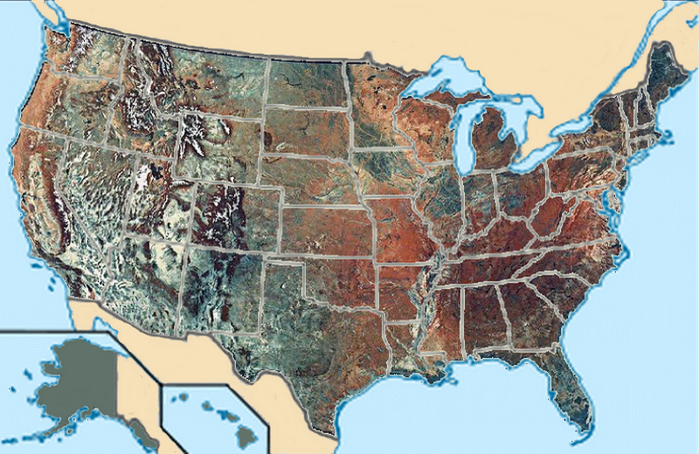
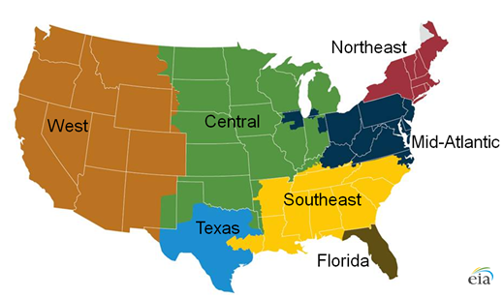
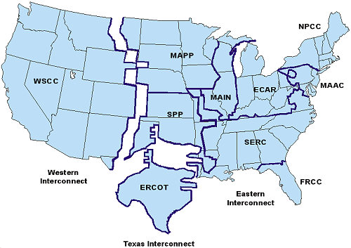
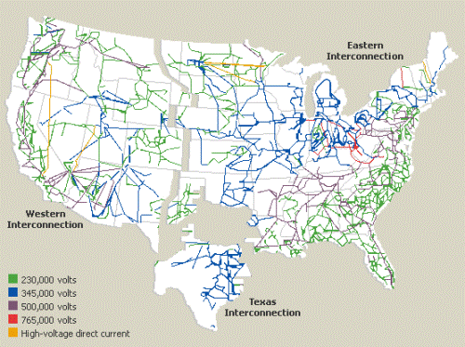
Things that impact energy use
Weather patterns
Gas usage
Daylight hours
Average home size
Average income
Infrastructure
Geography
CC-BY-SA: https://commons.wikimedia.org/wiki/File:800x520_USA_MAP_TOPO.png
Source: U.S. Energy Information Administration
Note: The gray area in Northern Maine is an area of the continental United States that is not connected to the wider U.S. grid
http://northshorejournal.org/solving-the-solar-energy-storage-problem

Slide 16
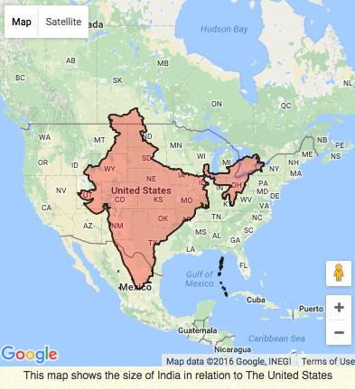
Activity: What about…India?
Also huge
Also has states
Also geographically diverse
Also has lots of data online…
Count off to 6 (groups of 3-4 people)
Review source data
Describe steps to create comparison data set
Identify where data doesn’t quite line up with original
Do you need a different source?
Can you create a reasonably close substitute using other data?

Slide 17
Source Data
http://ter.ps/IndiaData1
http://ter.ps/IndiaData2
http://ter.ps/IndiaData3
http://ter.ps/IndiaData4
Original workbook: http://ter.ps/USdata

Slide 18
Discuss: Causal factors in India
What (additional) factors might impact energy use in India?
Why might it be different in the US (or China)?
What data would you need to verify that?
How did national context impact our hypotheses about household energy use?
For secondary (reused) data, how can we try to establish context for better questions & interpretations?

Slide 19
Wrap-up notes
Next week:
Some of you will be asked to give 1-minute “pitch” on a data set; we’ll let you know as soon as we figure it out
Your team will prioritize data sets in class
Administrivia
Deadline for notice of planned absences: today!
Assignments returned in class & grades on Canvas
Don’t forget discussion posts: not every week will have topics available! (and questions no one answers are likely to come up in class…)

