Slide 1

INFM 600: Information Environments
Week 4: Collaborating with Data
Dr. Andrea Wiggins | September 21, 2016
<number>
Notes:
<number>

Slide 2
Today’s Episode
Overview
Kotlarsky & Oshri – key points & discuss
Activity 1: Iceberg Model Systems Thinking Analysis
Dabbish et al – key points & discuss
Activity 2: Transparent communication
Break – pick up assignments
Discuss Activity 2
Review Info Seeking assignments
Data pitches
Activity 3: Team breakouts
Discuss process & criteria
<number>

Slide 3
Social ties & knowledge sharing
Creating successful distributed IS development teams
Distributed = across time, geography, culture, rank, role, etc.
Technical solutions alone don’t ensure success
What concepts were the focus for Kotlarsky & Oshri (2005)?
Social ties: rapport & trust
Knowledge sharing: transactive memory & collective knowledge
Successful collaboration: product success & personal satisfaction
What were some key strategies for supporting social ties?
In what ways are your INFM 600 project teams similar to & different from the LeCroy & SAP teams in this study?
<number>

Slide 4
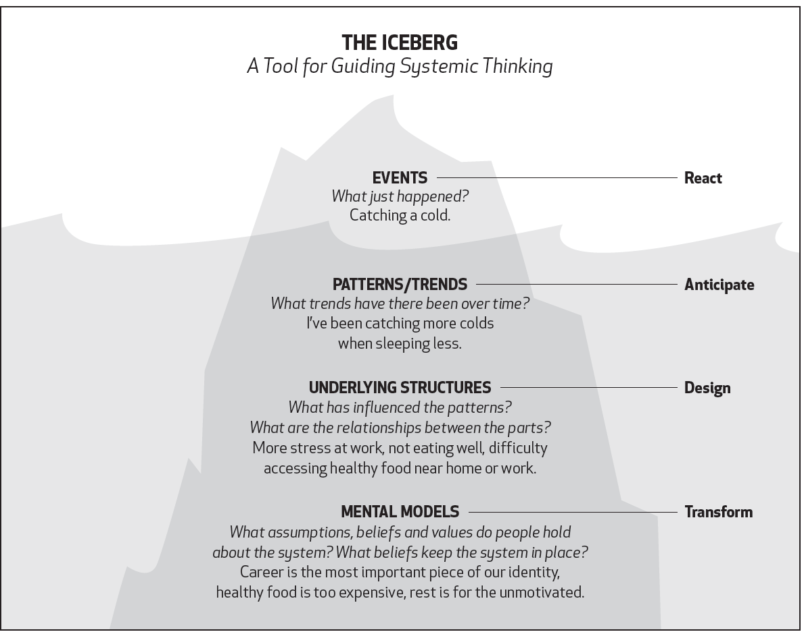
Systems Thinking Analysis
<number>

Slide 5
Activity: Iceberg Model
Count off to 8 (groups of ~3)
Spend 10-15 minutes together to:
Read the scenario (on paper)
Fill in the Iceberg Model analysis worksheet
Make sure you think through themes from Kotlarsky & Oshri
We will report out for a comprehensive model
<number>

Slide 6
Activity: Iceberg Model results
What were the important events in the scenario?
What patterns/trends were apparent or might be inferred?
What underlying structures might be involved? E.g., what could cause those patterns of behavior?
What assumptions and beliefs are represented by your answers to the prior items?
<number>

Slide 7
Social coding on GitHub
Why was transparency good for distributed collaborations?
Social inferences drawn from activity info
Helped users coordinate work, develop skills, manage reputation
What cues & inferences were highlighted?
Recency & volume of activity → interest & level of commitment
Sequence of actions over time → intention behind action
Attention to artifacts & people → importance to community
Details on actions → personal relevance & impact
What inferences might you be tempted to draw from visible cues in your INFM 600 team project repo?
Benefits of transparency: social accountability, ?
Drawbacks of transparency: no lying to teammates, ?
<number>

Slide 8
Activity: Transparent communication
Work individually, quietly! You have about 15 minutes to:
Review your analysis of the scenario
Write an email from Andrew to Charlie
Post it on the Canvas discussion board (by the end of 15 minutes; I’ll give a 5 minute & 2 minute warning.)
Your post will count for your participation grade for today
As you compose your message, make sure you consider...
Your Iceberg Model analysis
How social ties support collaboration success
The potential consequences & benefits of transparency in project management communication
<number>

Slide 9
Break
Pick up graded assignments from front of room
<number>

Slide 10
Transparency in Practice
Take 3 minutes to quickly skim everyone’s posts in the discussion thread (add likes if you like)
How did transparency impact what you wrote?
Did you consider &/or highlight social or technical issues?
What priorities do these messages convey?
Other points?
<number>

Slide 11

Info Seeking assignments
#1 problem: didn’t read the syllabus!
Missing headers
Didn’t put your name on it
Didn’t use Times New Roman
Lots of spelling & grammar errors (turn on spell/grammar check)
Minor citation & license issues
ALL URLS REQUIRE A “RETRIEVED BY” DATE, EVERY TIME
All data sets have creators/publishers (you can make reasonable assumptions when not specified)
Licenses other than standard ones (e.g., CC-any, ODBL) need a short summary; even standard licenses should be described!
https://www.pinterest.com/ProfSalam/advice-for-college-students/
<number>

Slide 12
Info Seeking assignments
Data sets were generally OK
Lots of repetition: I can tell which ones are “easy” to find
Many would be more interesting if they had a local focus!
NEARLY ALL needed more description of actual contents of data
Reduced penalty for lack of detail due to lack of clarity in syllabus
Consider audience (me) & purpose (data for team projects)!
Questions
Do questions have question marks?
Some are not answerable with data (as described), but very few noted where additional data are needed
Many are “simple” descriptives, but intro to interesting questions
<number>

Slide 13
Data pitches!
Removed list of 10 student data pitches and their titles.
<number>

Slide 14
Activity: Team breakouts
With your project team, create a team project repo on GitHub (anyone can be owner)
Suggestion: grant everyone commit access – later
List your top 4 priorities of data sets in order of preference
Number each one according to rank
For #1 & #2, you may include up to 4 sentences on why you want this data set &/or what questions you would answer
Paste your priorities into a .txt file & commit to GitHub repo
Email URL for team GitHub repo to wiggins@umd.edu with subject “INFM 600 Team project repo” BY THE END OF CLASS
You can also request a new team name of your choosing (for the next week) by email to brierjon@umd.edu
<number>

Slide 15
Discuss: Collaborative process
What were some of your criteria for prioritizing data sets?
Why were you more interested in some data than others?
Did your group…
Make sure that everyone’s opinions were heard?
Take available skills into consideration?
Look for available documentation?
Try an elimination process to rule out data sets?
Other strategies?
<number>

Slide 16
Parting Notes
No office hours next week
I’ll be in Indiana at a Midwest Big Data Hub workshop
<number>

