Slide 1
Capital Bikeshare
TEAM FABULOUS

Slide 2
Introduction
Capital Bikeshare puts over 3500 bicycles at your fingertips.
Services Over 400 stations across Washington, D.C., Arlington, Alexandria and Fairfax, VA, and Montgomery County, MD.
Plans available for a day, 3 days, a month, a year, and have access to our fleet of bikes 24 hours a day, 365 days a year.
The first 30 minutes of each trip are free.
Our project, in brief, aims to find out the possible factors that affect the bike ride count for Capital Bikeshare.

Slide 3
Target Audience
As the research helps to draw line between the factors that affect the bike ride counts, the outcome of the research would be beneficial to Capital Bikeshare Business Team.
Research outcomes will help Capital Bikeshare to make informed decisions to improve business.
We are testing factors that may have like:
Weather conditions (Temperature and dew point)
Time of the day (hourly trend)
Location of stations

Slide 4
Research Questions
How does the weather conditions effect bike trips?
If temperature and dew point play any role in the increase or decrease in bike ride count.
What are the peak hours on bike trips in a day?
Identify bike ride trend with respect to time.
How strongly/feebly the station location plays a role in bike trips?
Identify stations involved in frequent to-fro bike rides.
If distance between station influences bike ride count.
How does the national holidays impact the bike ride counts?
Identify if social events have influence on the bike ride count.

Slide 5
Datasets
Capital Bikeshare
These datasets were provided by Capital Bikeshare.
Contain bike-ride details for the period of 2010 to 2016.
In total there are seven columns including the information of start date with time, end date with time, start station, end station, bike ID, etc.
About 15,000,000 rows of data.
Holiday Schedule
This dataset was created by us from the holiday list published on dc.gov.
It is a minimalistic data set that contains details like date and event/holiday name for the years 2010 through 2016.

Slide 6
Datasets
Station Details
This dataset was provided by Capital Bikeshare.
Contains detailed information for 408 stations.
Provided in XML format, converted to excel for usability.
Weather History
These datasets were provided by Weather Underground.
Contain the weather conditions in Washington D.C. Metro area from Oct 1, 2010 to Jun 30, 2016 (in total of 2100 rows).
Dataset originally spreads in six different files for each year 2010 through 2016.

Slide 7
Data Processing
Unnecessary columns were dropped.
Many of the values were formatted correctly, and some rows with missing values were dropped, as no significant change would be visible due to the huge datasets.
Huge datasets (eg. Bikeshare Data) were cleaned by SQL Server and stored in phpMyAdmin.
We extracted data in .csv format from phpMyAdmin as per the analyses test requirements.

Slide 8
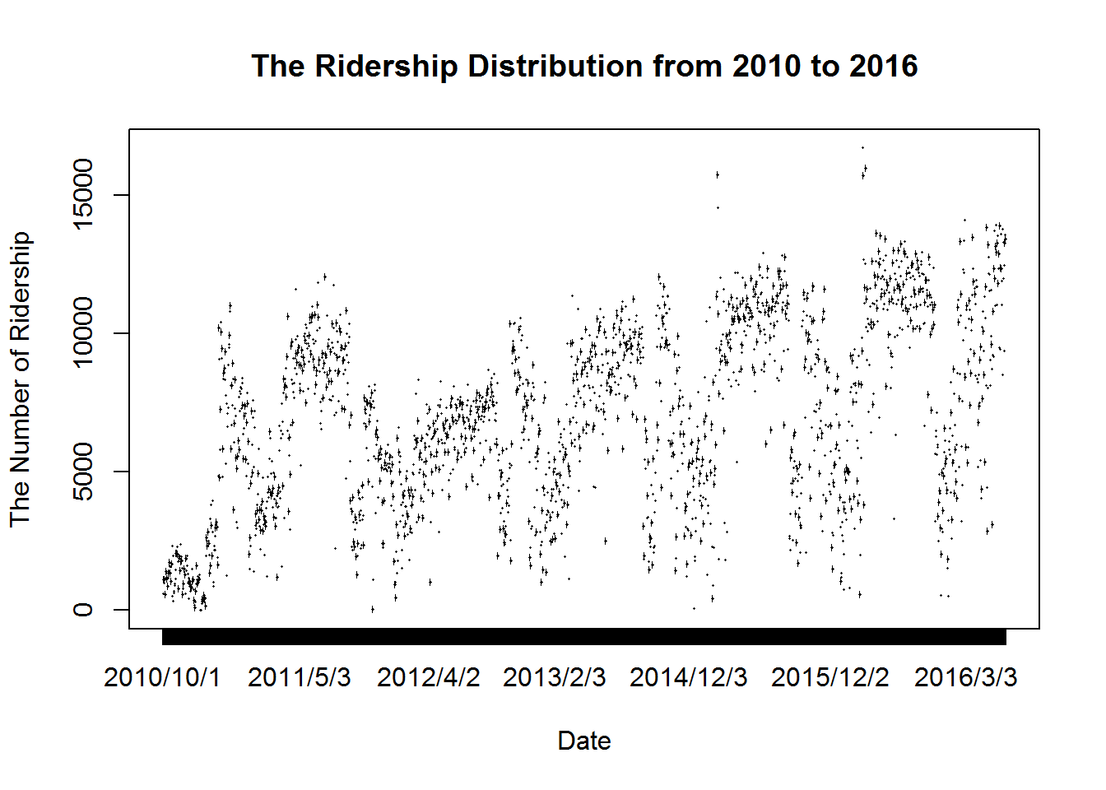
Outlier Analysis
Date | Ride Count | Reason
2014/4/12 | 15755 | Cherry Blossom Festival
2014/4/13 | 14578
2015/4/11 | 16726
2015/4/12 | 15724
2015/4/18 | 16004
2016/3/26 | 14116
Outliers
Based on official Cherry Blossom Calendar: http://www.nationalcherryblossomfestival.org/about/bloom-watch/

Slide 9
Analysis
How does the weather conditions effect bike trips?
IV – Temperature, Dew Point
DV – Bike Ride Count
As both the IV and DV are continuous (ratio) hence we performed Multiple Regression test to identify association between them.
Coefficientsª
Model |  | Unstandardized Coefficients |  | Standardized Coefficients | t | Sig. | 95.0% Confidence Interval for B
 |  | B | Std. Error | Beta |  |  | Lower Bound | Upper Bound
1 | (Constant) | -2144.664 | 224.145 |  | -9.568 | .000 | -2584.232 | -1705.096
 | mean_temperature | 238.743 | 8.765 | 1.240 | 27.238 | .000 | 221.554 | 255.932
 | mean_dew | -111.504 | 8.170 | -.621 | -13.649 | .000 | -127.525 | -95.483
a. Dependent Variable: rides

Slide 10
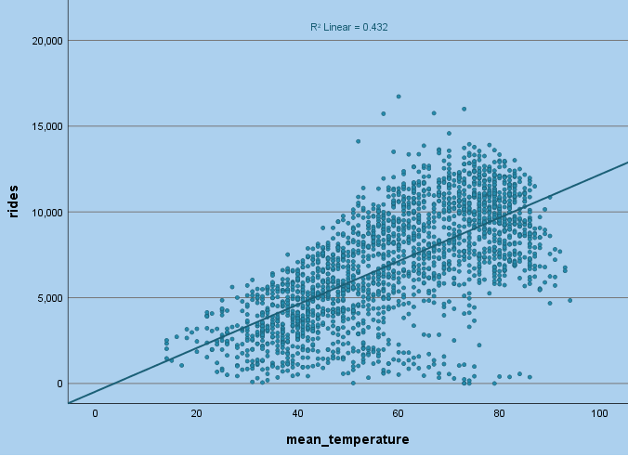
Temperature has moderate positive linear relationship with Bike Ride Count.

Slide 11
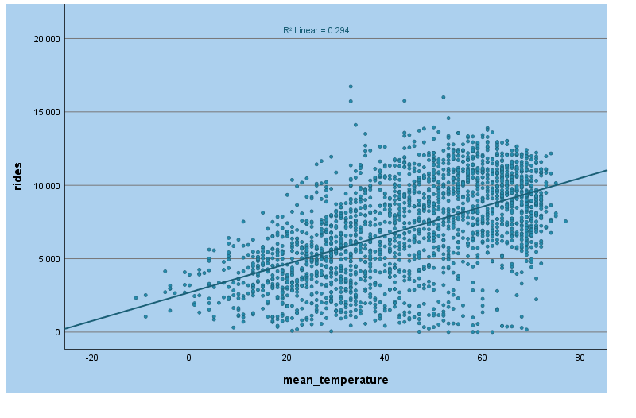
Dew Point has moderate positive linear relationship with Bike Ride Count.

Slide 12
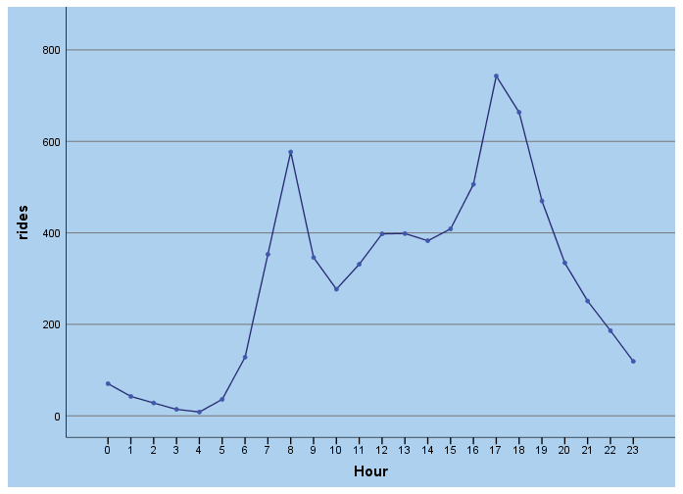
Analysis
What are the peak hours on bike trips in a day?
IV – Ride Count
DV – Ride Start Date
Test of Homogeneity of Variances
Ridership
Levene Statistic | df1 | df2 | Sig.
1467.671 | 23 | 50080 | 0.000
ANOVA
Ridership
 | Sum of Squares | df | Mean Square | F | Sig.
Between Groups | 2135852486.596 | 23 | 92863151.591 | 2007.414 | 0.000
Hence we can say that office work hours do influence ride count !!

Slide 13
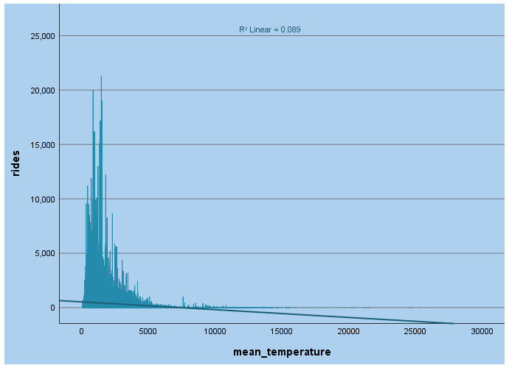
Analysis
How strongly/feebly the station location plays a role in bike trips?
IV – Ride Count
DV – Linear distance between stations
Correlations
 |  | Ridership | Distance
Ridership | Pearson Correlation | 1 | -.299**
 | Sig. (2-tailed) |  | 0.000
 | N | 37650 | 37650
Distance | Pearson Correlation | -.299** | 1
 | Sig. (2-tailed) | 0.000
 | N | 37650 | 37650
**. Correlation is significant at the 0.01 level (2-tailed).
There is a negative relationship between ridership and distance.

Slide 14
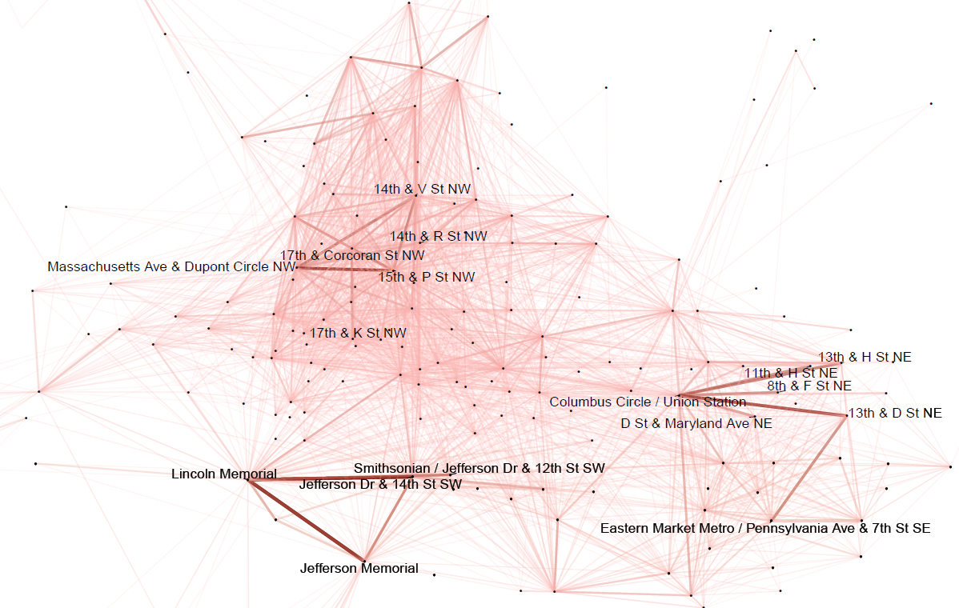
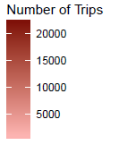
Popular Bicycle Routes

Slide 15
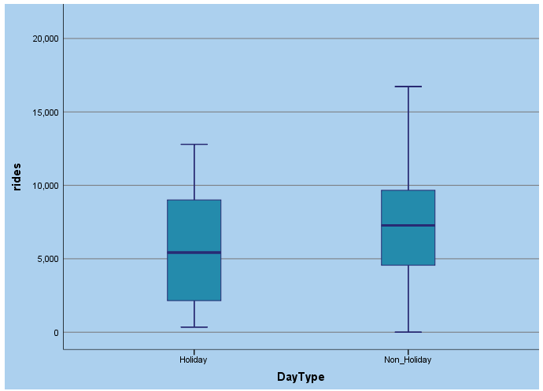
Analysis
How does the national holidays impact the bike ride counts?
IV – DC Holiday Dates
DV – Bike Ride Count
As seen in the graph, it is surprising that the number of ridership on holiday is smaller than the number on non-holiday, contrary to our expectations.

Slide 16
Analysis
The data was normally distributed with slight skews but satisfies the assumptions for T-test:
Independent Samples Test
 |  | Levene's Test for Equality of Variances |  | t-test for Equality of Means
 |  | F | Sig. | t | df | Sig. (2-tailed) | Mean Difference | Std. Error Difference | 95% Confidence Interval of the Difference
 |  |  |  |  |  |  |  |  | Lower | Upper
Ridership | Equal variances assumed | 8.248 | .004 | 3.391 | 2109 | .001 | 1416.788 | 417.828 | 597.390 | 2236.185
 | Equal variances not assumed |  |  | 2.910 | 65.875 | .005 | 1416.788 | 486.927 | 444.573 | 2389.003
As the P-Value is less than α (0.05), we reject null hypothesis. Hence, can say that a day being holiday/non-holiday influences the bike ride count.

Slide 17
Assumptions
Distance calculated is linear and not route based. Google MAP API restricts to process only 2500 elements for free. So for more accurate results Google MAP API would be useful.
Data has some outliers but considering the overall dataset size that can be accepted.

Slide 18
References
Capital Bikeshare: W., C. (2016). Exploratory Data Analysis of Capital Bikeshare. Retrieved October 5, 2016, from https://s3.amazonaws.com/capitalbikeshare-data/index.html.
Holiday Schedule: Holiday Schedules | dchr (A. Parihar, Trans.). (n.d.). Retrieved October 07, 2016, from http://dchr.dc.gov/page/holiday-schedules.
Station Details: Live XML - feeds.capitalbikeshare.com (Y. Liu, Trans.). (n.d.). Retrieved October 28, 2016, from https://feeds.capitalbikeshare.com/stations/stations.xml
Weather History:
2010: Weather UnderGround. Weather History for Washington, DC | Weather Underground. Retrieved October 9, 2016, from https://www.wunderground.com/history/airport/KDCA/2010/10/1/CustomHistory.html?dayend=31&monthend=12&yearend=2010&req_city=&req_state=&req_statename=&reqdb.zip=&reqdb.magic=&reqdb.wmo=&format=1
2011: Weather UnderGround. Weather History for Washington, DC | Weather Underground. Retrieved October 9, 2016, from https://www.wunderground.com/history/airport/KDCA/2011/1/1/CustomHistory.html?dayend=31&monthend=12&yearend=2011&req_city=&req_state=&req_statename=&reqdb.zip=&reqdb.magic=&reqdb.wmo=&format=1

Slide 19
References
2012: Weather UnderGround. Weather History for Washington, DC | Weather Underground. Retrieved October 9, 2016, from https://www.wunderground.com/history/airport/KDCA/2012/1/1/CustomHistory.html?dayend=31&monthend=12&yearend=2012&req_city=&req_state=&req_statename=&reqdb.zip=&reqdb.magic=&reqdb.wmo=&format=1
2013: Weather UnderGround. Weather History for Washington, DC | Weather Underground. Retrieved October 9, 2016, from https://www.wunderground.com/history/airport/KDCA/2013/1/1/CustomHistory.html?dayend=31&monthend=12&yearend=2013&req_city=&req_state=&req_statename=&reqdb.zip=&reqdb.magic=&reqdb.wmo=&format=1
2014: Weather UnderGround. Weather History for Washington, DC | Weather Underground. Retrieved October 9, 2016, from https://www.wunderground.com/history/airport/KDCA/2014/1/1/CustomHistory.html?dayend=31&monthend=12&yearend=2014&req_city=&req_state=&req_statename=&reqdb.zip=&reqdb.magic=&reqdb.wmo=&format=1

Slide 20
References
2015: Weather UnderGround. Weather History for Washington, DC | Weather Underground. Retrieved October 9, 2016, from https://www.wunderground.com/history/airport/KDCA/2015/1/1/CustomHistory.html?dayend=31&monthend=12&yearend=2015&req_city=&req_state=&req_statename=&reqdb.zip=&reqdb.magic=&reqdb.wmo=&format=1
2016: Weather UnderGround. Weather History for Washington, DC | Weather Underground. Retrieved October 9, 2016, from https://www.wunderground.com/history/airport/KDCA/2016/1/1/CustomHistory.html?dayend=30&monthend=6&yearend=2016&req_city=&req_state=&req_statename=&reqdb.zip=&reqdb.magic=&reqdb.wmo=&format=1

Slide 21
Thank You!
We would love your Suggestions and Queries on this !!

