Slide 1
Capital Bikeshare
TEAM FABULOUS

Slide 2
Introduction
Capital Bikeshare puts over 3500 bicycles at your fingertips.
Services Over 400 stations across Washington, D.C., Arlington, Alexandria and Fairfax, VA, and Montgomery County, MD.
Plans available for a day, 3 days, a month, a year, and have access to our fleet of bikes 24 hours a day, 365 days a year.
The first 30 minutes of each trip are free.
Our project, in brief, aims to find out the possible factors that affect the bike ride count for Capital Bikeshare.

Slide 3
Target Audience
As the research helps to draw line between the factors that affect the bike ride counts, the outcome of the research would be beneficial to Capital Bikeshare Business Team.
Research outcomes will help Capital Bikeshare to make informed decisions to improve business.
We are testing factors that may have like:
Weather conditions (Temperature and dew point)
Time of the day (hourly trend)
Location of stations

Slide 4
Research Questions
How does the weather conditions effect bike trips?
If temperature and dew point play any role in the increase or decrease in bike ride count.
What are the peak hours on bike trips in a day?
Identify bike ride trend with respect to time.
How strongly/feebly the station location plays a role in bike trips?
Identify stations involved in frequent to-fro bike rides.
If distance between station influences bike ride count.
How does the national holidays impact the bike ride counts?
Identify if social events have influence on the bike ride count.

Slide 5
Datasets
Capital Bikeshare
These datasets were provided by Capital Bikeshare.
Contain bike-ride details for the period of 2010 to 2016.
In total there are seven columns including the information of start date with time, end date with time, start station, end station, bike ID, etc.
About 15,000,000 rows of data.
Holiday Schedule
This dataset was created by us from the holiday list published on dc.gov.
It is a minimalistic data set that contains details like date and event/holiday name for the years 2010 through 2016.

Slide 6
Datasets
Station Details
This dataset was provided by Capital Bikeshare.
Contains detailed information for 408 stations.
Provided in XML format, converted to excel for usability.
Weather History
These datasets were provided by Weather Underground.
Contain the weather conditions in Washington D.C. Metro area from Oct 1, 2010 to Jun 30, 2016 (in total of 2100 rows).
Dataset originally spreads in six different files for each year 2010 through 2016.

Slide 7
Data Processing
Unnecessary columns were dropped.
Many of the values were formatted correctly, and some rows with missing values were dropped, as no significant change would be visible due to the huge datasets.
Huge datasets (eg. Bikeshare Data) were cleaned by SQL Server and stored in phpMyAdmin.
We extracted data in .csv format from phpMyAdmin as per the analyses test requirements.

Slide 8
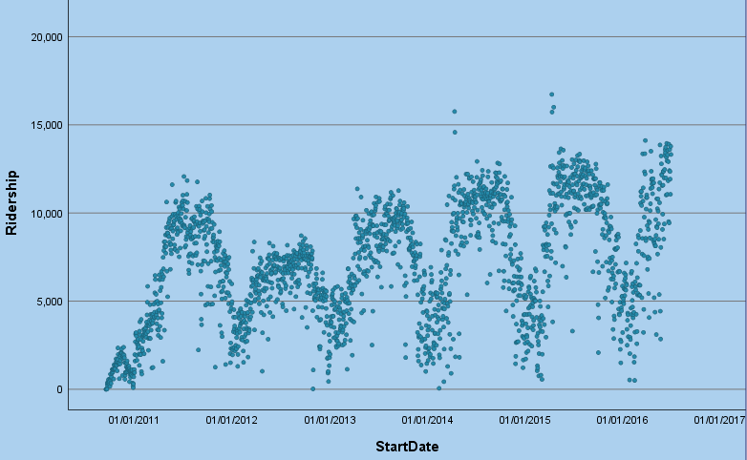
Outlier Analysis
Date | Ride Count | Reason
2014/4/12 | 15755 | Cherry Blossom Festival
2014/4/13 | 14578
2015/4/11 | 16726
2015/4/12 | 15724
2015/4/18 | 16004
2016/3/26 | 14116
Outliers
Based on official Cherry Blossom Calendar: http://www.nationalcherryblossomfestival.org/about/bloom-watch/
Ridership Distribution from 2010 to 2016

Slide 9
Analysis
How does the weather conditions effect bike trips?
IV – Temperature, Dew Point
DV – Bike Ride Count
As both the IV and DV are continuous (ratio) hence we performed Multiple Regression test to identify association between them.
Coefficientsª
Model |  | Unstandardized Coefficients |  | Standardized Coefficients | t | Sig. | 95.0% Confidence Interval for B
 |  | B | Std. Error | Beta |  |  | Lower Bound | Upper Bound
1 | (Constant) | -2144.664 | 224.145 |  | -9.568 | .000 | -2584.232 | -1705.096
 | mean_temperature | 238.743 | 8.765 | 1.240 | 27.238 | .000 | 221.554 | 255.932
 | mean_dew | -111.504 | 8.170 | -.621 | -13.649 | .000 | -127.525 | -95.483
a. Dependent Variable: rides

Slide 10
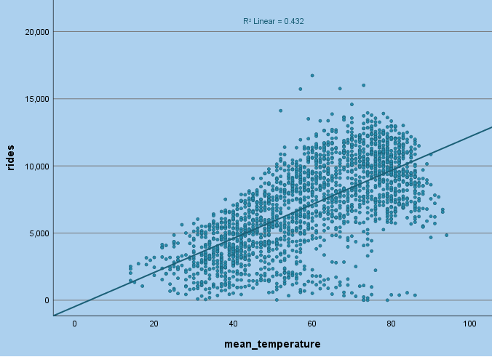
Temperature has moderate positive linear relationship with Bike Ride Count.

Slide 11
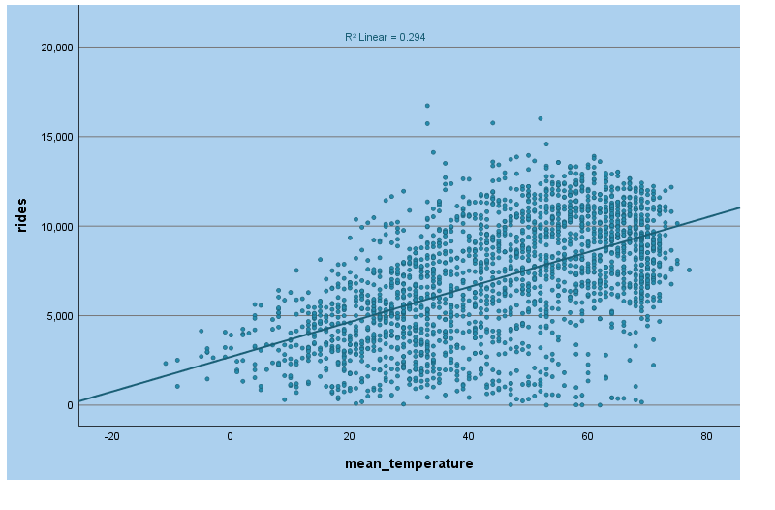
Dew Point has moderate positive linear relationship with Bike Ride Count.
Dew_point

Slide 12
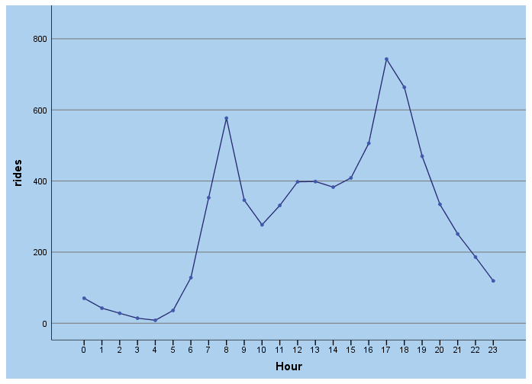
Analysis
What are the peak hours on bike trips in a day?
IV – Ride Start Date
DV – Ride Count
Test of Homogeneity of Variances
Ridership
Levene Statistic | df1 | df2 | Sig.
1467.671 | 23 | 50080 | 0.000
ANOVA
Ridership
 | Sum of Squares | df | Mean Square | F | Sig.
Between Groups | 2135852486.596 | 23 | 92863151.591 | 2007.414 | 0.000
Hence we can say that office work hours do influence ride count !!

Slide 13
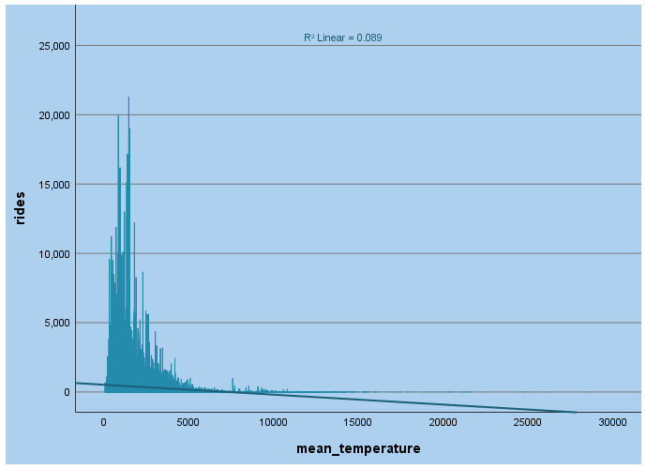
Analysis
How strongly/feebly the station location plays a role in bike trips?
IV – Linear distance between stations
DV– Ride Count
Correlations
 |  | Ridership | Distance
Ridership | Pearson Correlation | 1 | -.299**
 | Sig. (2-tailed) |  | 0.000
 | N | 37650 | 37650
Distance | Pearson Correlation | -.299** | 1
 | Sig. (2-tailed) | 0.000
 | N | 37650 | 37650
**. Correlation is significant at the 0.01 level (2-tailed).
There is a negative relationship between ridership and distance.
distance
Notes:
Our third research question is how strongly the station location plays a role in bike trips? For this research question, we aggregate all record by start station and end station by using database and then calculate the linear distance between two stations by using R. Therefore, our independent variable is linear distance between stations and dependent variable is ridership per start and end station. We use Pearson correlation to evaluate the relationship between those two variables. Since the p-value is extremely small and correlation coefficient is -0.299, we conclude that there is a negative relationship between ridership and distance.

Slide 14
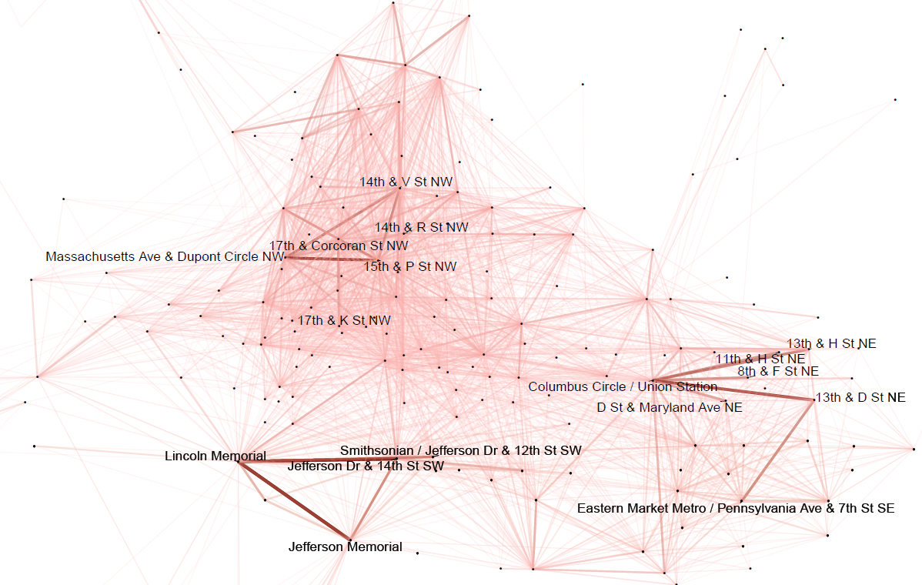
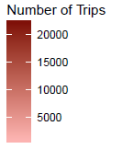
Popular Bicycle Routes
Notes:
After that, we visualize the popular bicycle routes by using ggplot. However since we have about 30 thousands routes, it is not very visible if we show all of them in one picture. Therefore, we only focus on routes in DC area. As Suyan mentioned earlier, we found the peak hours are 9 am and 5 pm and those commuter are the majority of Capital Bikeshare customers, so we are curious whether the popular bicycle routes could match the results of peak hours. Although the majority of Capital bikeshare customers are commuters, the most popular routes are around tourist attractions, like Lincoln memorial and Jefferson memorial. Including 6 outliers resulted from cherry bloosm festivals, Amit just mentioned, tourists are still very important for Capital bikeshare Co. As a result, Capital bikeshare Co. should have two different pricing policy for tourists and commuters to stimulate and increase the demand. For example, Capital bikeshare Co could provide a cheaper price for those tourists if they rent for 3 days and promise will return bikes to stations around tourist attractions. As for those commuters, Capital bikeshare could also provide a cheaper price if they rent more than 3 days in a week or they rent and return bikes in a same station,

Slide 15
Analysis
How does the national holidays impact the bike ride counts?
IV – DC Holiday Dates
DV – Bike Ride Count
The data was normally distributed with slight skews but satisfies the assumptions for T-test:
Independent Samples Test
 |  | Levene's Test for Equality of Variances |  | t-test for Equality of Means
 |  | F | Sig. | t | df | Sig. (2-tailed) | Mean Difference | Std. Error Difference | 95% Confidence Interval of the Difference
 |  |  |  |  |  |  |  |  | Lower | Upper
Ridership | Equal variances assumed | 8.248 | .004 | 3.391 | 2109 | .001 | 1416.788 | 417.828 | 597.390 | 2236.185
 | Equal variances not assumed |  |  | 2.910 | 65.875 | .005 | 1416.788 | 486.927 | 444.573 | 2389.003
As the P-Value is less than α (0.05), we reject null hypothesis. Hence, can say that a day being holiday/non-holiday influences the bike ride count.
Notes:
Our last research question is how does the national holiday impact the bike ride counts. For this research question, we categorized our records into two category, the ridership on holiday and on non-holiday. Our IV is DC holiday dates and dv is the ridership. We use two sample t-test to solve this question and we found the p=value is about .004. So we conclude that the ridership on holiday and non-holiday are not equal.

Slide 16
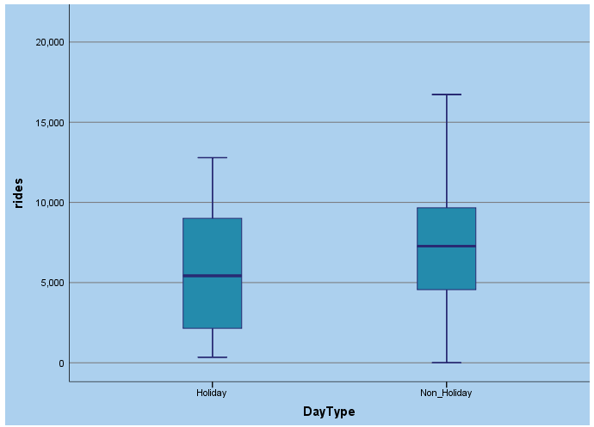
Analysis
As seen in the graph, it is surprising that the number of ridership on holiday is smaller than the number on non-holiday, contrary to our expectations.
Notes:
And then we use a bar graph to show the difference between these two groups. However, the result is contrary to our expectation that the number of ridership on holiday is smaller than the number on non-holiday.
At beginning, we had no idea why we have such result. But we have two explanations: first, the major holidays are in the winter, like new year eve, chrismas, thanksgiving. People definitely do not rent bikes in the winter even they have holiday and do not need to work. Second, as we mentioned earier, both tourists and commuters are important to Capital bikeshare Co. But we do not know who are more important. Therefore, this result tells us compared to tourists, commuters use renting service more often.

Slide 17
Assumptions
Distance calculated is linear and not route based. Google MAP API restricts to process only 2500 elements for free. So for more accurate results Google MAP API would be useful.
Data has some outliers but considering the overall dataset size that can be accepted.
Notes:
However, there is a limitation that we should use actual distance, not linear distance, as our independent variable, then our result would be more reliable. Actually we have finished python code to connect Google Map API to calculate the actual distance and it is successful when we were testing the sample data. Google Api will charge us if we have more than 2500 elements.
The second limitation is about outliers.

Slide 18
References
Capital Bikeshare: W., C. (2016). Exploratory Data Analysis of Capital Bikeshare. Retrieved October 5, 2016, from https://s3.amazonaws.com/capitalbikeshare-data/index.html.
Holiday Schedule: Holiday Schedules | dchr (A. Parihar, Trans.). (n.d.). Retrieved October 07, 2016, from http://dchr.dc.gov/page/holiday-schedules.
Station Details: Live XML - feeds.capitalbikeshare.com (Y. Liu, Trans.). (n.d.). Retrieved October 28, 2016, from https://feeds.capitalbikeshare.com/stations/stations.xml
Weather History:
2010: Weather UnderGround. Weather History for Washington, DC | Weather Underground. Retrieved October 9, 2016, from https://www.wunderground.com/history/airport/KDCA/2010/10/1/CustomHistory.html?dayend=31&monthend=12&yearend=2010&req_city=&req_state=&req_statename=&reqdb.zip=&reqdb.magic=&reqdb.wmo=&format=1
2011: Weather UnderGround. Weather History for Washington, DC | Weather Underground. Retrieved October 9, 2016, from https://www.wunderground.com/history/airport/KDCA/2011/1/1/CustomHistory.html?dayend=31&monthend=12&yearend=2011&req_city=&req_state=&req_statename=&reqdb.zip=&reqdb.magic=&reqdb.wmo=&format=1

Slide 19
References
2012: Weather UnderGround. Weather History for Washington, DC | Weather Underground. Retrieved October 9, 2016, from https://www.wunderground.com/history/airport/KDCA/2012/1/1/CustomHistory.html?dayend=31&monthend=12&yearend=2012&req_city=&req_state=&req_statename=&reqdb.zip=&reqdb.magic=&reqdb.wmo=&format=1
2013: Weather UnderGround. Weather History for Washington, DC | Weather Underground. Retrieved October 9, 2016, from https://www.wunderground.com/history/airport/KDCA/2013/1/1/CustomHistory.html?dayend=31&monthend=12&yearend=2013&req_city=&req_state=&req_statename=&reqdb.zip=&reqdb.magic=&reqdb.wmo=&format=1
2014: Weather UnderGround. Weather History for Washington, DC | Weather Underground. Retrieved October 9, 2016, from https://www.wunderground.com/history/airport/KDCA/2014/1/1/CustomHistory.html?dayend=31&monthend=12&yearend=2014&req_city=&req_state=&req_statename=&reqdb.zip=&reqdb.magic=&reqdb.wmo=&format=1

Slide 20
References
2015: Weather UnderGround. Weather History for Washington, DC | Weather Underground. Retrieved October 9, 2016, from https://www.wunderground.com/history/airport/KDCA/2015/1/1/CustomHistory.html?dayend=31&monthend=12&yearend=2015&req_city=&req_state=&req_statename=&reqdb.zip=&reqdb.magic=&reqdb.wmo=&format=1
2016: Weather UnderGround. Weather History for Washington, DC | Weather Underground. Retrieved October 9, 2016, from https://www.wunderground.com/history/airport/KDCA/2016/1/1/CustomHistory.html?dayend=30&monthend=6&yearend=2016&req_city=&req_state=&req_statename=&reqdb.zip=&reqdb.magic=&reqdb.wmo=&format=1

Slide 21
Thank You!
We would love your Suggestions and Queries on this !!

