Slide 1
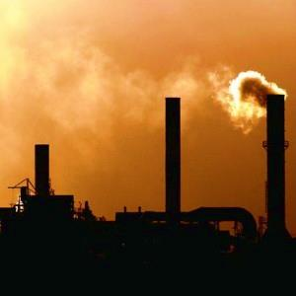
Toxic Release Inventory Analysis -2014
Team Grand Sanchari Chowdhuri
Khushal Navani
Matthew Mozeleski

Slide 2
INTRODUCTION
Located States and Counties of USA with high toxic releases in environment
Identified egregious industries based on their waste release for 2014.
Determined six most prominent chemicals in industrial effluents were evaluated
Identified Industries sectors with Carcinogenic compound releases
Waste Management Distribution

Slide 3
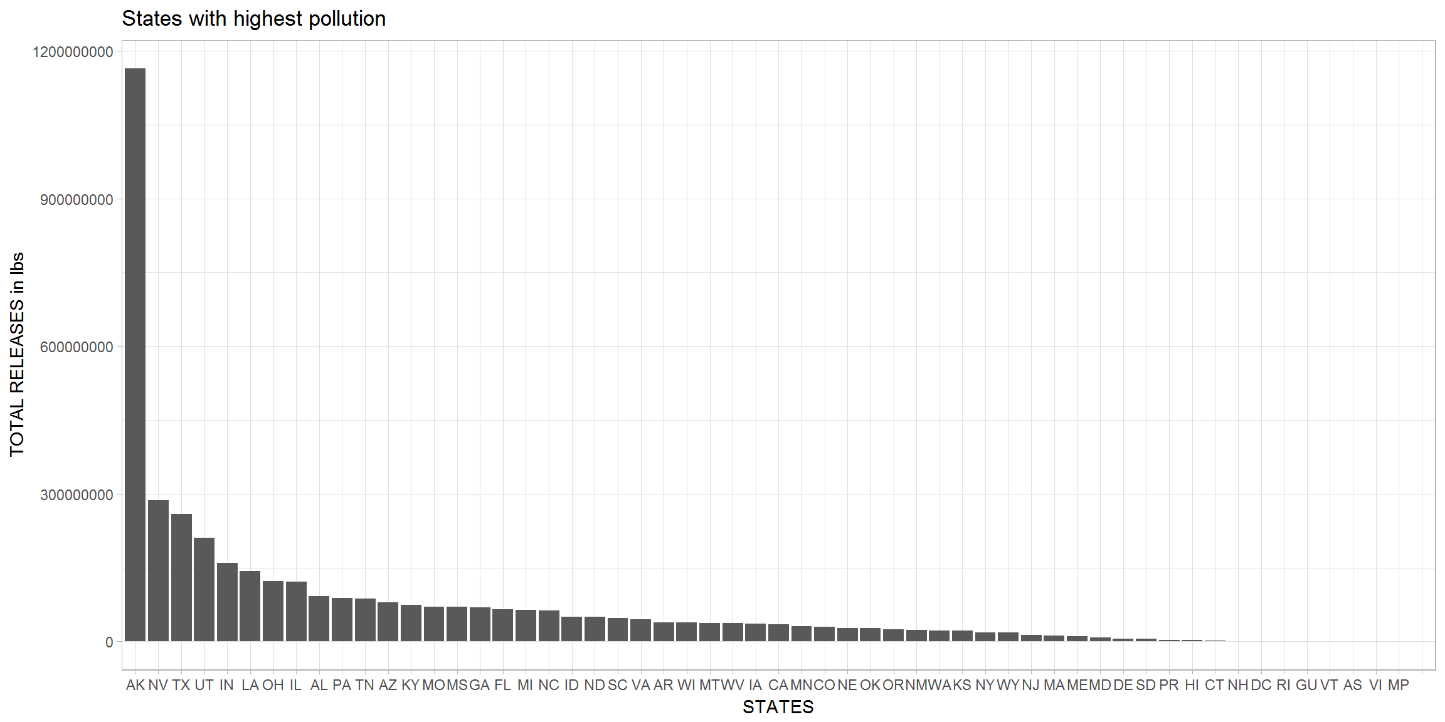

STATES ACCOUNTING FOR MAX POLLUTION AS OF 2014
ALASKA: 11,64,041,073 lbs
NEVADA: 286,752,417 lbs
TEXAS: 258,702,678 lbs

Slide 4
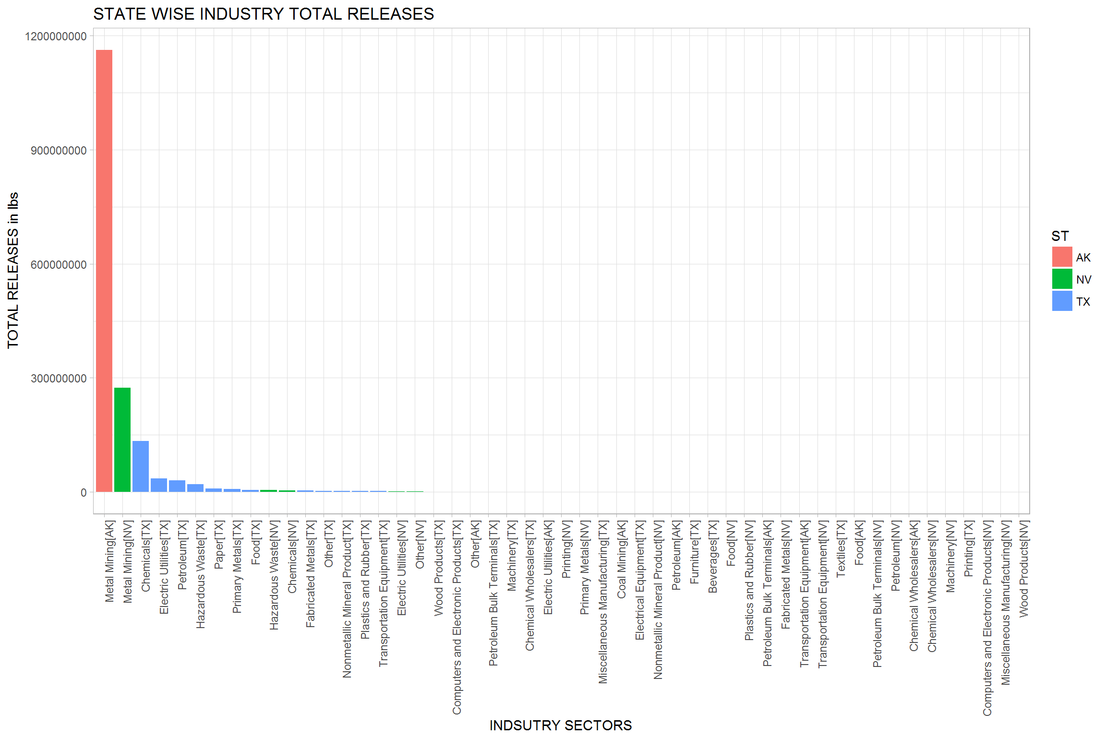

TOP 3 STATE-INDUSTRIES CASUING MAX POLLUTION AS OF 2014
1,162,896,885 lbs 274,381,795 lbs
134,328,840 lbs

Slide 5
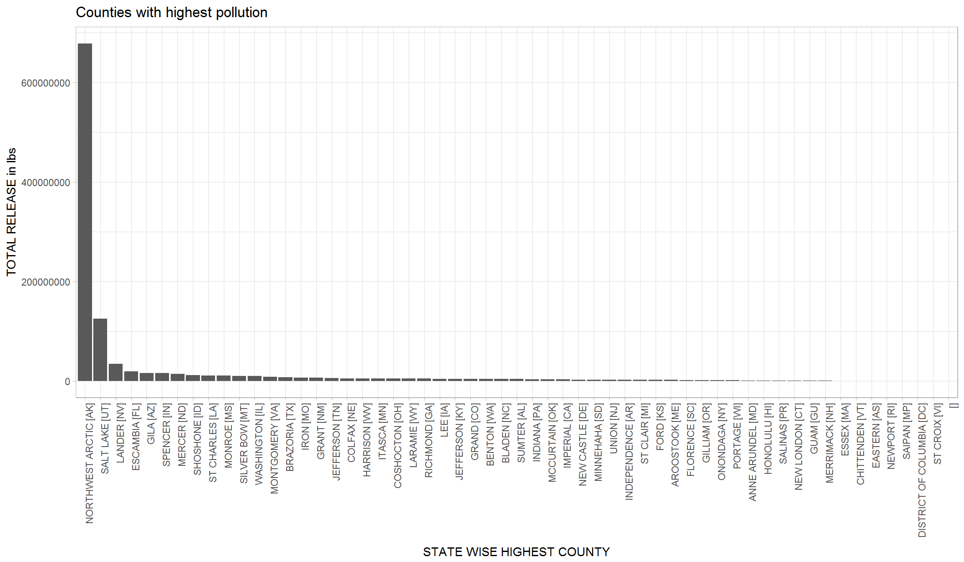


COUNTIES ACCOUNTING FOR MAX POLLUTION AS OF 2014
678,041,040 lbs
124,989,494 lbs
34,172,792 lbs

Slide 6
MOST POLLUTING STATES AS OF 2014
Metal Industry
Released 1.77x${10}^{09}$ pounds of toxic waste in 2014.
Metal Industry
Released 1.77x〖10〗^09 pounds of toxic waste in 2014.
Electric Utilities
Released 5.35x${10}^{08}$ pounds of toxic waste in 2014.
Electric Utilities
Released 5.35x〖10〗^08 pounds of toxic waste in 2014.
Chemical Industries
Released 5.30 x ${10}^{08 }$ pounds of toxic waste in 2014
Chemical Industries
Released 5.30 x 〖10〗^(08 ) pounds of toxic waste in 2014

Slide 7
MOST POLLUTING INDUSTRIES OF 2014
Metal Industry
Released 1.77x${10}^{09}$ pounds of toxic waste in 2014.
Metal Industry
Released 1.77x〖10〗^09 pounds of toxic waste in 2014.
Electric Utilities
Released 5.35x${10}^{08}$ pounds of toxic waste in 2014.
Electric Utilities
Released 5.35x〖10〗^08 pounds of toxic waste in 2014.
Chemical Industries
Released 5.30 x ${10}^{08 }$ pounds of toxic waste in 2014
Chemical Industries
Released 5.30 x 〖10〗^(08 ) pounds of toxic waste in 2014

Slide 8
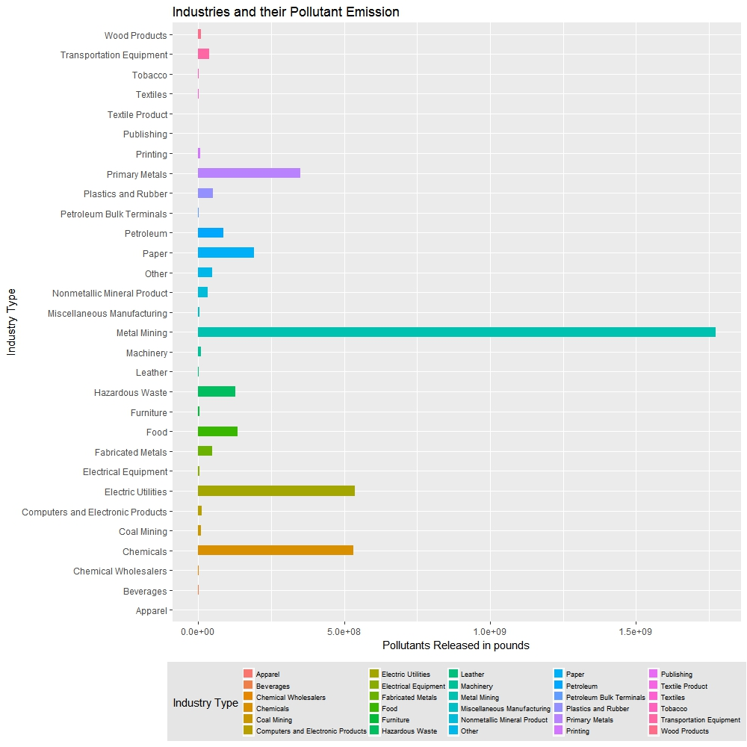

Slide 9
INDUSTRY WISE CHEMICAL EMISSION
Zinc compounds (766 million Pounds)
Lead compounds (688million Pounds)
Barium Compounds (162 million Pounds)
Ammonia Compounds( 89 million Pounds)
Nitrate Compounds (64 million Pounds)

Slide 10
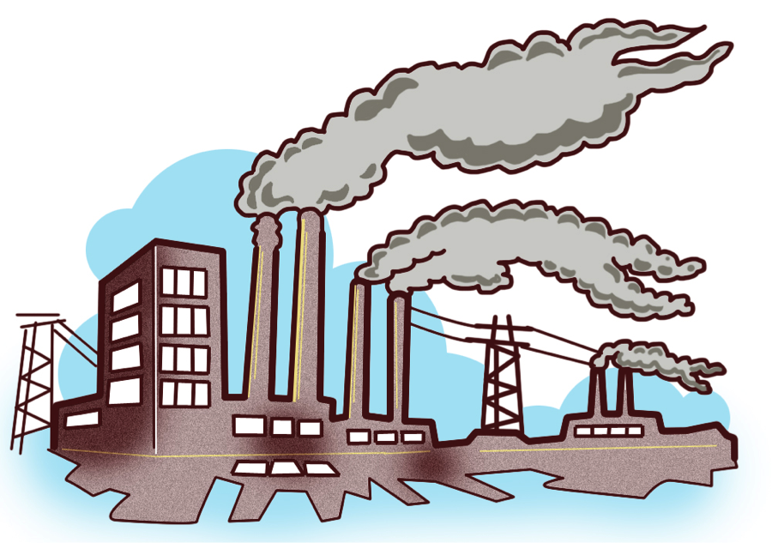
SIX MOST POLLUTING CHEMICALS PRESENT IN INDUSTRIAL WASTES

Slide 11
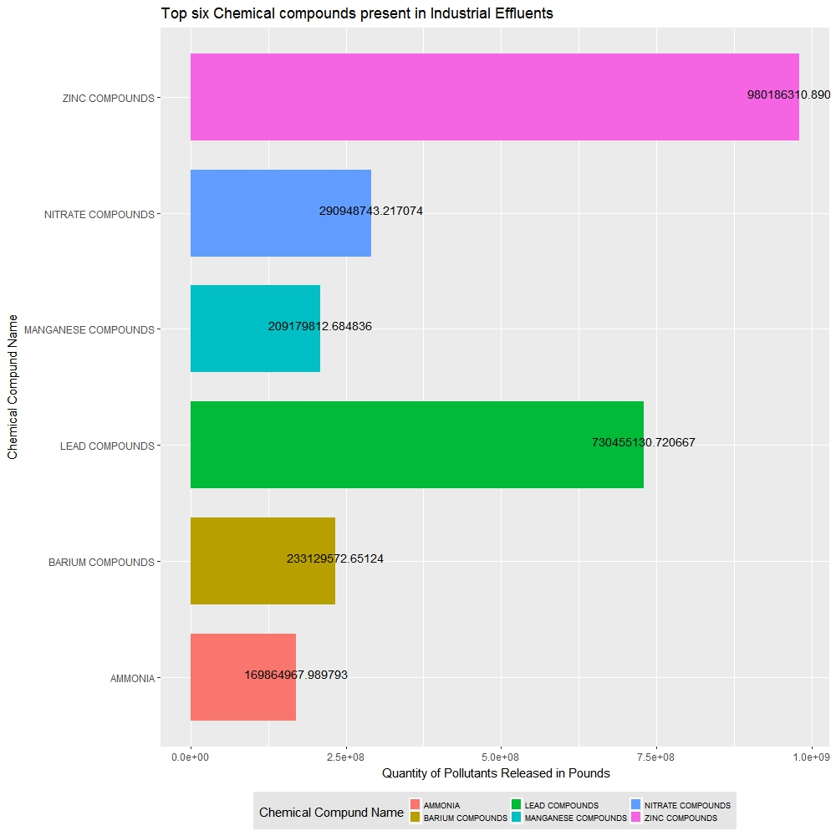

Slide 12
INDUSTRIES WITH CARCEOGENIC POLLUTANT EMISSION
Chemical Industries
Hazardous Waste Industries
Plastic and Rubber
50 million pounds emitted in 2014
30 million pounds emitted in 2014
17.9 million pounds emitted in 2014

Slide 13
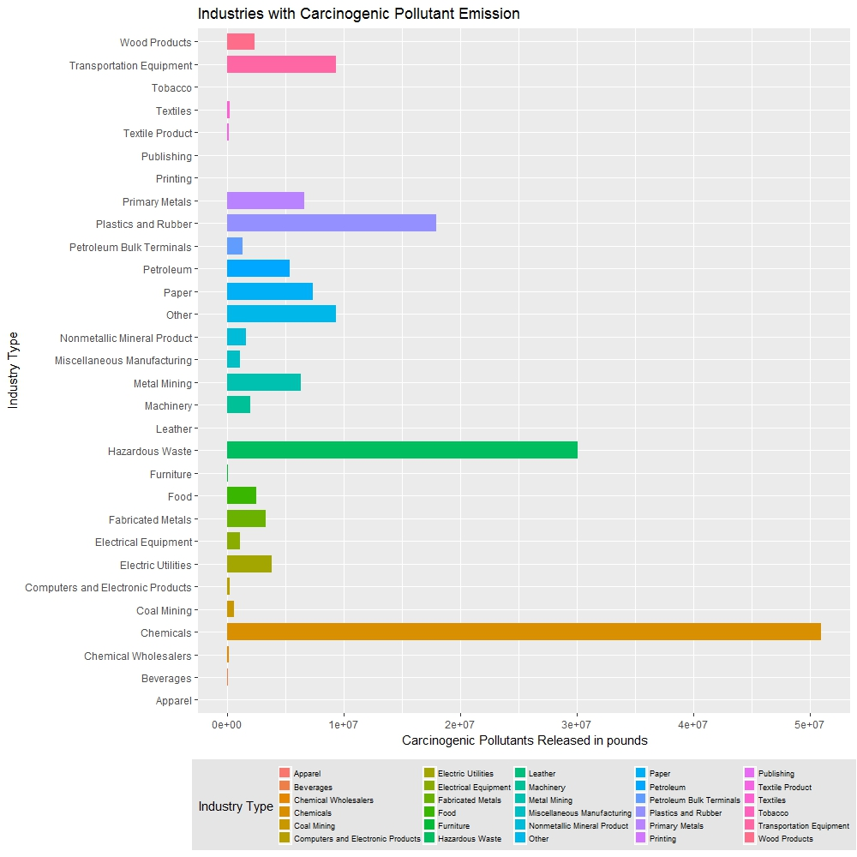

Slide 14
Top six states according to carcinogenic releases

Slide 15
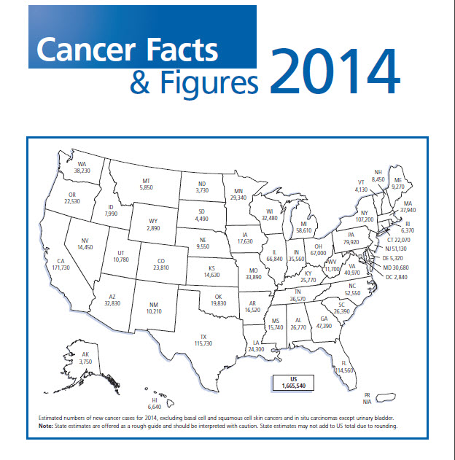
Retrieved December 14, 2016, from American Cancer Society, http://www.cancer.org/acs/groups/content/@research/documents/webcontent/acspc-042151.pdf

Slide 16
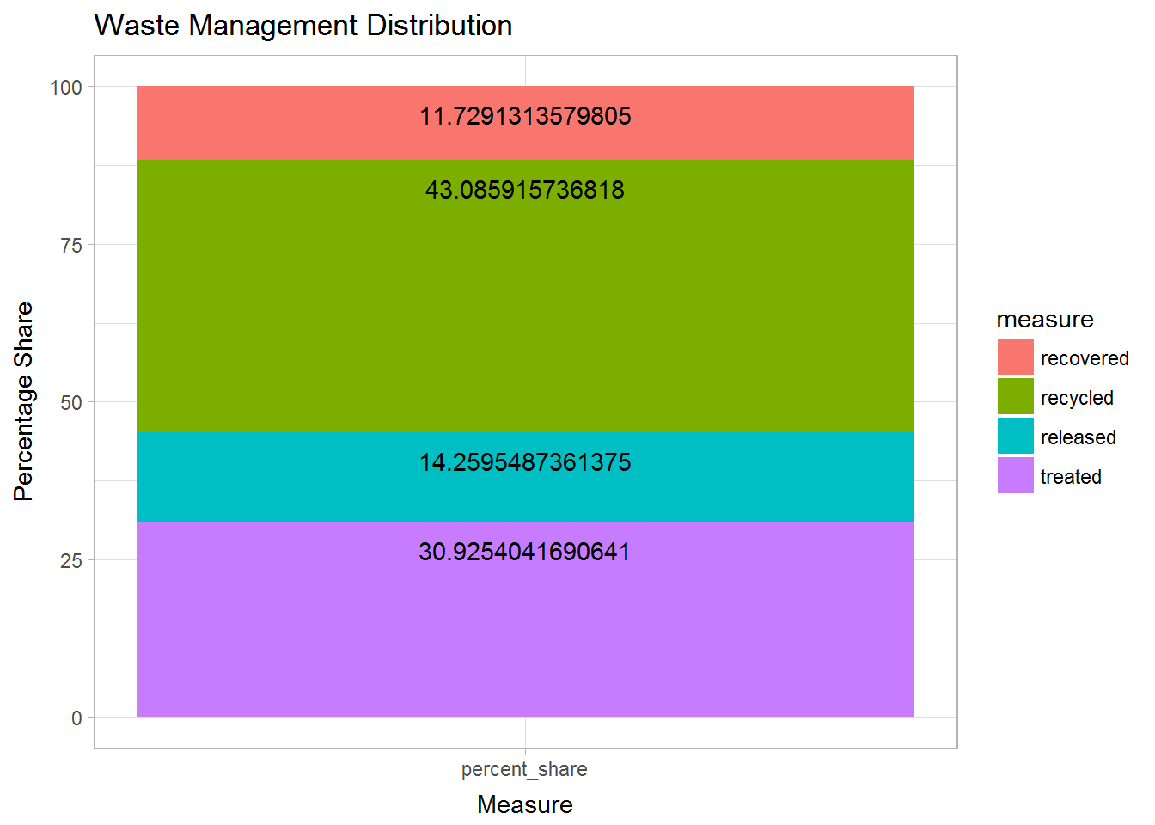
WASTE MANAGEMENT

Slide 17
INDUSTRIES WITH STACK AND FUGITIVE EMISSION
STACK EMISSION
Electric Utilities
Chemicals Industry
FUGITIVE EMISSION
Chemicals Industry
Paper Industry
Paper Industry
Food Industry

Slide 18
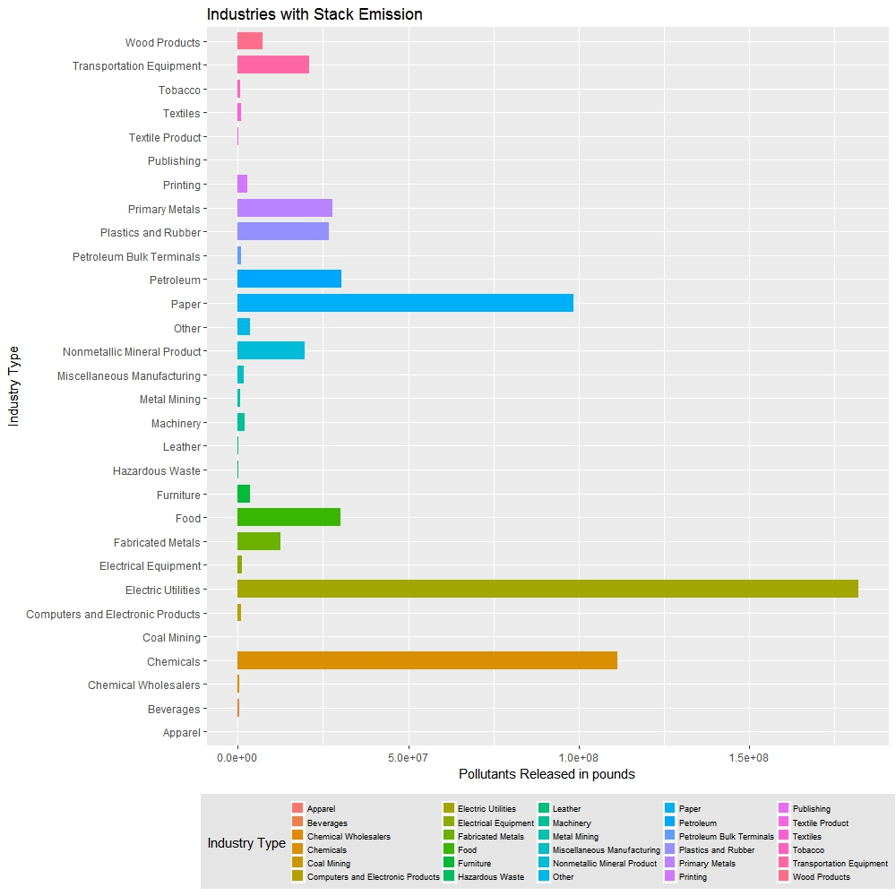

Slide 19
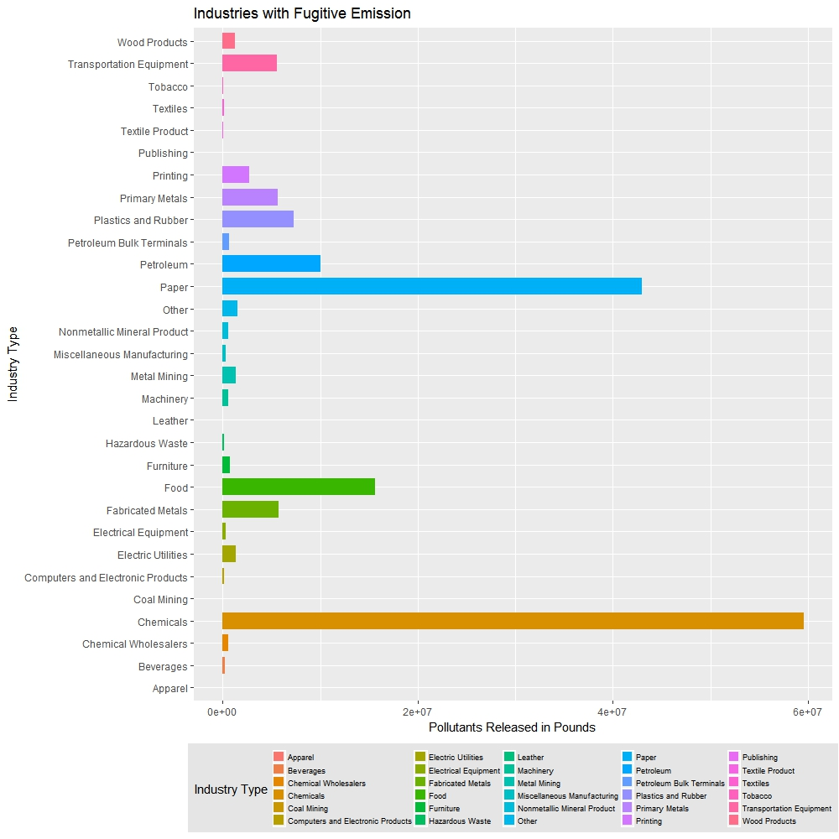

Slide 20

CONCLUSION
As primary watchdogs of industry behavior, the federal government has the important job of regulating known carcinogenic chemicals that are emitted into the atmosphere and should hold certain companies, as well as industries, accountable putting the health of the American public in jeopardy.
The results of this report show that certain chemicals should be examined more rigorously, as well as their mode of waste disposal.
EPA regulators and community climate change activists should use this information as added confirmation that the fight for more responsible industry disposal standards is a critical one for the safety of all Americans.
Companies should be financially incentivized to dispose in more environmentally healthy ways.

Slide 21

Thank You
Environment should be put in the category of national security. Defense of our resources is just as important as defense abroad. Else what is there to defend?

