Slide 1
Analysis of Air Crash Data since 1908

Slide 2
Marvelous Moose
Harshith Sharma
Namratha Jagadeesh
Shivam Saith

Slide 3
MOTIVATION
Despite advancements in technology, air crashes keep happening every year.
20 major air crashes in 2016 alone.
We intend to find out trends, using which we can find out interesting facts about air crash accidents!

Slide 4
OUR DATA
Sauro Grandi (September, 2016). Airplane Crashes Since 1908. Retrieved from https://www.kaggle.com/saurograndi/airplane-crashes-since-1908
Has details of every crash from 1908 to 2006 (5000+ crashes!)
Specific details like time, location, date, fatalities and summary for each aircrash.

Slide 5
TARGET AUDIENCE
Frequent travellers.
Air crash investigation agencies.
Airlines and Aeroplane manufacturing companies.

Slide 6
DATA CLEANING AND TRANSFORMATION
Ignored missing values in Time and Operator columns, as the percentage of missing values was negligible.
Created a new column with nominal variable for reasons (Technical Failure, Bad Weather, Pilot Error, Hijacked, Shot Down, Collision, and Unknown) based on keyword search in air crash summary.
Cleaned the time column, created time slots for Day & Night.

Slide 7
RESEARCH QUESTIONS
We have three research questions in total.

Slide 8
Research Question
1
Reasons for crashes

Slide 9
What reason causes majority of air crashes?

Slide 10
MOTIVATION
Can answer to what degree air crashes can be controlled, based on the past data.
Can help in analyzing important trends related to specific reasons of crashes.
For instance, areas which have high number of crashes due to bad weather conditions can be noted down.

Slide 11
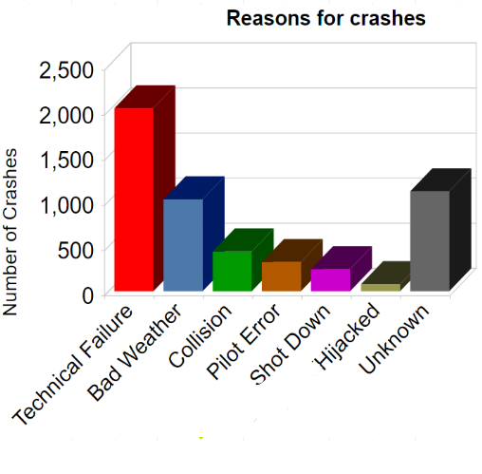
ANALYSIS AND FINDINGS
Majority of crashes happened due to technical failure, followed by unknown and bad weather conditions.
Most of the hijacks took place after 1950.
“Unknown” is assigned for missing data, or the crashes for which reason is actually not known.

Slide 12
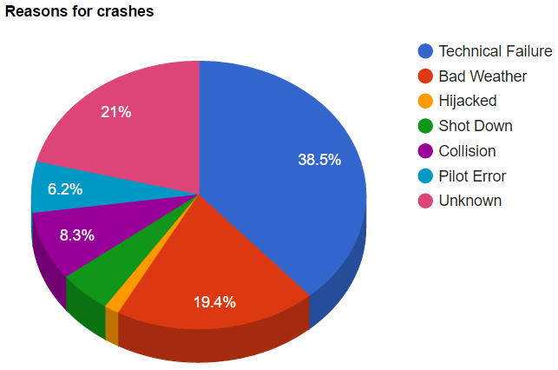
ANALYSIS AND FINDINGS
Probability of crashes due to human error very low compared to natural causes and technical malfunctions.
Almost all the aircrafts shot down were warplanes during the World Wars.

Slide 13
Research Question
2
Operators and crashes

Slide 14
Which commercial operators have the highest number of crashes?

Slide 15
MOTIVATION
Helps in finding out which operators are involved in frequent crashes.
Reasons of the crashes for each operator can be further analyzed (i.e. were majority of crashes linked to technical errors?)
Using this analysis and other data at hand, a safety score can be calculated and assigned to each of the major operators.

Slide 16
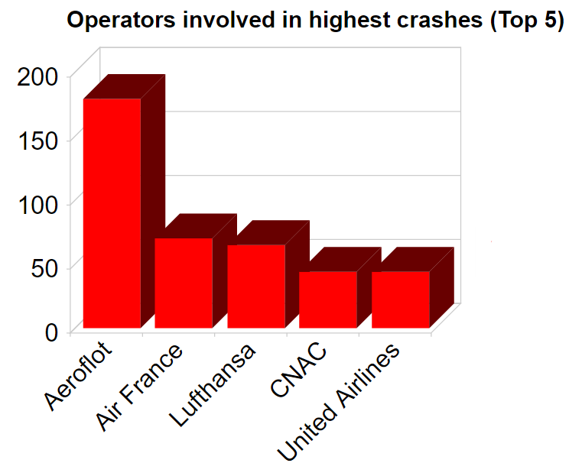
ANALYSIS AND FINDINGS
Aeroflot has the highest number of crashes (179). Way more than the others!
All these airlines have been operating for more or less the same amount of years.
Would be interesting to find out the average number of crashes per year for each of these five, since their inception.

Slide 17
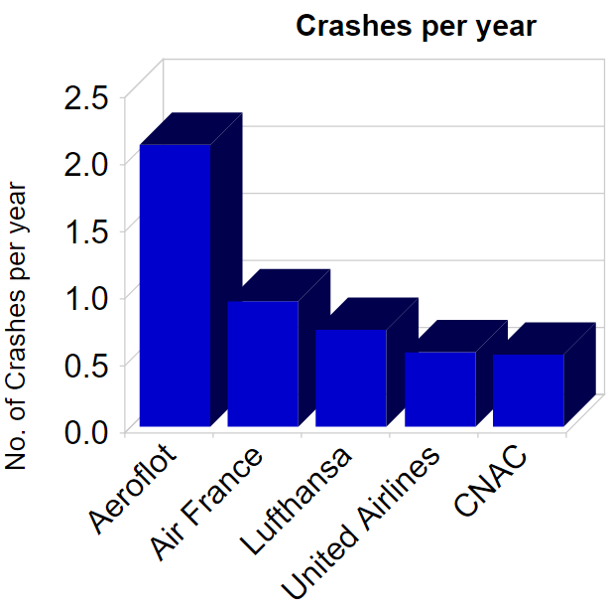
ANALYSIS AND FINDINGS
We found out the years in which each of the operators began operations, and calculated the number per year
Aeroflot has more than 2 crashes per year, way higher than the others.
The crashes related to these operators make up to almost 9% of the total crashes in our dataset.

Slide 18
Research Question
3
Reason for crash and fatalities

Slide 19
What reason for crash has caused highest number of fatalities compared to others?

Slide 20
MOTIVATION
We can get useful insights about population parameters like variances in number of fatalities across the reasons for crashes.
Helps us to further analyze specifics about fatalities for each reason.
We were also curious to know which reason caused the maximum number of fatalities!

Slide 21
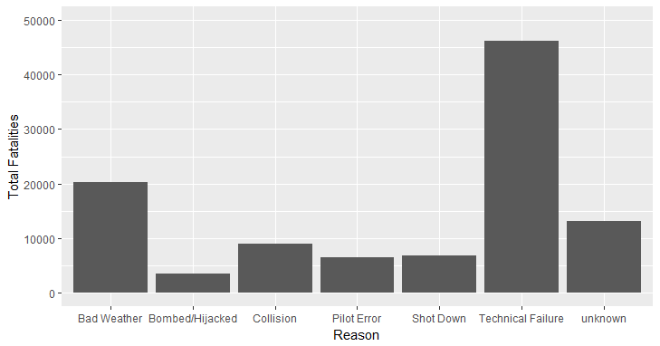
ANALYSIS AND FINDINGS
Graph shows total number of deaths caused with respect to each of the reasons.
Total deaths caused due to Technical Failure are highest.
Fatalities due to hijack is the lowest.

Slide 22
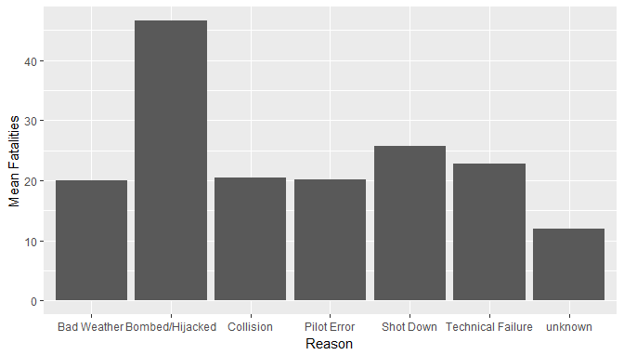
ANALYSIS AND FINDINGS
We performed ANOVA and Pairwise t-tests to compare deaths caused due to each reason.
Mean deaths caused due to Hijacks are significantly higher than the deaths caused by other reasons.
Graph shows mean of deaths for crashes related to each reason.

Slide 23
LIMITATIONS
Missing Data
We could not guess the values of missing data, since details of each crash is different.
Crash Summary too ambiguous at times
Summary was missing, unknown for some crashes, and was ambiguous without actual causes mentioned in some cases.
Data only up to 2009
Dataset contains crash data only up to 2009. Hence, our analysis is only till 2009.

Slide 24

REFERENCES
Sauro Grandi (September, 2016). Airplane Crashes Since 1908. Retrieved from https://www.kaggle.com/saurograndi/airplane-crashes-since-1908
Aeroflot - Wikipedia. Retrieved from https://en.wikipedia.org/wiki/Aeroflot
Air France - Wikipedia. Retrieved from https://en.wikipedia.org/wiki/Air_France
Chinese National Aviation Corporation - Wikipedia. Retrieved from https://en.wikipedia.org/wiki/China_National_Aviation_Holding
Deutsche Lufthansa - Wikipedia. Retrieved from https://en.wikipedia.org/wiki/Deutsche_Luft_Hansa
United Airlines - Wikipedia. Retrieved from https://en.wikipedia.org/wiki/United_Airlines

Slide 25
THANKS!

