Slide 1
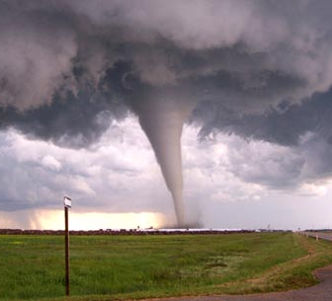
Tornadoes vs Agricultural Exports
impressive impalas
Sohan shah
Shashank kava
Alexandra steinheimer

Slide 2
Methodology & Approach
Data set merge
Graphical representation and analysis
Statistical tests using regression models
Interpretation

Slide 3
Graphical Analysis
Frequency distribution of tornado count in the United States

Slide 4
Graphical Analysis
South and North regions in the United States

Slide 5
Graphical Analysis
Tornado incidence over the last 15 years in Texas

Slide 6
Graphical Analysis
Revenue generated from agricultural exports (in millions) for the state of Texas

Slide 7
Graphical Analysis
Revenue from agricultural exports is generally greater when the tornado count is low

Slide 8
Graphical Analysis
Revenue from plant product exports is generally greater when the tornado count is low.

Slide 9
Graphical Analysis
Revenue from animal product exports is generally greater when the tornado count is low

Slide 10
Statistical Tests & Results
We conducted multiple regression tests to check which of our results were significant
Negative correlation between the count of tornadoes and revenue generated from agricultural exports in the state of Texas.
Modelling Result:
When the tornado count increases by 1
Revenue from agricultural exports drops by a approximately $23 Million
No significant relationship was noticed in any other region.
No significant relationship was noticed between tornado intensity and agricultural exports

Slide 11
Conclusion
No significant relationships in other regions could imply that the relationship exists only above a certain threshold value of tornado count, or a third variable factor in play.
Median value for tornado count in Texas is 120, which can be assumed as the threshold.
Low intensity tornadoes have the same effect on agricultural exports as high intensity tornadoes.

Slide 12
Thank You!

