Slide 1
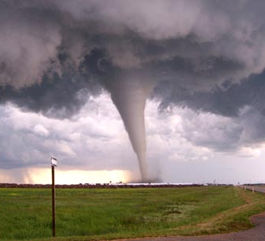
Tornadoes vs Agricultural Exports
impressive impalas
Sohan shah
Shashank kava
Alexandra steinheimer

Slide 2
Introduction
Each year in the United States, tornadoes:
Kill 60 people
Injure 1500 people
Cause roughly $400 million in damages
We narrow down the scope of damages to agricultural exports.

Slide 3
Research Questions
How has tornado occurrence varied over the last 10 years?
What is relationship between tornado occurrences and revenues generated from exports for states and regions in the United States?

Slide 4
Datasets
Tornado data in the United States since 1950 from National Oceanic and Atmospheric Administration (NOAA).
61217 tuples.
Important Attributes: Date of occurrence, State, Intensity(F-scale).
Agricultural export data from United States Department of Agriculture.
27 tuples and 50 sheets corresponding to each state in US.
Attributes: Revenue generated through Agricultural exports, Plant product exports and Animal product exports.

Slide 5
Benefits to USDA
Determine effect of tornadoes on agricultural exports, plant and animal products.
Gather weather data from the National Weather Service agency and leverage our model for reporting and analysis.
Proactive measures and minimize economic damage.

Slide 6
Methodology & Approach
Data set merge
Graphical representation and analysis
Statistical tests using regression models
Interpretation

Slide 7
Graphical Analysis
Frequency distribution of tornado count in the United States

Slide 8
Graphical Analysis
South and North regions in the United States

Slide 9
Graphical Analysis
Tornado incidence over the last 15 years in Texas

Slide 10
Graphical Analysis
Revenue generated from agricultural exports (in millions) for the state of Texas

Slide 11
Graphical Analysis
Revenue from agricultural exports is generally greater when the tornado count is low

Slide 12
Graphical Analysis
Revenue from plant product exports is generally greater when the tornado count is low.

Slide 13
Graphical Analysis
Revenue from animal product exports is generally greater when the tornado count is low

Slide 14
Statistical Tests & Results
We conducted multiple regression tests to check which of our results were significant
Negative correlation between the count of tornadoes and revenue generated from agricultural exports in the state of Texas.
Modelling Result:
When the tornado count increases by 1
Revenue from agricultural exports drops by approximately $23 Million
No significant relationship was noticed in any other region.
No significant relationship was noticed between tornado intensity and agricultural exports

Slide 15
Conclusion
No significant relationships in other regions could imply that the relationship exists only above a certain threshold value of tornado count, or a third variable factor in play.
Median value for tornado count in Texas is 120, which can be assumed as the threshold.
Low intensity tornadoes have the same effect on agricultural exports as high intensity tornadoes.

Slide 16
Thank You!

