Slide 1
Computer Graphics Assignment
Game : Plane run
ANIRUDDHA MAHAJAN – 2017A7PS0145P
Shreyas SRIKRISHNA – 2017A7PS0162P

Slide 2
Overview
Supported browsers
This game can be played in following browsers:-
Google Chrome 9+, Firefox 4+, Opera 15+, Safari 5.1+, Internet Explorer 11 and Microsoft Edge.
To check whether your browsers support WebGL or not open the following link.
https://get.webgl.org/
Required equipment to play
You will require a keyboard and a mouse to play this game.

Slide 3
Overview
What is the game?
It is inspired by flappy bird and temple run.
The goal is to fly the aircraft as long as possible, avoiding meteors in the way (or shooting them with bullets if needed).
Difficulty increases in stages and bullets are limited.
How to Play
Move the plane up/down by moving the mouse cursor up/down to avoid hitting the meteors.
Press X to shoot bullets at the meteors.

Slide 4
TOOLS USED
Frameworks / Libraries Used
HTML5
CSS3
JavaScript
Threejs (library used for creating and handling 3-D objects)
TweenMaxjs (library used for moving certain 3-D objects)

Slide 5
MODULAR DESCRIPTION
File structure
The source code of game is written in three files which are index.html, game.css and game.js.
The sounds used in game are present in sounds folder.
The libs folder contain
Explanation of content in each file
The game.js handles the 3-D objects, their properties and motion.
The index.html provides the basic structure to the web page.
The game.css handles the styling of the text in the web page.

Slide 6
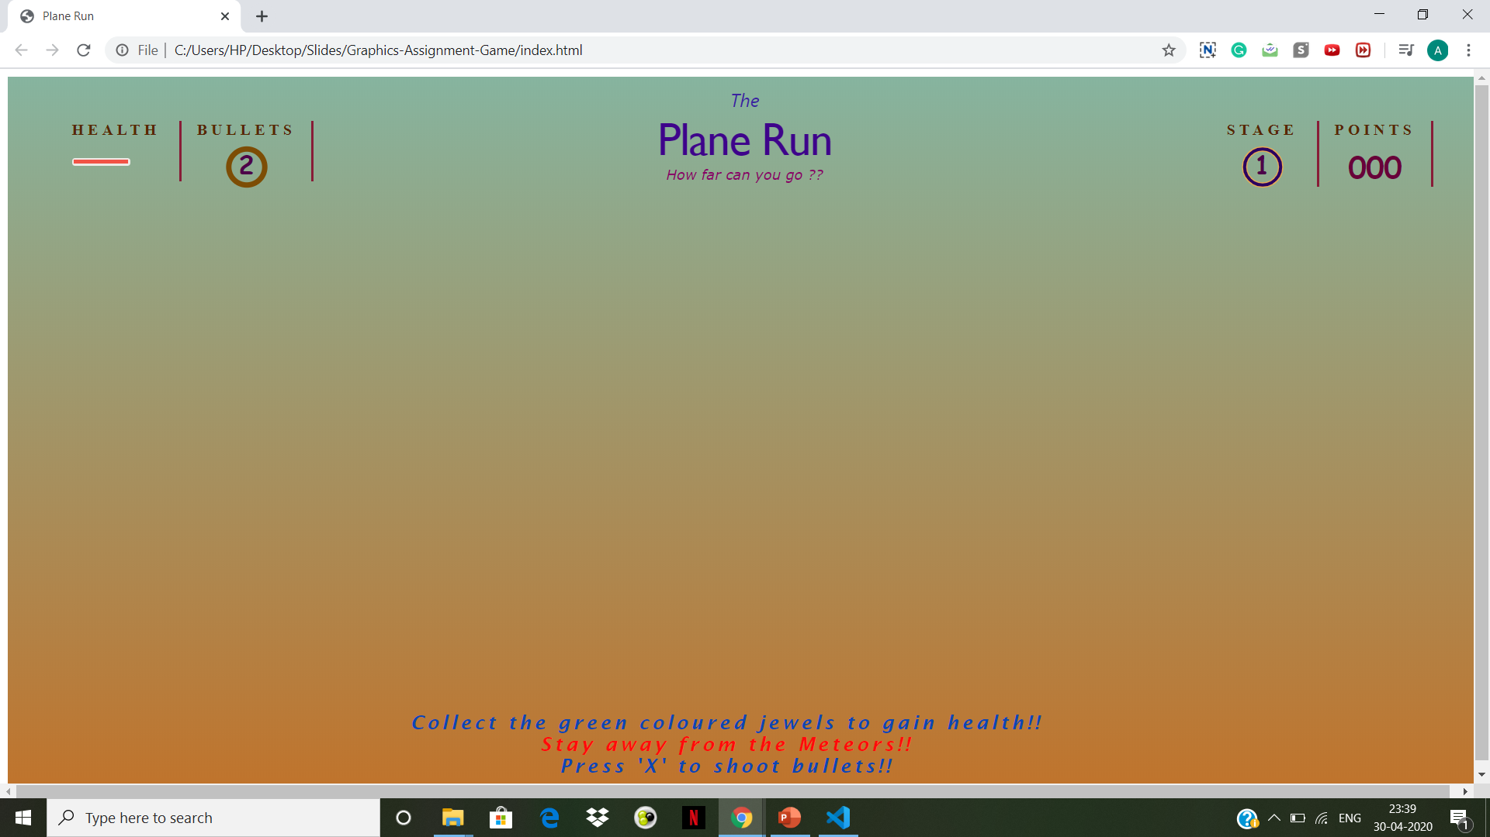
MODULAR DESCRIPTION – HTML AND CSS
Designing of HTML file
This file deals with basic structure of the web page. The snapshot of the html page is shown below.

Slide 7
MODULAR DESCRIPTION – HTML AND CSS
Designing of CSS file –
The stylesheet file contains the styles for all the text / static elements show in the image in previous slide.
The background colour for the sky has been given a gradient.
Flickering effect in the health bar is created using a CSS keyframe in which opacity is alternated between 0 and 1.

Slide 8
MODULAR DESCRIPTION – GAME.js – CAMERA & LIGHTING
Camera
A standard three.js perspective camera has been used
The viewing direction is along z axis.
The ocean, meteors, jewels, clouds rotate about the z-axis to give the effect that the plane is moving
Lighting
A light source is placed on the top of the scene
Three.js renders the shadow creation for the objects automatically if shadow attribute of object is set true.

Slide 9
MODULAR DESCRIPTION – GAME.JS
Object Creation
To create objects in the game we have followed a standard procedure followed in threejs:-
1. create a geometry
2. create a material
3. pass them into a mesh
4. add mesh to the source.

Slide 10
MODULAR DESCRIPTION – GAME.JS
List of objects in the scene:-
Sky and Clouds
Ocean
Aircraft
Meteors
Jewels
Bullets
Meteor Fragments

Slide 11
MODULAR DESCRIPTION – GAME.js – OBJECTS
Clouds
Combination of simple cubes whose number and angle are randomised.
We used polar coordinates for representation of clouds and converted them to cartesian coordinates
as per our requirement.
Sky
It is an empty 3D object. Just acts as a container for clouds
Made up of by placing clouds placing at an equal angle with each other.

Slide 12
MODULAR DESCRIPTION – GAME.js – OBJECTS
Ocean
Created using a cylinder whose axis coincides with z – axis.
Creating waves in ocean.
Manipulation of the vertices of the cylinder.
Applying cosine and sine to the x and y coordinates of the above created vertices.
Changing angle attribute of the vertices the waves w.r.t time.

Slide 13
MODULAR DESCRIPTION – GAME.js – OBJECTS
Aircraft
Fuselage – Made by altering the vertices of a basic cuboid object in three.js
Nose – Simple cuboid
Propeller – 2 cuboidal blades perpendicular to each other
Wing – Simple cuboid passing through the centre of the fuselage
Wheels – Simple cuboids placed at the bottom of the plane
Tail - Simple cuboid placed at the back

Slide 14
MODULAR DESCRIPTION – GAME.js – OBJECTS
Meteors
Simple tetrahedrons that are spawned periodically. Their number increases as the player progresses to next stage.
Meteor Fragments
Simple tetrahedrons that are generated on collision
After the fragments are spawned, their position

Slide 15
MODULAR DESCRIPTION – GAME.js – OBJECTS
Jewels
Created using tetrahedron geometry (available in threejs).
Number of jewels in each set is random.
The pattern of location of jewels in a set is formed using cosine wave.
The mean position of each set of jewel is also randomly decided.
Collection of jewels.

Slide 16
MODULAR DESCRIPTION – GAME.js – OBJECTS
Bullet
Created using a simple sphere geometry (available in standard threejs library).
Movement of bullet in the scene.
Checking collisions with obstacle meteors.

Slide 17
MODULAR DESCRIPTION – GAME.js – ANIMATION
How the frames are rendered
A function called loop() executes at the start of every animation frame.
Inside loop(), functions for updating the position of each object in the scene, increasing speed of the game, is invoked.
Also, functions for spawning meteors and jewels is periodically invoked after a particular distance is reached.
And, function for updating the points and stage is called.
The location of mouse pointer at each frame is stored (previous frame’s is also stored – used to calculate the extent to which aircraft is moved – basically how vigorous the movement is).

Slide 18
MODULAR DESCRIPTION – GAME.js – ANIMATION
Collision of meteor with bullet/aircraft
When bullet/aircraft reaches a tolerance distance to the meteor, the meteor explodes, spawning meteor fragments.
The TweenMax.js library has been used to animate the meteor fragments (The fragments’ scale, position and rotation is altered using this to give the effect of an explosion).

Slide 19
MODULAR DESCRIPTION – GAME.js – ANIMATION
Aircraft movement
Using the difference between current and previous mouse pointer position, the aircraft’s y-coordinate is altered.
Also the aircraft’s mesh is rotated about the z axis (nose pitching up and down) to give the effect of smooth upward/downward movement.
The magnitude of change in position and rotation is adjusted using sensitivity factor variables.

Slide 20
MODULAR DESCRIPTION – GAME.js – ANIMATION
Motion of sky, clouds, aircraft and ocean
The sky, clouds and ocean are rotating about z – axis and aircraft is kept stationary along z – axis and x-axis
This gives effect that aircraft is moving in 2 directions but actually it’s moving only in y-direction, based on mouse pointer input.

Slide 21
MODULAR DESCRIPTION – GAME.js – EVENT LISTENERS
There are total 5 event listeners present
For handling the movement of mouse pointer
For handling the event of mouse click.
For handling the event of pressing of any of the keyboard key.
For handling the event of pressing key ‘x’ in the key board.
For handling the event of resizing and reshaping the window.

Slide 22
MODULAR DESCRIPTION – GAME.JS - SOUNDS
Following sounds are added in the game:-
Background Sound
Sound when aircraft collects coin.
Sound of firing a bullet
Sound of breaking of meteor.
Level up sound.
Game over sound.
Sound is added using standard java script methods and different suitable attributes of the sound object are set.

