Slide 1
Decision Making
What is it?
Do I have it?
Can I develop it?

Slide 2
What is it?
Decision Making: the process of making choices by identifying a decision, gathering information, and assessing alternative resolutions.*
What choices have you made today?
When you made that choice did you think about what would happen after the choice was made?
Do you use different methods of decision-making depending on the severity of the problem?
*Source: Umass Dartmouth https://www.umassd.edu

Slide 3
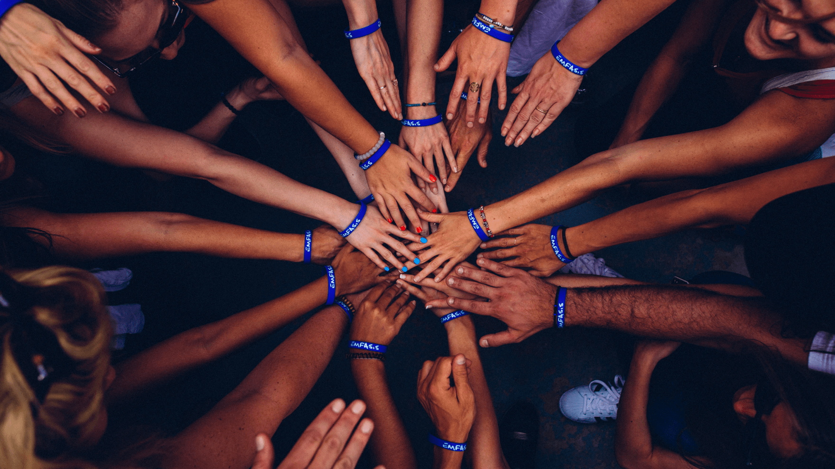
Do I have it?
Human knots
Helps with: Communication skills, collaboration.
Time: 10 – 15 minutes.
Have your team stand in a small circle (form multiple circles if you’re a larger group).
Each person should hold the hands of two other people in the circle that are not standing
directly beside them. This should create a messy knot of cross-crossed arms.
Untangle, without letting go of hands.
Notes:
Which traits, qualities and characteristics do you feel you excel in?
Which traits, qualities and characteristics do you feel you would like to develop?

Slide 4
Reflection and discussion… Can I develop it?
How did you decide to start working?
What happened with your communication?
Could we problem-solve to make decisions differently?

