Slide 1



Welcome to “Introduction to Scientific Programming with Python”!
Introduction to Python (Week 1, Fall 2026)
By the end of this four-week course, you will know:
Which Python libraries are most suitable for your application of interest and how to quickly look up documentation,
How to handle data in multiple formats (from text files to gridded spatial data via time series), manipulate them mathematically/statistically, and visualize them efficiently for scientific analysis and communication.

Slide 2
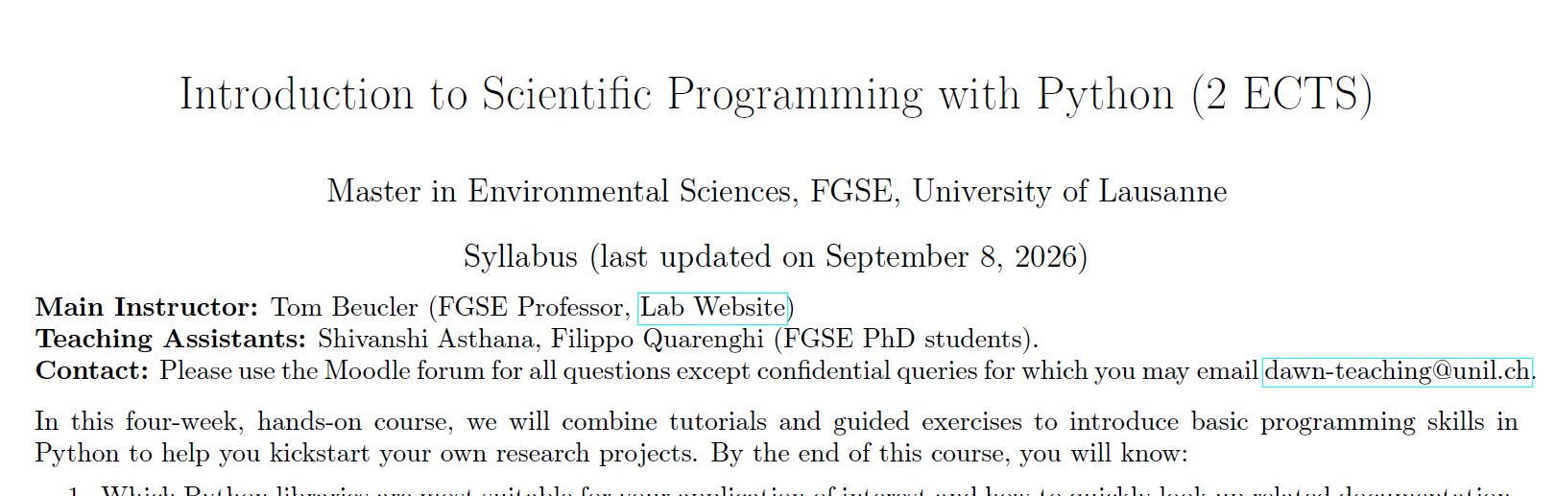
Min 15-30: Introductions, Moodle, and Syllabus
1) Instructor & TA
2) Open the course’s Moodle space: https://moodle.unil.ch/course/view.php?id=37057
3) Download the latest version of the syllabus

Slide 3





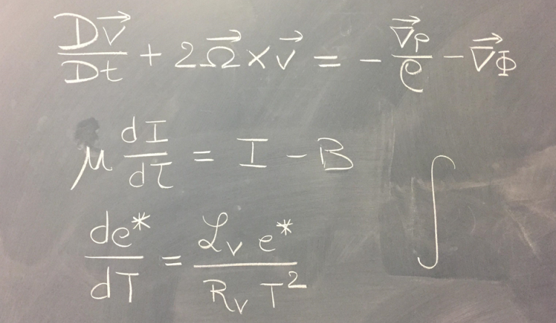


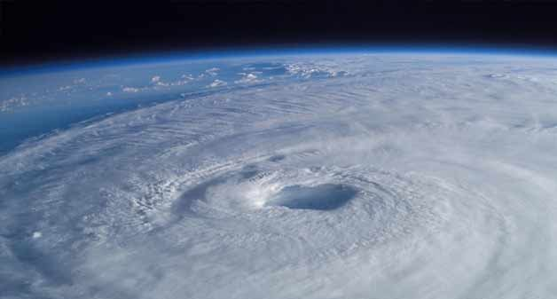
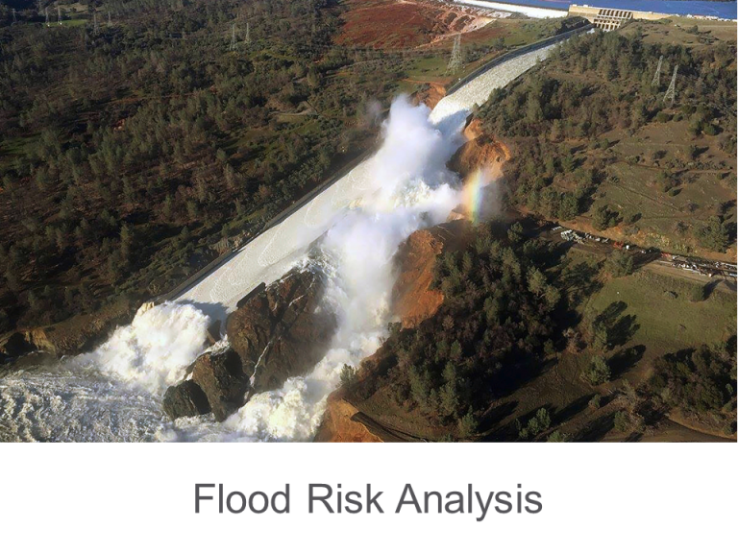
Atmospheric Physics + AI
Physics-Guided ML
Data-Driven Discovery
Extreme Weather Events
Forecasting,
Post-Processing,
Downscaling
Environmental
Data Science
Earth System Modeling
(Parameterization)
Image Sources: Adhithya Sandeep, John Lund, Cal. Dep. Wat. Res.
Notes:
EDS -> Methods developed general enough for wide geoscientific audience. Two-way interaction will also be outline of today’s talk.

Slide 4
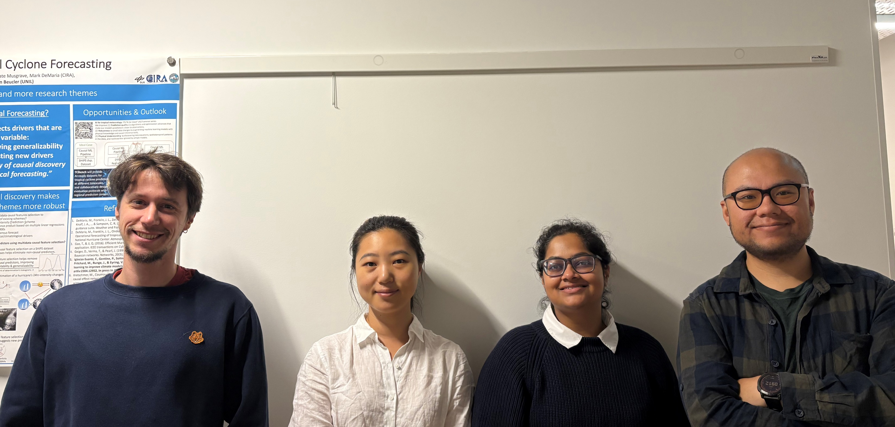
Filippo
Fei (substitute)
Frederick (substitute)
Shivanshi

Slide 5
Min 30-50: Tutorial
In Moodle, open “Session 1: Tutorial”

Slide 6
Min 50-60: Now it’s time to tell us about you!
Open “Session 1: Tell us about you” on Moodle
Don’t hesitate to ask for help regarding e.g., your GitHub account creation

Slide 7


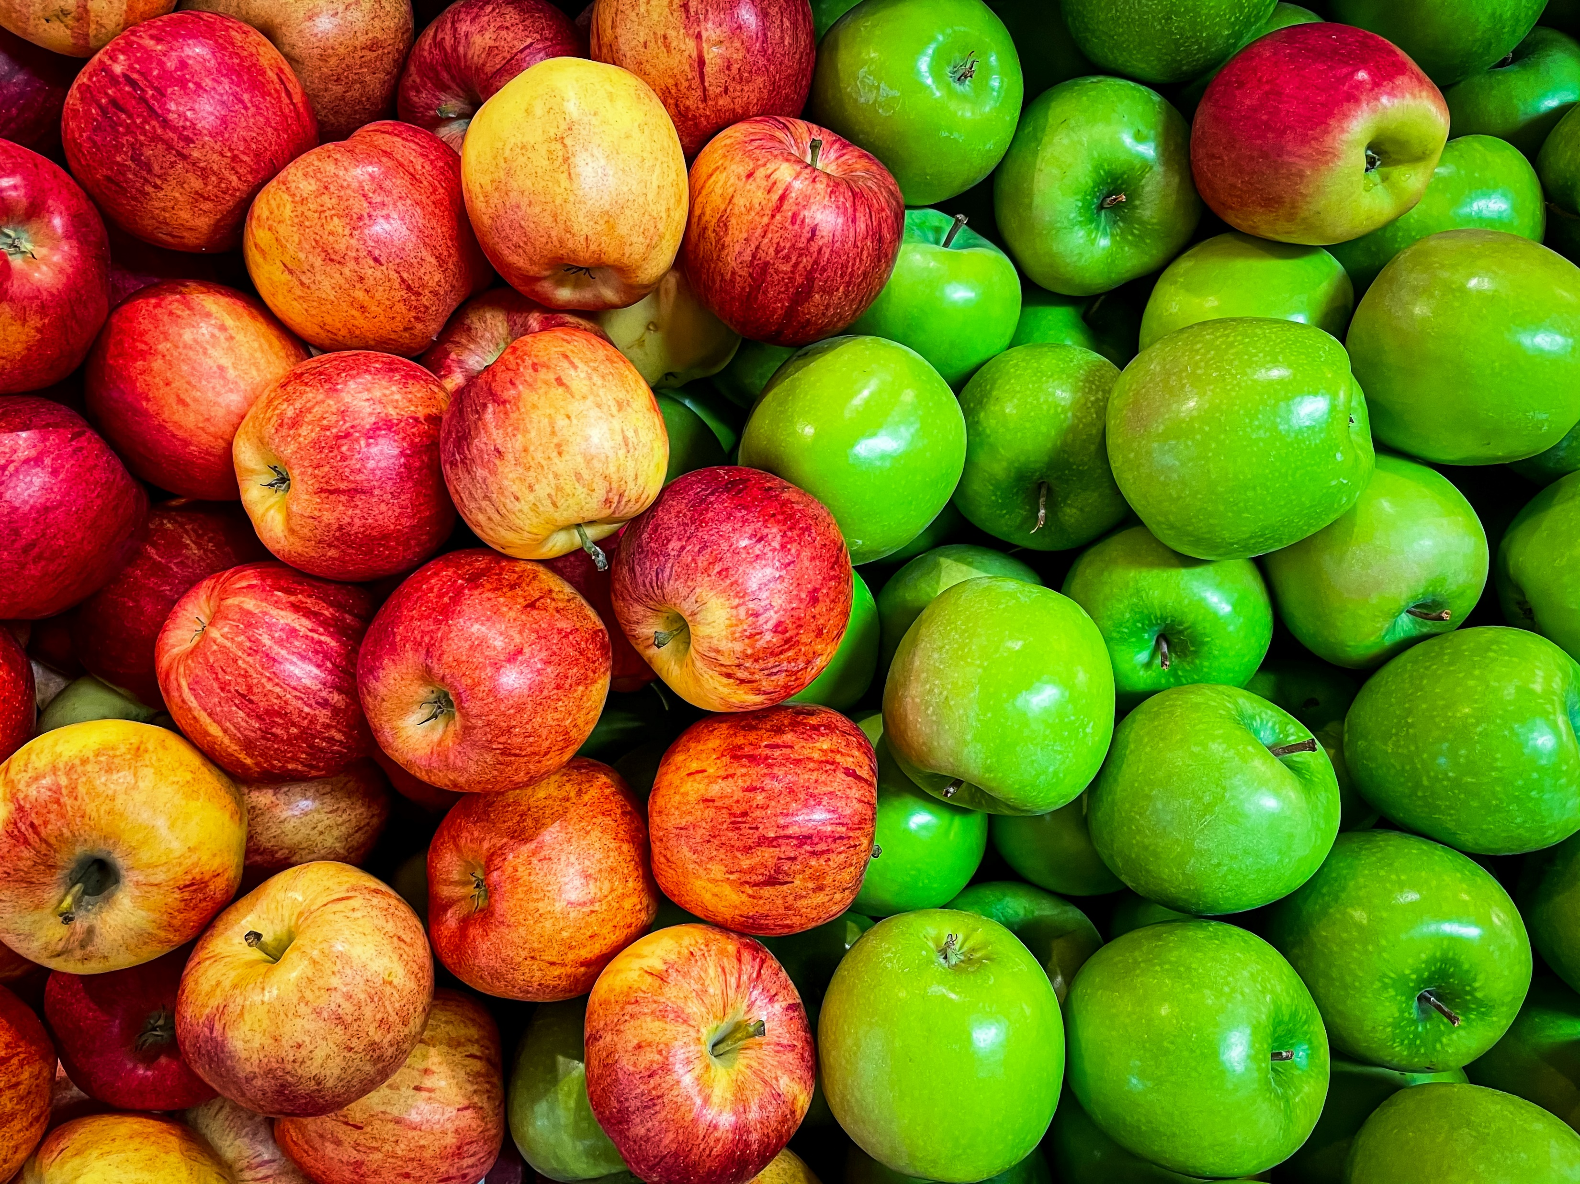
Min 60-75: Break

Slide 8
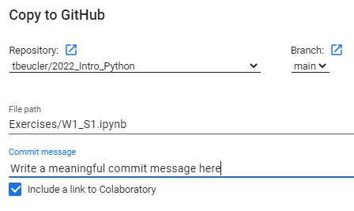
Min 75-120: Exercises (GitHub tutorial available)
1) In Moodle, open “Session 1: Exercises”
2) Have fun coding and don’t hesitate to look up the Python documentation. Please ask us if you have any question(s). We’re here to help 😊
3) Save your work regularly (“File” →”Save”)
4) At the end: “File”→”Save a copy in GitHub” to push the completed exercise
Your fork of latest repo
Write commit message
Keep box ticked for link
Exercises/W1_S1.ipynb

