Slide 1
MOCK PROJECT : MAGIC NUMBER
PRESENTATOR: NGỌC VINH

Slide 2
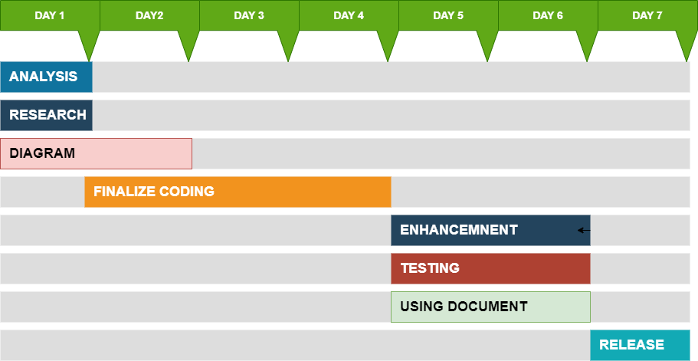
PLANING

Slide 3
FLOW CHART DESIGN
game_ flow_chart.pdf

Slide 4
RUN PROGRAM
MOCK_OFFICIAL\MAIN.exe

Slide 5
THANKS

Slide 6


