Slide 1
Remote Method Invocation (RMI)
By:
Anib Manandhar
Roshan Shrestha ‘b’

Slide 2
What is RMI ?
Remote Method Invocation allows applications to call object methods located remotely.
It helps to share resources and load across the distributed system.

Slide 3
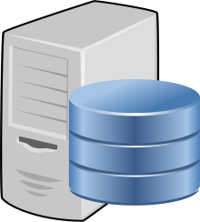

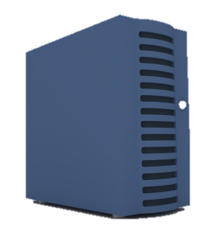
RMI Architecture
RMIRegistry
Client
Server
Stub Class
2. Lookup
3. Remote Procedure Call
1. Bind/Rebind
1. Server Bind/Rebind into RMI registry.
2. Client Lookup into RMI registry.
3. Client Remote Procedure Calls Server.
4. Stub class is tranfered to the client.

Slide 4
Basic RMI Flow
Client
Remote object Host
----------------------Interface (Prototypes)--------------------
main()
myFunction()
myFunction()
Return Value
Unmarshaling
STUB
Marshaling
SKELETON
RMI Registry with JVM
RMI Registry with JVM
Transport Layer

Slide 5
Basic Components
Client : This is the device application which calls/invokes the object remotely.
Client Stub : It is proxy server, which act as if the remote object is in the client machine. Hence the client calls object to the stub.
Marshaling : It is the conversion of invoked function into network portable form to send through network environment.
RMI registry : It is a special server that looks up objects by name (i.e. it must be unique).

Slide 6
Basic Components
Transport Layer : The transport layer is the low-layer that ships marshal streams between different address spaces.
Server Skeleton : It is proxy client. Hence the server returns value to the Skeleton.
Remote Object Host (server) : It is the device hosting the object (methods).The server binds the object for the client.
Interface : Interface is the behavior containing methods’ prototypes.

Slide 7
Code Notes
Interface :
Must Import java.rmi.*.
Must extend Remote class.
Must declare methods’ prototypes.

Slide 8
Code Notes
Server :
Must Import
java.rmi.*
java.rmi.registry.LocateRegistry
import java.rmi.server.*
Must extend UnicastRemoteObject class and handle exception for its constructor.
Must implement interface class.
The function are defined in the class.
“LocateRegistry.createRegistry(port)” is used to start “rmiregistry”.
“Naming.rebind(“Unique Caption”, serverObject)” is used to bind the object.

Slide 9
Code Notes
Client :
Must import java.rmi.Naming
The interface lookup is done using following:- Interface object = (Interface)Naming.lookup(" Unique Caption ");
The Naming Lookup must be type casted to interface class as above, so to use object like a local object.
The object is then used to invoke functions.

Slide 10
Execution Procedure
Run cmd on Server.
Compile all java files.
Start rmiregistry is not yet started.
Run Server class.
Run cmd on Client.
Compile all java files.
Run Client classes.

Slide 11


