Slide 1
Hardware Acceleration of CNN for MNIST Digit Recognition on FPGA
E3-231 Digital System Design for FPGA | 2026
Prayanshu Sharma (27451)
Vedant Saxena (26110)
Anirudh Chaturvedi (25850)
DESE
Microelectronics and VLSI Design

Slide 2
1. Introduction & Motivation
Project Goal
Why Not a Systolic Array?
Real-time MNIST handwritten digit recognition on FPGA
Image received via UART from a Python application
CNN inference entirely in hardware — no CPU involvement
Result displayed on FPGA LEDs as 4-bit digit code
Total Inference time < 10 ms
Initial Plan: Systolic array (as described in Kung 1982 & Eyeriss ISCA 2016)
Why We Pivoted:
Systolic arrays require im2col input unrolling — each input pixel is read multiple times, increasing memory bandwidth
Even on-the-fly unrolling demands complex NoC/routing logic between PEs
For small MNIST kernels (5×5), a simpler Row-Stationary dataflow with line buffers gives equivalent reuse at far less design complexity
Row-Stationary chosen: minimises data movement without systolic routing overhead
✓ Row-Stationary Dataflow with Line Buffers selected

Slide 3
2. What is a CNN? — Our Architecture
Convolutional Neural Network Basics
Our 2-Layer CNN Architecture (MNIST)
Stacked layers extract hierarchical features from raw pixels
CONV layer: slides filters over input to produce feature maps
Activation (ReLU): non-linearity — max(0, x)
Max Pooling: spatial downsampling, retains strongest feature
FC layer: maps flattened features → class scores
ArgMax: selects class with highest score → digit 0–9
Input
28×28×1
CONV1+ReLU
5×5, 4 filt
MaxPool
2×2
24×24×4
12×12×4
FC Layer
128→10
MaxPool
2×2
CONV2+ReLU
5×5, 8 flt
4×4×8
8×8×8
ArgMax
Classifier
Digit 0–9
Why only 2 CONV layers? — Achieved 98%+ test accuracy on MNIST.
Additional layers add complexity without meaningful gain for this task.

Slide 4
3. Design Strategies Overview
3a. Q1.5.10 Fixed-Point Quantization
3b. Clock Gating per Module
Weights verified in Python — all fall within −31 to +31 (5 integer bits needed)
1 sign bit + 5 integer bits + 10 fractional bits = 16-bit format
Quantization-Aware Training (QAT) applied to preserve accuracy
Reduced memory footprint vs FP32; each weight stored in 1 × 16-bit BRAM word
Each compute module uses BUFGCE for synchronous clock gating
Controller asserts MODULE_EN only for the active opcode
Idle modules draw near-zero dynamic power
Significant power saving across multi-stage inference pipeline
3c. Row-Stationary Dataflow
3d. Fully Pipelined Compute
Avoids complex NoC: uses simple line buffers for activations & weights
Each PE row holds one kernel row; slides across input feature map
Minimises BRAM reads — 128-bit-wide activation BRAM fills 8 pixels per read
Spatial unrolling: 24×5 PE rows compute all output rows in parallel
All operator modules (ConvReLU, MaxPool, Classifier) are pipelined internally
Controller state machine sequences operations via instruction BRAM
End-of-operation (EOP) handshake allows zero-idle chaining of layers
Target: operate at system clock frequency (100 MHz on Artix-7)

Slide 5
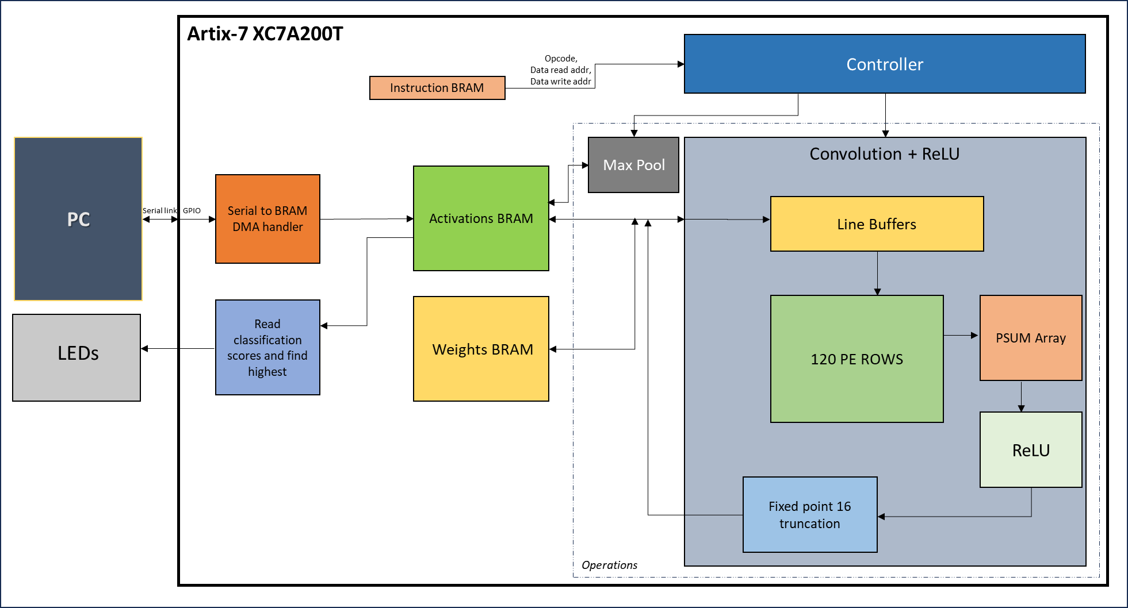
4. Top-Level Architecture Block Diagram
Controller
(Sequencer FSM)
Instruction
BRAM
64-bit
Classifier
(ArgMax)
LEDs
(Digit)
MMCM
All compute modules use BUFGCE clock gating — only the active module is clocked each cycle

Slide 6
4a. Top-Level Interfaces
Signal | Dir | Description
UART_RX_ASYNC | IN | Asynchronous UART receive from PC (Python app sends 28×28 grayscale image)
UART_TX | OUT | Tied HIGH (idle) — transmission not used in this design
CLK / RESET | IN | 100 MHz system clock; active-high synchronous reset
LED_OPS_BUSY | OUT | HIGH while CNN inference is running (controller not in IDLE)
LED_OPS_DONE | OUT | HIGH when HALT instruction executed — inference complete
LED_OPS_DATARX | OUT | HIGH while image bytes are being received over UART
LED_IDLE | OUT | HIGH when system is idle (no data, no inference)
CNN_DETECTED_DIGIT[3:0] | OUT | 4-bit binary code of recognised digit (0–9) on discrete LEDs

Slide 7
5a. Controller Module
Controller — Instruction Sequencer
Controller FSM
Program Counter (PC) fetches 64-bit instructions from Instruction BRAM
Each instruction encodes: opcode (8-bit), base
addresses (3×14-bit), input/output dimensions (9×10-
bit), and parameters (pool_dim, stride, num_filters,
relu_en)
Opcodes: OP_CONV (0x01), OP_MAXPOOL (0x02), OP_CLASS (0x03), OP_HALT (0xFF)
Asserts EN_CONV / EN_MAXP / EN_CLASS (clock-gate + BRAM mux select)
Asserts SOP (start-of-operation) to active module; waits for EOP
On HALT: asserts halt flag → triggers LEDs → inference done
CNN_BUSY wire: HIGH whenever controller is not in IDLE state
IDLE
FETCH0
WAIT0
DECODE0
FETCH1
WAIT1
DECODE1
ASSERT_SOP
FETCH2
WAIT2
DECODE2
NEXT
WAIT_EOP
START_CONTROLLER → IDLE→FETCH0

Slide 8
5b. MaxPool Module
MaxPool — Description
MaxPool 7-Stage Pipeline
Supports variable kernel sizes up to 4×4; stride = kernel size (non-overlapping)
128-bit activation BRAM interface: fetches 8 pixels per clock cycle
Barrel-shift extraction aligns pixels across 128-bit word boundaries
Pipeline: AGU (3 phases) → WAIT → LATCH → SHIFT → MAX_L1 → MAX_L2 → PACK+WRITE
7-stage pipeline; throughput: 1 pooling window row per 3 cycles
Clock gated via BUFGCE — inactive when controller deasserts MODULE_EN
S1: AGU
(PREP/W0/W1)
S2: WAIT
(BRAM latency)
S3: LATCH
(Word 0)
S4c: MAX_L2
(Row max)
S4b: MAX_L1
(Pairwise)
S4a: SHIFT
(Barrel)
S4d: PACK
+WRITE
Throughput: 1 window-row per 3 cycles | BRAM: 128-bit, 8 pixels/read

Slide 9
5c-i. Dataflows for CNN Implementation
Three major dataflow strategies for CNN on spatial architectures
Weight Stationary (WS)
Output Stationary (OS)
Input Stationary (IS)
Weights stay in PE registers; all N×E² uses served from local RF
Maximises filter & convolutional reuse of weights
Psums spill to global buffer — high buffer bandwidth
Inefficient for ifmap reuse
Each PE accumulates one output pixel in its register file
Minimises partial sum movement (stays in RF)
Ifmap/filter reuse done at array level (inter-PE broadcast)
Struggles with high-dim convolutions
Inputs stay in PE registers; all filter uses served from local RF
Maximises convolutional reuse of input feature maps
Weights and psums spill to global buffer — high buffer bandwidth
Inefficient for weight reuse
Good when weights >> ifmaps (FC layers)
Good when output feature map fits in PEs
Good when ifmaps >> weights (early CONV layers)

Slide 10
5c-ii. Why Not a Systolic Array ?
Systolic Array Approach (Kung 1982)
Our Solution: RS with Line Buffers
Weights stay in cells; inputs/outputs flow rhythmically
High throughput without high memory bandwidth
Suitable for matrix multiply and convolution
Used in Google TPU and Eyeriss variants
Line buffer holds one full row of input activations (128-bit wide reads pack 8 pixels)
Weight line buffer loads one filter row (5 × 16-bit words) per PE row
No im2col: activations are read once per row, then broadcast to all PE rows simultaneously
PE rows are spatially unrolled — 24 output rows × 5 kernel rows = 120 PE rows
Each PE row independently computes its convolution sliding window
Avoids complex NoC: only broadcast load buses and vertical psum accumulation needed
Why we avoided it:
Requires im2col input transformation (copying/rearranging ifmap)
Even on-the-fly: each pixel read multiple times → high BRAM bandwidth
Complex inter-PE routing (NoC) for 2D systolic array
Result: 3D Convolution mapped natively to hardware—avoiding the NoC complexity of standard Eyeriss.

Slide 11
5c-iii. ConvReLU Module — PE Array
ConvReLU — How It Works
PE Array Layout (24×5 = 120 PE Rows)
PE Array:
  Size = 24 × 5 = 120 PE rows
  Each row has 5 PEs, each storing one weight
  Computes dot product (filter row × ifmap slice)
Data Movement:
  Line Buffer: Loads 1 activation row (128-bit BRAM) → broadcast to all PE rows
  Weight Buffer: Loads 1 filter row per PE row (16-bit BRAM)
Computation:
  Partial sums accumulated across input channels
  Stored in 24 × 24 psum registers
Post-Processing:
  Q1.5.10 quantization → optional ReLU → write to activation BRAM
Fully Connected Layer:
  Reuses Conv+ReLU with kernel = ifmap size (single output pixel)
Control:
Clock gated (BUFGCE) → active only when EN_CONV = 1
Act BRAM
(128-bit)
Wgt BRAM
(16-bit)
Act Line Buffer
(8 pixels)
Wgt Line Buffer
(5 weights)
Broadcast
PE
0
PE
1
PE
2
PE
3
PE
4
Psum
Accum
24×24
PE Row 0
PE
5
PE
6
PE
7
PE
8
PE
9
PE Row 1
PE
10
PE
11
PE
12
PE
13
PE
14
PE Row ... (row 23)
↕ psum accumulation across channels
Weights broadcast per PE row

Slide 12
5c-iv. ConvReLU — FSM & Pipeline
ConvReLU FSM States & Data Flow per Channel
S_IDLE
S_INIT_FILT
S_LOAD
S_COMPUTE
Wait for SOP pulse from controller
Initialise filter / psum arrays for new filter
Load activation & weight line buffers from BRAM
Enable PEs — slide window across row; accumulate psums
S_PIPE_DRAIN
S_CHAN_INC
S_WRITE_INIT
S_WRITE
Wait for PE pipeline to flush last products
Move to next input channel; repeat LOAD→COMPUTE
Quantise accumulated psum; apply ReLU if enabled
Write quantised output rows to activation BRAM
S_WRITE_FLUSH
S_FILT_INC
S_DONE
Flush final BRAM write
Move to next filter; repeat from S_INIT_FILT
Assert EOP → controller fetches next instruction
Inner loop: LOAD → COMPUTE → PIPE_DRAIN (repeated for each input channel C)
Outer loop: per filter (INIT_FILT → channel loop → WRITE → FILT_INC)

Slide 13
5d. Classifier (ArgMax) Module
Classifier — Description
Classifier Pipeline
Reads 10 output activations (FC layer output: one per digit class)
Finds the index of the maximum signed 16-bit Q1.5.10 value
Fully pipelined: streams BRAM reads with 3-cycle latency pipeline
Writes winning index to activation BRAM at OUT_ACT_ADDR
Clock gated — only active when EN_CLASS asserted
Latency: ~13 cycles total (10 reads + 3 pipeline stages)
S_IDLE
Wait SOP
D1: valid_d1
idx_d1 latched
S_PIPELINE
Stream BRAM reads
(req_cnt < 10)
D2: valid_d2
BRAM data available
D3: valid_d3
Compare vs max_val
Update max_idx
S_DONE
Assert EOP
S_WRITE
Write max_idx
to Act BRAM

Slide 14
5e. Serial-to-BRAM (UART Image Loader)
Serial-to-BRAM — Description
UART Receiver FSM
Baud Rate: 9.6 kbps, 19.2 kbps,115.2kbps; system clock: 100 MHz
Start Adder sequence: 0xAABBCCDDEEFF1122 (64-bit) detected to begin reception
Header: 3 × 16-bit words = image H, W, C (e.g. 28, 28, 1)
Receives H×W×C bytes, packs 8 pixels per 128-bit BRAM word
End footer sequence: 0x2211FFEEDDCCBBAA confirms complete image
On completion: pulses START_CNN → controller begins inference
CNN_BUSY prevents overwrite during active inference
IS_RECEIVING tied to LED_OPS_DATARX for user feedback
S_WAIT_START
Detect magic seq
S_READ_HEAD
H, W, C header
S_CALC_DIMS
Compute expected
bytes & addresses
S_RECEIVE
Store bytes to BRAM
8px / 128-bit word
S_WAIT_END
Detect end magic
START_CNN
Pulse → Controller

Slide 15
5f. BRAM Design — Memory Architecture
Three BRAMs, each width-optimised for its access pattern:
Instruction BRAM
64-bit × 1024
1 port (R/W)
Each instruction is 3 × 64-bit words. Wide data bus reduces the number of BRAM reads per instruction fetch from 6 (if 32-bit) to 3, cutting fetch latency and controller cycles.
Weights BRAM
16-bit × 16384
1 port (R-only)
Each weight is exactly one Q1.5.10 16-bit word. A wider bus would waste bandwidth; 16-bit is the minimal width that matches our fixed-point format, maximising depth for many filters.
Activations BRAM
128-bit × 16384
Dual-Port
8 Q1.5.10 activations per 128-bit word. Fills the ConvReLU activation line buffer (up to 28 pixels wide) in ≤4 reads. MaxPool also fetches 8 pixels per cycle. Wide width is key to throughput.

Slide 16
6. Simulation & Implementation Results
6a. Behavioural Simulation
6b. Post-Implementation Timing
6c. Timing Summary
UART image transmission verified at 9.6 kbps, 96.2 kbps and 115.2 kbps
Controller correctly sequences CONV→POOL→CONV→POOL→FC→CLASS→HALT
ConvReLU psum accumulation verified against Python golden model
MaxPool outputs match expected downsampled feature maps
Classifier ArgMax selects correct class index
Worst Negative Slack (WNS): 0.092ns
All paths met at 70 MHz target frequency
Critical path: PE multiplier → psum accumulator chain
BUFGCE clock gates validated in post-impl netlist
No hold violations reported
Target clock period: 10 ns (100 MHz)
Setup slack (WNS): 0.092 ns
Hold slack (WHS): 0.026 ns
Pulse width slack: 3 ns
Total negative slack: 0.00 ns
6d. Utilisation
6e. Power Summary
LUTs: 65710 / 133800 (Artix-7 35T)
FFs: 71277 / 267600
BRAM: 39 / 365
DSP48 slices: 614 / 740
I/O: 14 / 285
MMCM: 1 / 10
Total on-chip power: 1.483 W
Dynamic power: 1.345 W (with clock gating)
Static power: 0.138 W
Primary dynamic contributor: ConvReLU PE array

Slide 17
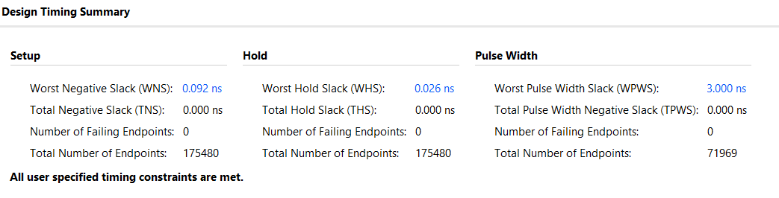
6c. Timing Summary

Slide 18
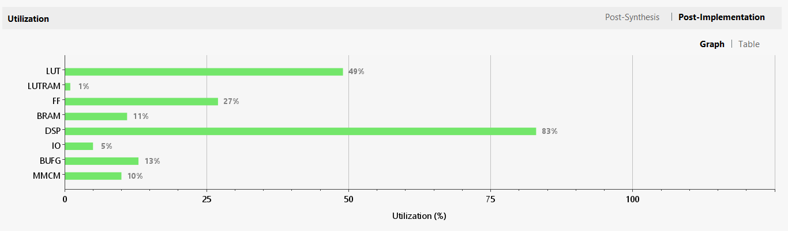
6d. Utilisation

Slide 19
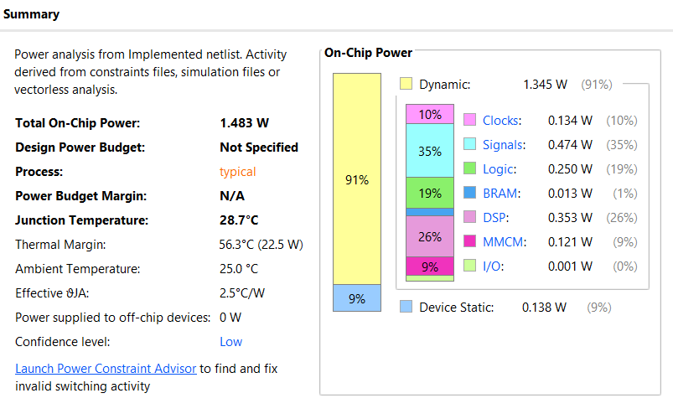
6e. Power Summary

Slide 20
7. Live Demo — End-to-End Flow
1
Draw Digit
2
Preprocess
3
UART → BRAM
User draws a digit (0–9) on the Python GUI canvas
Python app resizes to 28×28 grayscale, sends magic header + image over UART at 2 Mbps
Serial-to-BRAM packs 8 pixels per 128-bit word; LED_OPS_DATARX lights during transfer
4
CNN Inference
5
Result Out
6
Display
Controller sequences: CONV1+ReLU → MaxPool → CONV2+ReLU → MaxPool → FC → ArgMax
Classifier writes digit index (0–9) to BRAM; LED_OPS_DONE asserts; CNN_DETECTED_DIGIT[3:0] drives LEDs
4 discrete LEDs show binary-encoded digit; optional 7-segment also shows result

Slide 21
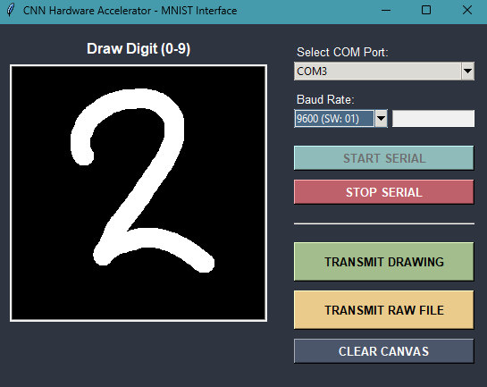
7a. Demo Setup & Python Application
Hardware Setup
Tkinter GUI with drawing canvas (left-click to draw)
Send button: preprocesses and transmits image via pyserial
Image pipeline: PIL resize to 28×28 → grayscale → byte array
Prepends Adder and Footer + H,W,C header (9 bytes)
Appends magic end sequence (8 bytes)
Baud Rate: 9.6 kbps, 19.2 kbps,115.2kbps
Python Application
Board: Xilinx Artix-7 (Nexys Video A7)
UART via USB-UART bridge (CP2102/CH340)
Input: USB cable to PC running Python GUI
Output: 4 × discrete LEDs showing digit (binary)
LED_OPS_BUSY / DONE / DATARX for status feedback
Inference Sequence:
Phase | Indicator
Image receiving | LED_OPS_DATARX ON
CNN running | LED_OPS_BUSY ON
Done | LED_OPS_DONE ON, Digit on LEDs
Idle | LED_IDLE ON

Slide 22
References
[1] H. T. Kung, “Why Systolic Architectures?” Computer, vol. 15, no. 1, pp. 37–46, Jan. 1982.
[2] Y.-H. Chen, J. Emer, and V. Sze, “Eyeriss: A Spatial Architecture for Energy-Efficient Dataflow for Convolutional Neural Networks,” in Proc. ACM/IEEE 43rd Annual International Symposium on Computer Architecture (ISCA), Seoul, South Korea, 2016, pp. 367–379.
[3] E3:231 Digital Systems Design with FPGAs, Course Lecture Slides, DESE, Indian Institute of Science, Bangalore, 2026.

Slide 23
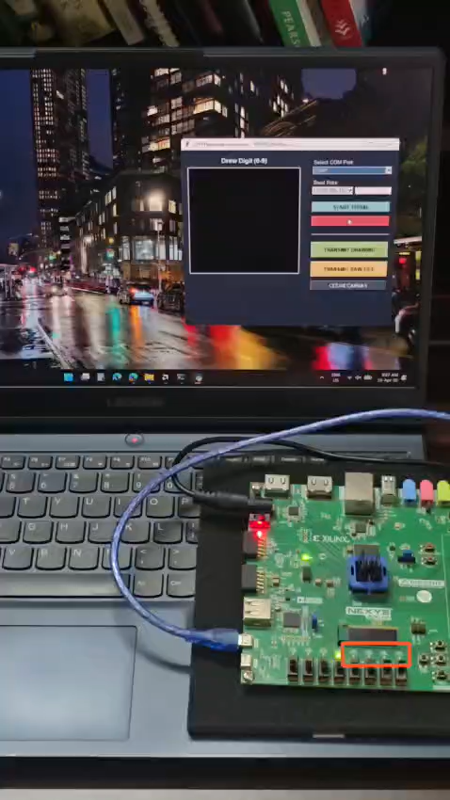
Thank You

