Slide 1
Model Context Protocol (MCP)
A simple way for AI to connect with tools
Ankit Dogra, Anideep Kalia
Associate Engineer
Customer Success Services (CSS)
September 18, 2025

Slide 2
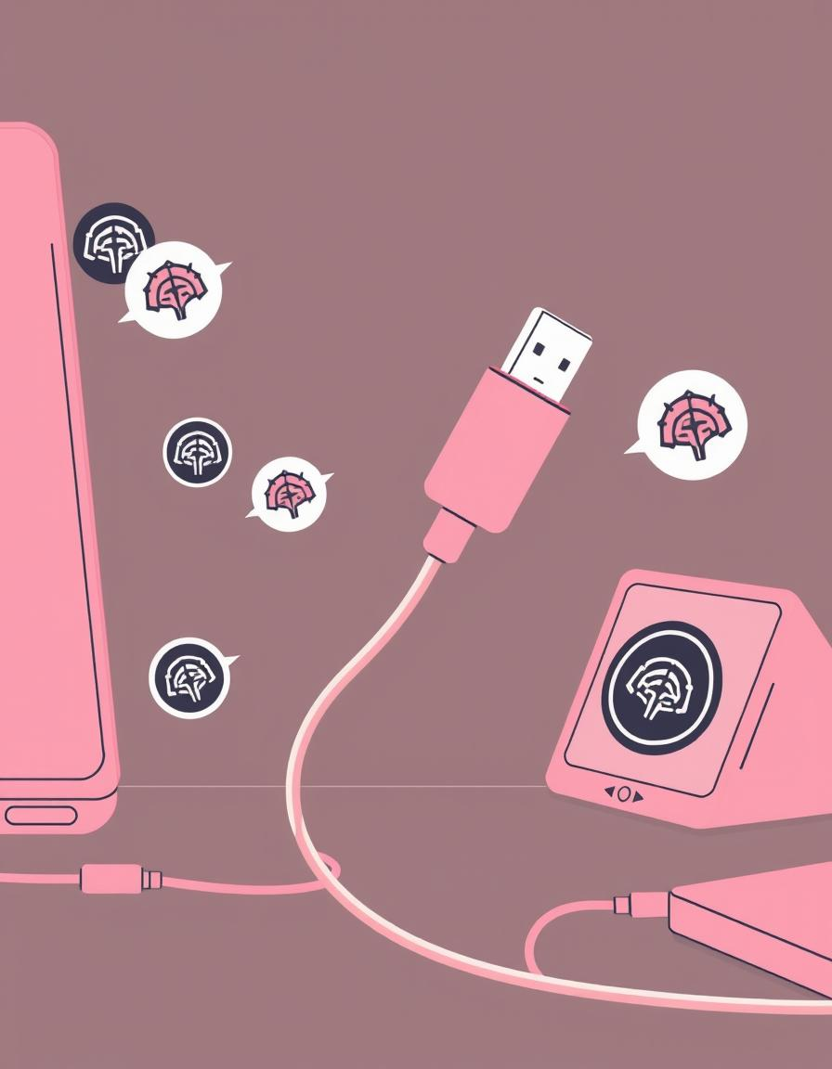
CHAPTER 1
What Is MCP?
1
Open, Universal Standard
MCP provides a standardized framework that allows AI models to seamlessly connect with a multitude of external data sources and tools.
2
AI's "USB-C Port"
Imagine a universal connector for AI. MCP serves this purpose, enabling any AI to "plug and play" with applications, databases, and services through a single, unified interface.
2

Slide 3
CHAPTER 2
Why Does MCP Exist ?
Isolated Intelligence
Before MCP, large language models (LLMs) were powerful but isolated, unable to directly access real-time data or interact with external tools.
The Integration Challenge
2
Connecting AI to different systems required custom, complex coding for every single integration, creating an overwhelming "NxM" problem that hindered widespread AI adoption.
MCP was developed to overcome these significant hurdles, paving the way for truly integrated AI.

Slide 4



CHAPTER 3
How MCP Works: The Basics
MCP Clients
MCP Servers
MCP Protocol
AI applications, like Claude, initiate requests for information or actions.
These connectors interpret AI requests and translate them into commands for external applications (e.g., Google Drive, Slack, calendars).
The standardized language that ensures smooth, real-time communication and interoperability.
2
This elegant three-part structure enables AI to interact dynamically with the digital ecosystem.

Slide 5
CHAPTER 3(cont.)
Capabilities of MCP
MCP Resources
MCP Tools
MCP Prompts
Shared data or services that MCP (Model Context Protocol) exposes to clients
Purpose: Let different apps/models access common, structured information (e.g., documents, datasets, configs)
Functions or actions that MCP makes available for clients to call.
Purpose: Allow automation, computation, or external integrations.
Predefined or dynamic instructions/templates that guide how the model interacts with resources/tools.
Purpose: Ensure consistency and efficiency when asking the model to perform tasks.
2

Slide 6
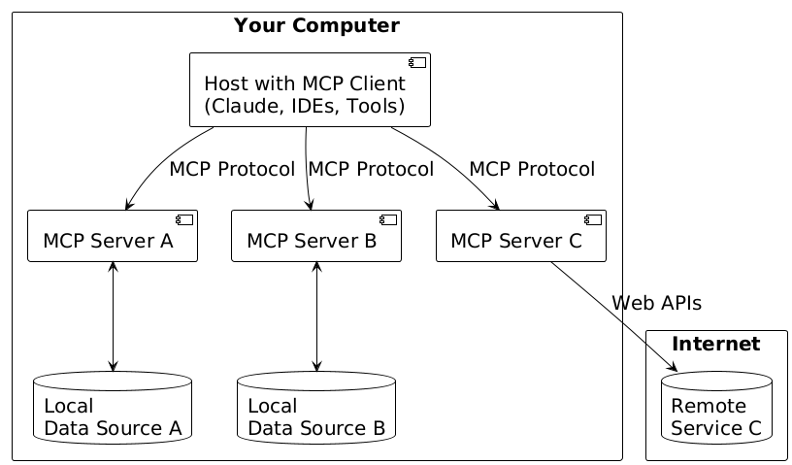
CHAPTER 4
General Structure of MCP
2

Slide 7
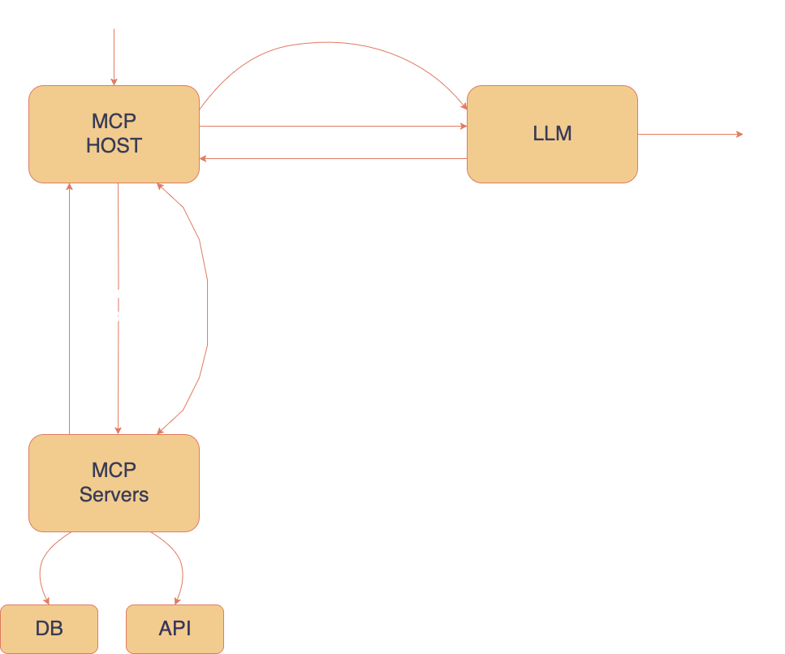
CHAPTER 5:
Flow Diagram
2

Slide 8

CHAPTER 5
Real-World Impact: MCP in Action
Smart Assistants: AI can access your emails, calendars, and documents to schedule meetings or summarize projects.
Developer Efficiency: Developers save time by building once against MCP, eliminating the need for custom integrations for every AI-tool pair.
Enhanced Productivity: Businesses gain smarter AI assistants that can act on live data, significantly improving productivity and user experience.
2
MCP transforms AI from a static tool into a dynamic, active participant in daily operations.

Slide 9
CHAPTER 6
Conclusion
MCP provides a standardized way for models, tools, and systems to communicate.
With resources, tools, and prompts, it creates a bridge between AI and real-world workflows.
MCP ensures interoperability, flexibility, and scalability, making it easier to build powerful AI-driven applications.
2
In essence, MCP is not just a protocol – it’s a foundation for the future of AI integration.

