Slide 1
PROJECT DEFENSE
AraCare
Health OS
A hospital operating system built for how Nigerian facilities actually run.
[Your name] · [Matric no.] · Supervisor: [Name] · [Department]
AraCare Health OS
01 / 10
01 / 10
Notes:
Opening. Frame the question for the panel: anyone who has attended a public hospital in Nigeria knows this experience. The project is AraCare Health OS, a hospital operating system built for Nigerian facilities. State your name, matric number and supervisor.

Slide 2
PART 1 · THE PATIENT'S DAY
Before sunrise, the line has formed
Her child has a fever. She joins the line early, because she knows what the day will look like.
There is no ticket, no order and no estimate. Place in line is decided by who pushes in first, and every patient waits without knowing for how long.
Queue position: unknown
AraCare Health OS
02 / 10
Notes:
Introduce the composite patient: Mrs. Ngozi, with a feverish child. She arrives before sunrise because she knows what the queue is like. There is no ticket and no order; the queue is whoever pushed in first. Ask the panel to recall their own experience. Note this is a composite scenario used to illustrate the observed problem.

Slide 3
PART 1 · THE PATIENT'S DAY
The file cannot be found
A new folder is opened and her history starts again from zero.
Earlier diagnoses, allergies and prescriptions are not available to the clinician at the moment they matter most.
?
Patient history: not available
AraCare Health OS
03 / 10
Notes:
At the desk, her file cannot be found. With paper records, the file is in a shelf, in another department, or misplaced. The consequence is a new file and a lost history: previous diagnoses, allergies and prescriptions disappear. Point out that this is a patient-safety issue, not only an inconvenience.

Slide 4
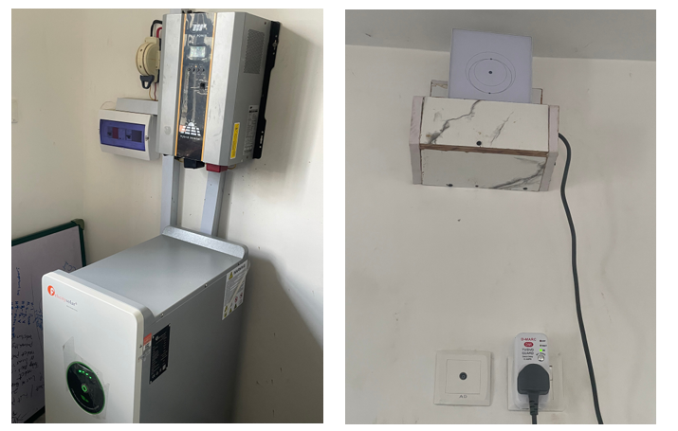
PART 1 · THE FACILITY'S REALITY
Power and network are not guaranteed
Facilities depend on inverters and generators.
Internet access drops without warning.
A system that needs the cloud stops when the connection does.
Power infrastructure at a working site
Design requirement: keep working offline, on the facility LAN
AraCare Health OS
04 / 10
Notes:
Facilities run on inverters and generators. Power and connectivity fail mid-consultation. This photo is from a real working environment. The design implication: a cloud-only system is not viable here. Whatever we build must keep working on the facility's local network when the internet or power is interrupted.

Slide 5
PART 1 · THE CONSULTATION
Writing instead of listening
Consultation time is limited, and a large share of it goes to documentation.
What the visit is for
What the visit becomes
Listen to the history
Examine and reason
Explain the plan to the patient
Handwrite every note
Re-copy details into records
Eyes on paper, not on the patient
AraCare Health OS
05 / 10
Notes:
She finally reaches the doctor. The doctor's time is split between the patient and the paperwork. Notes are written by hand, in addition to examining, diagnosing and prescribing. Every minute spent writing is a minute not spent listening. This is the gap the AI scribe addresses later in the deck.

Slide 6
PART 2 · THE RESPONSE
One connected system
Each problem from the patient's day has a matching module.
1
2
3
4
›
›
›
Registration
Queue engine
EHR
AI scribe
Check-in and patient identity
Ordered tickets, live status
Triage and SOAP notes
Voice to draft note
no lost files
no pushing in
history is kept
less writing
Designed, with event hooks in place, not yet built: Billing · Pharmacy and inventory · Cloud sync
AraCare Health OS
06 / 10
Notes:
The turning point. Four problems: no queue order, lost records, unreliable infrastructure, documentation burden. AraCare answers each with a module. Walk the flow left to right: Registration and check-in, the queue engine, the electronic health record with triage and SOAP notes, and the AI voice scribe. Billing and pharmacy are designed and have event hooks, but are not built yet; say so honestly.

Slide 7
PART 2 · TECHNICAL DESIGN
One server per facility
Clients
Reception · Nurse · Doctor · Admin
Key decisions
Runs on the facility LAN, offline-capable
Modular, so billing and pharmacy plug in
Docker Compose deploy on one server
FastAPI
Core · Registration · Queues · EHR · Scribe
Real-time
Event bus · WebSocket queue updates
Data
PostgreSQL 16 (SQLite in dev) · Alembic
AraCare Health OS
07 / 10
Notes:
Architecture. Clients (reception, nurse, doctor, admin) talk to one FastAPI server per facility. The API is organised into modules: core, registration, queues, EHR and scribe, joined by an internal event system. PostgreSQL in production, SQLite in development, schema managed by Alembic. A WebSocket hub pushes live queue updates. Important caveat: run exactly one API process, because the queue sweeper and WebSocket hub are in-process; scaling out would require Redis pub/sub first.

Slide 8
PART 2 · TECHNICAL DESIGN
The AI scribe runs on-site
Consultation
Whisper
Local LLM
Clinician review
›
›
›
Doctor and patient speak
Local speech-to-text
Qwen via Ollama drafts a SOAP note
Edit, approve, save to EHR
No cloud API
Data stays on-site
Clinician in control
no per-call cost
privacy by design
draft, never final
AraCare Health OS
08 / 10
Notes:
The AI voice scribe addresses slide 5. Audio from the consultation is transcribed locally by Whisper through faster-whisper, then a local LLM, Qwen 2.5 7B through Ollama, structures the text into a SOAP note draft. The clinician always reviews and approves the draft. Everything runs on the facility's own machine: no cloud API, no per-call cost, and patient data never leaves the building. Likely examiner question: accuracy with Nigerian accents and clinical terms; answer: the model size is configurable and the clinician review step is the safeguard.

Slide 9
PART 2 · RELIABILITY AND EVIDENCE
Engineered to be trusted
36
automated tests covering flow, queue, scribe and security
Safeguards built in
Role-based access
Account lockout after repeated failures
Refuses weak secrets in production
Versioned database migrations
AraCare Health OS
09 / 10
Notes:
Evidence that the system is engineered, not just demonstrated. Left: load test of the /predict endpoint. Before the fix throughput stayed flat at about 14 requests per second regardless of concurrency; after the fix it scales to about 139 per second at 40 concurrent requests. Note this endpoint is from the supporting ML service, tested as a separate load test. Right: safeguards in the AraCare backend: 36 automated tests, account lockout after 5 wrong passwords for 15 minutes, forced password change for the first admin, the server refusing to start in production with a weak secret or wildcard CORS, and sessions invalidated on password or role change.

Slide 10
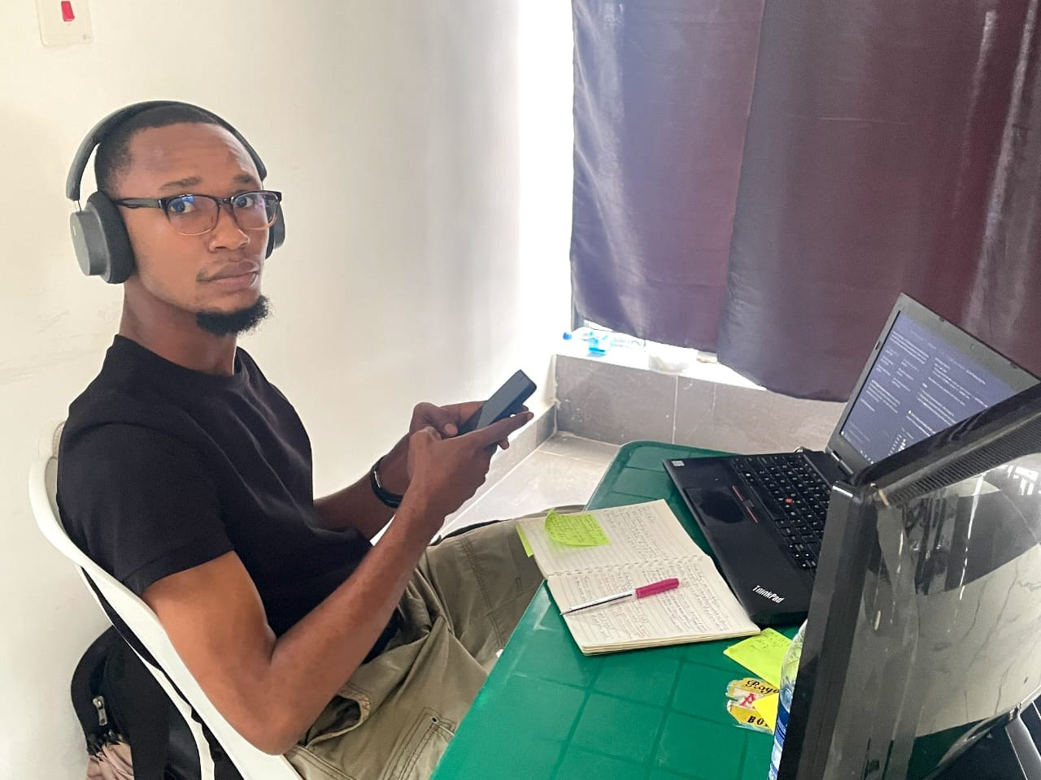
CONCLUSION
Her next visit looks different
✓
Registered once identity on record
✓
Position known an ordered, visible queue
✓
History on screen at the point of care
✓
Doctor listens the scribe drafts the note
Thank you. Questions welcome.
Next: billing · pharmacy and inventory · cloud sync
AraCare Health OS
10 / 10
Notes:
Close the loop on Mrs. Ngozi: on her next visit she is registered once, receives a queue position, her history is already on screen, and the doctor can listen while the scribe drafts the note. Then be straightforward about limits: the first release covers registration, queue, EHR and the scribe. Billing, pharmacy and cloud sync are designed but not built. Thank the panel and invite questions. The photo is the developer working on the system locally.

