Slide 1
Optimizing DFEI on CERN Monte Carlo
A progress report on the optimization attempts, organized by theme
Qingxiang Guo · University of Chinese Academy of Sciences · 2026-09-02
Qingxiang Guo · UCAS · DFEI group meeting 1

Slide 2
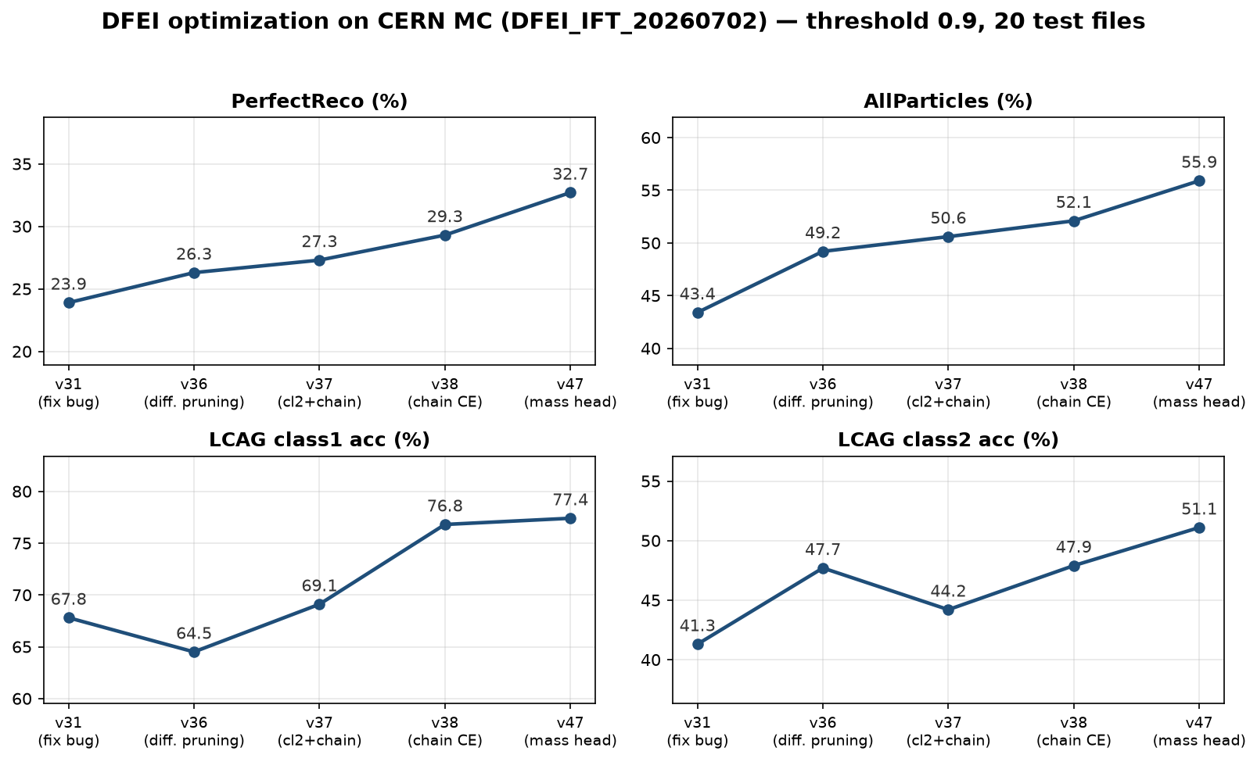
Data and Overall Effect
CERN MC: /eos/lhcb/user/y/yukaiz/DFEI_IFT_20260702 · threshold 0.9 · 20 test files
• All work uses the CERN official Monte Carlo production (DFEI_IFT_20260702)
• Since fixing a silent class-weight bug, the line has raised
– PerfectReco 23.9% → 32.7% (+8.8pp)
– AllParticles 43.4% → 55.9% (+12.5pp)
Qingxiang Guo · UCAS · DFEI group meeting 2

Slide 3
Outline
Organized by theme, not by chronology
• Part 1 — Differentiable Pruning with Annealing
– training–inference alignment: soft mask w_eff = w·σ((w−cut)/τ), τ annealed
• Part 2 — Rewarding the Chain
– why chains die · the rewards (hinge, chain-CE) · evidence it works
• Part 3 — Supervising Representations with Physics (source / mass / struct / mom)
• Part 4 — Controlled Failures and Their Lessons
• Part 5 — Ongoing Attempts
Qingxiang Guo · UCAS · DFEI group meeting 3

Slide 4
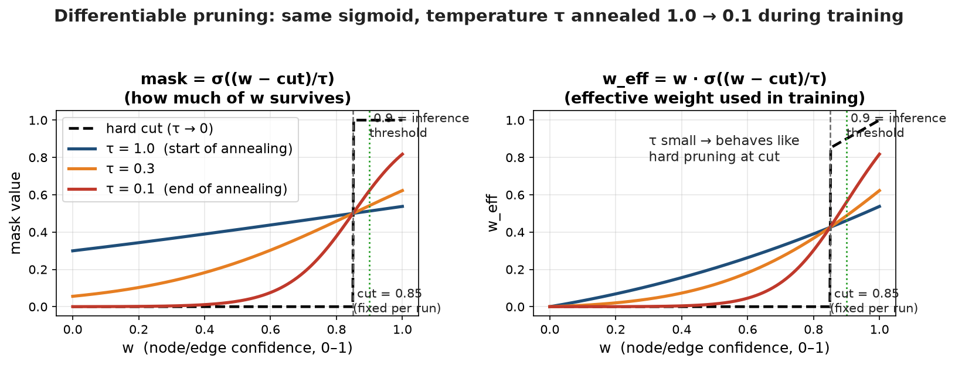
Part 1 — Differentiable Pruning with Annealing
Align training with the pruned graphs seen at inference
• Problem: training sees the full graph; inference prunes with hard thresholds first
• Fix: soft mask w_eff = w · σ((w − cut)/τ), temperature τ annealed 1.0 → 0.1
– large τ → smooth mask, stable gradients; small τ → approximates the hard threshold
• Cut aligned to inference and tightened over versions: 0.5 (v36) → 0.7 (v37) → 0.85 (v38) → 0.9 (inference)
GNN block
(node/edge
reprs)
Weight MLP
(sigmoid head)
w ∈ [0,1]
within a run:
cut fixed, τ anneals
→ same cut, sharper enforcement
Soft mask
w_eff = w·σ((w−cut)/τ)
cut fixed per run (0.85)
τ annealed: 1.0 → 0.1
weighted message passing
(back into the GN blocks)
inference (no mask): keep if w ≥ 0.9
pruning loss vs truth (BCE)
(mask makes it differentiable)
Qingxiang Guo · UCAS · DFEI group meeting 4

Slide 5
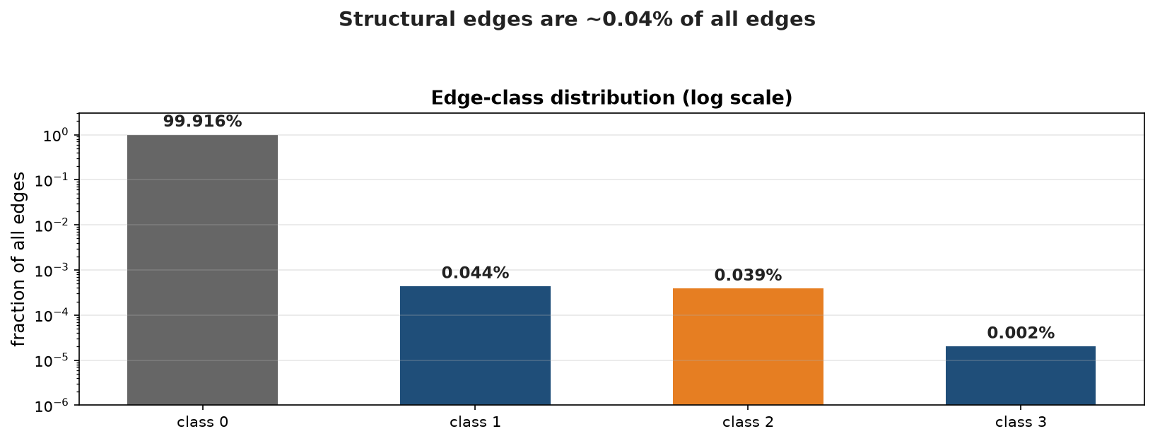
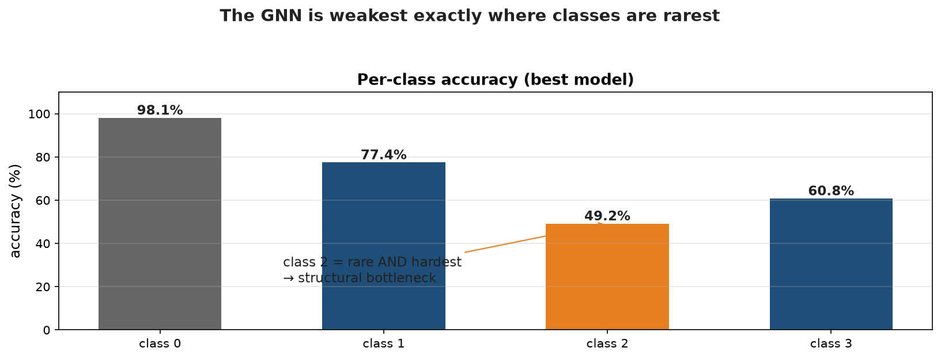
Part 2 — Why Chains Die (1/2): The Class Imbalance
Structural edges are ~0.1% and the hardest to classify
• class 0 (background) is 99.9% of edges; each structural class is ~0.04%
• The GNN is weakest exactly on the rarest classes — especially class 2 (sister)
• Per-class accuracy: worst exactly on the rare structural classes
Implication: without extra supervision, the classifier barely learns classes 1/2/3 — the rewards exist to fix this
Qingxiang Guo · UCAS · DFEI group meeting 5

Slide 6
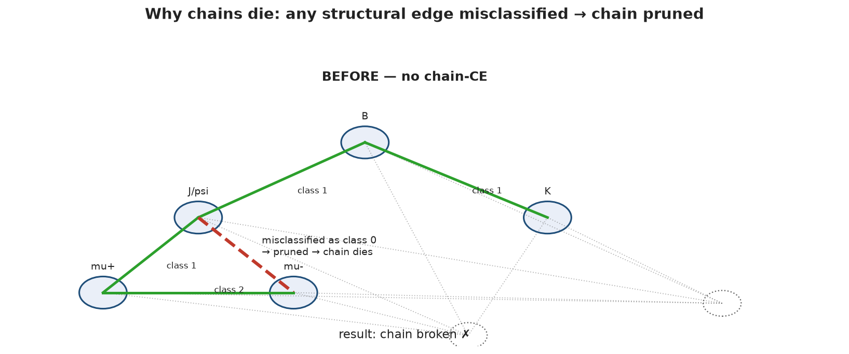
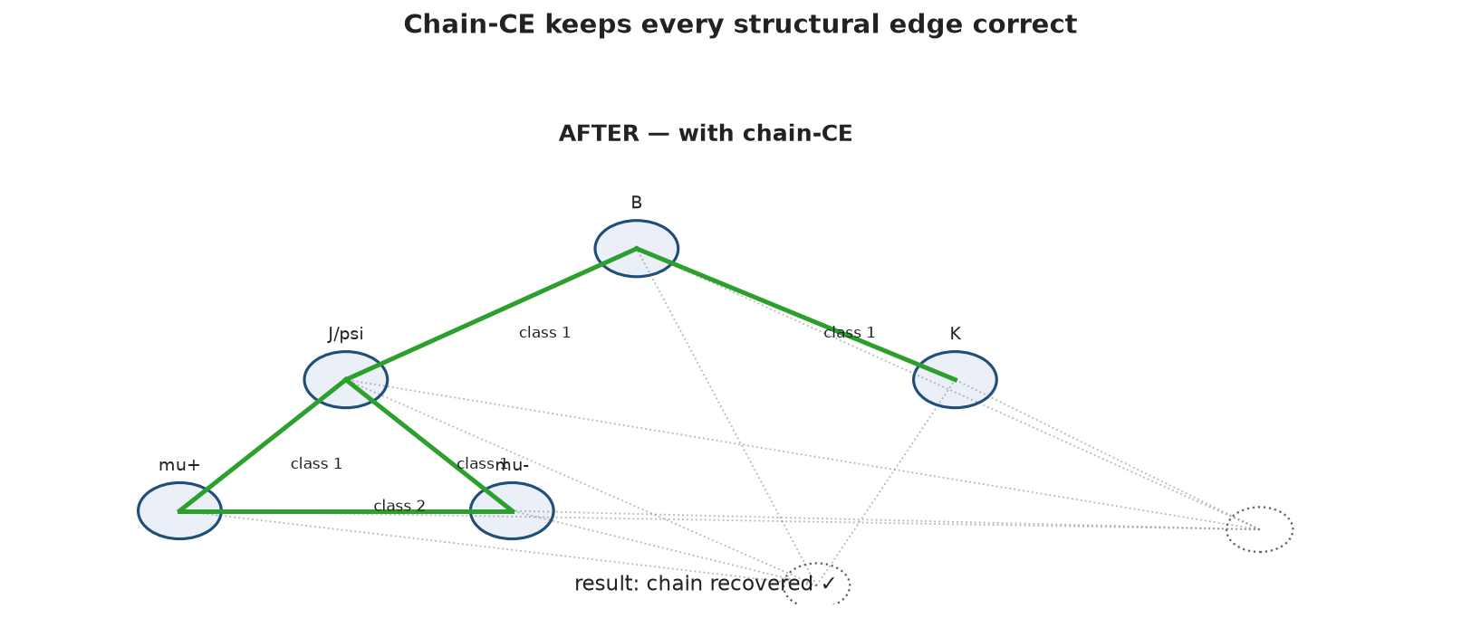
Part 2 — Why Chains Die (2/2): One Misclassified Edge
Chain survival needs every structural edge correct
• At inference, an edge the classifier calls class 0 is pruned
• If ANY structural edge of a chain is misclassified, the whole chain dies
• The rewards (next slides) supervise truth-chain edge classes directly → chains survive
Implication: chain survival depends on every structural edge being classified correctly
Qingxiang Guo · UCAS · DFEI group meeting 6

Slide 7
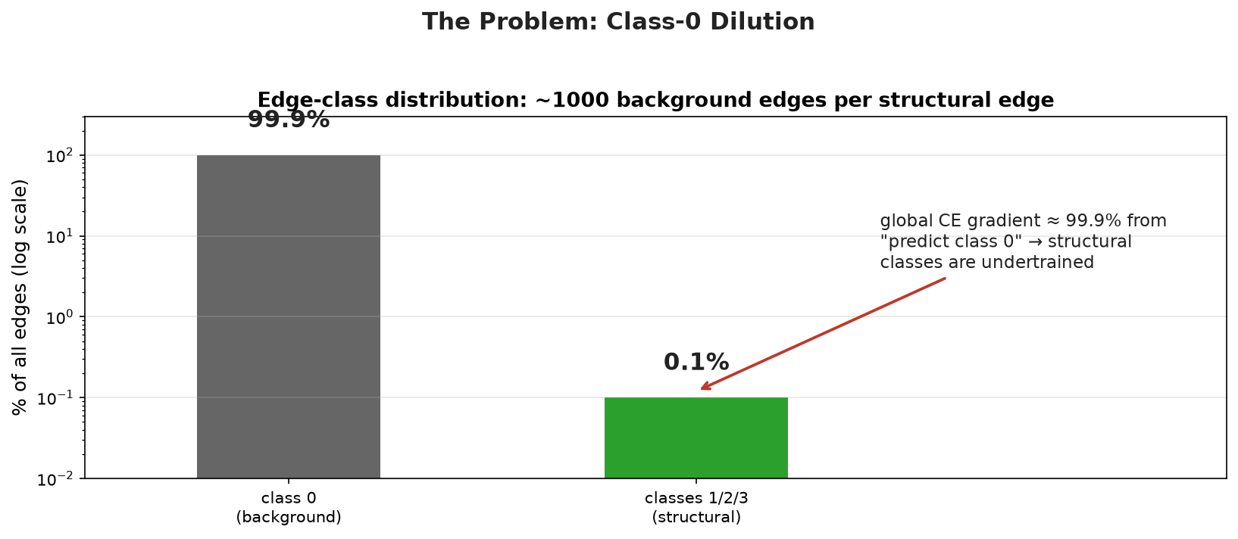
Part 2 — The Root Cause: Class-0 Dilution
Why the standard classifier fails on chain structure
• class 0 (background) is 99.9% of edges; structural classes 1/2/3 together are ~0.1%
• The main LCAG loss is a global cross-entropy over every edge → its gradient is ~99.9% "predict background"
• Consequence: rare structural edges are undertrained → misclassified → chains break
• The fix: reward the chain — class-2 weighting (3.0 → 2.0), then hinge (v37), then chain-CE (v38)
Implication: with ~1000 background edges per structural edge, the global CE alone cannot teach the model classes 1/2/3
Qingxiang Guo · UCAS · DFEI group meeting 7

Slide 8
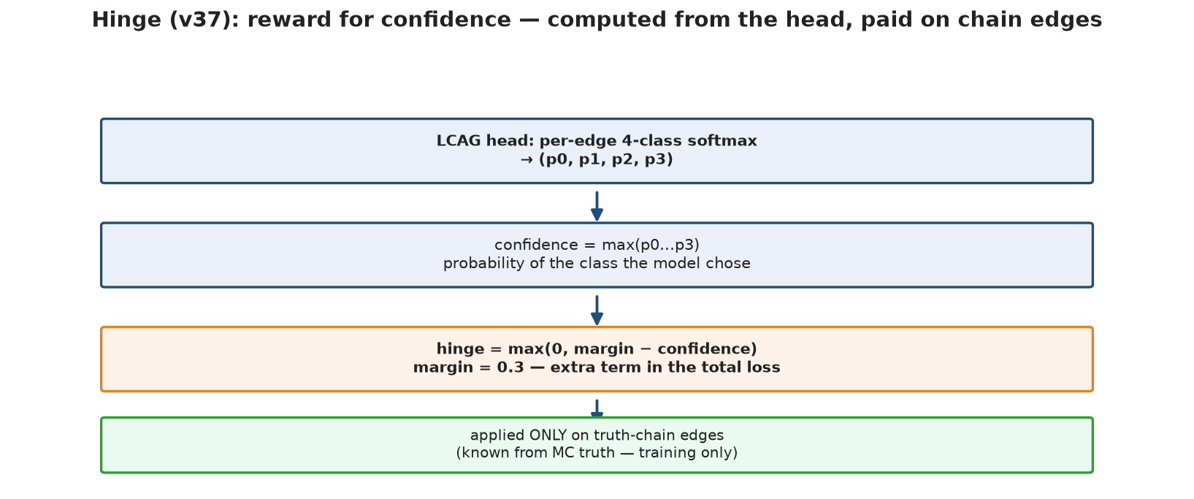
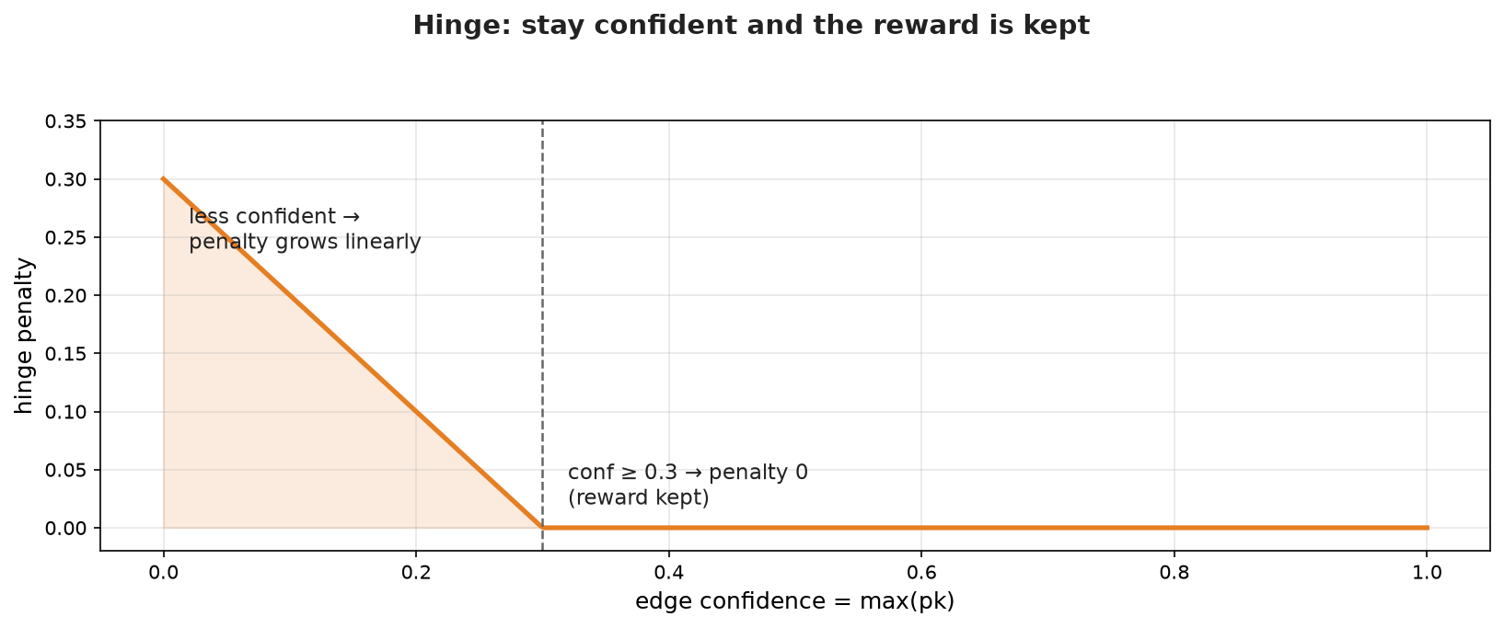
Reward 1 (v37): Hinge — Confidence Bonus
A training-only reward that pays out when chain edges are confidently classified
• It is a loss term that behaves like a reward: be confident on a chain edge → pay nothing
• Confidence comes from the LCAG head: per-edge 4-class softmax (p0…p3), confidence = max(pk)
• Penalty = max(0, margin − confidence), margin 0.3 → zero once confidence ≥ 0.3
• Paid ONLY on truth-chain edges — the true chains are known from MC truth during training
• Role: chain edges give the global CE almost no gradient → hinge keeps them confident; CE (next) fixes "which class"
Implication: hinge is a training-only confidence bonus on chain edges — confidence = max(pk), not the pruning weight w
Qingxiang Guo · UCAS · DFEI group meeting 8

Slide 9
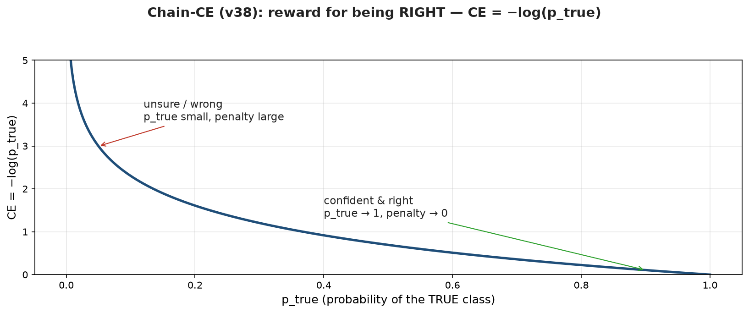
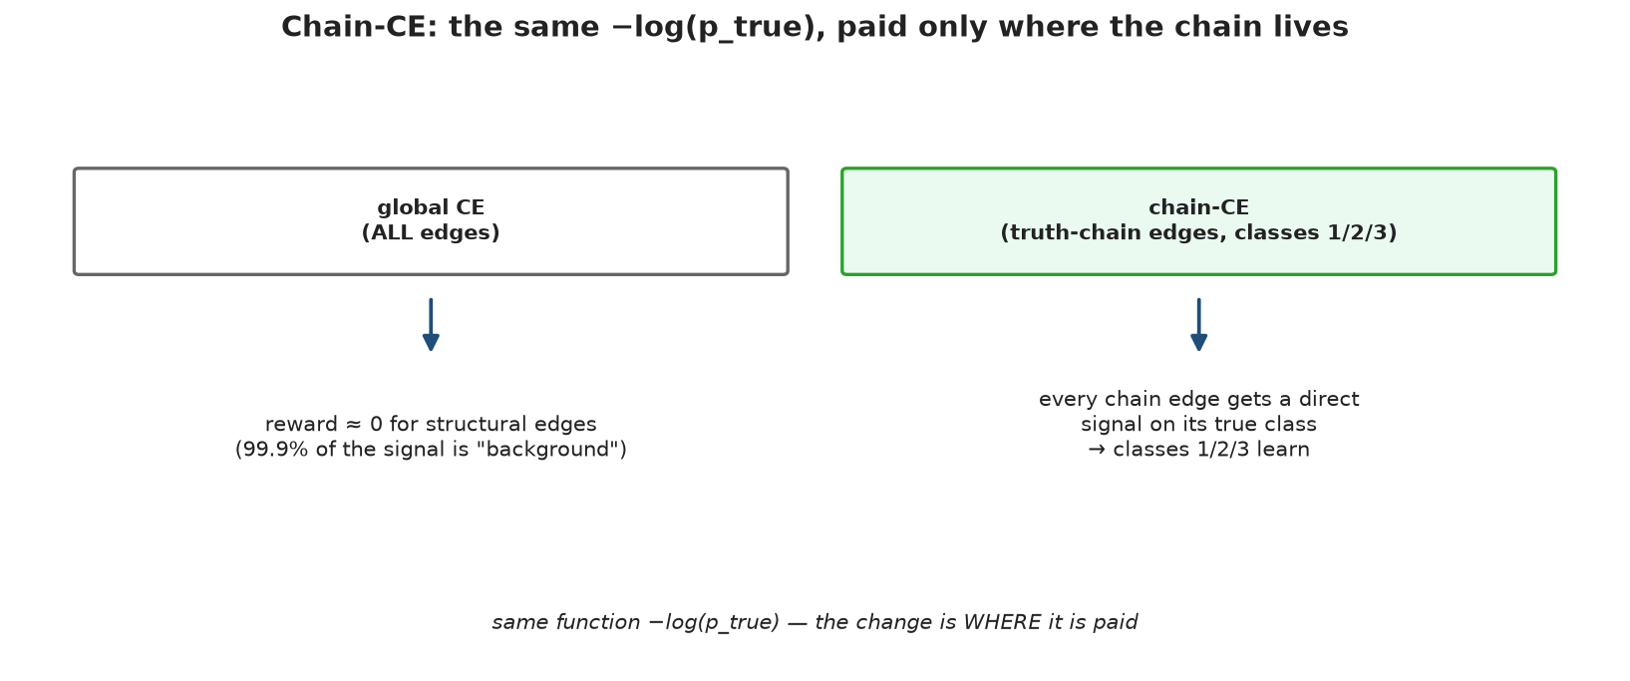
Reward 2 (v38): Chain-CE — Correctness Bonus
A training-only reward for being the RIGHT class, on chain edges
• CE = −log(p_true): p_true is the probability the model assigns to the edge’s TRUE class
• Right and confident (p_true → 1) → penalty ≈ 0; unsure or wrong → penalty large
• Chain-CE (v38): added ON TOP of the hinge, paid on truth-chain edges (classes 1/2/3) → direct, undiluted gradient
• v37 → v38 (weight 2.0 + chain-CE + cut 0.85): PerfectReco 27.3% → 29.3%
• Net effect of Part 2 (v31 → v38): 23.9% → 29.3%
Implication: same function as the global CE — the reward is WHERE it is paid (chain edges only)
Qingxiang Guo · UCAS · DFEI group meeting 9

Slide 10
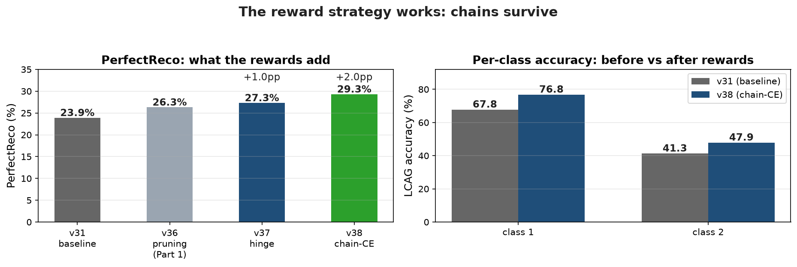
Part 2 — The Strategy Works
Rewards raise PerfectReco and per-class accuracy
• Reward line builds on Part 1 (pruning, v36: 26.3%)
– hinge (v37): 26.3% → 27.3%
– chain-CE (v38): 27.3% → 29.3%
• Per-class accuracy (v31 → v38): class1 67.8 → 76.8; class2 41.3 → 47.9
• Same evaluation: CERN MC, thr 0.9, 20 test files
Implication: the rewards directly improve the structural classes the global CE ignores — chains survive more often
Qingxiang Guo · UCAS · DFEI group meeting 10

Slide 11
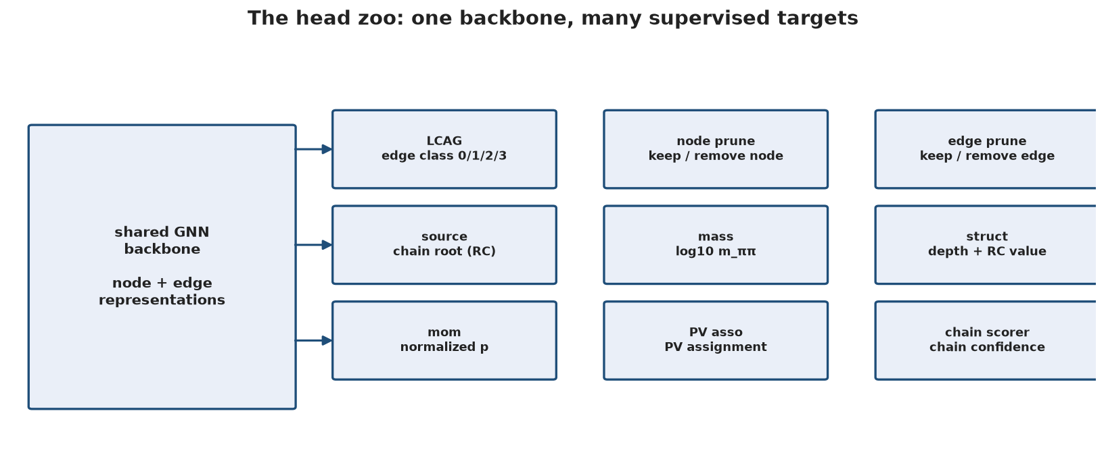
Part 3 — Supervising Representations with Physics
One common idea behind several heads
• Idea: physical / structural quantities are data-intrinsic; supervise the representation with them, keeping the model end-to-end
• The head zoo: one shared backbone, many supervised targets
– source head (v36) — Rumor-Centrality root; early instance of the same idea
– mass head — edge-level log10(m_ππ)
– structure head — node depth + RC value
– momentum head — node normalized momentum
• Verification: linear probes on the frozen backbone (Ridge regression)
Implication: the backbone must represent the physics — the heads only tell it what to keep
Qingxiang Guo · UCAS · DFEI group meeting 11

Slide 12
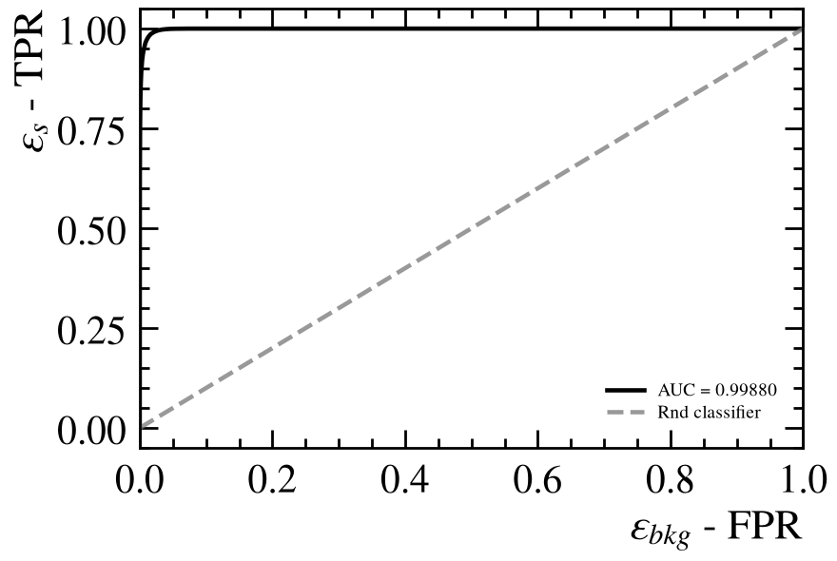
The Mass Head: Main Result
Edge-level regression of log10(m_ππ)
• Same-mother track pairs sit near resonance masses → the edge representation must encode sister relations
• Setup: SmoothL1 on log10(m_MeV), sentinel edges masked, weight 1.0
• v38 → masshead2 (20 test files):
– PerfectReco 29.3% → 32.7% (+3.4pp)
– AllParticles 52.1% → 55.9% (+3.8pp)
– LCAG class2 44.7% → 51.1% (+6.4pp)
ROC — LCAG class-2 (sister) edge detection, v47 masshead2, 20 test files. Mass supervision moves sister information into the edge representation.
Implication: supervising a physical target improved the hardest structural class — and the whole reconstruction
Qingxiang Guo · UCAS · DFEI group meeting 12

Slide 13
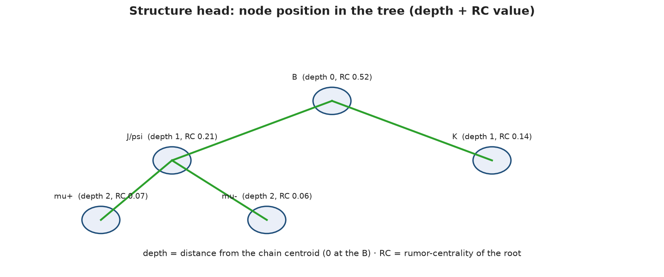
Structure and Momentum Heads
Node-level supervision of tree position and momentum
Head | Target | All / Perfect (5-file eval)
baseline | mass only | 51.4 / 29.7
+ struct | depth + RC | 54.5 / 30.5 (+0.8) — best
+ mom | normalized p | 53.8 / 30.5 (+0.8)
• Struct: depth (BFS to chain centroid) + RC value — where the node sits in the tree (see right); class3 60.8→63.2
• Mom: motivated by a probe — node representations were linearly unreadable for momentum (R² ≈ 0)
• Lesson: probe first, find the missing quantity, then supervise it
Implication: depth/RC label the node’s role in the tree — the struct head forces the node representation to encode it
Qingxiang Guo · UCAS · DFEI group meeting 13

Slide 14
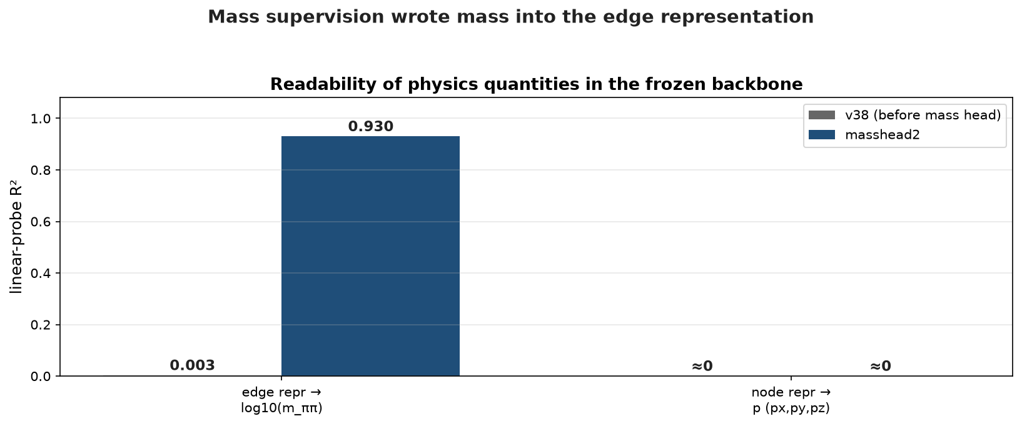
Verification: Linear Probes on the Frozen Backbone
Ridge regression; R² of the physical quantity
• Probe: fit a linear regressor on the frozen backbone — can the quantity be read off?
• Edge repr → log10(m_ππ): R² 0.003 → 0.930 (masshead2)
• Node repr → p (px/py/pz): R² ≈ 0 both before and after
• Mass supervision moves mass information into the edge representation — confirmed end-to-end
• Nodes remain unreadable for momentum → addressed by the momentum head (to be re-probed)
Implication: the probe is the check that supervision actually wrote the physics into the representation
Qingxiang Guo · UCAS · DFEI group meeting 14

Slide 15
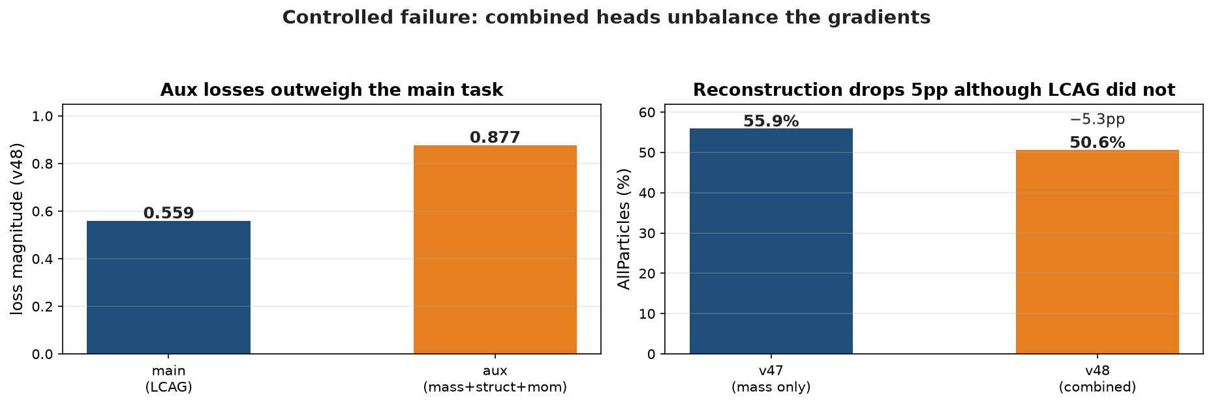
Part 4 — Controlled Failures and Their Lessons
Two failed lines, two lessons
• PV subgraph training (v39-42): training on per-PV subgraphs while inference runs on the full graph
– full-graph ability degraded: class1 76.8% → 56.4%; line closed
• Combined mass + struct + mom (v48): aux losses (0.877) exceed the main task (0.559)
– reconstruction dropped 5pp although LCAG did not — backbone pulled toward auxiliary tasks
– resolution: lower aux weights — mom 0.2, struct 0.3
• Lessons: train/infer graph mismatch is fatal; gradient balance must be explicit
Implication: the v48 failure shows why the head zoo needs explicit gradient balance — and why we ablate before stacking
Qingxiang Guo · UCAS · DFEI group meeting 15

Slide 16
Part 5 — Ongoing Attempts
• Wider latent space (v53): tracks nodes 32-dim, tt edges 24-dim — 16-dim sits at the physical-DOF lower bound
– from-scratch training interrupted at ep74/150, not converged; resume planned
• Public-data verification (v45/v49): no PID, class2/3 counts differ 4-14×; resume best val 33.4 @ep73
• Learned deterministic annealing: inference-side PV clustering with learned affinity (no subgraph training); core module CPU-verified
• Chain scoring for trigger assistance: criteria AUC 0.90 / 0.78 (realistic); training ready, needs GPU
Qingxiang Guo · UCAS · DFEI group meeting 16

Slide 17
Next Steps and Open Questions
• Resume the wider-latent training to 150 ep; layer struct + mom at reduced weights
• Run queued evaluations; train the chain scorer; plug GNN affinity into learned DA
• Open questions:
– trigger assistance vs full-event reconstruction — which metric would the collaboration trust?
– is same-source (class2) clustering the real problem DFEI should solve?
– HLT2 / Upgrade-II time budget for a lightweight GNN per event?
Qingxiang Guo · UCAS · DFEI group meeting 17

