Slide 1
DFEI Local Run Results and Optimization Strategy
Progress Report
official CERN MC & public dataset · RTX 2080 Ti (10 GB)
Qingxiang Guo · University of Chinese Academy of Sciences · DFEI group meeting · Aug 11, 2026
Qingxiang Guo · UCAS · DFEI group meeting · Aug 11, 2026 1

Slide 2
What This Report Covers
• Reconstruction results on the official CERN MC and the public dataset
• A concrete training-speed problem on the 10 GB GPU
• Why hard-threshold pruning loses signal chains (diagnosis)
• Three targeted changes to fix it (edges / nodes / candidate selection)
Qingxiang Guo · UCAS · DFEI group meeting · Aug 11, 2026 2

Slide 3
Setup
Code
scalable_mtl_hgnn (branch yukai_IFT, weight-fix carried locally)
Data 1
Official CERN MC — DFEI_IFT_20260702/MC_normed (~91 trk/evt)
Data 2
Public (paper) dataset — converted_LHCbcollision (~139 trk/evt)
GPU
NVIDIA RTX 2080 Ti, 10.6 GB VRAM
Model
HGNN, 4 message-passing blocks, ~570 k params
Qingxiang Guo · UCAS · DFEI group meeting · Aug 11, 2026 3

Slide 4
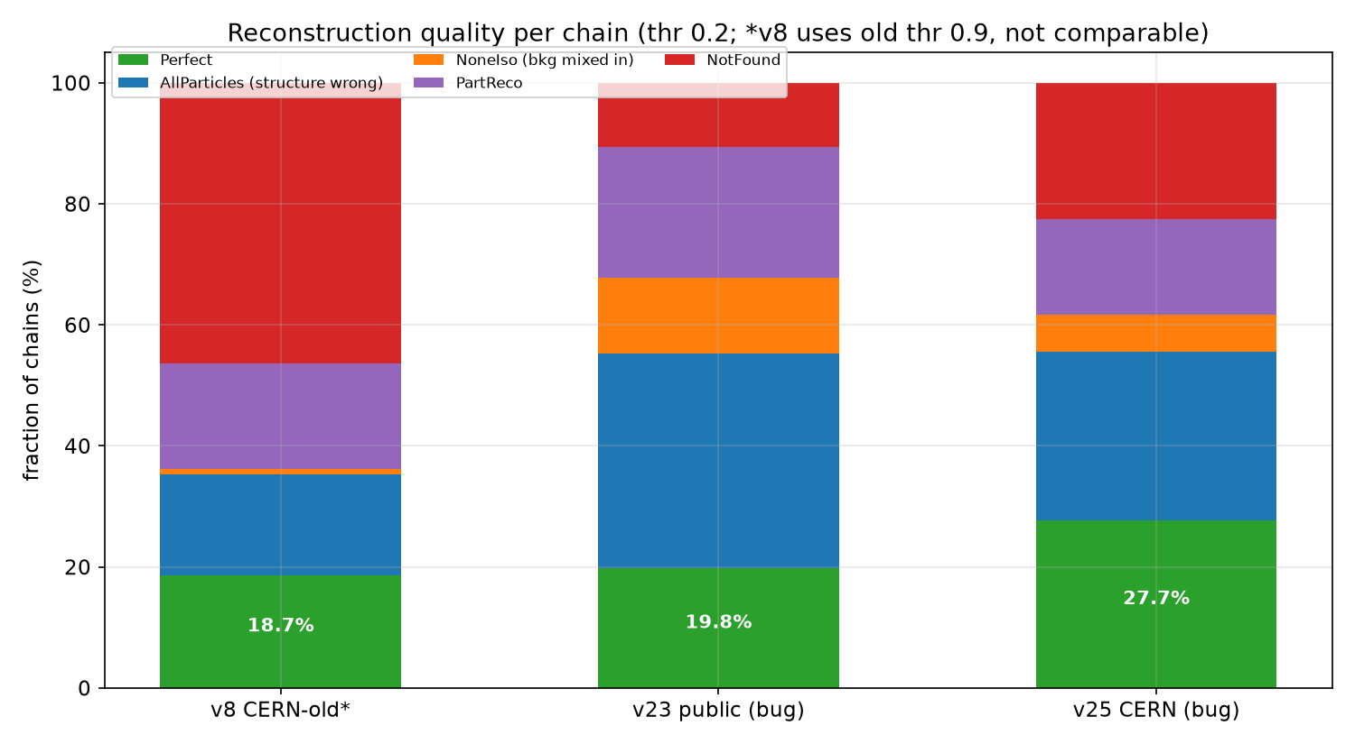
Reconstruction Results (thr 0.2)
• CERN MC (v25): per-chain Perfect 27.7%, AllParticles 55.6%, NoneIso 6.0%, PartReco 15.9%, NotFound 22.5%
• Public (v23): per-chain Perfect 19.8%
• Paper WHGNN reference: per-event Perfect 21.5% (different metric def., harder test set)
• Status: retraining with corrected class weights in progress
Qingxiang Guo · UCAS · DFEI group meeting · Aug 11, 2026 4

Slide 5
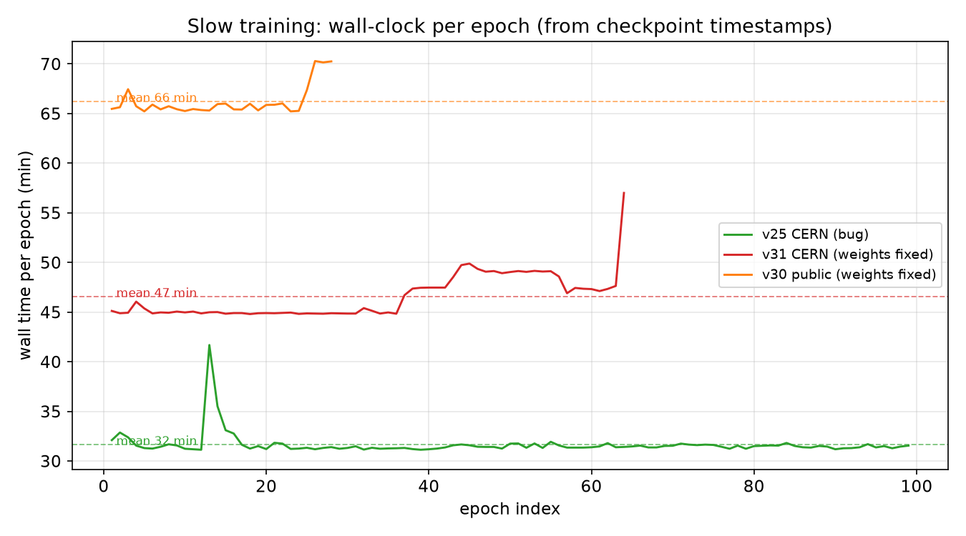
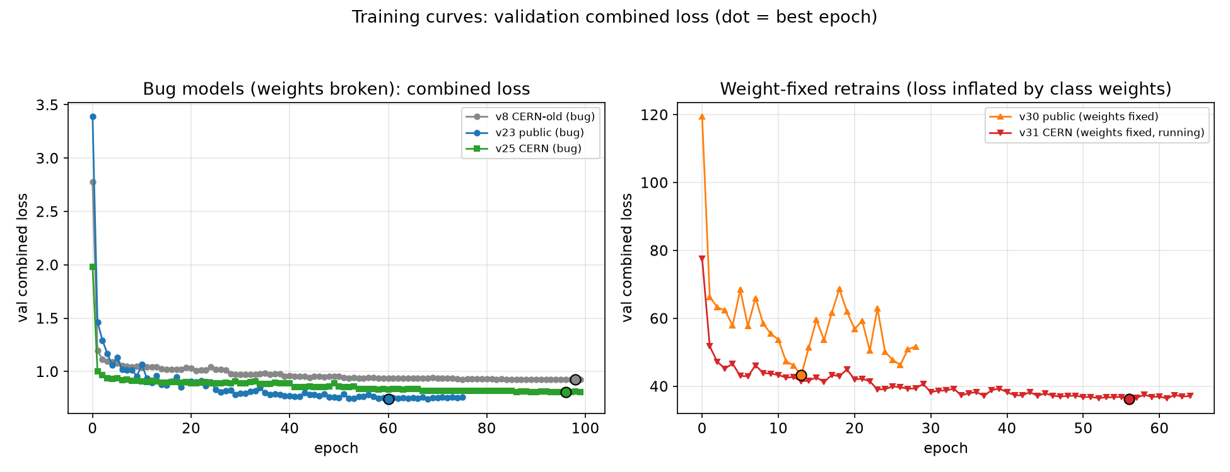
Problem 1: Training Is Slow
• ~30–50 min/epoch on 10 GB RTX 2080 Ti (full graph: ~150 tracks → ~23k edges/event)
• 10 GB VRAM forces small batches — the main slowdown
• 100 epochs ≈ days
Qingxiang Guo · UCAS · DFEI group meeting · Aug 11, 2026 5

Slide 6
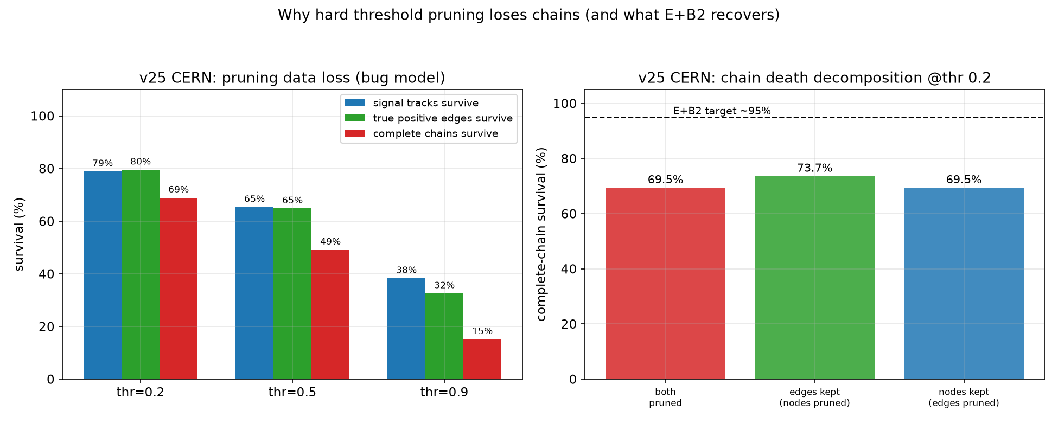
Problem 2: Hard-Threshold Pruning Loses Chains
• Perfect ≈ (chain survives pruning) × (structure correct)
• At thr 0.2, pruning kills ~30% of chains via edges and ~26% via nodes (overlap; edges dominate)
• Only ~40% of surviving chains get the exact LCA structure right
• Two bottlenecks: greedy hard threshold, and classification quality
Qingxiang Guo · UCAS · DFEI group meeting · Aug 11, 2026 6

Slide 7
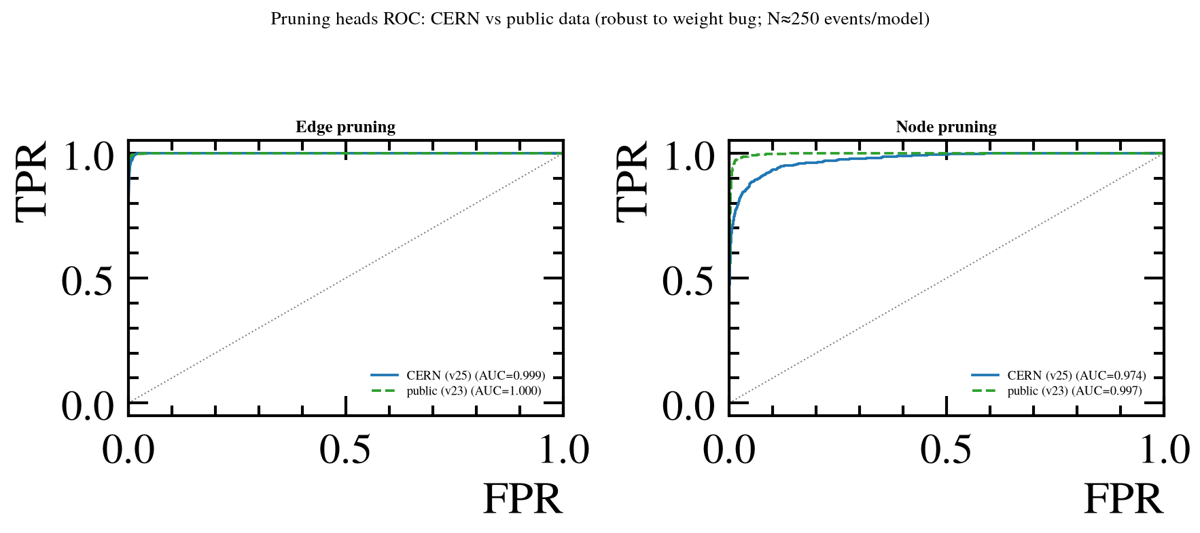
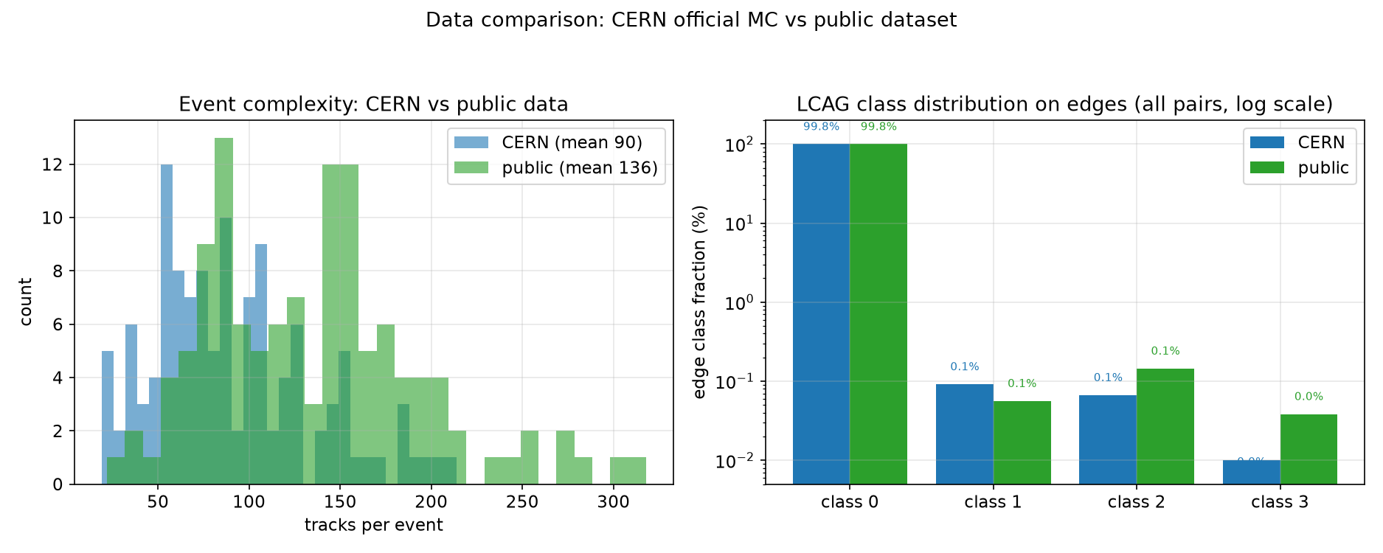
Pruning Heads Are Strong — It's the Threshold, Not the Heads
• Edge-pruning AUC: 0.999 (CERN) / 1.000 (public)
• Node-pruning AUC: 0.974 / 0.997
• Ranking is nearly perfect — yet the 0.2 cut still deletes true edges
• Data note: public data has LCA class-2/3 edges; CERN MC almost none
Qingxiang Guo · UCAS · DFEI group meeting · Aug 11, 2026 7

Slide 8
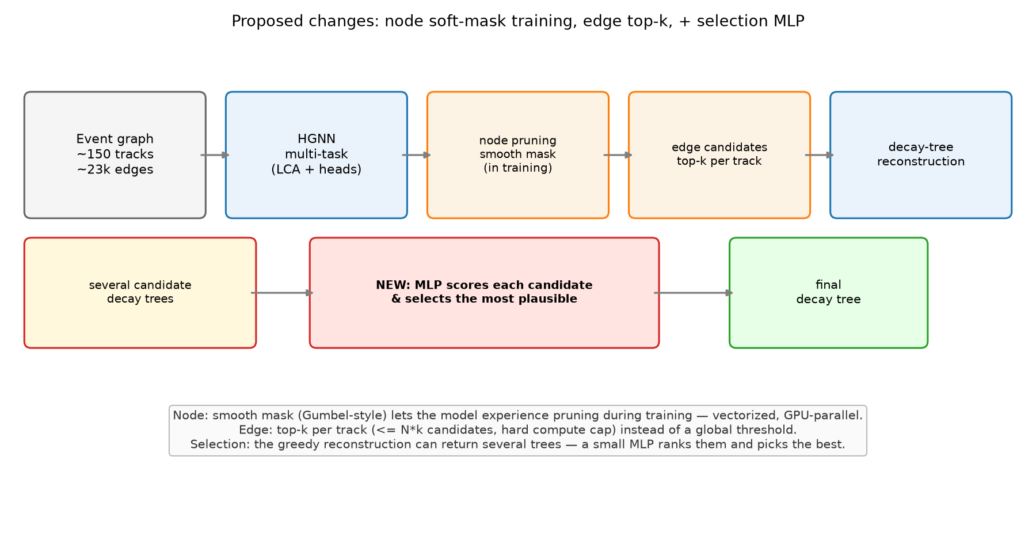
Fix 1 (Edges): Top-k Per Track Instead of a Global Threshold
• Per track, keep its top-k most confident edges (k≈10–20) instead of a fixed 0.2 cut
• Hard compute cap: ≤ N×k (~1.5k pairs) vs ~11k fully connected
• Inside top-k, keep low-confidence true edges — LCA classifier decides their class
• Why not “keep everything + soft weights”: tree reconstruction is a discrete clustering — weights have no entry point; all background edges would merge the event into one cluster
• Pure decode change — testable on existing models immediately
Qingxiang Guo · UCAS · DFEI group meeting · Aug 11, 2026 8

Slide 9
Fix 2 (Nodes): Train With a Smooth Pruning Mask
• Nodes and edges have very different scales (~150 vs ~23k/event) → need different fixes
• Make node keep/drop a smooth mask during training (temperature-annealed)
• The model “experiences” pruning and becomes robust to it (closes train/inference gap)
• Fully vectorized tensor ops → GPU-parallel, negligible cost
• Motivation: on CERN data, node pruning alone kills ~26% of chains
Qingxiang Guo · UCAS · DFEI group meeting · Aug 11, 2026 9

Slide 10
Fix 3: Choose the Best Reconstruction Among Candidates
• The greedy reconstruction has no backtracking; softer candidates can yield several plausible trees per event
• Add a small MLP that scores each candidate tree (size, edge confidence, isolation from background) and selects the most plausible
• Needs one extra supervised training step (labels = truth-matching tree)
Qingxiang Guo · UCAS · DFEI group meeting · Aug 11, 2026 10

Slide 11
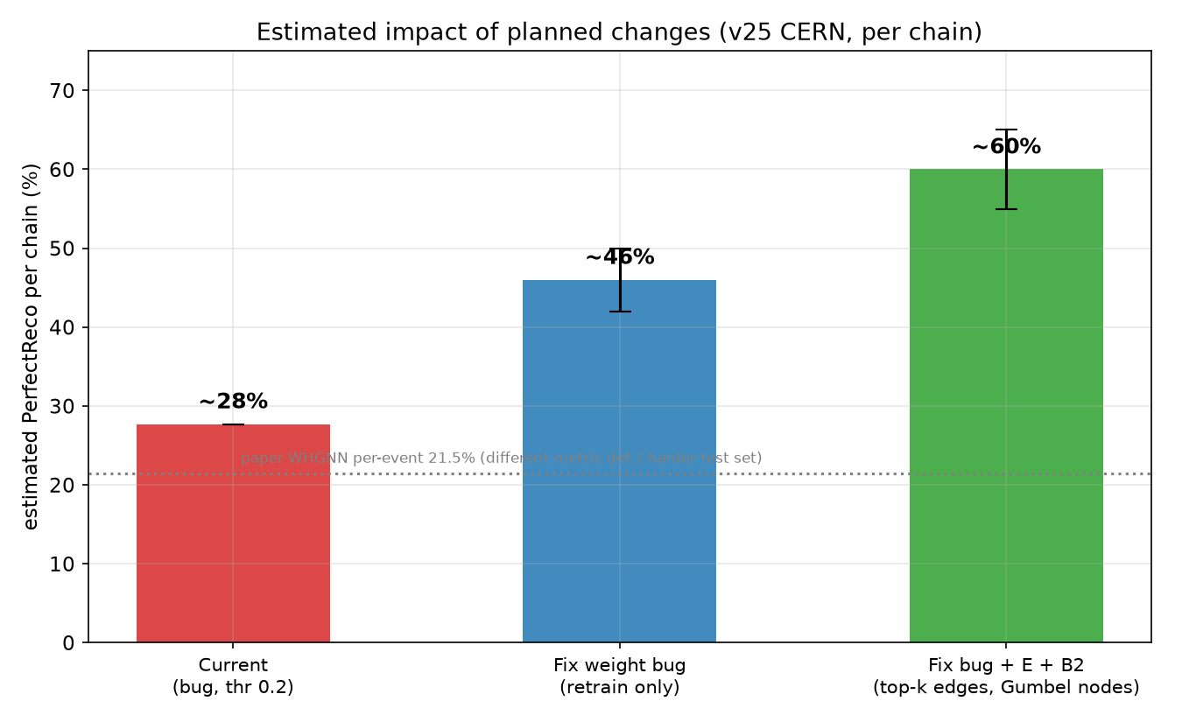
Expected Impact
• Current (inactive-weights model, thr 0.2): 27.7% per-chain
• After retraining with corrected weights: ~42–50%
• Retrain + the three fixes: ~55–65% per-chain (≈43–51% per-event)
• Caveats: estimates anchored on paper class accuracies; CERN lacks class-2/3; hyper-parameters not tuned
Qingxiang Guo · UCAS · DFEI group meeting · Aug 11, 2026 11

Slide 12
Next Steps
• Finish & evaluate the CERN retrain (v31); re-evaluate the public retrain (v30) at thr 0.2
• Implement the edge top-k change (decode-only) and test on existing models
• Put the node smooth-mask training + selection MLP into the next retrain
• Clarify with the group the track-sorting issue in the current CERN production data
Qingxiang Guo · UCAS · DFEI group meeting · Aug 11, 2026 12

