Slide 1
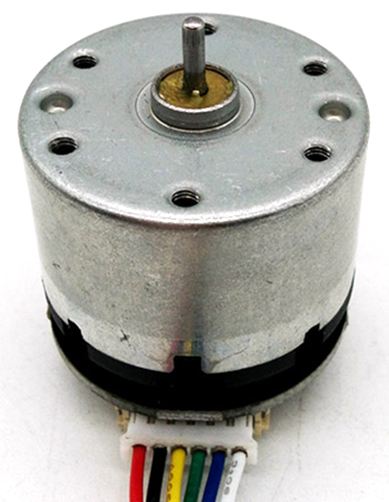
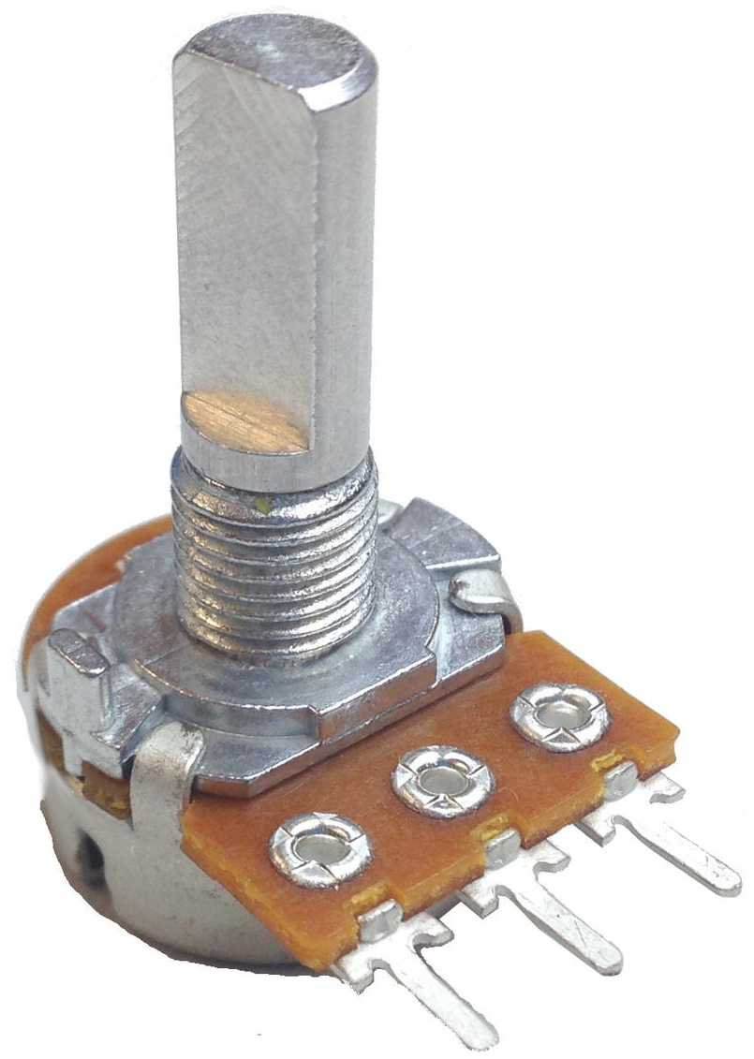
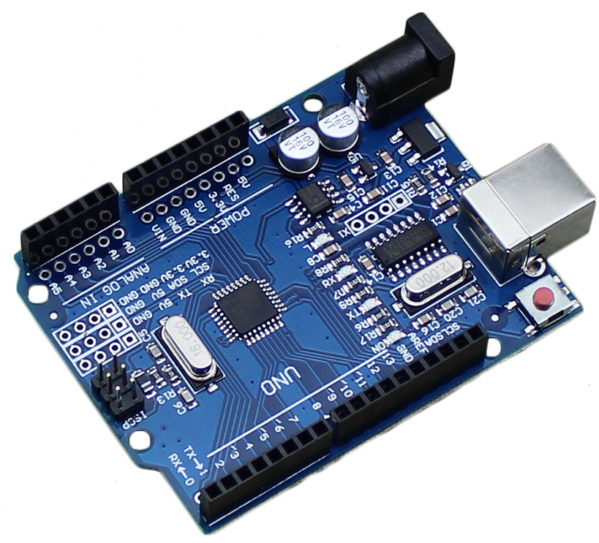
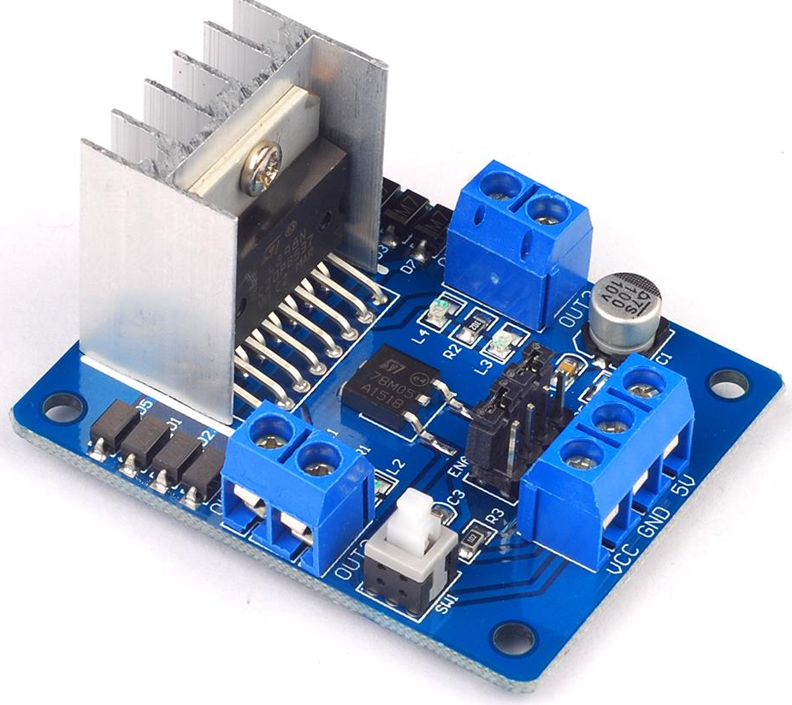
Encoder interrupt
Analog read
Motor Voltage
Analog write
12V DC

Slide 2
12V DC
Arduino
Plant
User
R_{pot}
Analog Read/Write
Motor Driver
DC Motor
Rotation
UI
Serial
Interrupt
Encoder

Slide 3
Plant dynamics do not change
Serial output not relevant for control system
Simplify schematic
Arduino
User
R_{pot}
Analog Read/Write
Plant
Rotation
UI
Interrupt
Encoder

Slide 4
Remove potentiometer with fixed set point
Add PID controller
Close the loop
Set Point
Arduino
PID
Analog Write
Plant
Rotation
UI
Interrupt
Encoder

