Slide 1

Simple Arduino PID-Controller
DC-Motor demo
https://github.com/AnielShri/Simple-Arduino-PID

Slide 2
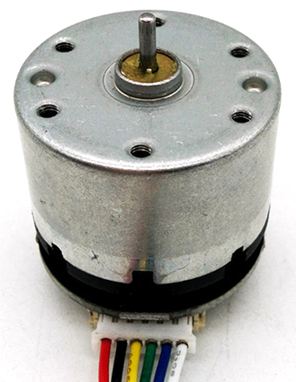
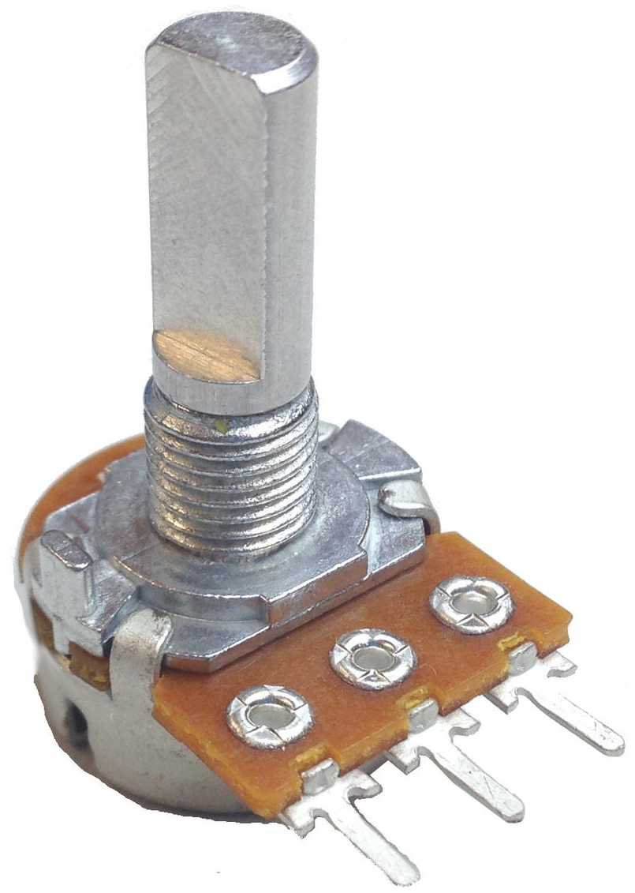
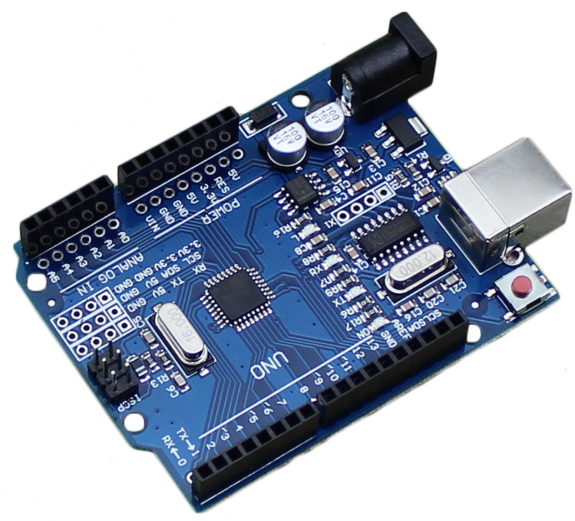
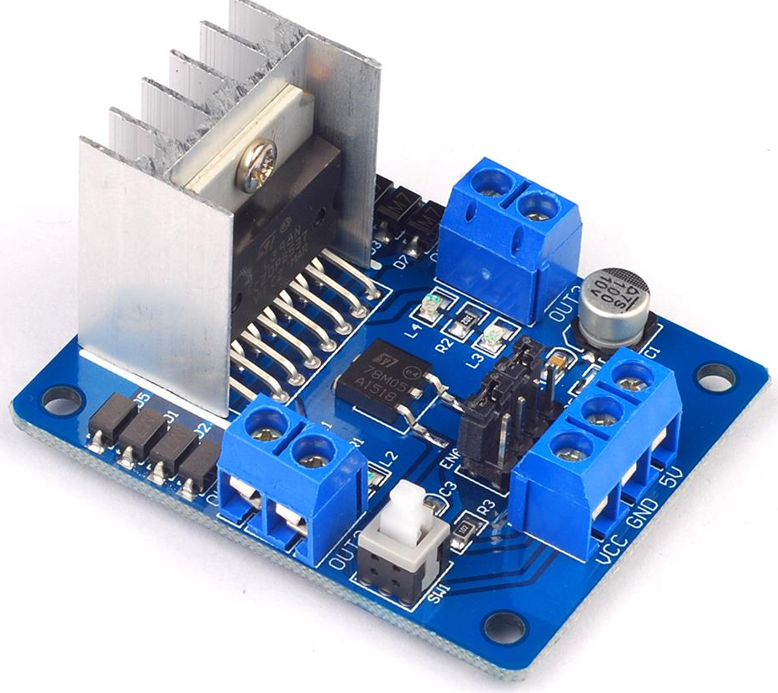
Circuit Overview
Encoder interrupt
Analog read
Motor Voltage
Analog write
12V DC

Slide 3
Schematic – Open-Loop
12V DC
Arduino
Plant
User
R_{pot}
Analog Read/Write
Motor Driver
DC Motor
Rotation
UI
Serial
Interrupt
Encoder

Slide 4
Schematic – Open-Loop (simplified)
Assume plant dynamics do not change
Serial output not relevant for control system
Simplify schematic
Arduino
User
R_{pot}
Analog Read/Write
Plant
Rotation
UI
Interrupt
Encoder

Slide 5
Schematic – Closed-Loop
Remove potentiometer with fixed set point
Add PID controller and close the loop
Set Point
Arduino
PID Algorithm
Analog Write
Plant
Rotation
UI
Interrupt
Encoder

Slide 6
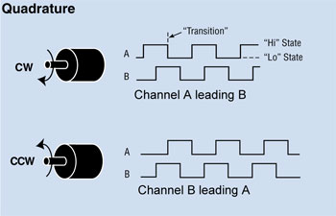
Quadrature encoders
https://dronebotworkshop.com/rotary-encoders-arduino/

Slide 7
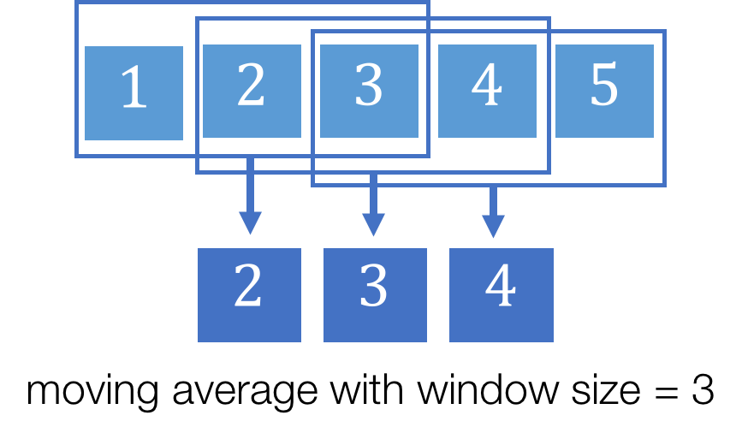

Moving Average Window

