Slide 1

HBFC BANK PROJECT Business Report
By
Anies Ghousia J

Slide 2
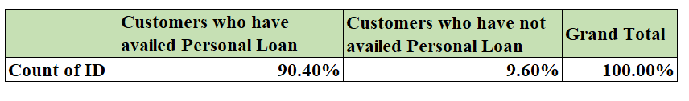
Q1. What percentage of the bank’s customers (according to the data) have availed Personal Loans?
Observation:
The customers who have availed personal loan
>
the customer who have not availed personal loan

Slide 3
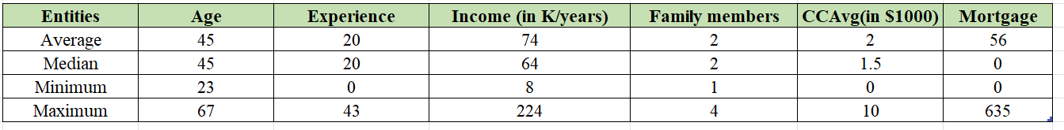
Q2. Generate a table with min, max, median & average for all numeric variables (age, experience, income, family members, CCAvg, Mortgage). What are your observations?
The above analysis has been arrived through descriptive statistics option in the data analysis menu.

Slide 4
Observation:
Age and Experience:
The average age of customer is 45 with an average experience of 20 years. So the customers are relatively mature and experienced. Minimum age is 23 so bank has customers in all age group.
Income :
The average salary of customer is 74,000 with minimum salary of 8,000. So the bank has customers with different income level.
Family members :
The bank has average of family with 2 members with maximum 4 members. so the customers are either single or nuclear family.
Credit cards :
The credit card spending average ranges from 2k to 10k. So customers who are willing to spend on credit card also willing to buy personal loans.
Mortgage : The mortgage ranges between 56k to 635k. So the bank customers are both home owners and renters

Slide 5
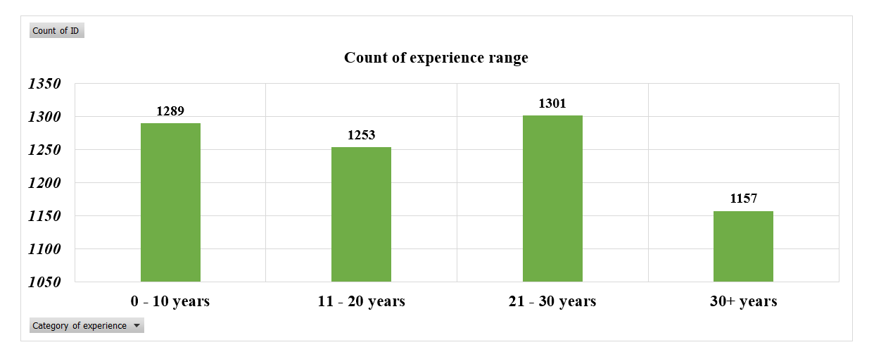
3. Create a new categorical variable for Experience using 4 categories –
a. 0 to 10 years
b. 11 to 20 years
c. 21 to 30 years and
d. 30+ years.
Plot a bar graph for this new categorical variable

Slide 6
Observation:
There is a anomaly between 0 -10 years and 11-20 years because the people who are fresher gain their experience of 10 years and want to explore other career option, hence there is drop in the category of 11-20 years experience.
The rise in the category of 21 -30 years experience indicates that they wanted to gain more experience for their promotion and stick to company and remain loyal until their retirement.
The category of 30+ experience is reduced compared to 21-30 years experience because of many factors like early retirement, switching to new technology or industries.

Slide 7
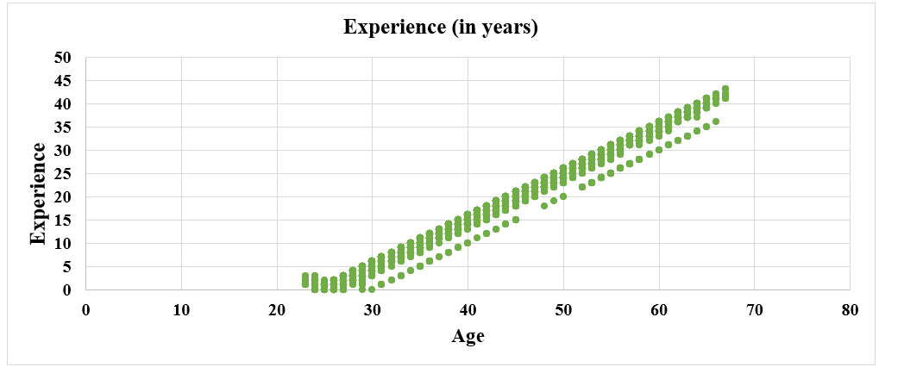
4. Create a scatter plot of the Age and the Experience variable. What do you observe?
Observation:
From the graph we come to know that as the age increases the experience also get increased and hence the graph is linear.

Slide 8
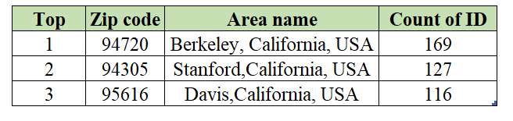
5. What are the top 3 areas (ZIP Codes) where the bank’s customers are located?

Slide 9
Observation:
Mostly the banks are highly located in tier1, tier 2, and tier3 cities among 6 tiers, because of higher population density to maximize the customer base.
This includes a higher residential area, industries with many businesses, and colleges where the student will attain the age to open bank accounts.
These areas will have higher economic activities like lending and investment opportunities.
These areas will have major transportation hubs, and shopping malls, where people looking for convenience and ease of access.

Slide 10
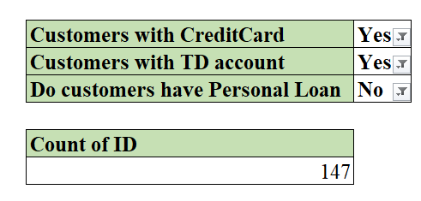
6. How many customers have a combination of Fixed Deposits and Credit Cards but not Personal Loan?
The number of customers who have a combination of Fixed Deposits and Credit Cards but not Personal Loan = 147

Slide 11
Observation:
The customers who are having credit cards and FD may not need personal loan as it is sufficient to cover the expenses.
In Personal loan EMI has to be paid at the beginning of the month whereas in credit card and fixed deposit it doesn't require regular payment.
The interest rate of personal loan may often be higher than the interest rate of credit card so people choose credit card or fixed deposit instead of personal loan.

Slide 12

7. What is the median income of the customers who have availed personal loans and compare it with the median income of those customers who have not availed personal loans? What do you infer?
Observation:
1) This suggest that the personal loan may be more accessible to the customers with higher income as they have low risk of repayment of the loan. 2) Personal loans are often used for large purchase like renovations and for buying car. So if people bought under these category there is more chance of median of this group is higher.

Slide 13
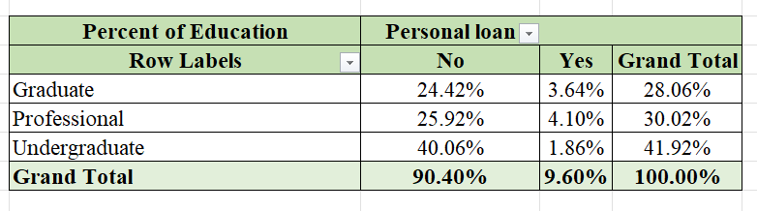
8. Create 4 separate Pivot Tables. Summarise your data by percentages.
8a&9. Education vs Personal Loan

Slide 14
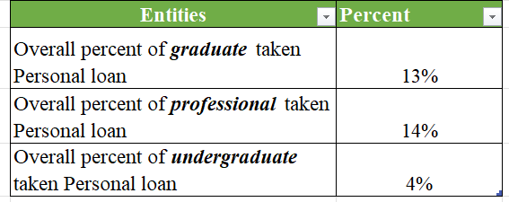
Observation:
Reason for taking loan:
The Professional people took more personal loan compared to other people because they are capable of getting loan as they can repay with assured salary every month

Slide 15
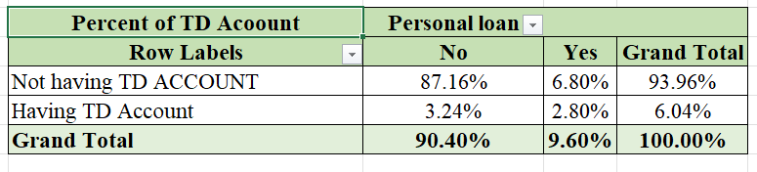
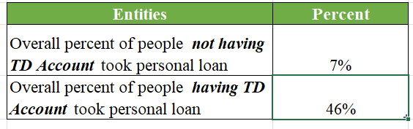
8b & 9. TD Account Vs Personal Loan

Slide 16
Observation:
Reason for taking loan:
The people who are not having TD Account get more personal than the people who are not having TD account, because the people who have TD account can get loan easily by providing their fixed deposit as collateral.
To recover this situation bank should encourage people to have TD account to get a loan in future quickly.

Slide 17
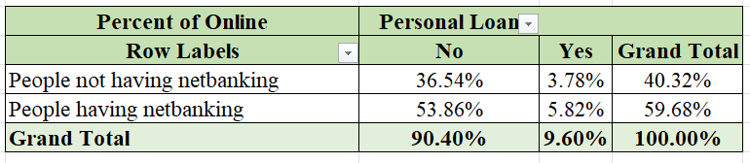
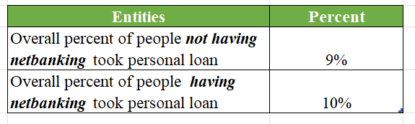
8c & 9. Online vs Personal Loan

Slide 18
Observation:
Reason for taking loan:
Here the people having who are having and not having net banking took less personal loan, because the people without net baking are not aware of net banking option which is easier than by getting loan in virtual. not
Those who are having net banking are also getting less personal loan because the interface of the app is not user friendly.

Slide 19
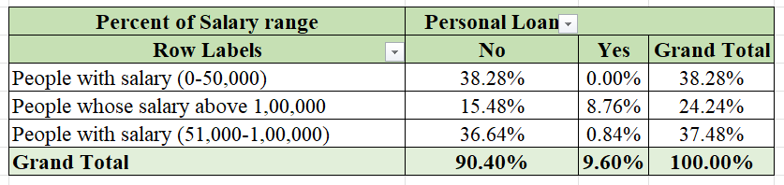
8d&9 . Income Category vs Personal Loan

Slide 20
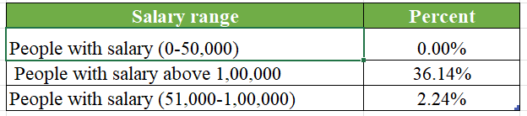
Observation:
Reason for taking loan:
The people whose salary above 1,00,000 get more personal loan compared to others, because a person with salary above 1,00,000 can bear the monthly expenses as well as EMI while others cannot.

Slide 21
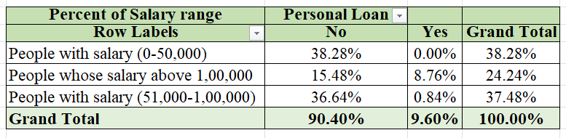
10. In the last campaign, bank reached out to 5000 customers out of which 480 customers accepted the personal loan offer. The bank incurred a huge cost in running a marketing campaign to reach out to so many customers. This is where you as a strategic business consultant step in. You are tasked to optimise the cost of this campaign by identifying the correct target base (without significant reduction in number of acceptance of offers). The bank can then send Personal Loan offers to these target customers who have a higher chance of accepting the offer. Based on your analysis, what strategy would you suggest to the management of HBFC bank?

Slide 22
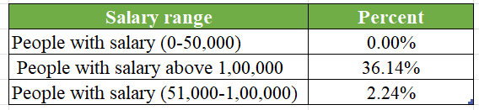
Observation:
Targeting the right audience:
Target the people who haven't took personal loan ie. people with salary (0-50,000) and understand their needs like people who need finance for big purchase like car, and home renovations.

Slide 23
Observation:
Clearly defining the benefits:
Making sure that the potential customers understand how personal loans can help them to achieve their financial goals.
Offer the competitive intererst rate:
Personal loan with low interest rate compared to other banks can attract the customers. It makes huge difference and allowing the customer to decide whether to take loan or not.
Making the application process easy:
Making every customers of banks to get the mobile app of the bank in their mobile and making the interface in user friendly manner to reduce the hassle.

Slide 24
Observation:
Social Proof:
Social media is the powerful tool in convincing the customers by sharing the success stories of previous customers who took personal loans to built trust and credibility
Providing excellent customer service:
It can make big difference in attracting and retaining the customers. Be responsive to the inquiries and offer helpful advice and make sure that the customer is valued and appreciated.

Slide 25


