Slide 1






Slide 2















Slide 3












Slide 4












Slide 5

















Slide 6



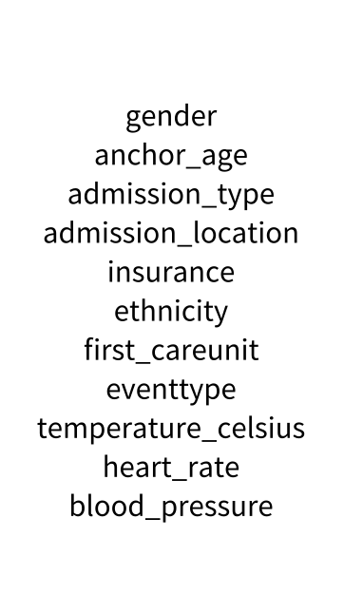
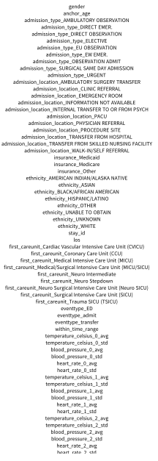




Slide 7

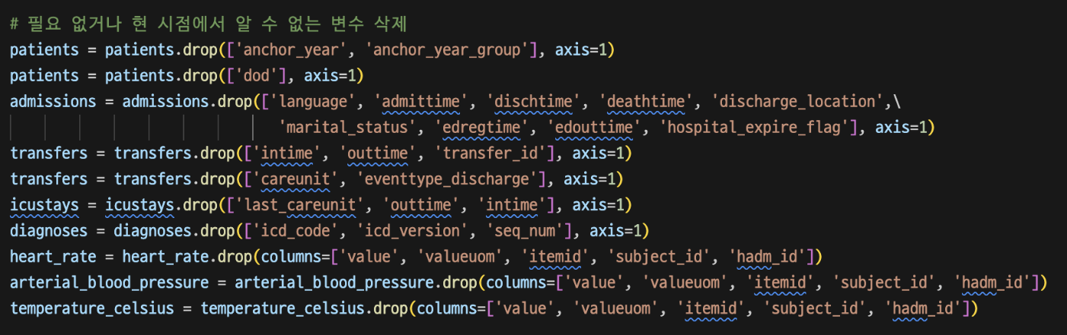

Slide 8

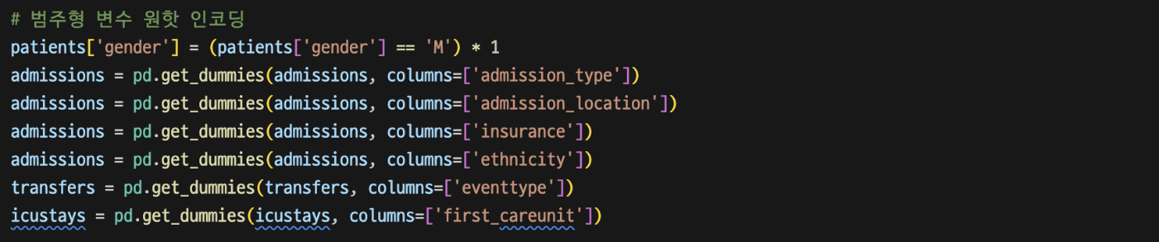

Slide 9
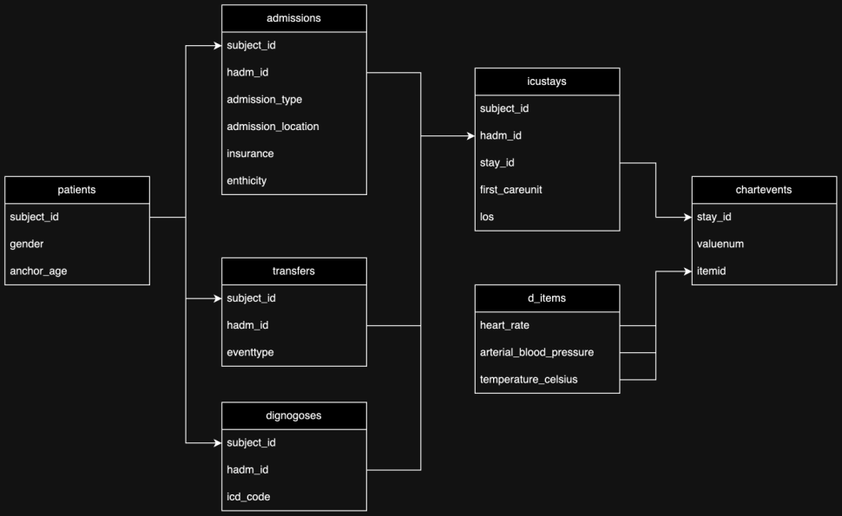


Slide 10
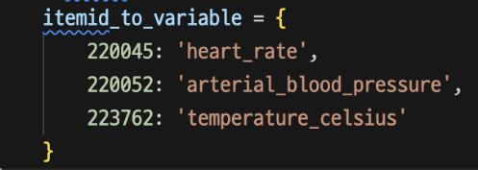
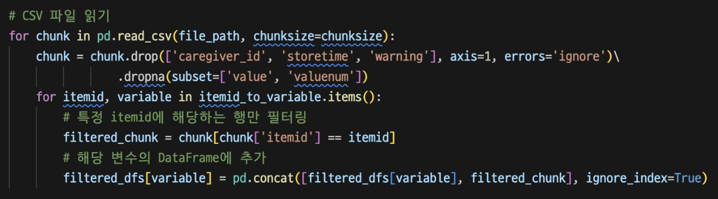

Slide 11
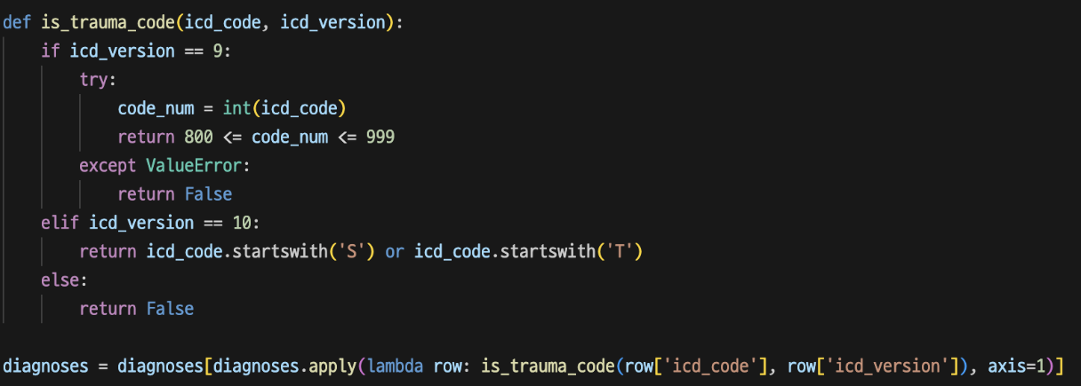


Slide 12
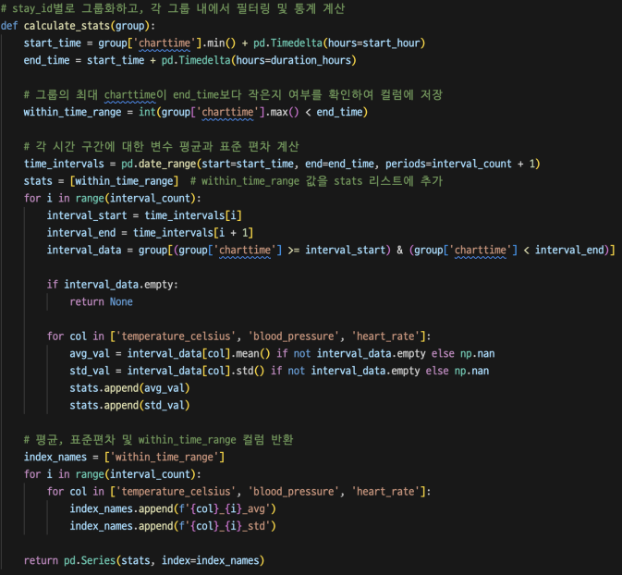
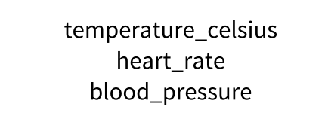




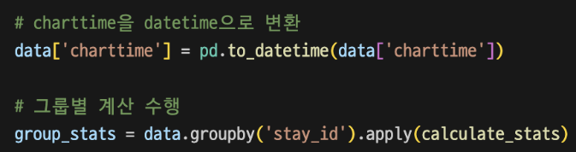


Slide 13














Slide 14









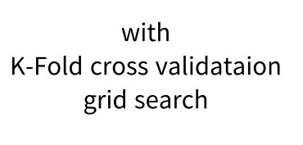


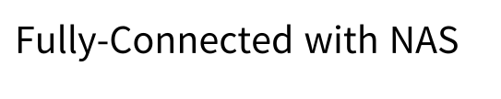
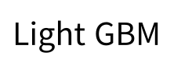
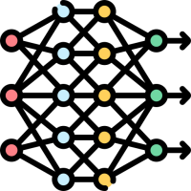


Slide 15









Slide 16
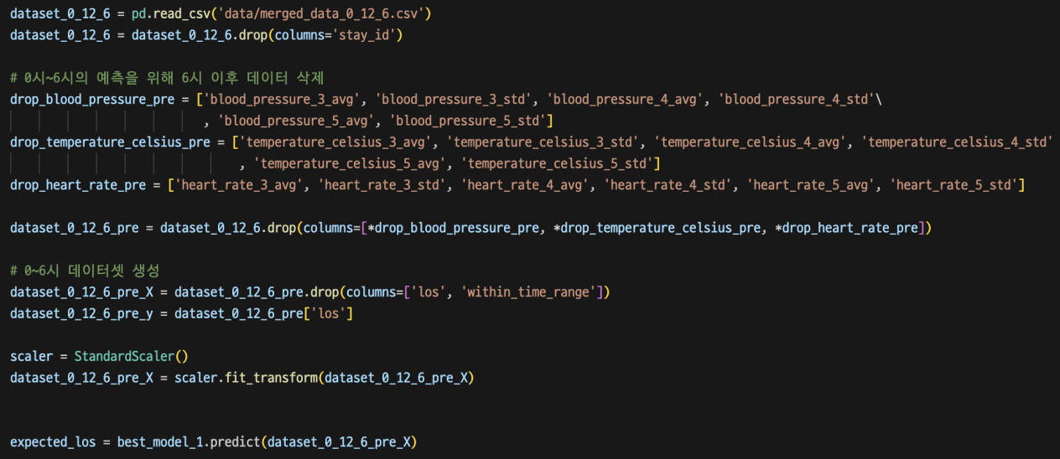

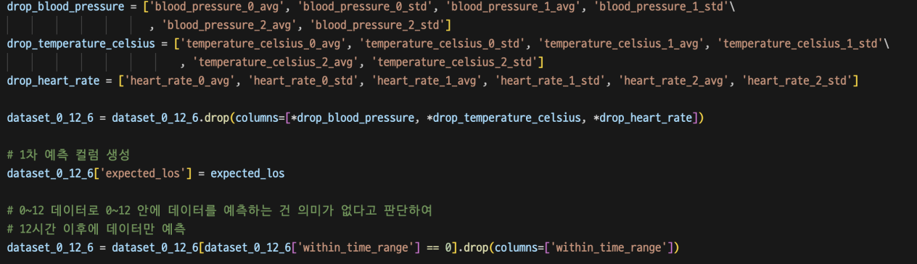

Slide 17

1차 예측 결과
 | fc1 | fc2 | fc3 | nas | DT | XG | rf | CB | LGB
mse | 19.82168 | 21.61604 | 20.70128 | 48.26021 | 21.51604 | 21.41604 | 21.31604 | 21.21604 | 21.11604
mae | 2.206472 | 2.208324 | 2.483151 | 4.600285 | 2.108324 | 2.008324 | 1.908324 | 1.808324 | 1.708324
rmse | 1.48542 | 1.486043 | 1.575802 | 2.144827 | 1.386043 | 1.286043 | 1.186043 | 1.086043 | 0.986043
r2 | 0.893956 | 0.884357 | 0.889251 | 0.741813 | 0.874357 | 0.864357 | 0.854357 | 0.844357 | 0.834357
adjusted r2 | 0.878125 | 0.867092 | 0.872717 | 0.703269 | 0.857092 | 0.847092 | 0.837092 | 0.827092 | 0.817092

Slide 18
2차 예측 결과
metric | fc1 | fc2 | fc3 | nas | DT | XG | rf | CB | LGB
mse | 5.228066 | 2.871528 | 8.951874 | 30.87644 | 2.771528 | 2.671528 | 2.571528 | 2.471528 | 2.371528
mae | 1.12091 | 1.092209 | 1.697075 | 2.752445 | 0.992209 | 0.892209 | 0.792209 | 0.692209 | 0.592209
rmse | 1.05873 | 1.045088 | 1.302718 | 1.659049 | 0.945088 | 0.845088 | 0.745088 | 0.645088 | 0.545088
r2 | 0.971401 | 0.984292 | 0.951031 | 0.831099 | 0.974292 | 0.964292 | 0.954292 | 0.944292 | 0.934292
adjusted r2 | 0.965855 | 0.981246 | 0.941534 | 0.798342 | 0.971246 | 0.961246 | 0.951246 | 0.941246 | 0.931246

Slide 19


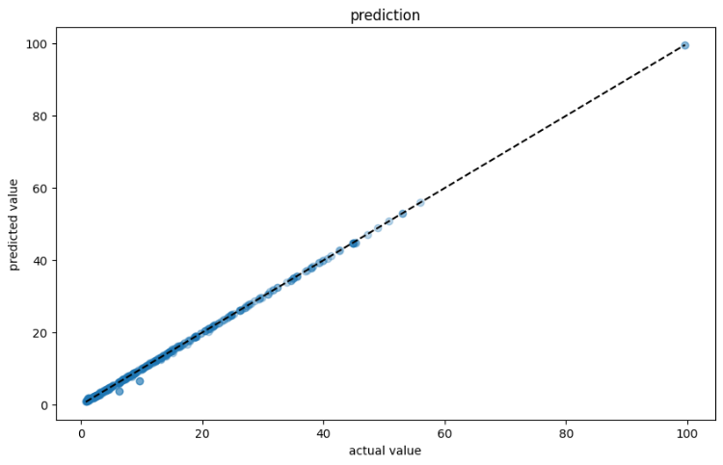
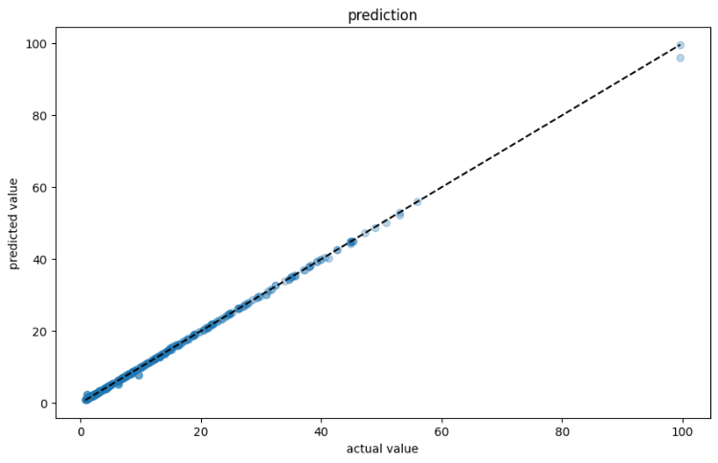

Slide 20

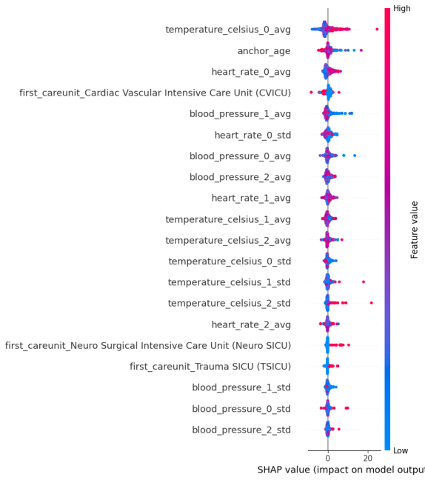


Slide 21

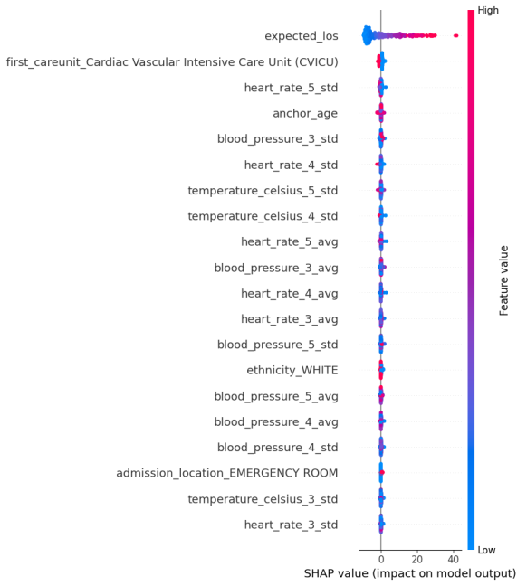


Slide 22













Slide 23











Slide 24


Slide 25




Slide 26



Slide 27

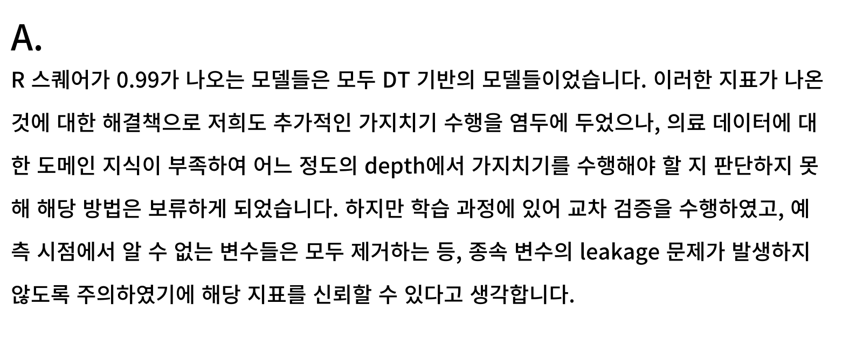

Slide 28



Slide 29



Slide 30



Slide 31



