Slide 1
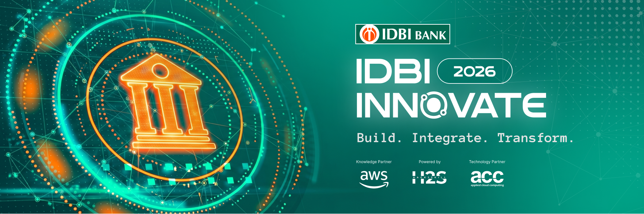
Team Details
Team name: Code_With_Anik
Team leader name: Anik Kumar Biswas- (Single contributor)
Problem Statement: Prospect Assist AI – AI-Powered Retail Lending Decision Intelligence & Maker-Checker Platform
Project Name: Project NIRNAY

Slide 2
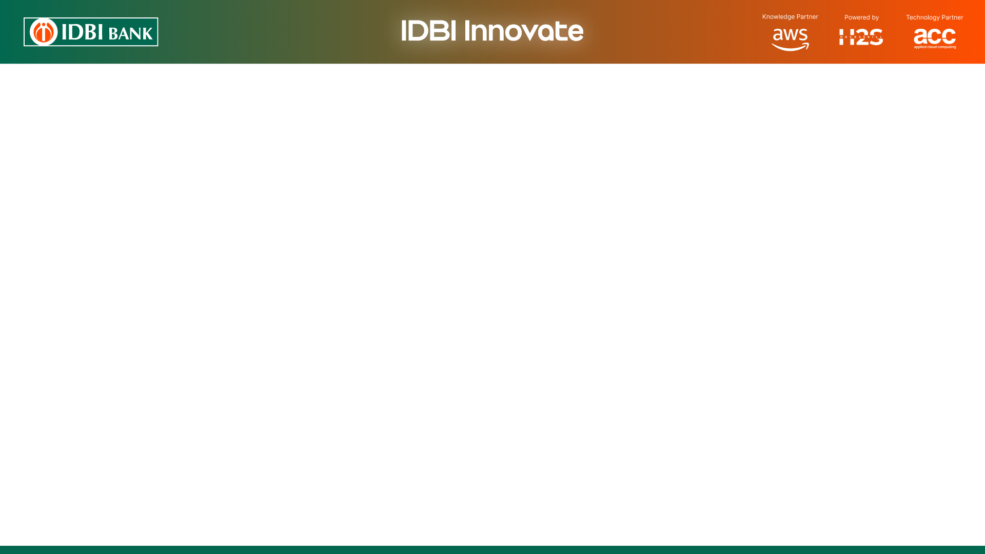
Brief about the idea:
Project NIRNAY is an AI-powered Retail Lending Decision Intelligence Platform designed to help banks identify high-quality loan prospects, accurately estimate repayment capacity, and improve lending decisions through a transparent Maker–Checker approval workflow.
The solution combines machine learning, underwriting analytics, and explainable AI to analyze customer transaction behavior, credit profile, salary consistency, and repayment capability. It generates prospect scores, recommends suitable loan products, validates lending policies, and provides AI-assisted decision support while ensuring every approval passes through a secure Maker–Checker process with a complete audit trail.
By reducing manual effort, improving lead quality, and enabling transparent, policy-driven credit decisions, Project NIRNAY helps banks increase loan conversion rates while maintaining strong governance and regulatory compliance.

Slide 3
Opportunities
How different is it from any of the other existing ideas? – Moves beyond traditional rule-based lending by combining AI-driven prospect scoring, income estimation, and behavioral transaction analysis.Integrates a Maker–Checker approval workflow, ensuring every lending decision is transparent, auditable, and compliant with banking governance.
How will it be able to solve the problem?- Identifies high-quality loan prospects using customer transaction patterns, credit score, salary consistency, and repayment behavior.Estimates actual repayment capacity through underwriting metrics such as FOIR (Fixed Obligation to Income Ratio) and repayment capacity analysis.Recommends the most suitable loan product while validating applications against predefined lending policies.
USP of the proposed solution - End-to-End AI-Powered Lending Decision Platform combining Prospect Scoring, Underwriting Intelligence, Explainable AI, Policy Validation, and Maker–Checker Governance.Transparent and auditable decision-making with a complete Audit Trail for regulatory compliance.Modular, scalable architecture that can be integrated with existing Core Banking Systems, Loan Origination Systems (LOS), and Credit Bureau services.

Slide 4
List of Features Offered by the Solution:
🤖 AI-Powered Prospect Scoring – Identifies high-quality loan prospects using transaction behaviour, credit profile, and customer intent.
💰 Intelligent Underwriting – Estimates income, calculates FOIR and repayment capacity for prudent lending decisions.
🏦 Smart Loan Recommendation – Recommends the most suitable loan product (Personal, Home, Auto, Mortgage) based on customer eligibility.
🔍 Explainable AI (XAI) – Provides transparent reasons behind every AI recommendation to improve trust and decision-making.
📑 Lending Policy Validation – Automatically checks applications against predefined banking policies and eligibility criteria.
⚠️ Risk & Eligibility Assessment – Generates eligibility scores and risk classifications to support credit officers.
👥 Maker–Checker Workflow – Enables dual authorization with Maker and Checker approvals to ensure governance and compliance.
📋 Audit Trail & Dashboard – Maintains complete decision history and provides real-time insights through an interactive lending dashboard.

Slide 5
Process flow diagram or Use-case diagram :
Customer Data & Transactions ⬇️ Data Preprocessing & Feature Engineering ⬇️ AI Prospect Scoring & Income Estimation ⬇️ Underwriting Assessment (FOIR, Repayment Capacity, Eligibility Score) ⬇️ Lending Policy Validation & Risk Assessment ⬇️ Explainable AI Recommendation (Approve / Review / Reject) ⬇️ Maker–Checker Approval Workflow ⬇️ Final Loan Decision, Audit Trail & Dashboard

Slide 6
Architecture diagram of the proposed solution:
👤 Customer Data (Customer Profile • Transactions • Credit Score)
➡️
⚙️ Data Processing (Feature Engineering)
➡️
🤖 AI Decision Engine (Prospect Scoring • Income Prediction • Underwriting)
➡️
📑 Policy & Risk Engine (Policy Validation • Explainable AI)
➡️
👥 Maker–Checker Workflow (Dual Authorization & Approval)
➡️
📊 Dashboard & Audit Trail (Final Decision • Loan Recommendation • Portfolio KPIs)

Slide 7
Technologies to be used in the solution:
Category | Technology
Programming Language | Python
Machine Learning | Scikit-learn, Pandas, NumPy
Data Generation | Faker
Frontend / Dashboard | Streamlit
Model Persistence | Joblib
Data Storage | CSV Files (Prototype)
Development Environment | PyCharm, Git, GitHub
Deployment | Streamlit Community Cloud / GitHub

Slide 8
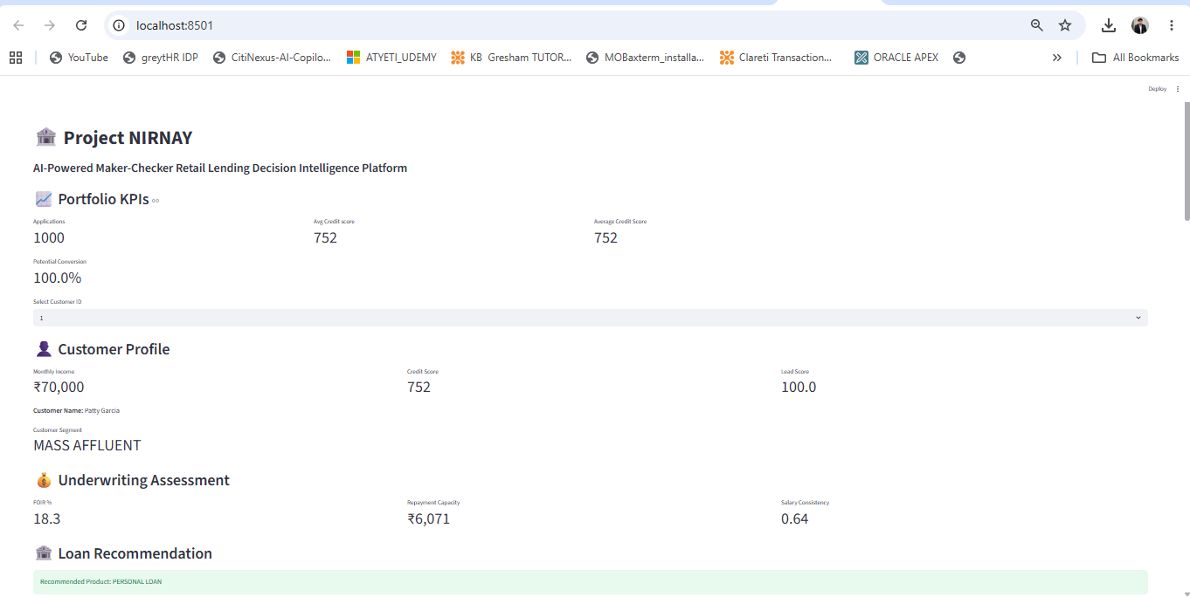
Snapshots of the prototype:

Slide 9
Prototype Performance report/Benchmarking:
Metric | Prototype Result
Prospect Scoring | Successfully identifies high-potential loan prospects
Income Prediction Model | R² Score: 1.00 (Synthetic Dataset)
Income Prediction Error | MAE: 0.00 (Synthetic Dataset)
Underwriting Assessment | Automated FOIR & Repayment Capacity Calculation
Policy Validation | Real-time eligibility checks against lending rules
Decision Transparency | Explainable AI with decision reasons
Governance | Dual Maker–Checker approval with Audit Trail
User Interface | Interactive Streamlit Dashboard with real-time recommendations

Slide 10
Additional Details / Future Development :
Integrate with Core Banking Systems (CBS) and Loan Origination Systems (LOS) for end-to-end loan processing.
Connect to Credit Bureau APIs (e.g., CIBIL, Experian, CRIF) for real-time credit assessment.
Support Bank Statement Analysis using OCR and AI to improve income verification.
Implement Fraud Detection & AML models to identify suspicious lending activities.
Introduce a GenAI Lending Assistant to help credit officers summarize applications and explain decisions.
Add Role-Based Access Control (RBAC), multi-level approvals, and digital signatures for enterprise deployment.
Deploy on a secure cloud platform with monitoring, logging, and scalable microservices architecture.
Enhance analytics with portfolio monitoring, loan default prediction, and customer retention insights.

Slide 11
Provide links to your:
GitHub Public Repository : https://github.com/Anik-1997-Biswas/IDBI-AI-Powered-Maker-Checker-Retail-Lending-Decision-Intelligence-Platform
Final Product Link:

Slide 12
