Slide 1
Stop And Wait ARQ using CRC32 bit check

Slide 2
Problem Statement
Sending and receiving data frames in data layer protocol
Using Stop and Wait ARQ to send and receive data
CRC-32 to check if there is any error or not.

Slide 3
Working Procedure
Added Fcs to the frame
Check error using CRC-32
Sender
Receiver
If any error found
If any no error found
Negative ACK will be send and sender send same frame again
Positive ACK will be send and sender sends next frame

Slide 4
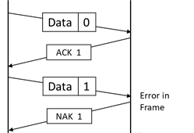
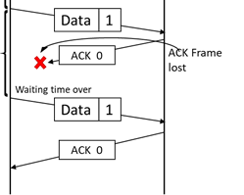
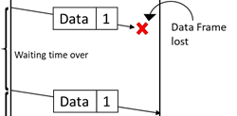
Stop and Wait ARQ
Damaged frame
Lost Frame
Damaged acknowledgment

Slide 5

CRC 32
Error detecting code.
Divide the data by a predetermined divisor.
XOR operation .
FCS code added to the end of the data unit.

Slide 6
Implementation
First of all, We take data input from the file which will be transferred.
Then we have calculated the required frame number needed for transfer the data.
We have fixed the data field to 64 bits.

Slide 7
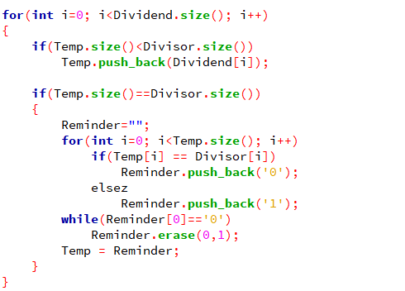
Implementation
We have store the predetermined divisor into a string by using
32-bit polynomial equation.
Then we generate the FCS code by using CRC function and attached it into the frame.
CRC function:

Slide 8
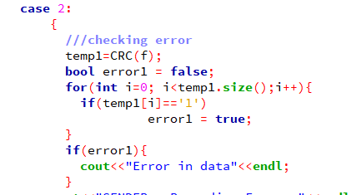
Implementation
Before transmitting the frame we have to choose error randomly and the number of error will not more than 3 times.
We checked the frame only for error in data and for others we just resend that frame again to the receiver.

Slide 9
Thank You

