Slide 1
Presentation on
Project Name: “Location Alarming System”
Course code: CSE 278
Project Supervisor:
Dr. Mrinal Kanti Baowaly
Associate Professor
Department of CSE, BSMRSU,Gopalganj-8100
Submitted By:
Anik Kumar
Student ID: 19CSE003
Department of CSE,
BSMRSTU,Gopalganj-8100

Slide 2
Presentation Outline
Introduction
The process of Project
Features
Testing & Screenshots
Result & Evaluations
Future plan
Limitation
Conclusion

Slide 3
Introduction
“Location alarming system” is a simple mobile app, it is develop in java. Where we can set a location.
My “Location alarming system” app, when current location and setup location distance less then or equal 5.5 km then ringing a ton or notify.
This app helps the user to set, cancel and edit of the alarms as he wishes.
This system also helps to check the task location on the map how far he is from the current location.

Slide 4
The process of Project
Some task of our simple mobile app view will be given and you can choose the task if you want.
“Set alarm" is a task, we can set alarm anywhere in the world.
“Cancel alarm" , this is used when we cancel the alarm.
We can change the map view. Example: Normal Mode, Satellite Mode.
When click the “Exit” button then finished the app and closed.

Slide 5
Features
Real-time GPS location tracking.
Proximity-based alarms and notifications.
Platform compatibility for Android devices.
Enhances user safety and awareness.
Efficient and reliable location-based alarm system.
Seamless integration with existing mobile devices.
Platform independence for broader device compatibility.
Timely alarm for entering or exiting defined areas.
User-friendly interface for easy setup and management.

Slide 6
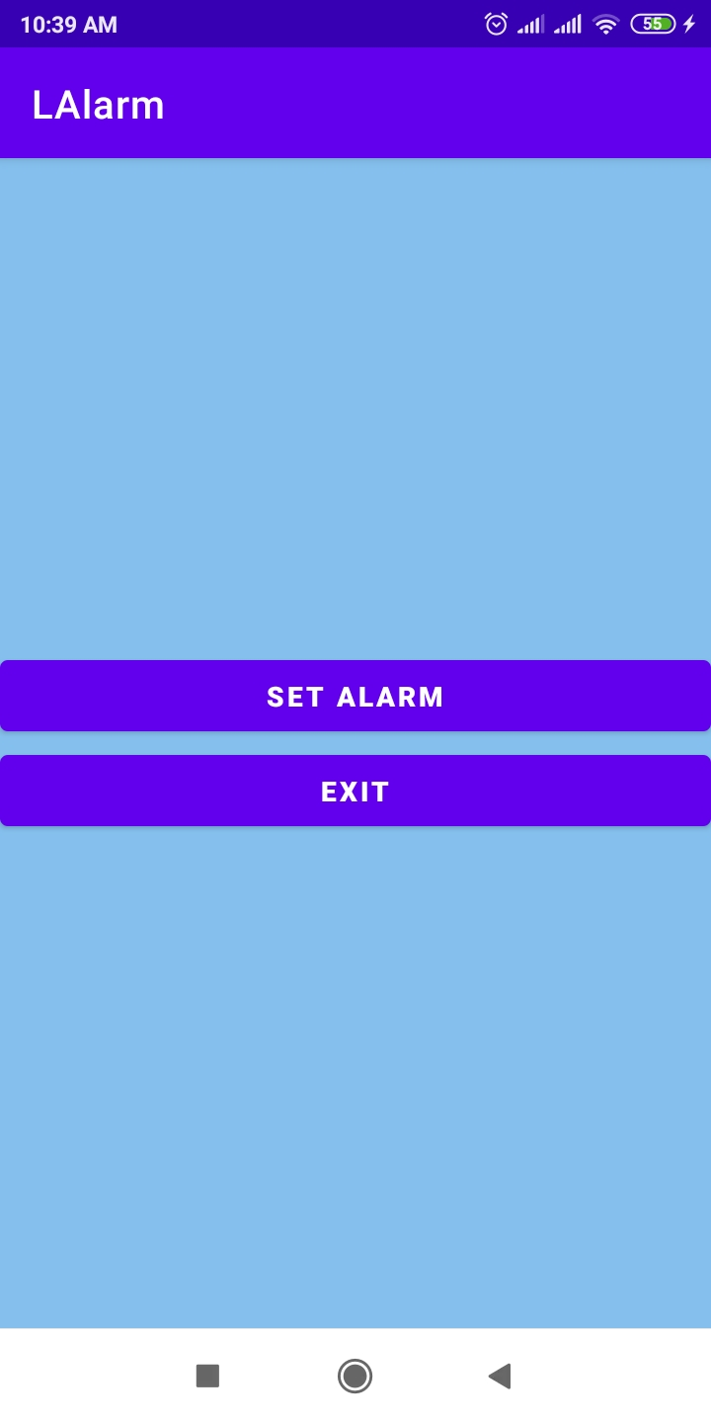
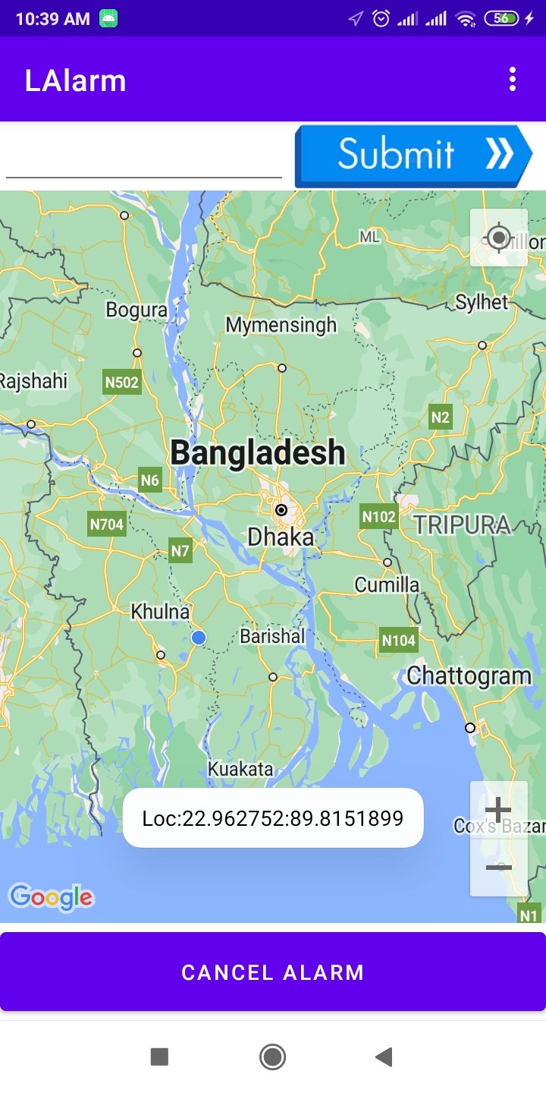
Testing & Screenshots
First view of apps
Main view and Toasting view

Slide 7
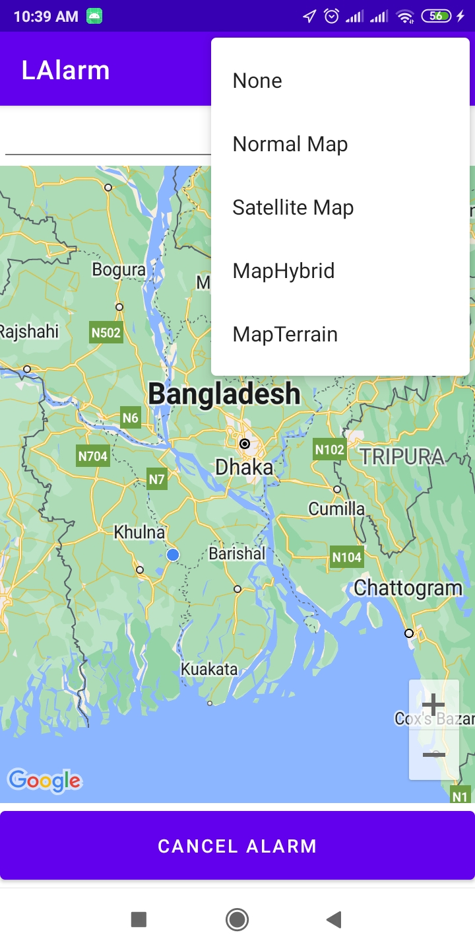
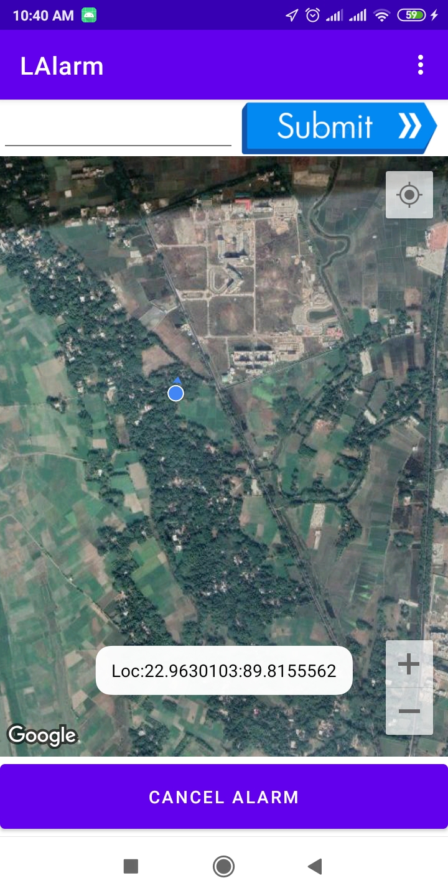
Testing & Screenshots(Continue)
Changing map view
Satellite view

Slide 8
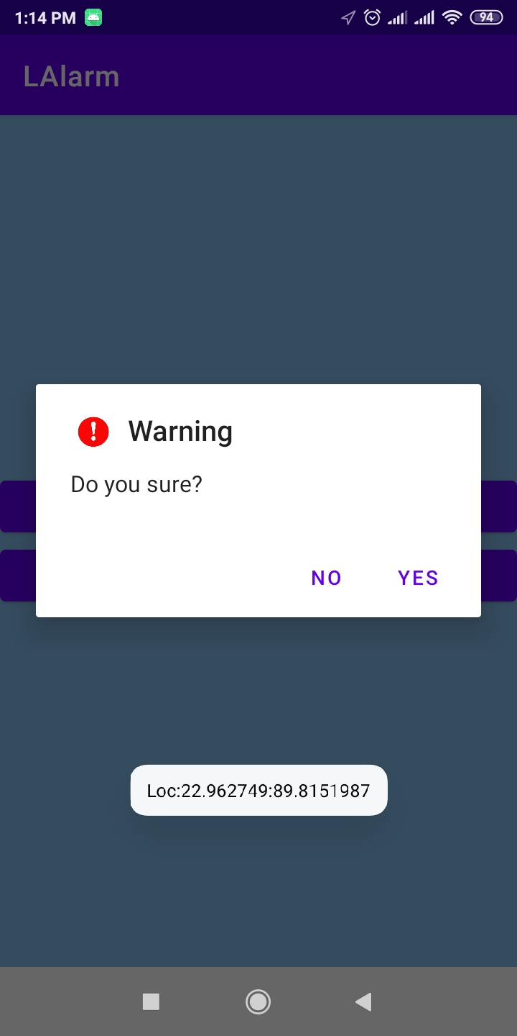
Testing & Screenshots(Continue)
Exit view

Slide 9
Result & Evaluations
The "Location Alarming System" app has shown positive results and received favorable evaluations.
Users appreciate the accurate GPS tracking, timely alarms, and customizable features.
The app's user-friendly interface and compatibility with Android devices have been well-received.
The app received positive feedback for its user-friendly interface, making it easy for users to set up and manage their location-based alarms and preferences.
Overall, the app has demonstrated reliability, effectiveness, and user satisfaction in its location-based alarming capabilities.

Slide 10
Result & Evaluations(Continue)
Users found the app valuable for personal safety and convenience, appreciating its ability to customize alarm conditions and notification preferences.
Exploring additional features could add value to the app.
Ex. If have a habit of sleeping while traveling in the vehicle, then set the alarm and the phone will ring when reach the specified place.

Slide 11
Future plan
Launch the app on playstore.
Add the database later.
Machine learning algorithms for more accurate and personalized alert generation.
Continuous refinement and updates based on user feedback and technological advancements.
Add a new feature, so that a company manager can track the location of his employer’s phone and sure whether he is at workplace or not?

Slide 12
Limitation
Can’t work if GPS is disabled.
Environmental factors such as tall buildings, dense forests, or adverse weather conditions can lead to signal interference, affecting the app's ability to provide accurate location updates and triggering of alarms or notifications.

Slide 13
Conclusion
The Location Alarming System app has demonstrated its value as an effective tool for enhancing user safety and convenience through real-time location tracking and intelligent alerts.
With features like proximity-based alarms, geofencing, and speed limit monitoring, the app provides users with timely notifications and has received positive feedback for its usability and reliability.
With its effective features and positive user feedback, the app demonstrates its potential to provide reliable and efficient location-based alarming services.

Slide 14
Thank You

