Slide 1
Forecasting
Chapter-3

Slide 2
FORECAST
A statement about the future value of a variable of interest.
  Forecasts are the basis for manage budgeting, capacity, sales, production and inventory, personnel, purchasing and many more.
  Forecasts play an important role in the planning process because they enable managers to anticipate the future so they can plan accordingly.

Slide 3
FORECAST
Accounting | Cost/profit estimates
Finance | Cash flow and funding
Human Resources | Hiring/recruiting/training
Marketing | Pricing, promotion, strategy
MIS | IT/IS systems, services
Operations | Schedules, MRP, workloads
Product/service design | New products and services

Slide 4
COMMON FEATURES TO ALL FORECASTS
Assumes causal system
past ==> future
Forecasts rarely perfect because of randomness
Forecasts more accurate for groups vs. individuals
Forecast accuracy decreases as time horizon increases
I see that you will
get an A+ this semester

Slide 5
ELEMENTS OF A GOOD FORECAST
The forecast should be timely.
The forecast should be accurate and the degree of accuracy should be stated.
The forecast should be reliable; it should work consistently.
The forecast should be expressed in meaningful units.
The forecast should be in writing.
The forecasting technique should be simple to understand and use.
The forecast should be cost effective.
More than one technique should be used
The use of both Qualitative and quantitative techniques provide best result

Slide 6

STEPS IN THE FORECASTING PROCESS
“The forecast”
Step 6 Monitor the forecast
Step 5 Prepare the forecast
Step 4 Gather and analyze data
Step 3 Select a forecasting technique
Step 2 Establish a time horizon
Step 1 Determine purpose of forecast

Slide 7
APPROACHES TO FORECASTING
QUALITATIVE-
  Judgmental Forecasts
    Forecasts that use subjective inputs such as opinions from consumer surveys, sales staff, managers, executives and experts.
QUANTITATIVE -
  Time - series Forecasts
    uses historical data assuming the future will be like the past
  Associative Model
    Forecasting technique that uses explanatory variables to predict future demand.

Slide 8
Judgmental Forecasts
Executive opinions
Sales force opinions
Consumer surveys
Outside opinion
Delphi method
  Opinions of managers and staff
  Achieves a consensus forecast
3-<number>

Slide 9
TIME - SERIES FORECASTS
A time series is a time ordered sequence of observations taken at regular intervals; e.g. – hourly, daily, weekly, monthly etc.
  Analysis of time series data requires the analyst to identify the underlying behavior of the series. This can often be accomplished by merely plotting the data and visually examining the plot.
  Different patterns are –
    Trend, Seasonality, Cycles, Irregular variations and Random variations.

Slide 10
TIME - SERIES FORECASTS (CONTD.)
Trend - A long term upward or downward movement in data.
Seasonality - Short term regular variations related to the calendar or time of day.
Cycle - Wavelike variations lasting more than one year.
Irregular variation - Caused by unusual circumstances, not reflective of typical behavior.
Random variations - Residual variations after all other behaviors are accounted for.

Slide 11
TIME - SERIES FORECASTS (CONTD.)
Irregular
variation
Trend
Cycles
90
89
88
Seasonal variations

Slide 12
FORECASTING METHOD
Naive Method
  The forecast for any period equals the previous period’s value.
    The naive approach can be used with a stable series (variations around an average), with seasonal variations.
Techniques for Averaging/ Averaging Methods
  Simple average
  Moving Average
  Weighted Moving Average
  Exponential Smoothing

Slide 13

Naive Forecasts
Uh, give me a minute....
We sold 250 wheels last
week.... Now, next week we should sell....
The forecast for any period equals the previous period’s actual value.
3-<number>

Slide 14
Naïve Forecasts
Simple to use
Virtually no cost
Quick and easy to prepare
Data analysis is nonexistent
Easily understandable
Cannot provide high accuracy
Can be a standard for accuracy

Slide 15
Uses for Naïve Forecasts
Stable time series data
  F(t) = A(t-1)
Seasonal variations
  F(t) = A(t-n)
Data with trends
  F(t) = A(t-1) + (A(t-1) – A(t-2))
3-<number>

Slide 16
MOVING AVERAGE
Technique that averages a number of recent actual values, updated as new values become available.
n
∑
A_{i}
MA_{n}
=
i = 1
n

Slide 17
WEIGHTED MOVING AVERAGE
More recent values in a series are given more weight in computing the forecast.
EXPONENTIAL SMOOTHING
Weighted averaging method based on previous forecast plus a percentage of the forecast error.
F_{t} = F_{t-1} + α(A_{t-1} - F_{t-1})

Slide 18
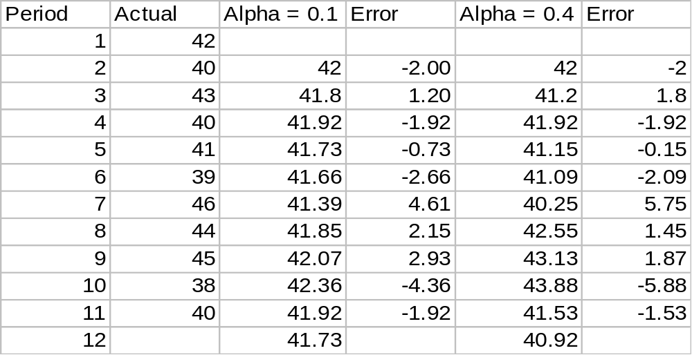
Example 1 - Exponential Smoothing
3-<number>

Slide 19
Linear Trend Equation
F_{t}
F_{t} = a + bt
0 1 2 3 4 5 t
F_{t} = Forecast for period t
t = Specified number of time periods
a = Value of F_{t} at t = 0
b = Slope of the line
3-<number>

Slide 20
Calculating a and b
n
∑
(ty)
-
∑
t
y
∑
b
=
2
2
n
t
-
(
t)
∑
∑
∑
y
-
b
∑
t
a
=
n
3-<number>

Slide 21
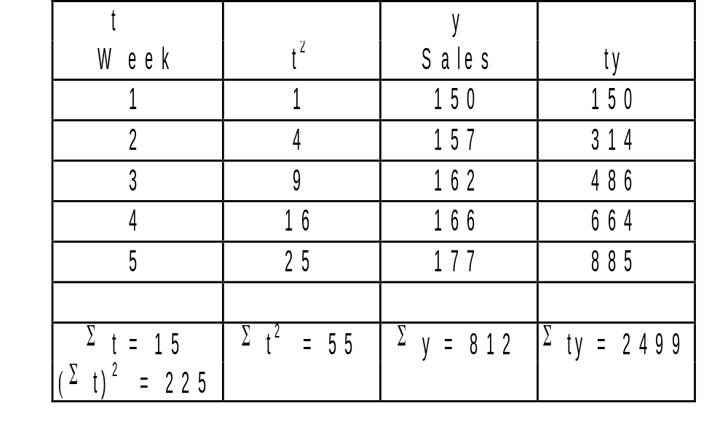
Linear Trend Equation Example
3-<number>

Slide 22
Linear Trend Calculation
5 (2499)
-
15(812)
12495
-
12180
b
=
=
=
6.3
5(55)
-
225
275
-
225
812
-
6.3(15)
a
=
=
143.5
5
y = 143.5 + 6.3t
3-<number>

Slide 23
Problem for Practice (Trend Equation)
Cell phone sales for a New firm is based over the last ten weeks as shown. Plot the data and check if a linear trend line is visible. Determine the equation and predict the sales for the weeks of 11 and 12.
Result: F₁₁=782.01 and F₁₂=789.52
F= 699.40+7.51t
Week | 1 | 2 | 3 | 4 | 5 | 6 | 7 | 8 | 9 | 10
Sales | 700 | 724 | 720 | 728 | 740 | 742 | 758 | 750 | 770 | 775
1-<number>

Slide 24
FORECAST ACCURACY
Mean Absolute Deviation (MAD)
  Average absolute error
Mean Squared Error (MSE)
  Average of squared error
Mean Absolute Percent Error (MAPE)
  Average absolute percent error
∑
−
Actual
forecast
MAD
=
n
(
Actual
−
2
∑
forecast)
MSE
=
n
-
1
∑((
Actual
−
forecast
/ Actual)*100%)
MAPE
=
n

Slide 25
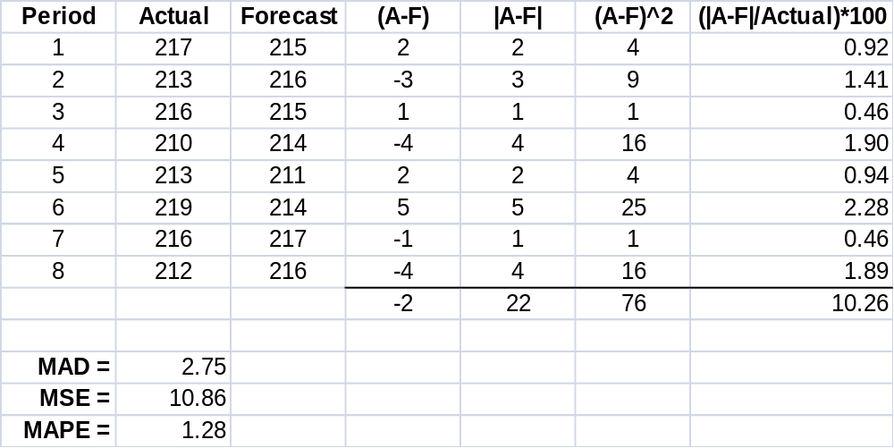
EXAMPLE 1

Slide 26
EXAMPLE 02
Period | Actual
(t) | (A) | Forecast | (A-F) | |E| | E² | (|E| / A)*100
1 | 42 | - | - | - | - | -
2 | 38
3 | 40
4 | 39
5 | 37
6 | 39
7 | -
 |  | ∑
Forecast Accuracy |  | (α=0.1) |  | MAD | MSE | MAPE

