Slide 1

FACIAL EMOTION RECOGNITION SYSTEM
ANIK MONDAL
2211301042
SHAHIDA AKTER
2222446642
AL-AF MUKTADIR
22329755642
ASIF MAHBUB
22321119042

Slide 2
WHY FACIAL EMOTION RECOGNITION SYSTEM?
A face recognition system in ML is a deep learning model that can identify or verify a person’s emotion by learning patterns from their facial images
Human emotions are important in communication
Emotion-aware systems can improve:
Education
Healthcare
Security
Human–computer interaction
Why Emotion
Recognition
Machines often fail to understand emotional context

Slide 3

Real-Time Facial Emotion Recognition System
Using Deep Learning & Computer Vision
Real-Time Facial Emotion Recognition System
Built with TensorFlow, Keras, and OpenCV
Real-time camera-based emotion detection

Slide 4
WHAT THIS PROJECT DOES
Detects human faces from a live camera
Classifies emotions in real time
Shows prediction confidence visually
Smooth prediction using historical frames
RECOGNIZED EMOTIONS
Angry, Disgust, Fear, Happy, Neutral, Sad, Surprise

Slide 5
KEY FEATURES & ADVANTAGES
FEATURES
ADVANTAGES
Live webcam emotion prediction
Confidence bar visualization
Real-time frame-by-frame smoothing
Save current frame
Reset emotion history
Lightweight and fast
Works well with low-light grayscale images
Easy to integrate into any software

Slide 6
MODELS
In this project, three different deep learning models were implemented for Facial Emotion Recognition
CNN-Based Custom Model
Models Used in This Project
ResNet50-Based Transfer Learning Model
YOLOv11m-cls Model

Slide 7
WHY THREE DIFFERENT MODELS WERE USED
To compare different learning strategies:
Training from scratch
Transfer learning
Advanced multi-scale feature learning
To analyze:
Accuracy
Generalization capability
Overfitting behavior
To identify the best-performing model for real-world deployment

Slide 8
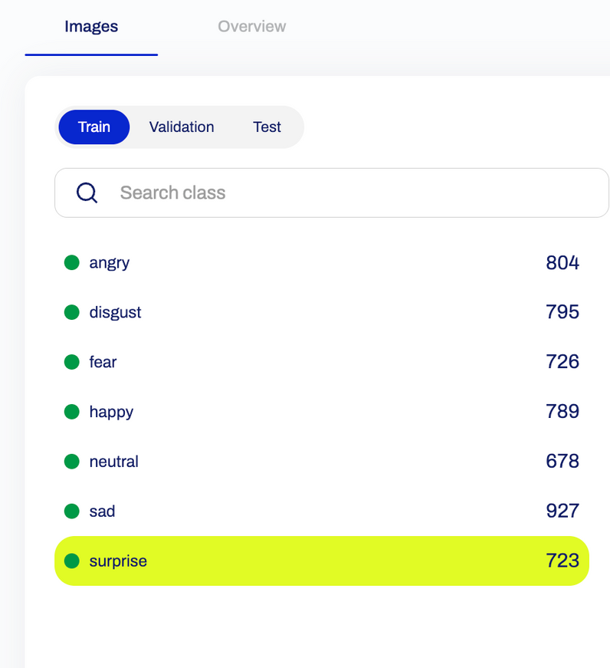
DATASET DESCRIPTION
Total images: 8,400
Emotion classes (7 total):
Angry
Disgust
Fear
Happy
Neutral
Sad
Surprise
Images contain:
Frontal facial expressions
Different lighting and pose variations

Slide 9
DATASET SPLIT
Training set: 80%
Validation set: 10%
Test set: 10%
Same split used for all three models
Ensures fair and unbiased comparison

Slide 10

DATA PREPROCESSING (COMMON FOR ALL MODELS)
Face detection and cropping
Image normalization to [0,1]
Image resizing:
CNN → 48 × 48
ResNet50 → 224 × 224
YOLOv11m-cls → 640 × 640
Data augmentation:
Rotation
Scaling
Flipping

Slide 11
MODEL PERFORMANCE COMPARISON
Model | Accuracy
CNN Based model | ~85%
ResNet50 model | ~95%
YOLOv11m-cls | ~92%
Precision
Recall
0.83
~0.84
~0.94
~0.94
~0.92
~0.91

Slide 12
BEST PERFORMING MODEL
ResNet50-based model achieved the highest accuracy (~95%)
Reasons:
Strong feature extraction
Transfer learning from ImageNet
Effective data augmentation
Balanced bias–variance trade-off

Slide 13
CONCLUSION
Implemented three FER models for comparison
Transfer learning models outperformed basic CNN
ResNet50 model achieved the best performance
YOLO model showed strong real-time potential
Project demonstrates importance of:
Model selection
Dataset handling
Optimization techniques

Slide 14
THANK YOU
Demo video :
https://drive.google.com/file/d/1EB9ScRsX5_gHHN53N_BQdS9y_u5XJSwT/view?usp=sharing

