Slide 1
Lung Cancer Ditection Using Deep Learning Techniques
Semester: Fall 2022
Faculty: DR. NABEEL MOHAMMED
Submitted by
Sun Debnath 1821787042
Anik Aich 1821829042

Slide 2
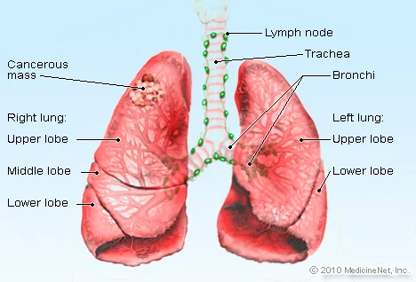
Introduction
Lung carcinoma also known as lung cancer is one of the dangerous diseases.
It is caused due to the reluctant increase of cells in the lung tissues.
In2020 Lung Cancers Deaths in Bangladesh reached 12,174 or 1.70% of total deaths(WHO).
However, the early detection of improves survival rate.
Cancerous (malignant) and noncancerous (benign) pulmonary nodules are the small growths of cells inside the lung.
It is cured only during its early stage, by starting the treatment.
Goal
Build a model that will identify the cancer cells.

Slide 3
Problem Statement
The most suitable method used for the investigation of lung diseases is computed tomography (CT) imaging. Results show that only 68% of the time lung cancer nodules are correctly diagnosed when only one radiologist examines the scan, and are accurately detected up to 82% of the time with two radiologists. The detection of cancerous lung nodules at an early stage is a very difficult, tedious, and time-consuming task for radiologists.

Slide 4
System Design
Data Collection
Model Training
Data Preprocessing
Train Data and validation data
Image Ct Scan dataset
Splitting into training,
validation and testing
subsets
Data visualization
Resizing the image
Type of model: CNN
Pre trained model:
ResNet50,
DenseNet201,
VGG16
Model training with hyper parameter tuning
Test data
Model
selection

Slide 5
Methodology
Data Acquistion - The dataset is obtained from kaggle. The dataset contains 2016 images. There are mainly 3 types of CT images- normal cell images, adenocarcinoma cell image, large cell image and squamous cell image. Adenocarcinoma cell, large cell and squamous cell are the cancer cells. And this dataset are split into 3 part’s- test set, train set and valid set.
Image Preprocessing- When using Models,, We should ensure that all Features have a similar scale, otherwise, it will take much longer to converge. So, we resized all images into 305*430

Slide 6
Methodology
Proposed Models
The proposed model is a convolutional neural network approach based on lung segmentation on CT scan images. At first we preprocess the dataset.
We tried 3 different models of Convolutional Neural Networks-
ResNet50
DenseNet201
VGG-16
Those models are very populr models of CNN which are based on the comparative study of performance of each type model in different dataset and for different classification problems. The models combined with softmax layer is developed and used to efficiently classify the lung CT images for cancer.
Parameter Hyper tuning are also applied for getting the better accuracy from the models.

Slide 7
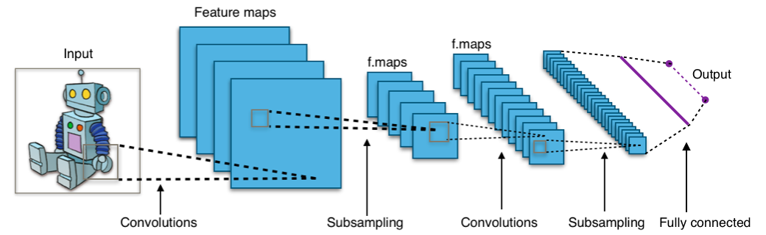
Tools & Technologies Used
Google Colab platform for team collaboration and cloud GPU
Kaggle for Melanoma dataset and Google Drive for storing the dataset
Github for development and version control
Python programming language and Tensorflow framework
Pretainined model: ResNet50, DenseNet201,VGG16
Convolutional Neural Network (CNN) to analyze visual imagery. They are based on the shared-weight architecture of the convolution kernels or filters that slide along input features and provide translation-equivariant responses known as feature maps.

Slide 8
Result
Before doing the hypertuning the Accuracy of the three models is given below:
So here we can see that ResNet50 and DenseNet201 gives the better accuracy. So then we applied parameter hypertuning on this two model for the better accuracy.
After hypertuning the accuracy for two model :
Accuracy
The highest train accuracy achieved 100% and test accuracy achieved 90%.
 | Test | Train
ResNet50 | 88% | 98%
VGG16 | 47% | 30%
Densenet201 | 81% | 99%
 | Train | Test
ResNet50 | 99.5% | 90%
Densenet201 | 100% | 90%

Slide 9
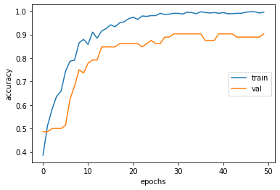
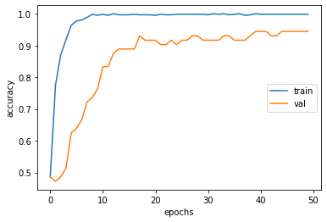
Figure- 1 Figure-2rve
ROC curve
This figure1 represents the Training and Validation Accuracy of ResNet50. Now the test accuracy reach to 90%, validation accuracy reach to 98%
The figure2 represents the Training and Validation Accuracy of DenseNet201. Now the train accuracy is 100% and validation accuracy reach to 90%.

Slide 10
Conclusion
Cancer is considered to be one of the main sources of mortality around the world. So a model lung cancer disease prediction system is developed using deep learning image classification techniques. A deep learning model leveraging DenseNet201 pretrained model combined with a softmax layer is developed and used to efficiently classify the lung CT images for cancer. The proposed model is compared with two other models ResNet50 and VGG16. With an best accuracy level , the analyses of the suggested model show that it performs better than other, comparable models that are available in the literature.

