Slide 1


SMART INDIA HACKATHON 2025
TITLE PAGE
Problem Statement ID - 25028
Problem Statement Title - Smart Classroom & Timetable Scheduler
Theme – Smart Education
PS Category- Software
Team ID-
Team Name (Registered on portal) - CodeManthan

Slide 2
IDEA TITLE
CodeManthan
PROPOSED SOLUTION :
PROBLEM RESOLUTION
A web-based scheduling platform is being proposed to replace manual systems in colleges, allowing authorized personnel to log in and generate optimized timetables based on variables like faculty availability, subject combinations, classroom capacity, and student preferences.
Our hybrid model combines GA for fast candidate generation with CP-SAT for constraint enforcement and refinement, enabling scalable, correct timetables.
The system will include features such as :
Feedback-based subject prioritization
Load balancing for teachers
Syllabus & attendance tracking facility by both students & faculties
Safeguards against time overlaps
Additional modules like student feedback, offline/online class modes with room details or Google Meet links, notes sharing may also be integrated to enhance academic coordination.
Intelligent optimization of academic resources
Personalized and adaptive timetabling
Seamless workflow and Centralized control with secure admin access
UNIQUE VALUE :
Scalable Intelligence: Hybrid GA + CP-SAT adapts seamlessly from small departmental schedules to large institutional datasets—ensuring speed without sacrificing feasibility.
Robust Flexibility: Handles dynamic updates (absences, extra classes) with quick re-repair, making it ideal for real-time, evolving academic environments.

Slide 3

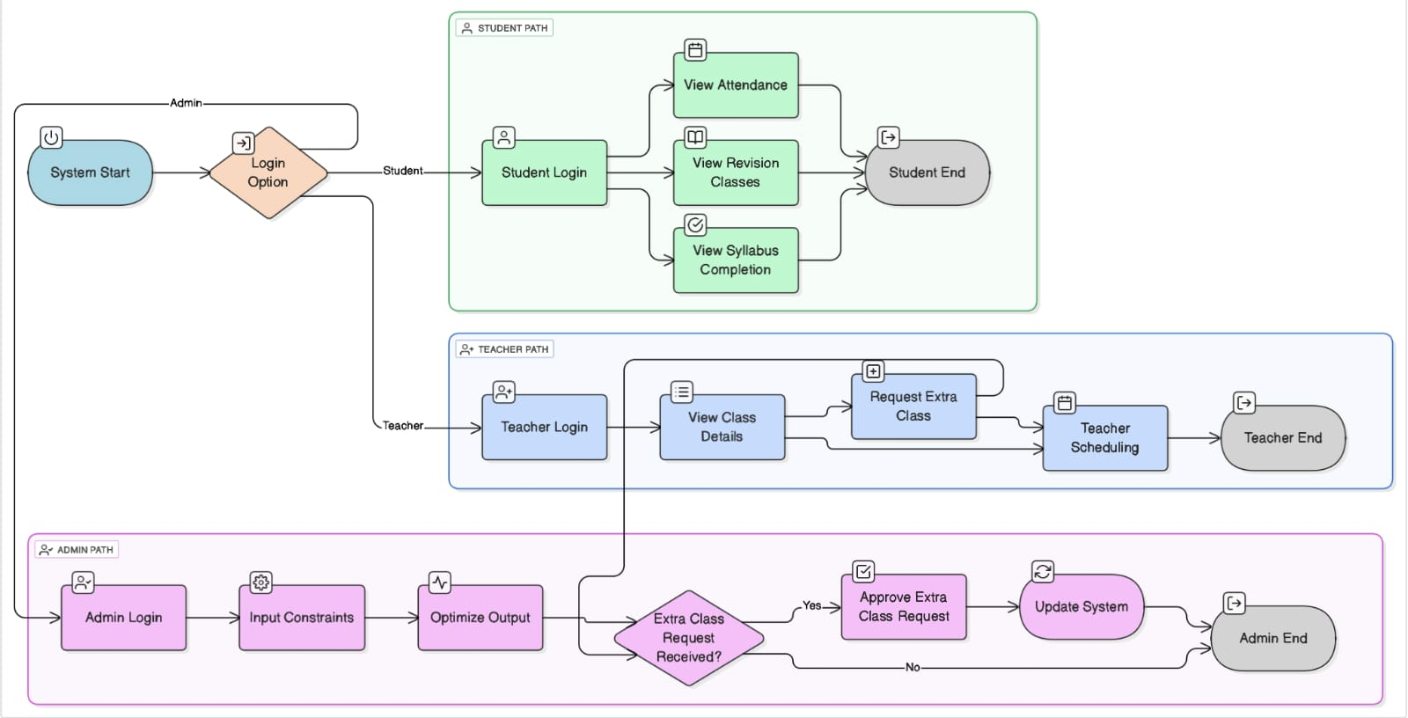
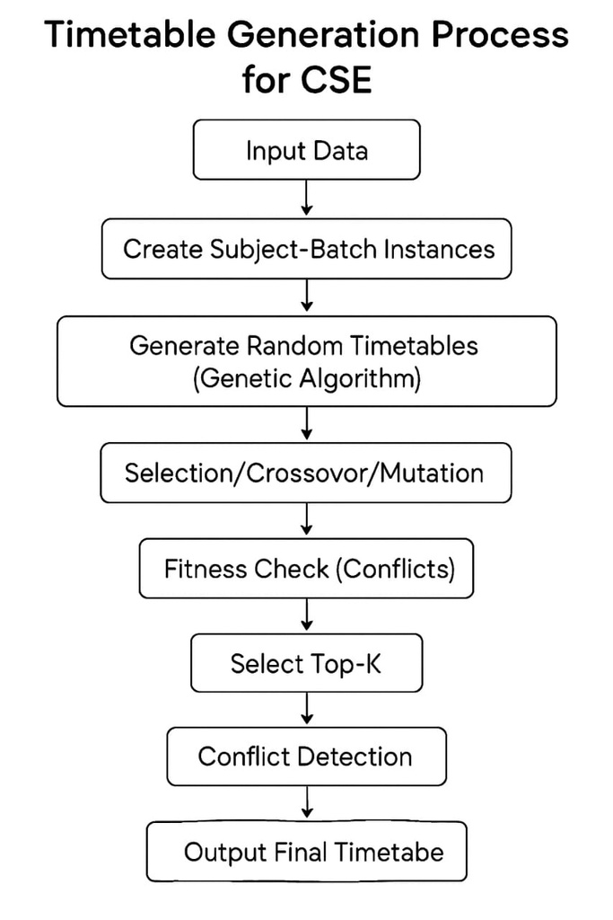
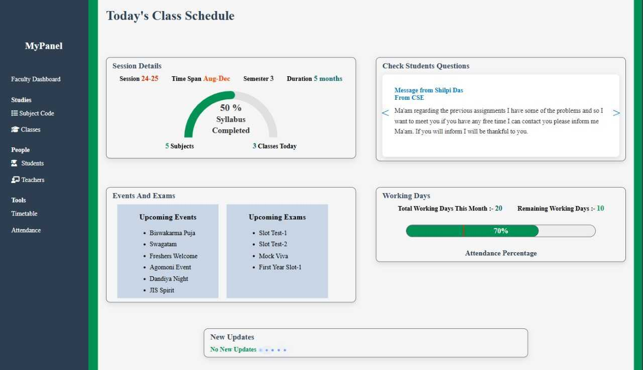
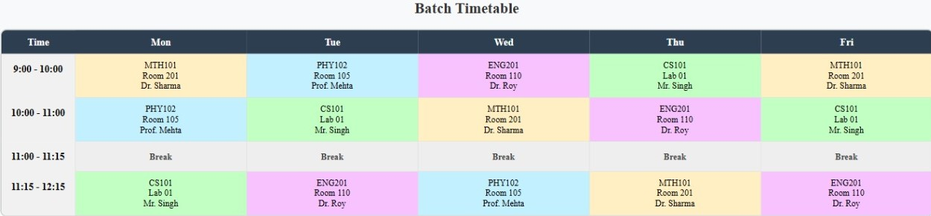
TECHNICAL APPROACH
CodeManthan
FLOWCHART
WORKFLOW
TECH STACK
FRONTEND : HTML , CSS ,JS
BACKEND: PYTHON , NODE.JS
DATABASE: MySQL
HYBRID MODEL:
:
GA(Genetic Algorithm) sketches diverse timetable drafts like a creative designer, while CP-SAT(Constraint Programming) enforces rules like a strict checker. Together, they craft fast, feasible, and scalable college schedules with precision and flair.
PROTOTYPE
@SIH Idea submission- Template
3

Slide 4
FEASIBILITY AND VIABILITY
CodeManthan
Analysis of the feasibility of the idea
1.Technically Viable : This platform can be built using reliable web technologies and proven scheduling algorithms, ensuring smooth development and deployment, GA reduces CP research space and CP ensures hard constraints always satisfied.
2. Operationally Relevant: It directly solves real scheduling challenges in colleges, improving efficiency, reducing conflicts, and supporting academic goals.
3. Economically Scalable: With low maintenance costs and high institutional value, it offers a cost-effective solution that can be expanded across departments and shifts as it works for medium-to-large institutions.
STRATEGIC COMPARISON OF TIMETABLING APPROACHES
Feature | CP-only | GA-only | Hybrid(GA+CP-SAT)
Speed | Medium(low for large data) | Fast | Fast(GA)+Efficient repair
Feasibility | Guaranteed (but at cost of time) | Not guaranteed (needs manual fixes) | Guaranteed (CP-SAT repair)
Scalability | Limited beyond 1000+ classes | Good | Excellent (GA reduces CP load)
Flexibility | Hard to adapt to new constraints | Flexible but weak at strict rules | Highly flexible & robust
User Intervention | High (adjusting rules manually) | Medium (manual conflict fixing) | Low (automatic repair)
Soft Constraints(gaps, load balance) | Weak (focus only on feasibility) | Strong (heuristics optimize soft goals) | Balanced (GA optimizes + CP ensures hard rules)
Practical usage | Works for small-medium institutions | Works but needs manual cleanup | Best suited for medium-large colleges
Potential challenges
Teachers’ unavailability and scheduling conflicts.
Limited classrooms and labs
Tech adoption bottleneck
Strategies to overcome the challenges
CP-SAT for hard constraints(e.g. unavailability slots) &
GA to evolve conflict-free schedules.
Modeling dynamic balancing of room capacities, time slots.
Using GA and clear rules to test different rollout plans for
smooth execution.

Slide 5
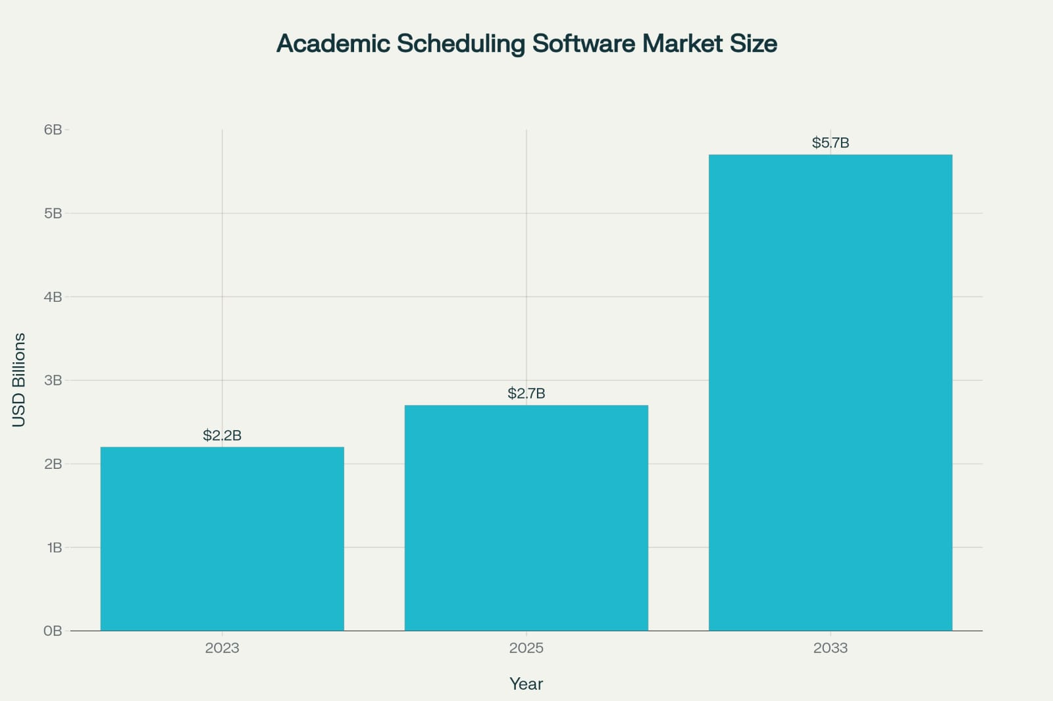
IMPACT AND BENEFITS
CodeManthan
Potential impact on target audience :
This project empowers college authorities with faster, conflict-free scheduling, improving administrative efficiency. Teachers gain clarity and flexibility in their timetables, while students benefit from more consistent academic routines. It fosters smoother coordination across departments and enhances overall institutional productivity.
Benefits of the solution :
Social Impact
Promotes smoother academic coordination, reducing stress for teachers and students through predictable, conflict-free schedules.
Economic Efficiency
Saves administrative time and resources by automating manual tasks, allowing institutions to allocate staff and infrastructure more effectively.
Technological Upliftment
Encourages digital literacy and tech adoption among faculty, fostering a more future-ready educational environment.
The data highlights a strong upward trend, indicating rising demand and adoption of scheduling solutions in the education sector.

Slide 6

RESEARCH AND REFERENCES
CodeManthan
IJCRT25A4273.pdf https://www.ijcrt.org/papers/IJCRT25A4273.pdf
https://www.ssgmce.ac.in/uploads/UG_Projects/cse/202324/Project%2
0Report%20Gr.%20No.%2007_2023-24.pdf
https://share.google/4DyRN9M7hohgxwLpi
https://share.google/Jh7HdltDDBy8wekMZ
https://uplanner.com/how-to-achieve-optimal-class-scheduling/
‘’Optimizing Time, Empowering Campuses.”

