Slide 1

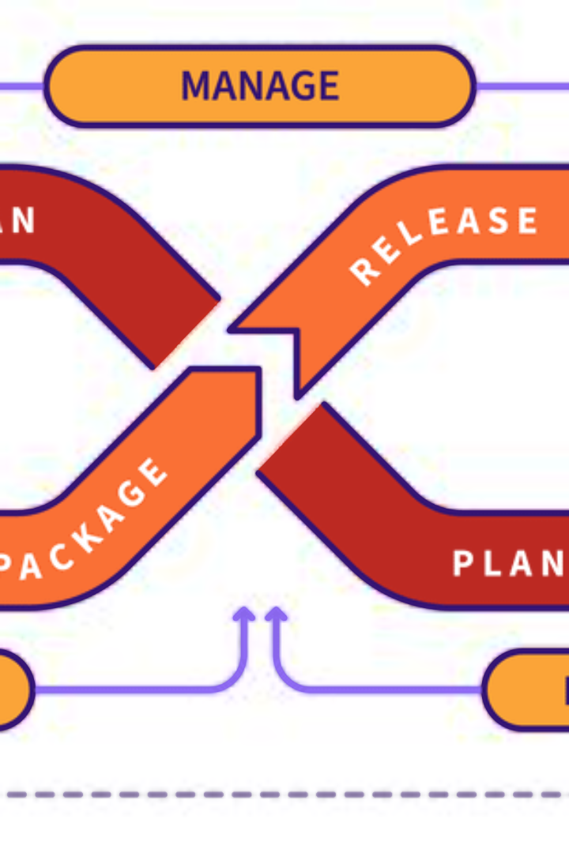

Understanding DevOps
DevOps is a set of practices that combines software development and IT operations to shorten the systems development life cycle and provide continuous delivery with high software quality
by ANIK ACHARJEE

Slide 2
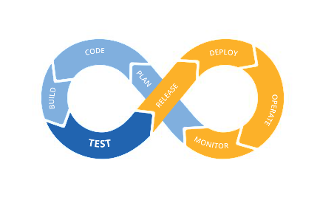

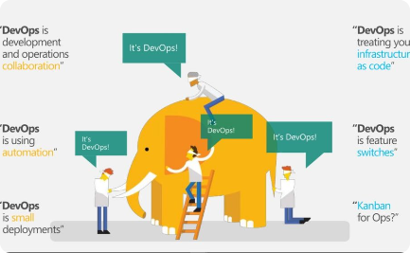
Why DevOps Matters
Increased Efficiency
Enhanced Collaboration
Automation Advantage
Accelerate the development and deployment process
Automate manual processes for greater speed and accuracy
Seamless communication between teams for faster results

Slide 3
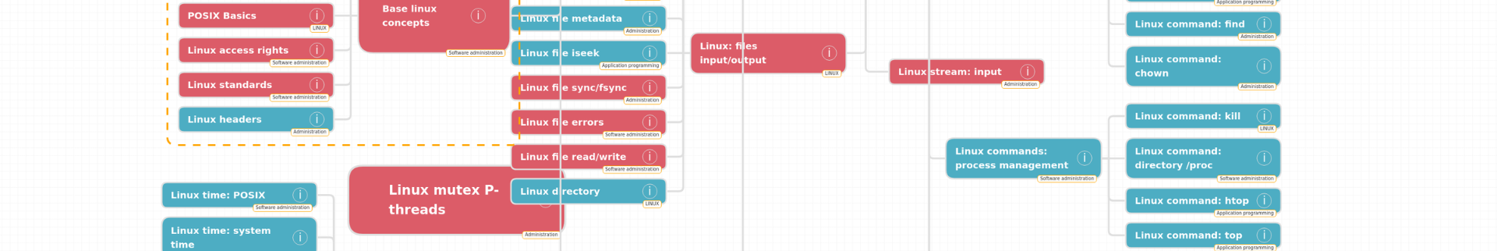
Essential Characteristics
1
Collaboration
Encourages cooperation between development and operations teams
2
Automation
Automates repetitive tasks to streamline operations
3
Continuous Integration/Continuous Deployment (CI/CD)
Facilitates rapid and reliable software releases

Slide 4

Benefits of DevOps
Improved Deployment Frequency
Enhanced Recovery
Scalability & Flexibility
Faster recovery from failures with minimal downtimes
Adapt to changing business needs with ease and efficiency
Shorter development cycles lead to more frequent releases

Slide 5
Implementing DevOps
1
Build a Collaborative Culture
2
Automate Everything Possible
Encourage teamwork and shared responsibility
Automate from testing to deployment processes
3
Implement Monitoring & Feedback Loops
4
Embrace a DevOps Mindset
Cultural shift towards a collaborative and innovative environment
Utilize monitoring tools for continuous improvement

Slide 6
Challenges of DevOps
Resistance to Change
Toolchain Complexity
Teams may resist altering established workflows and processes
Implementing and managing multiple tools can be complex
Lack of Trust
Siloed Departments
Developers and operations teams may not trust each other's competence
Existing departments may hold onto individual ownership of their part in the process

Slide 7
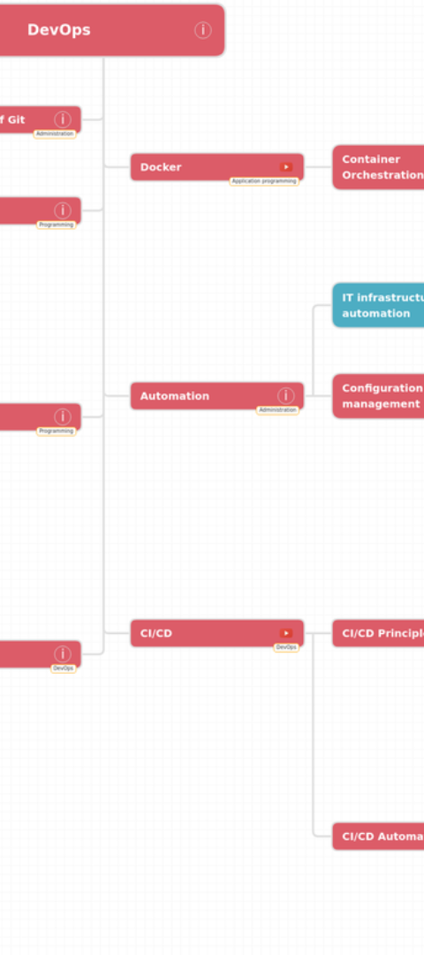
DevOps Success Metrics
1
Deployment Frequency
Measure how often new code is deployed to production
2
Mean Time to Recovery (MTTR)
Calculate the time taken to recover from system failures
3
Change Failure Rate
Assess the frequency of unsuccessful changes

Slide 8




Tools in the DevOps Ecosystem
Source Code Management
Continuous Integration
Tools like Git, SVN, and Mercurial
Jenkins, CircleCI, and Travis CI are popular choices
Containerization & Orchestration
Monitoring & Logging
Docker, Kubernetes, and OpenShift lead the way
Utilize tools such as Nagios, ELK Stack, and Prometheus

Slide 9

DevOps Adoption Strategies
1
Start Small, Scale Fast
Begin with a pilot project, then expand across the organization
2
Training & Education
Ensure teams are equipped with the necessary skills and knowledge
3
Continuous Improvement
Strive for ongoing enhancement of processes and systems

