Slide 1

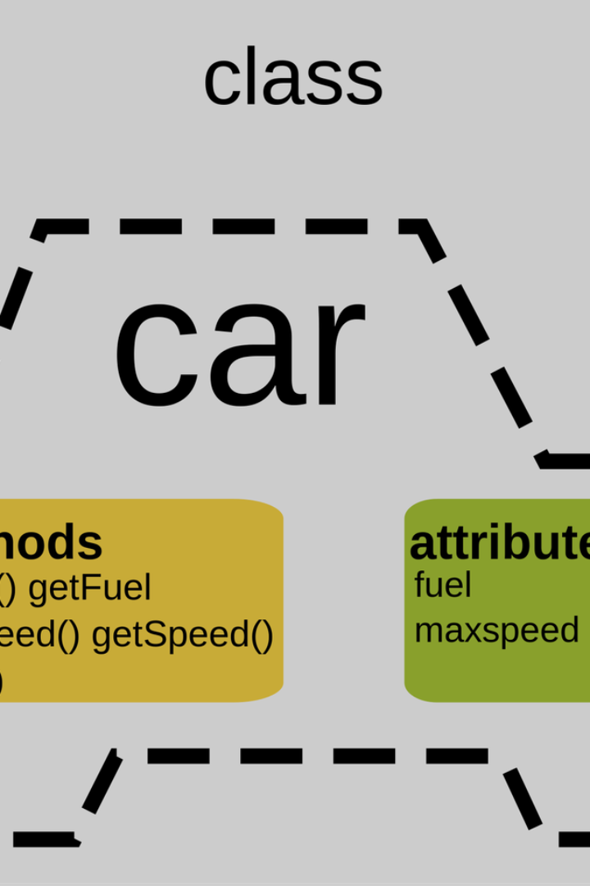

Importance of OOPs in Python
Object-Oriented Programming (OOPs) is a fundamental programming paradigm in Python that promotes code organization, reusability, and scalability.
by ANIK ACHARJEE

Slide 2

Introduction to OOPs
OOPs is a programming paradigm that focuses on creating objects that can encapsulate data and behavior. It enables modular and structured programming.

Slide 3
Definition and Principles of OOPs
Abstraction
Inheritance
OOPs allows abstraction, where complex data and actions are hidden behind simpler interfaces.
OOPs facilitates inheritance, enabling the creation of new classes by inheriting properties and behaviors from existing classes.
Encapsulation
Polymorphism
OOPs promotes encapsulation, encapsulating data and functions within an object to improve code organization.
OOPs supports polymorphism, which allows objects of different types to be used interchangeably.

Slide 4

Benefits of Using OOPs in Python
1
Modularity
2
Code Reusability
OOPs enhances code modularity, making it easier to develop, debug, and maintain large projects.
OOPs promotes code reusability, allowing developers to use existing classes and objects in new projects.
3
Data Security
OOPs provides data security by incorporating access control mechanisms through encapsulation.

Slide 5
Key Concepts of OOPs in Python
Classes
Objects
Inheritance
Classes define objects in Python and act as a blueprint for creating instances.
Objects are instances of classes that contain attributes and methods to represent real-world entities.
Inheritance allows the creation of new classes by inheriting properties and behaviors from existing classes.

Slide 6

Examples of Implementing OOPs in Python
1
Creating a Class
Define a class with attributes and methods to represent a specific entity.
Instantiating Objects
2
Create instances of the class and assign values to their attributes.
3
Accessing and Manipulating Data
Use methods and attributes to access and modify the data of objects.

Slide 7
Common Pitfalls and Challenges of OOPs in Python
Overcomplicating Design
Lack of Proper Inheritance
One common pitfall is overcomplicating the design by creating unnecessary levels of abstraction.
Improper use of inheritance can lead to code redundancy and maintenance issues.
Difficulties in Debugging
Performance Impact
Complex object structures and interactions can make debugging more challenging.
OOPs can introduce slight performance overhead compared to other programming paradigms.

Slide 8

Conclusion and Summary of OOPs in Python
OOPs is an essential concept in Python, enabling developers to write structured, modular, and reusable code. It promotes code organization, enhances code reusability, and provides data security through encapsulation. Understanding the key principles, concepts, and potential pitfalls of OOPs is crucial for effective Python programming.

