Slide 1

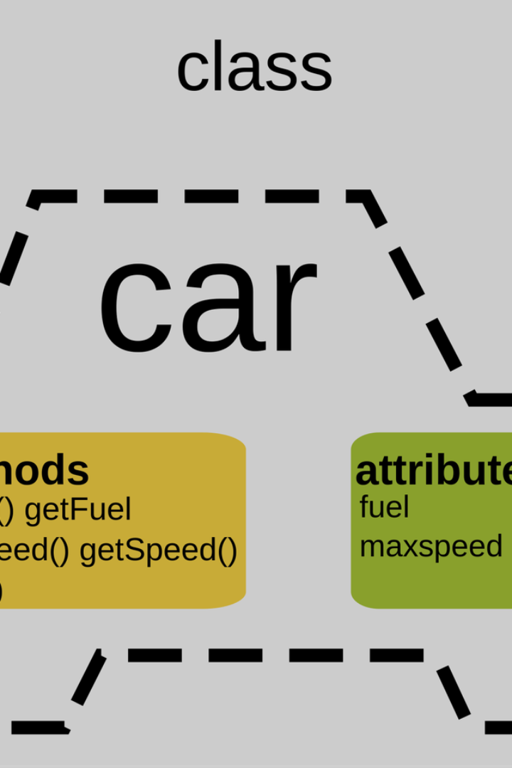

Introduction to OOP Concepts in Python
An overview of the key Object-Oriented Programming (OOP) concepts in Python, designed for beginners and individuals with basic programming knowledge.
by ANIK ACHARJEE

Slide 2
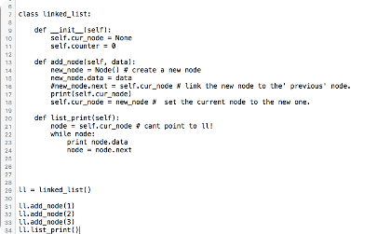
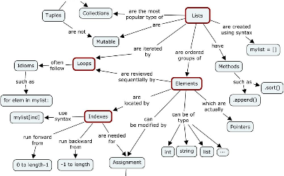
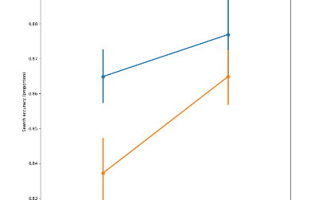
Classes and Objects
Class Definition
Object Instances
Inheritance
Learn about defining classes, creating objects, and the attributes and methods associated with them.
Understand the concept of instances, instantiation, and the role of objects in OOP in Python.
Explore inheritance, subclassing, and the principles of reusability and extensibility.

Slide 3

Encapsulation and Abstraction
Data Hiding
Abstraction Principles
Learn how Python utilizes encapsulation to restrict access to certain components and prevent direct modification.
Understand the concept of abstraction, focusing on essential features while hiding unnecessary details.
Access Specifiers
Explore the use of access specifiers for controlling access to different attributes and methods.

Slide 4

Polymorphism
1
Method Overriding
2
Operator Overloading
Understand how Python supports method overriding, allowing a subclass to provide a specific implementation of a method that is already provided by its parent class.
Explore the concept of overloading operators to give them more functionality than they have by default, enhancing the flexibility of Python classes in OOP.

Slide 5
Key Concepts of OOP
Modularity
Encapsulation
Inheritance
Understanding how OOP enables the creation of modular code, enhancing reusability and maintainability.
Exploring the role of encapsulation in OOP, leading to better control and security of the data within an object.
Discovering the benefits of inheritance, facilitating the creation of new classes based on existing ones.

Slide 6

Practical Implementation
1
Design Patterns
Understanding how to apply common design patterns to create effective and maintainable OOP solutions in Python.
2
Project Development
Exploring real-world examples to illustrate the application of OOP concepts in Python, providing hands-on experience.
3
Code Refactoring
Learning the art of improving the structure and design of existing code without changing its external behavior.

Slide 7




Error Handling and Debugging
Exception Handling
Understanding how exceptions are handled in Python to improve error resilience and maintain code integrity.
Debugging Tools
Exploring essential debugging tools and techniques to identify, diagnose, and resolve errors in Python OOP programs.
Best Practices
Learning best practices for error handling to ensure robustness in OOP Python applications.

Slide 8
Advanced OOP Topics
Composition vs. Inheritance
Multiple Inheritance
Comparing and contrasting the use of composition and inheritance to create relationships between classes in Python OOP.
Understanding how multiple inheritance works in Python, including its advantages, challenges, and best practices.

Slide 9

Testing and Documentation
1
Unit Testing
2
Documentation Practices
Exploring the importance of unit testing to validate each piece of code in Python OOP, ensuring its correctness and robustness.
Understanding the significance of thorough documentation for Python OOP projects, enhancing code clarity and maintainability.

