Slide 1

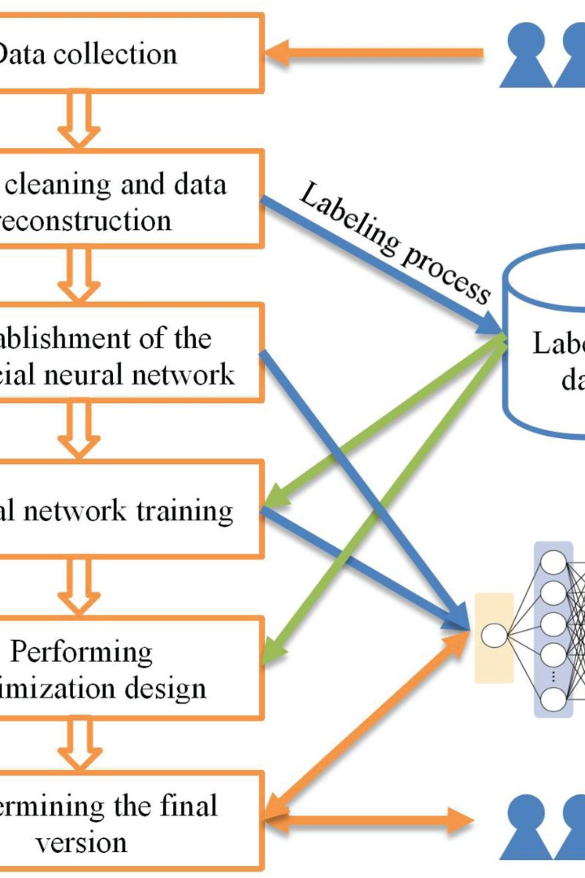

Importance of GUI in Software Development
Graphical User Interface (GUI) plays a crucial role in enhancing user experience by providing visual elements.
by ANIK ACHARJEE

Slide 2
Benefits of Python Tkinter
1
Easy to Learn
2
Extensive Widget Set
Python Tkinter is user-friendly and suitable for beginners.
It offers a wide range of widgets for creating interactive and responsive interfaces.
3
Cross-Platform Support
4
Community Support
Python Tkinter supports multiple operating systems, making it versatile for development.
It has an active community contributing to its development and providing assistance.

Slide 3

The Role of GUI Frameworks in Software Development
Enhanced User Interaction
Improved Aesthetics
Increased Functionality
They enhance the visual appeal of applications, making them more engaging and attractive.
GUI frameworks facilitate seamless interaction between users and software applications.
GUI frameworks enable the integration of complex functionalities in software applications.

Slide 4




Overview of GUI Frameworks
Python
Java
Javascript
C++
Python offers Tkinter and other powerful GUI frameworks for developers.
Java provides Swing and JavaFX as popular choices for building GUI applications.
JavaScript supports frameworks like React and Angular for web-based GUI development.
C++ offers Qt and FLTK as robust options for developing graphical interfaces.

Slide 5

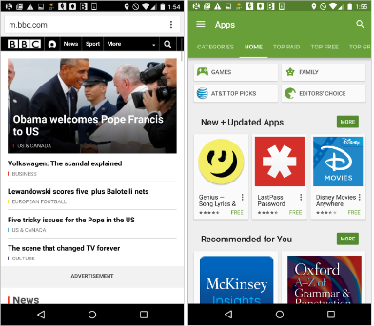
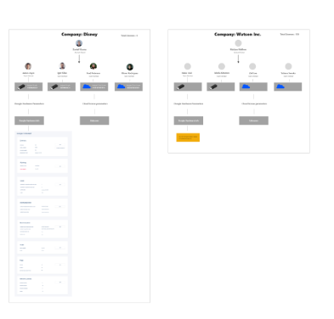
GUI Frameworks for Enhanced User Interfaces
Customization
Efficiency
Integration
GUI frameworks allow customizing interfaces to align with specific user requirements.
They enhance the efficiency of software development by providing pre-built components.
They offer seamless integration with backend systems to deliver powerful applications.

Slide 6
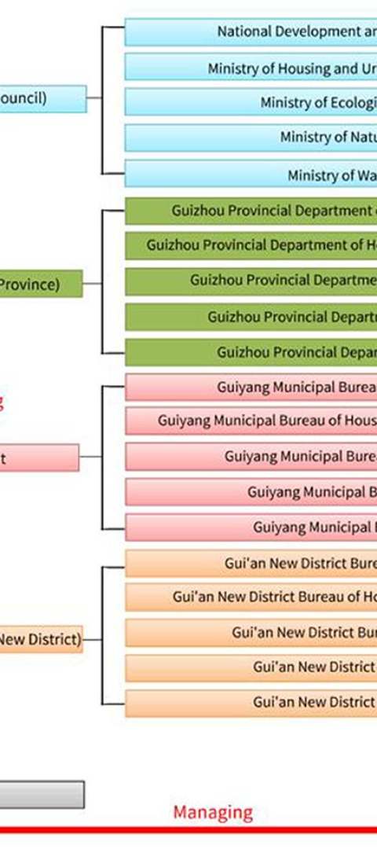
Challenges in GUI Development
1
Cross-Platform Compatibility
2
Performance Optimization
Optimizing performance while maintaining a rich user interface can pose technical challenges.
Ensuring consistent compatibility across different devices and OS can be challenging.
3
User Experience Design
Balancing functionality with intuitive and user-friendly design requires careful consideration.

Slide 7
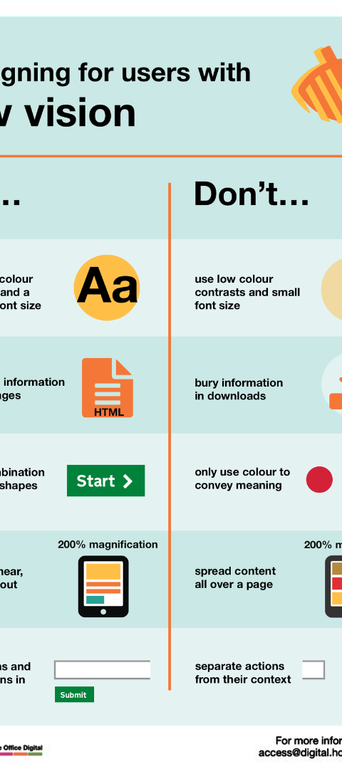
Usability and Accessibility in GUI Design
Usability Testing
Accessibility Standards
Conduct rigorous usability testing to ensure intuitive interface design and navigation.
Adhering to accessibility standards ensures inclusivity for all users.
Responsive Design
Implement responsive design to optimize user experience across various devices.

Slide 8
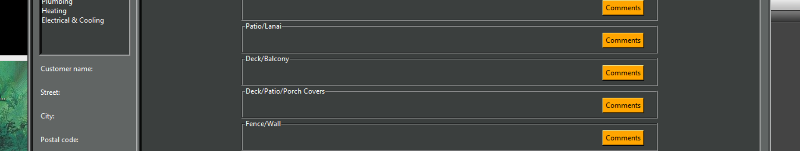
Best Practices for GUI Development
1
Consistent Design Patterns
2
Interactive Feedback
3
Optimized Performance
Adopt consistent design patterns for a seamless and coherent user experience.
Provide clear and interactive feedback to enhance user engagement and understanding.
Focus on optimizing performance without compromising the visual appeal of the interface.

Slide 9



Future Trends in GUI Development
VR and AR Integration
Voice-Enabled Interfaces
Gesture-Based Interactions
Integration of Virtual Reality (VR) and Augmented Reality (AR) into GUI for immersive experiences.
Advancements in speech recognition technology for voice-controlled interactions in GUI.
Developments in gesture recognition for intuitive and natural interactions with GUIs.

