Slide 1
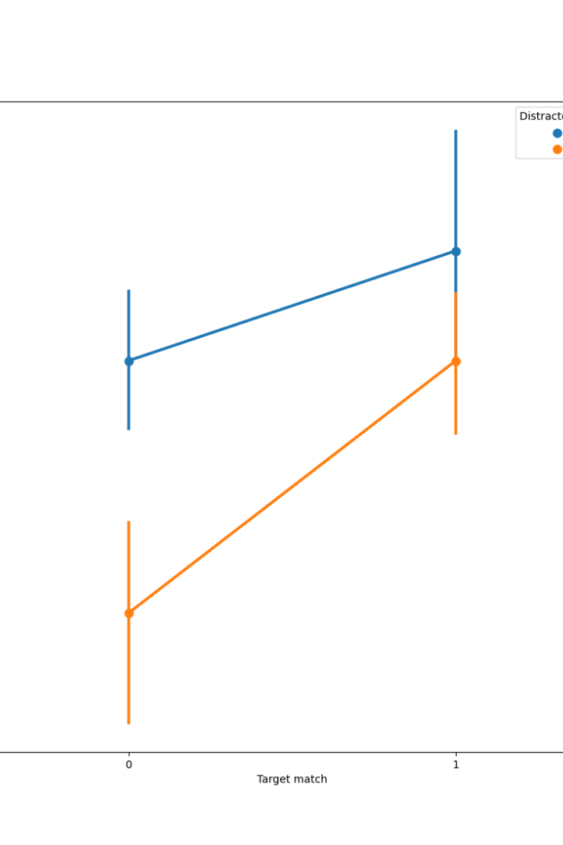

Inheritance and Polymorphism in Python
Understanding inheritance and polymorphism is crucial for Python developers. These concepts enable classes to inherit attributes and methods from other classes, allowing for code reusability and flexibility.
by ANIK ACHARJEE

Slide 2
Understanding Inheritance
Parent and Child Classes
Code Reusability
Overriding Methods
Inheritance involves defining new classes with little to no modification by deriving them from existing classes. The existing classes are called base or parent classes, and the new ones are derived or child classes.
With inheritance, the information is defined only once and shared by multiple classes. It allows the creation of a general class, then more specialized classes later.
Derived classes can override or extend the functionality of the base class. This provides flexibility in adapting the methods to suit different applications.

Slide 3
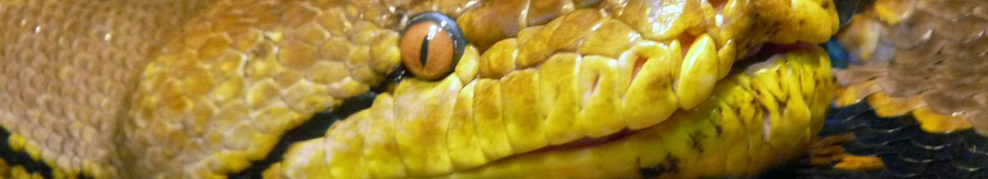
Polymorphism in Python
1
Multiple Forms
2
Flexibility
3
Method Overloading
Polymorphism allows objects of different classes to be treated as objects of a common class. It helps in specifying a single interface for multiple data types.
It enables the development of a single method or function that supports arguments and variables of multiple types.
Python does not support traditional method overloading, but polymorphism allows the implementation of the same method in different ways in different classes.

Slide 4

Abstract Base Classes (ABCs)
1
Enforcing Constraints
2
Code Readability
3
Classifying Operations
ABCs allow for the creation of a set of methods that must be implemented within derived classes. This ensures that derived classes conform to a particular interface.
Using ABCs makes the code easier to maintain and understand, as it provides a clear way to define interfaces.
ABCs can be used to define a common API for a set of classes with a specific set of methods. This helps in categorizing operations and creating a structure for similar classes.

Slide 5
Composition Over Inheritance
Code Flexibility
Loose Coupling
Encapsulation
Composition provides more flexibility as it doesn’t force a "One Size Fits All" approach, allowing changes in behavior dynamically.
It leads to loose coupling between classes and high reusability since the parent and child classes are not tightly bound to each other.
Composition encourages encapsulation, keeping the details hidden and providing a clear interface for interaction between objects.

Slide 6



Real-life Examples
Social Media
Vehicle Simulation
Geometric Shapes
Various social media platforms have multiple types of users interacting with the system, showcasing polymorphism.
Simulating different types of vehicles with common specifications highlights the concept of inheritance and polymorphism.
Different geometric shapes sharing certain properties exemplify the use of inheritance and polymorphism in graphical applications.

Slide 7
Method Resolution Order (MRO)
1
2
3
Maintains Object Hierarchy
Determines Method Order
Defined by C3 Linearization

Slide 8
Advantages of Advanced OOP Concepts
Enhanced Code Reusability
Improved Code Readability
Flexibility to Modify Behavior
Efficient Code Organization

Slide 9
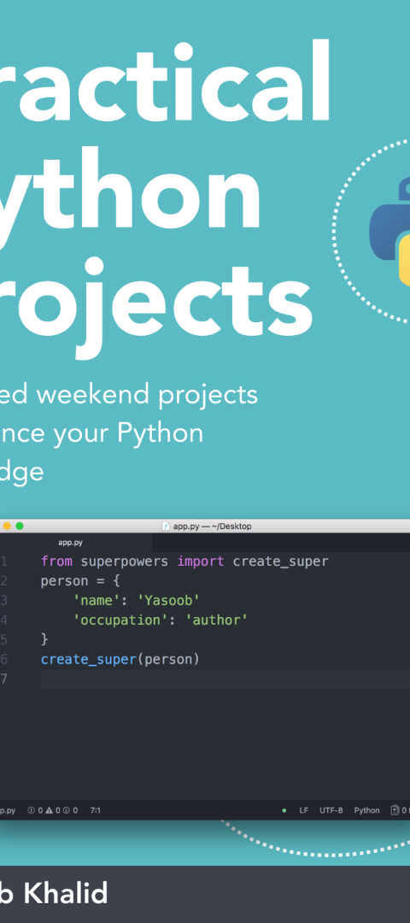



Conclusion
Understand Core Concepts
Master the fundamentals of inheritance and polymorphism.
Apply in Real Projects
Implement these concepts in practical Python projects for a deeper understanding.
Explore Advanced OOP
Delve into other advanced OOP concepts to enrich your programming skills.

