Slide 1



GitHub: The Ultimate Guide
Welcome! In this presentation, we'll guide you through every step of creating a GitHub account and repository, including tips on best practices and sharing with others.
by Anik Acharjee

Slide 2
Create Your Account
Sign Up
Email Confirmation
Click on the Sign Up button in the top right corner of github.com. Choose a username and enter your email and password.
Go to your email and look for the confirmation link sent by GitHub. Click on it to verify your account.
Personalizing Your Profile
Two-Factor Authentication
Add a profile picture, a bio, and your company to make your account more professional and engaging.
Protect your account by enabling two-factor authentication in your settings.

Slide 3
Create a Repository
Repository Settings
Repository License
Choose whether your repository is public or private. If it's a public repository, anyone can see and contribute to it.
Choose a license for your repository to protect your project and let others know how they can use it.
1
2
3
4
New Repository
README File
Click on the New Repository button on your GitHub homepage. Choose a repository name and description.
Add a README file to your repository to give an overview of what your project is about.

Slide 4
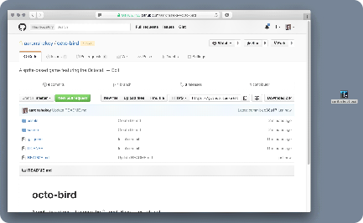
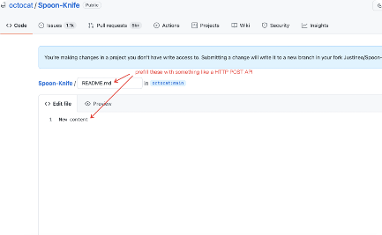
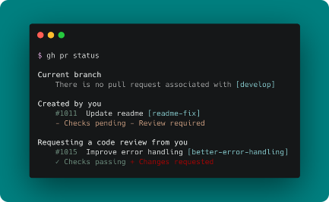
Adding and Editing Files
Drag and Drop
Online Editing
Command Line
Simply drag and drop files into your repository's file view and add a commit message.
You can also edit files online by clicking on any file in your repository and making changes.
If you prefer, you can also use the command line interface to add and edit files in your repository.

Slide 5
Naming Conventions and Best Practices
1
Repository Names
Use descriptive and concise names for your repositories. Avoid using special characters or spaces.
README File
2
Always add a README file with an overview of your project and instructions on how to use it.
3
Branches
Create branches for your repository and avoid making changes directly in the main branch.

Slide 6

Collaboration and Sharing
1
Collaborators
2
Branches
Add collaborators to your repository to work on projects together. Collaborators with write access can push changes to the repository.
If working on a team project, create a branch for each collaborator to make changes without affecting the main branch.
3
Forking
Allow other users to fork your repository to use it as a starting point for their own projects.

Slide 7
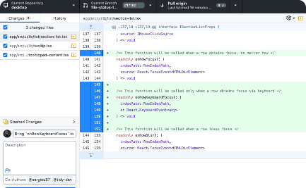
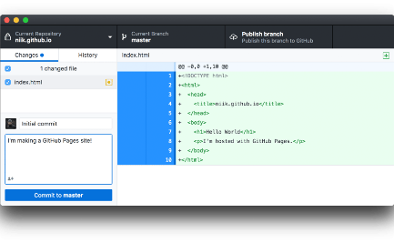

Extras
GitHub Desktop
GitHub Pages
GitHub Education
A desktop application to make working with your repositories easier.
Host a website directly from your repository using GitHub Pages.
Acquire access to tools, education and experiences that will help shape your future in tech. Plus, get free access to GitHub Pro!

Slide 8

Conclusion
With this guide, you are now able to easily create your own GitHub account and repository, as well as share and collaborate on projects with others like an expert. As you continue to work with GitHub, remember to follow best practices, and most importantly, have fun!

