Slide 1
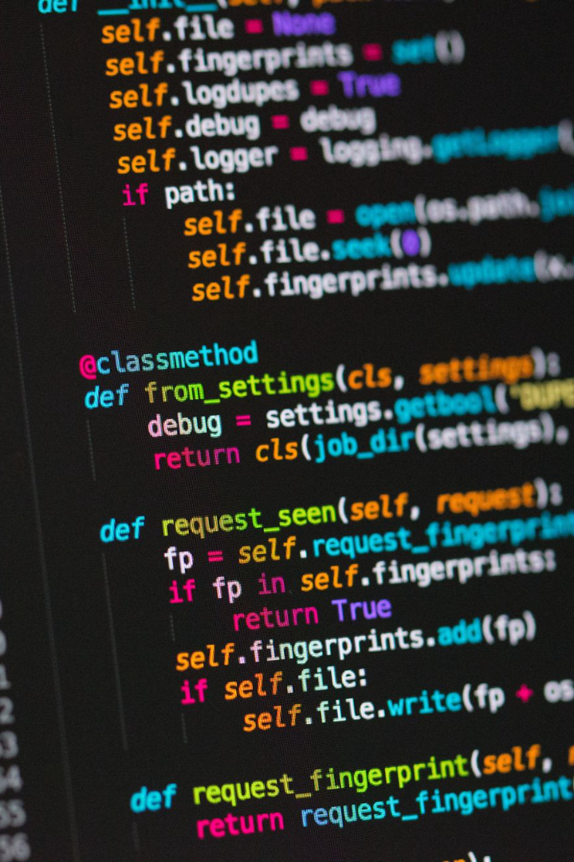

Discover the Power of Python
Python is a high-level language that offers powerful tools for solving complex problems. Whether you're a beginner or an expert, Python's simplicity and flexibility make it an ideal choice for any project.
by Anik Acharjee

Slide 2
A Brief History of Python
The Release of Python 2
Python 2 was released in 2000, which became the most widely used version of the language for over a decade.
1
2
3
Birth of Python
The Arrival of Python 3
Created in 1989 by Guido van Rossum, Python was named after Monty Python's Flying Circus comedy show.
Python 3 was released in 2008, and it made breaking changes to the language and library, leading to a long transition period from Python 2.

Slide 3
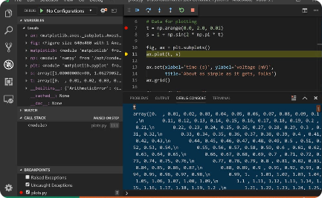
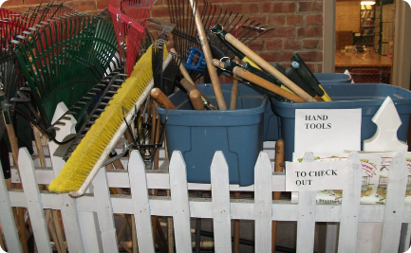

Key Features of Python
Easy to Learn
Powerful Libraries
Community-driven Language
Python has a clear and concise syntax that makes it easy to read and write code even for beginners.
Python has a vast collection of open-source libraries for data science, web development, and machine learning.
The Python community is welcoming, enthusiastic, and passionate about sharing knowledge and collaborating on projects.

Slide 4
Python Interpreters and Coding Standards
1
CPython
CPython is the standard implementation of Python, the interpreter written in C that compiles Python code into bytecode.
Other Interpreters
2
There are other Python interpreters besides CPython, such as Jython, which runs on the Java Virtual Machine, and IronPython, which runs on the .NET Framework.
3
Coding Standards
Python has a set of guidelines for writing readable, maintainable, and efficient code, known as PEP 8.

Slide 5
Basic Syntax, Variables, Identifiers, and Operators
Indentation Matters
Variables and Identifiers
Data Types and Operators
Python uses indentation to delimit blocks instead of curly braces or keywords like "end".
Python variables are dynamically typed and can hold any value. Identifiers are names given to variables, functions, and classes.
Python has built-in data types like strings, numbers, and booleans, and a wide range of operators, including arithmetic, comparison, and boolean operators.

Slide 6
Functions, Classes, and Modules
1
Functions
A function is a block of reusable code that performs a specific task. Python has built-in functions and allows users to create their own functions.
Classes
2
A class is a blueprint for creating objects that have properties and methods. Python is an object-oriented language that supports inheritance and polymorphism.
3
Modules
A module is a file containing Python definitions and statements that can be used in other Python programs. Python has a standard library and allows users to create their own modules.

Slide 7

Exception Handling and Debugging
1
Try-Except Blocks
2
Debugging Tools
Python has a try-except block that allows users to handle exceptions gracefully and prevent the program from crashing.
Python offers built-in debugging tools, such as the pdb module and the traceback module, which helps to identify and fix errors in the code.
3
Best Practices
To avoid common mistakes, it's important to follow best practices like using descriptive variable names, commenting the code, and testing the code thoroughly.

Slide 8
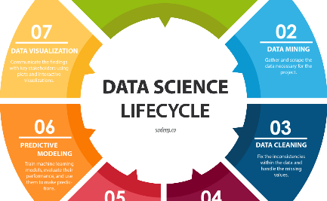
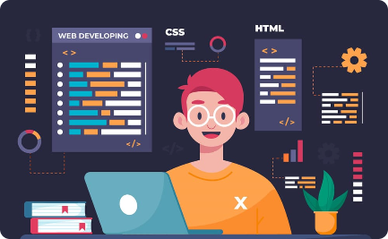
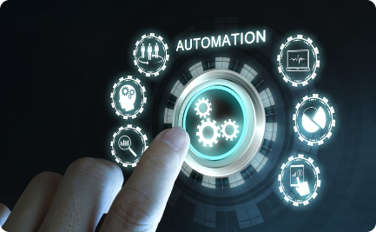
Real-world Applications of Python
Data Science
Web Development
Automation
Python is widely used in data science for data analysis, visualization, and machine learning, with popular libraries like NumPy, Pandas, and Scikit-learn.
Python is popular in web development frameworks, like Django, Flask, and Pyramid, that offer rapid prototyping and scalability.
Python is used in automation scripts for tasks like web scraping, testing, and scheduling, with libraries like Requests, BeautifulSoup, and Selenium.

