Slide 1


Visual Studio code installation in Windows
Welcome to this comprehensive guide on how to successfully install Visual Studio Code in Windows. By the end of this presentation, you will have everything you need to know about customizing and working with this powerful code editor.
by Anik Acharjee

Slide 2
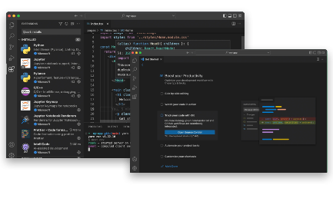
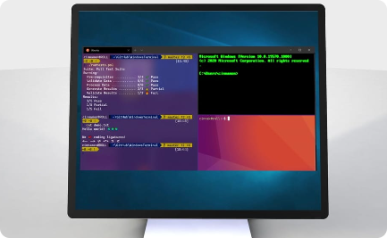
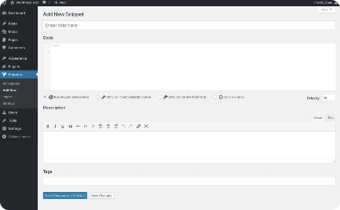
Visual Studio Code - Overview
Lightweight and Free
Integrated Terminal
Code Snippets
Visual Studio Code is a lightweight, yet powerful code editor that is free for developers. It is a cross-platform tool that can be used on Windows, Linux, and MacOS.
Visual Studio Code comes with an integrated terminal that allows you to run commands and code snippets with ease, all within the editor.
Code snippets are shortcut codes that rapidly expand into larger code blocks when triggered. Visual Studio Code supports snippets for different languages, making it easy to write code quickly and efficiently.

Slide 3
Download and Installation of Visual Studio Code
Download and Installation
System Requirements
Licensing and Activation
Visual Studio Code requires at least 1 GB of RAM and a 1.6 GHz or faster processor. Make sure your system meets these requirements before downloading and installing the editor.
You can download the Visual Studio Code installer for your preferred operating system from the official Visual Studio Code website. The installation process is easy and straightforward, and the installer will guide you through it step-by-step.
Visual Studio Code is open-source software and is free to use. There is no activation or licensing required to use the editor for development purposes.

Slide 4
Setting up Visual Studio Code for first-time use
Add Extensions
Extensions help you customize and get the most out of Visual Studio Code. There are thousands of extensions available in the Visual Studio Code Marketplace to help you work with different languages, debug code, and integrate with other development tools.
Install Recommended Extensions
Visual Studio Code has a set of recommended extensions that you can install to get started quickly. These extensions are designed to work seamlessly with the editor and help you maximize productivity.
1
2
3
4
Choosing a Theme
Configure Settings
Visual Studio Code comes with a variety of built-in themes that you can choose from. You can also download and install additional themes from the Visual Studio Code Marketplace. Choose a theme that fits your personal preference and coding style.
You can configure Visual Studio Code settings to suit your needs. Settings can be found under "File" > "Preferences" > "Settings". You can configure settings for different languages, themes, and extensions.

Slide 5

Customizing Visual Studio Code for enhanced productivity
1
User Snippets
2
Code Folding
3
Code Navigation
User-defined code snippets can save you time when working on repetitive tasks. Use the built-in User Snippets feature to create and manage your personal snippets in Visual Studio Code.
Code folding lets you collapse and expand sections of your code. This feature helps you minimize distraction and focus on the code that matters. Use the "Ctrl+Shift+[ ]" shortcut to fold and unfold code blocks in Visual Studio Code.
You can quickly navigate through code in Visual Studio Code. Use the "Ctrl+P" shortcut to search for files, and the "Ctrl+Shift+O" shortcut to search for symbols.

Slide 6
Working with extensions and themes
Extensions
Themes
REST Client
Monokai
Prettier
Dracula
ESLint
Material Theme
GitLens
Ayu

Slide 7
Conclusion
Pros
Cons
Free and open-source
Requires some configuration out of the box
Lightweight and customizable
Not as fully-featured as some other IDEs
Integrated terminal and built-in Git support
Visual Studio Code is an excellent code editor that is free, lightweight, and highly customizable. With its vast marketplace of extensions and themes, it can be tailored to fit any developer's needs. We hope you found this guide helpful and that you can now confidently install and use Visual Studio Code on Windows.

