Slide 1

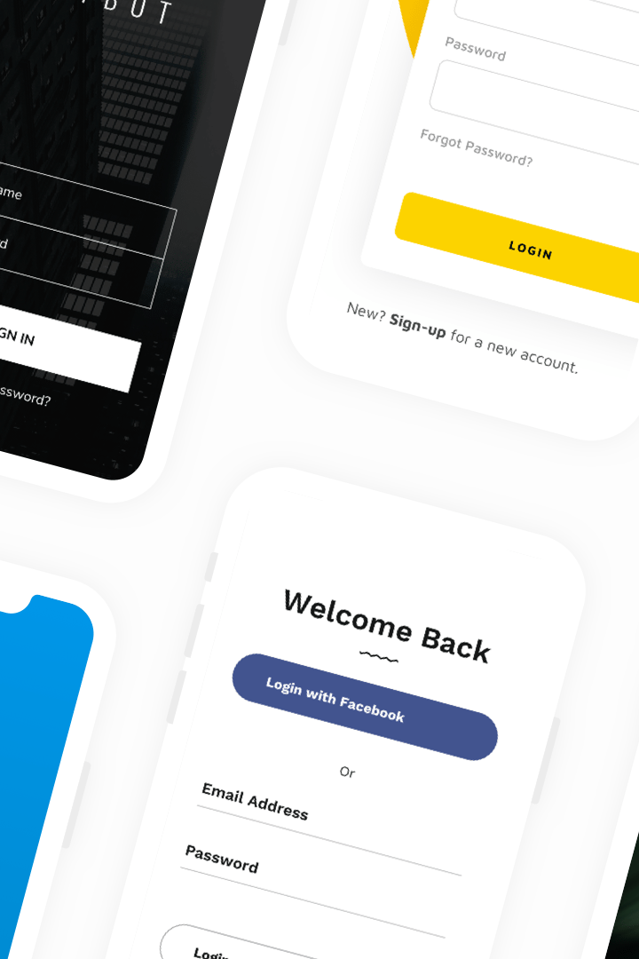

Creating a GitHub Account
Welcome to GitHub! Create a free account to get access to millions of repositories from around the world. Follow these simple steps to sign up:
Enter your preferred username and email address
Create a strong password and verify your email address
Sign in and start exploring GitHub
by Anik Acharjee

Slide 2
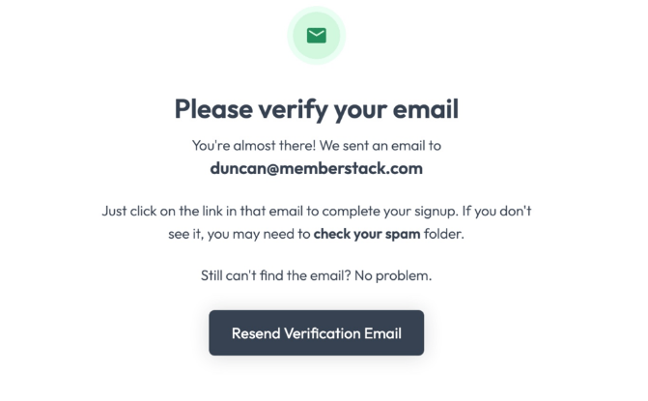
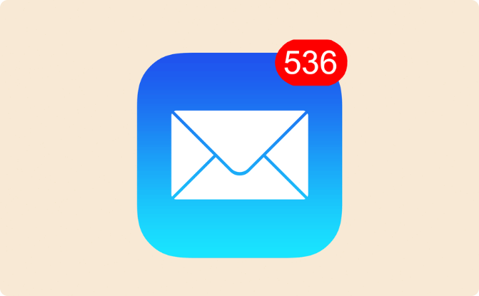
Verifying Your Email Address
Check Your Inbox
Lost Your Email?
Click on the link in the email sent to the address you registered. This will verify your email address with GitHub.
Check your spam folder, or go to your settings to have the email resent.

Slide 3
Navigating the GitHub Dashboard
Your Dashboard
Your Repositories
Your Profile
From dashboard, browse repositories, invite others to collaborate, manage your profile settings, and even access integrations.
Here's where you'll be able to find all of your repositories, organize them into projects, and invite collaborators to join your work.
Don't forget to fill out your bio and share your location. This will help others find you and your work!

Slide 4
Creating a New Repository
Choose Public or Private
Select "New Repository"
If you want others to be able to view and contribute to your code, select "Public." If you'd rather keep it private, select "Private" and invite specific collaborators.
Click on the green "New" button in the top right corner of the screen, and select "New Repository" from the drop-down menu.
1
2
3
4
Choose Your User/ Organization Account
Name Your Repository
Choose a descriptive, unique name for your repository that reflects its content and purpose.
If you have an organization account, you can choose to create the new repository there. Otherwise, you can create it as a user repository.

Slide 5
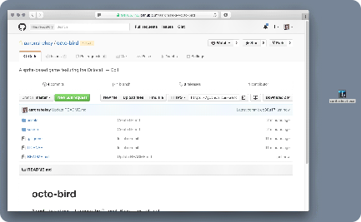
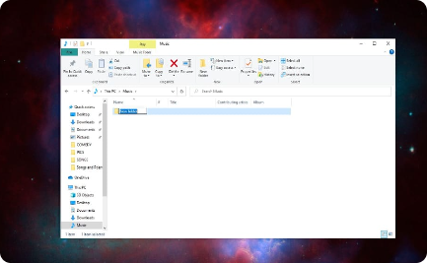
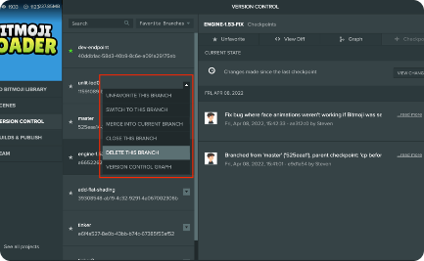
Adding Files to Your Repository
Drag and Drop
Create a New Folder
Create a New Branch
It's easy to add files by dragging and dropping them into your repository. You can also click on the "Add file" button.
To keep your repository organized, you can create folders and subfolders to contain your files.
If you're working on a new feature, always create a new branch before making changes to the original code.

Slide 6
Committing and Pushing Changes
Create a New Commit
Once you're done editing, create a new commit. This saves all of your changes and will create a new version of your code.
1
2
3
Make Your Changes
Push Your Changes
Edit the files in your selected branch to make changes or add new features.
Now it's time to share your changes with others. Push your changes to update your repository.

Slide 7
Viewing Your Repository in Your Account
Go to Your Profile
Find Your Repository
Browse and Collaborate
Select your profile from the dropdown menu in the top right corner of the screen. This will bring you to your profile page.
Under the "Repositories" tab, you'll find a list of all the repositories you have created. Select the one you want to view.
Now you can browse your code, see its history, and invite others to collaborate with you.

Slide 8
Congratulations, You're a GitHub Master!
By following these steps, you are now a GitHub expert! It's time to build, share, and grow your code with a global community of developers!

