Slide 1


Different Types of Operators in Python
In Python, operators are used to perform operations on variables and values. There are several types of operators, each with its own set of rules and uses. Let's explore them one by one.
by Anik Acharjee

Slide 2
Arithmetic Operators
Addition (+)
Subtraction (-)
Adds values on either side of the operator.
Subtracts the right-hand operand from the left-hand operand.
Multiplication (*)
Division (/)
Multiplies values on either side of the operator.
Divides left-hand operand by right-hand operand and returns a floating-point value.

Slide 3

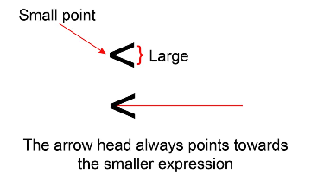


Comparison Operators
Greater than (>)
Less than (<)
Not equal (!=)
Returns true if the left operand is greater than the right operand.
Returns true if the left operand is less than the right operand.
Returns true if the operands are not equal.
Equal (==)
Returns true if the operands are equal.

Slide 4
Assignment Operators
Add and Assign (+=)
Multiply and Assign (*=)
Adds right operand to the left operand and assign the result to left operand.
Multiplies right operand with the left operand and assign the result to the left operand.
1
2
3
4
Assignment (=)
Subtract and Assign (-=)
Assigns values from the right side operand to the left side operand.
Subtracts right operand from the left operand and assign the result to left operand.

Slide 5
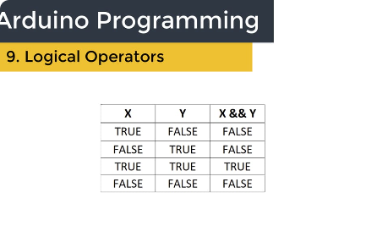

Logical Operators
Logical AND (and)
Logical OR (or)
Logical NOT (not)
Returns true if both operands are true.
Returns true if either of the operands is true.
Reverses the logical state of its operand.

Slide 6
Bitwise Operators
&
Bitwise AND
|
Bitwise OR
^
Bitwise XOR
~
Bitwise NOT
<<
Bitwise Left Shift
>>
Bitwise Right Shift

Slide 7
Identity Operators
is
is not
Returns true if both operands are the same object.
Returns true if both operands are not the same object.

Slide 8
Membership Operators
1
in
Returns true if a sequence with the specified value is present in the object.
2
not in
Returns true if a sequence with the specified value is not present in the object.

