Slide 1
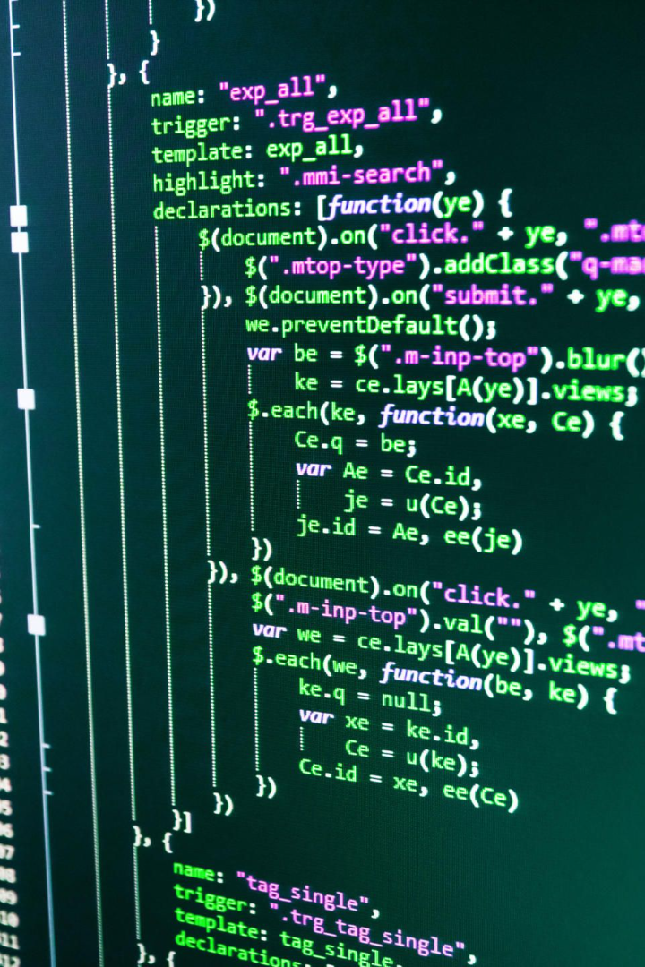

Python: A Comprehensive Overview
Welcome to this in-depth presentation on Python programming language. Over the next few slides, we will cover its history, features, and practical application.
by Anik Acharjee

Slide 2


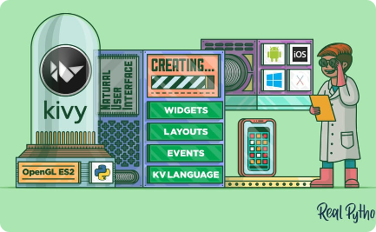
Why Python is the Future of Programming
Innovative
Collaborative
Cross-Platform
Python is at the forefront of technological advancements, making it ideal for emerging fields like AI and data analysis
Python's user-friendly syntax and open-source code make it easy for diverse teams to collaborate on complex projects.
Python can be used on multiple platforms, including mobile devices and desktop computers.

Slide 3
Basic Syntax and Data Types
Syntax
Data Types
print("Hello, World!")
Integers and Floats
x = 5
Strings
if x > 3:
Boolean
print("x is greater than 3")
List and Dictionary

Slide 4
Working with Python
Operators
Learn about various arithmetic, logical, and comparison operators in Python to perform mathematical and logical calculations.
1
2
3
Variable and Identifiers
Control Statements
Understand the concept of variables and identifiers to write cleaner and more efficient code.
Use conditional (if-else) and loop (for and while) statements to control the execution of your code.

Slide 5
Python Interpreters and Coding Standards
Interpretation vs. Compilation
PEP 8
Understand the differences between interpreting and compiling code and how to choose the right interpreter for your project.
Follow the Python Enhancement Proposals to maintain clean, readable, and scalable code.
Debugging Tools
Virtual Environments
Learn how to use Python's built-in debugging tools like pdb and pytest to troubleshoot your code.
Create isolated Python environments using tools like pipenv or virtualenv to avoid version conflicts and dependencies issues.

Slide 6
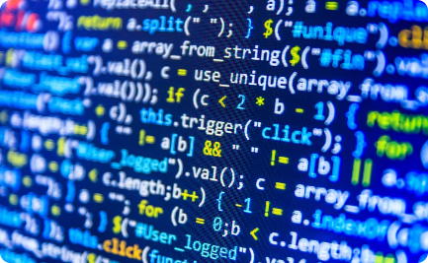
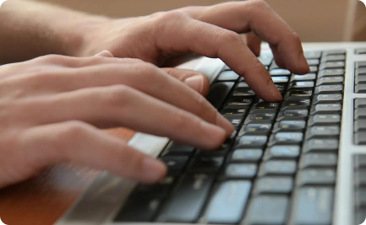
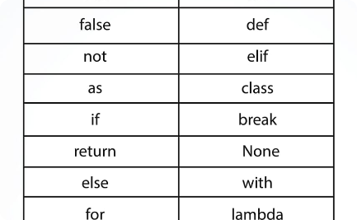
Input-Output in Python
Printing on Screen
Reading From Keyboard
Inbuilt Functions
Use the 'print' function to print text, variables, and expressions to the console or terminal.
Use the 'input' function to accept user input from the keyboard.
Explore Python's vast collection of inbuilt functions to automate common tasks like sorting, filtering, and data manipulation.

Slide 7
Conclusion: Real World Applications of Python
1
Web Development
2
Data Analysis
3
Machine Learning
Use Python's popular web frameworks like Django or Flask to build responsive and scalable web applications.
Use Python libraries like Numpy, Pandas, and Matplotlib to analyze complex data sets, visualize results and draw actionable insights.
Use Python programming language to develop machine learning algorithms, train and test models in frameworks like TensorFlow, Keras, and PyTorch.

Slide 8

Are You Ready to Learn Python?
Python programming language is one of the most versatile, intuitive, and accessible languages in use today. With its dynamic semantics, extensive standard libraries, and rich ecosystem, it offers an excellent foundation both for learning and for real-world programming projects. Get started with Python today and join the growing community of developers around the world.

