Slide 1
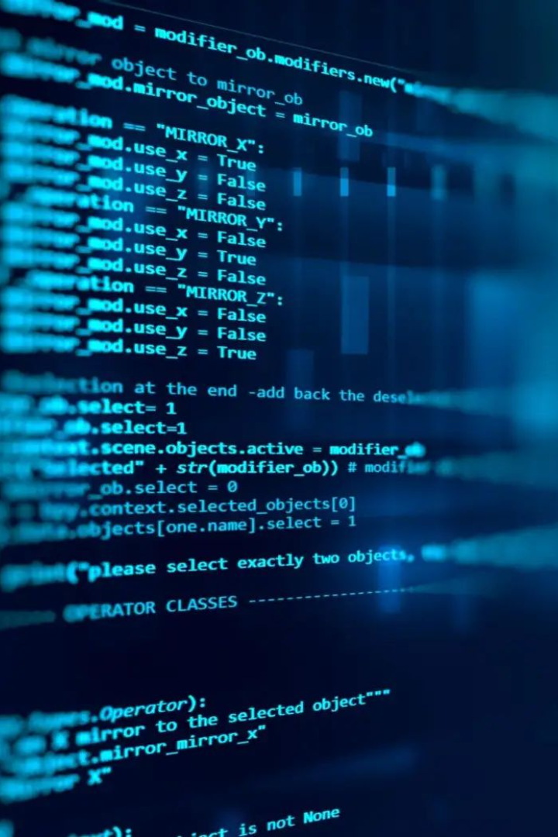

Python - Loops
Discover the power of loops in Python programming. From while loops to nested loops and control statements, unlock new possibilities in your code.
by Anik Acharjee

Slide 2
Introduction
Importance of Loops
Brief Overview of Python
Loops are essential for repetitive tasks, allowing us to iterate over data, perform calculations, and automate processes.
Python is a versatile and beginner-friendly programming language known for its simplicity and readability.

Slide 3
While Loop
1
Syntax and Structure
While loops consist of a condition and a block of code, which is executed repeatedly as long as the condition remains true.
2
Example Code
Check out this simple while loop that prints numbers from 1 to 5: num = 1 while num <= 5: print(num) num += 1
3
Use Cases for While Loops
While loops are great for iterating until a specific condition is met, such as reading data from a file or processing user input.

Slide 4
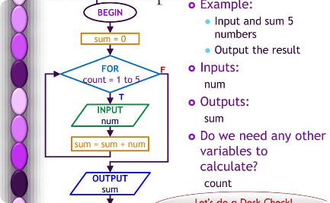

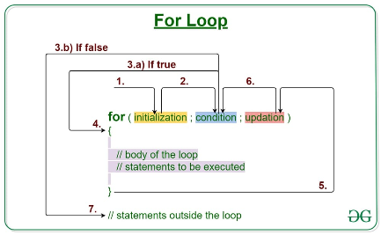
For Loop
Syntax and Structure
Example Code
Use Cases for For Loops
The for loop iterates over a sequence of elements, such as a list or string, executing a block of code for each element.
Here's a basic for loop that prints the elements of a list: fruits = ["apple", "banana", "orange"] for fruit in fruits: print(fruit)
For loops are ideal for processing collections, such as performing calculations on each item, generating reports, or iterating over database results.

Slide 5
Nested Loops
1
Definition and Purpose
Nested loops are loops within loops, allowing us to perform repetitive tasks with multiple levels of iteration.
Example Code
2
Explore this nested loop that prints a multiplication table: for i in range(1, 6): for j in range(1, 6): print(i * j, end=" ") print()
3
Common Applications
Nested loops are used in scenarios like generating patterns, searching through multi-dimensional data, and simulating complex systems.

Slide 6
Loop Control Statements
Break Statement
Continue Statement
Examples
The break statement allows us to exit a loop prematurely when a specific condition is met, providing greater control over the program flow.
The continue statement skips the rest of the current iteration and moves to the next iteration, enabling us to selectively process certain elements.
See how we can use break and continue to improve efficiency and handle specific situations, like skipping invalid data or terminating a search early.

Slide 7

Conclusion
1
Recap of Key Points
Loops are essential for repetitive tasks, with while loops and for loops being the most commonly used in Python.
2
Importance of Loops in Programming
By leveraging loops effectively, you can write concise and efficient code, automate processes, and solve complex problems with ease.

